Slide 1
Streaming Applications for Robots with Real Time QoS
Oct-28-2015
Supun Kamburugamuve
Indiana University

Slide 2
Research at IU Digital Science Center
Offloading robotic algorithms to servers
Save power
Increase mobility
We consider expensive computations
Latency and Jitter are the most important performance characteristics
Need parallel computations to reduce latency
Both at robot level and across robots
We work with mostly constant rate data streams

Slide 3
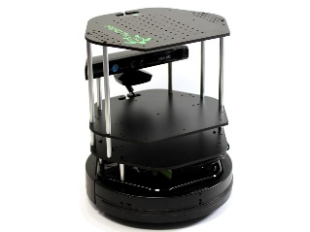
Data pipeline
Sending to
pub-sub
Sending to
Persisting
to storage
Multiple
streaming
workflows
Streaming
workflow
A stream application with some tasks running in parallel
Gateway
Message Brokers
RabbitMQ, Kafka
Streaming Workflows
Apache Storm
End to end delays without any processing is less than 10ms
Hosted in FutureSystems OpenStack VMs which are accessible through IU network

Slide 4
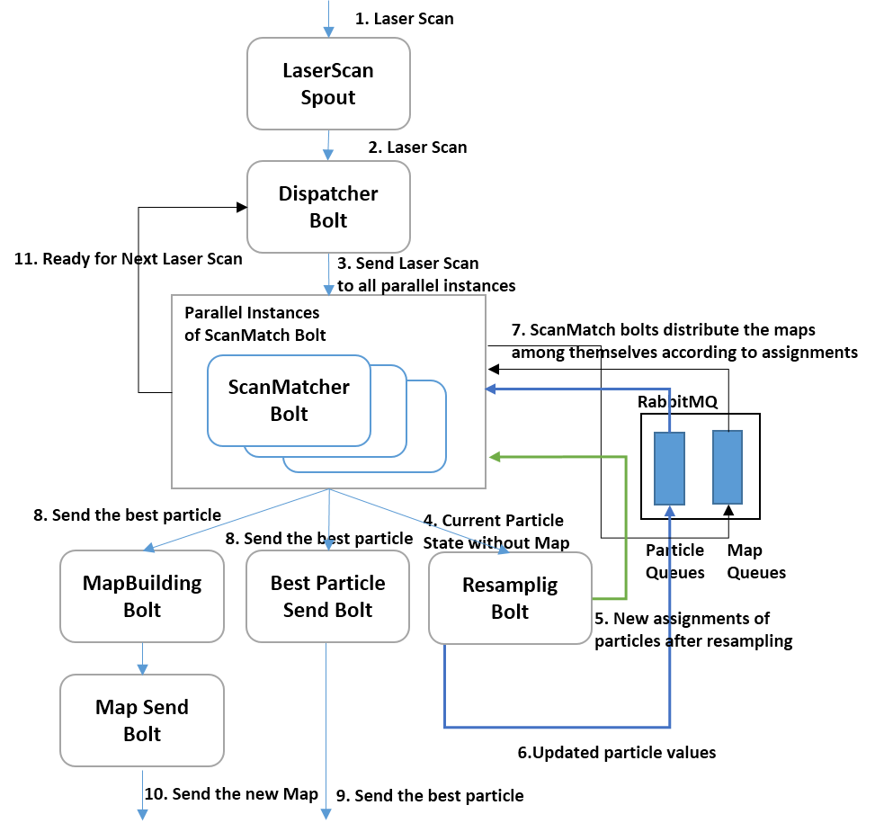
Simultaneous Localization & Mapping (SLAM)
Build a map given the distance measurements from robot to objects around it and its pose
Streaming Workflow
$$\left.p(x_{1:t},m|z_{1:t},u_{1:t−1})=p\left(m | x_{1:t}, z_{1:t}\right)p(x_{1:t}|z_{1:t},u_{1:t−1}\right)$$
Rao-Blackwellized particle filtering based algorithm for SLAM. Distribute the particles across parallel tasks and compute in parallel.
Particles are distributed
in parallel tasks
Map building happens periodically
Parallel Speedup

Slide 5
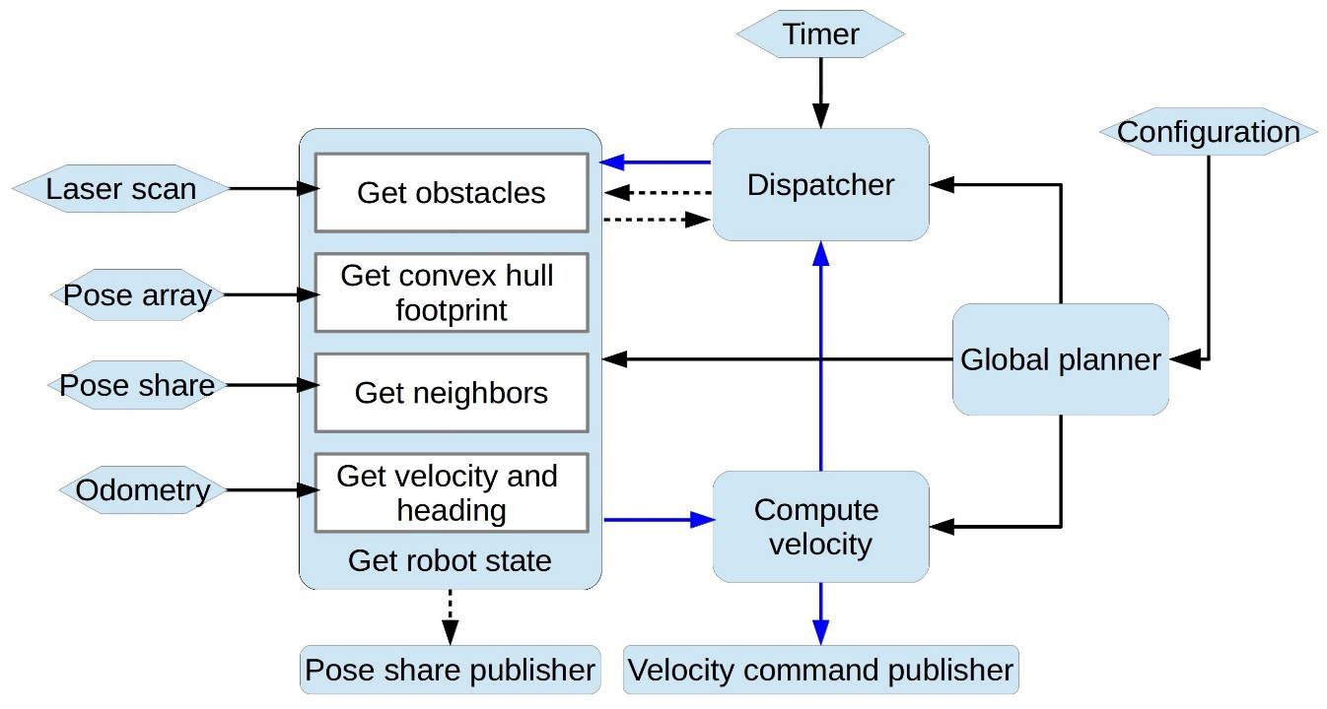
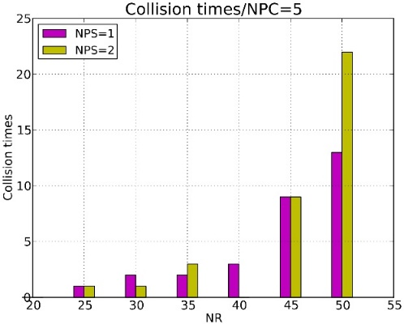
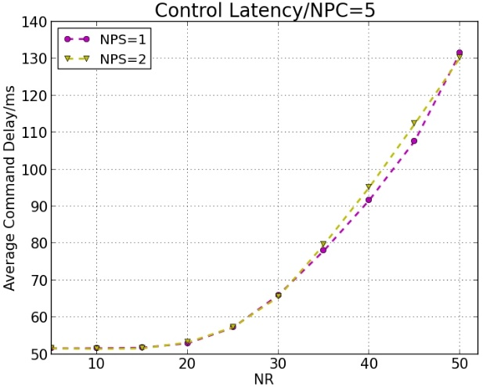
Multi-Robot Collision Avoidance
Streaming Workflow
Velocity Obstacles (VOs) along with other constrains such as acceleration and max velocity limits, Non-Holonomic constraints, for differential robots, and localization uncertainty.
Information from robots
5 Compute Velocity Tasks
Runs in parallel
Collisions with number of robots
Control Latency

Slide 6
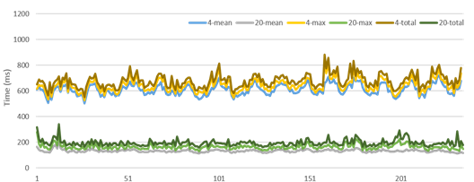
Jitter
SLAM Latency variations
Nature of application
System level influences
Network
Garbage collection
Scheduling of tasks
Virtualization
No Cut
Fluctuations decrease after Cut on #iterations per swarm member

Slide 7
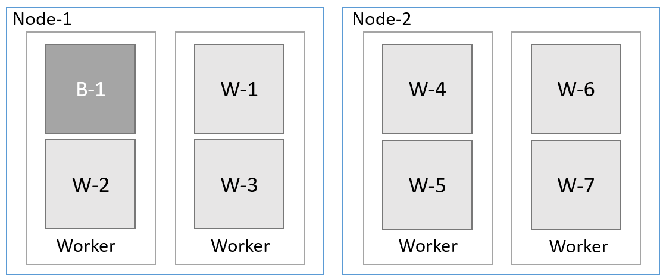
Bringing Optimal Communications to Storm
Both process based and thread based
parallelism is used
Binary tree broadcast
Original
50 Tasks
Original
20 Tasks
Optimized
20 or 50 tasks
Worker and Task distribution of Storm
Memory mapped files for intra-node communications
Broadcast takes advantage of task locality

Slide 8
Summary of Challenges
Maintaining the latency within reasonable bounds
Scheduling for predictable performance
Duplicate computations to remove random increases
Higher level abstractions for complex streaming applications
Storm API is low level (MPI like, fast) and Spark Streaming is high level (Slow).
Scaling to multiple data sources

Slide 9
Thank You
References
Projects https://github.com/iotcloud
Apache Storm http://storm.apache.org/
SLAM http://dsc.soic.indiana.edu/publications/SLAM_In_the_cloud.pdf
Collision Avoidance http://goo.gl/xdB8LZ

