Slide 1

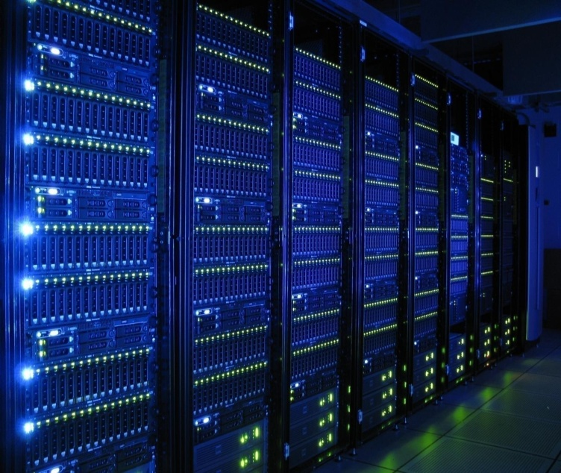

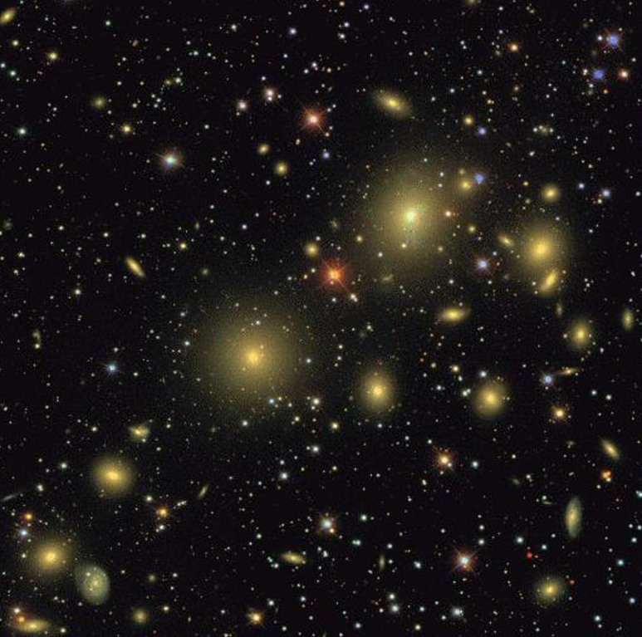
Streaming Problems in Astrophysics
Alex Szalay
Institute for Data-Intensive Engineering and Science
The Johns Hopkins University

Slide 2

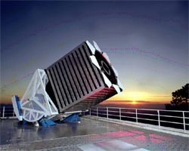
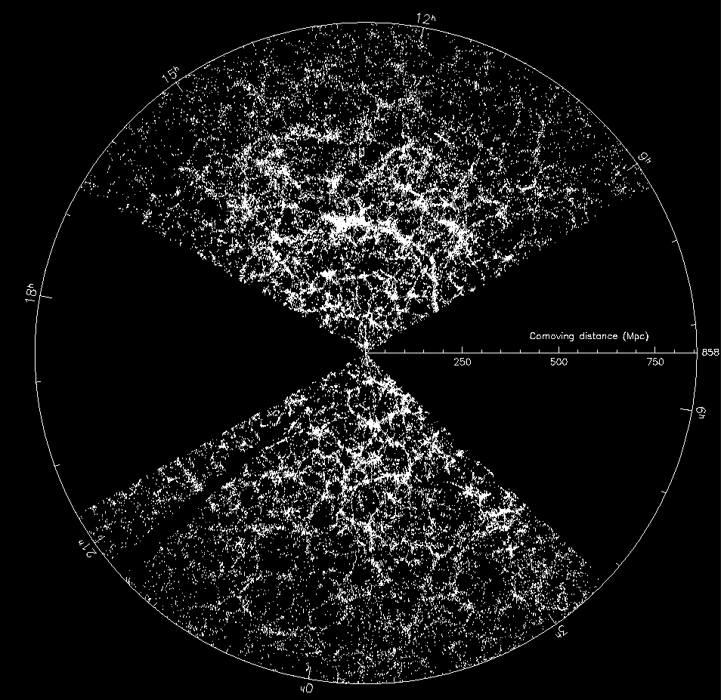
Sloan Digital Sky Survey
“The Cosmic Genome Project”
Started in 1992, finished in 2008
Data is public
  2.5 Terapixels of images => 5 Tpx of sky
  10 TB of raw data => 100TB processed
  0.5 TB catalogs => 35TB in the end
Database and spectrograph
built at JHU (SkyServer)
Now SDSS-3/4 data served from JHU

Slide 3
The Broad Impact of SDSS
Changed the way we do astronomy
Remarkably fast transition seen for the community
Speeded up the first phase of exploration
Wide-area statistical queries easy
Multi-wavelength astronomy is now the norm
SDSS earned the TRUST of the community
Enormous number of projects, way beyond original vision and expectation
Many other surveys now follow
Established expectations for data delivery
Serves as a model for other communities of science

Slide 4
How Do We Prioritize?
Data Explosion: science is becoming data driven
It is becoming “too easy” to collect even more data
Robotic telescopes, next generation sequencers, complex simulations
How long can this go on?
“Do I have enough data or would I like to have more?”
No scientist ever wanted less data….
But: Big Data is synonymous with Dirty Data
How can we decide how to collect data that is more relevant ?

Slide 5
Statistical Challenges
Data volume and computing power double every year,
  no polynomial algorithm can survive, only N log N
Minimal variance estimators scale as N^{3,}
they also optimize on the wrong thing
The problem today is not the statistical variance
  systematic errors => optimal subspace filtering (PCA)
We need incremental algorithms, where computing
is part of the cost function:
  the best estimator in a minute, day, week, year?

Slide 6
Randomization and Sampling
In many data sets lots of redundancy
Random subsampling is an obvious choice
  Sublinear scaling
  Streaming algorithms (linear in the number of items drawn)
How do we sample from highly skewed distributions?
Sample in linear transform space?
  Central limit theorem -> approximate Gaussian
  Random projections, FFT
Remap PDF onto Gaussian PDF
Compressed sensing

Slide 7
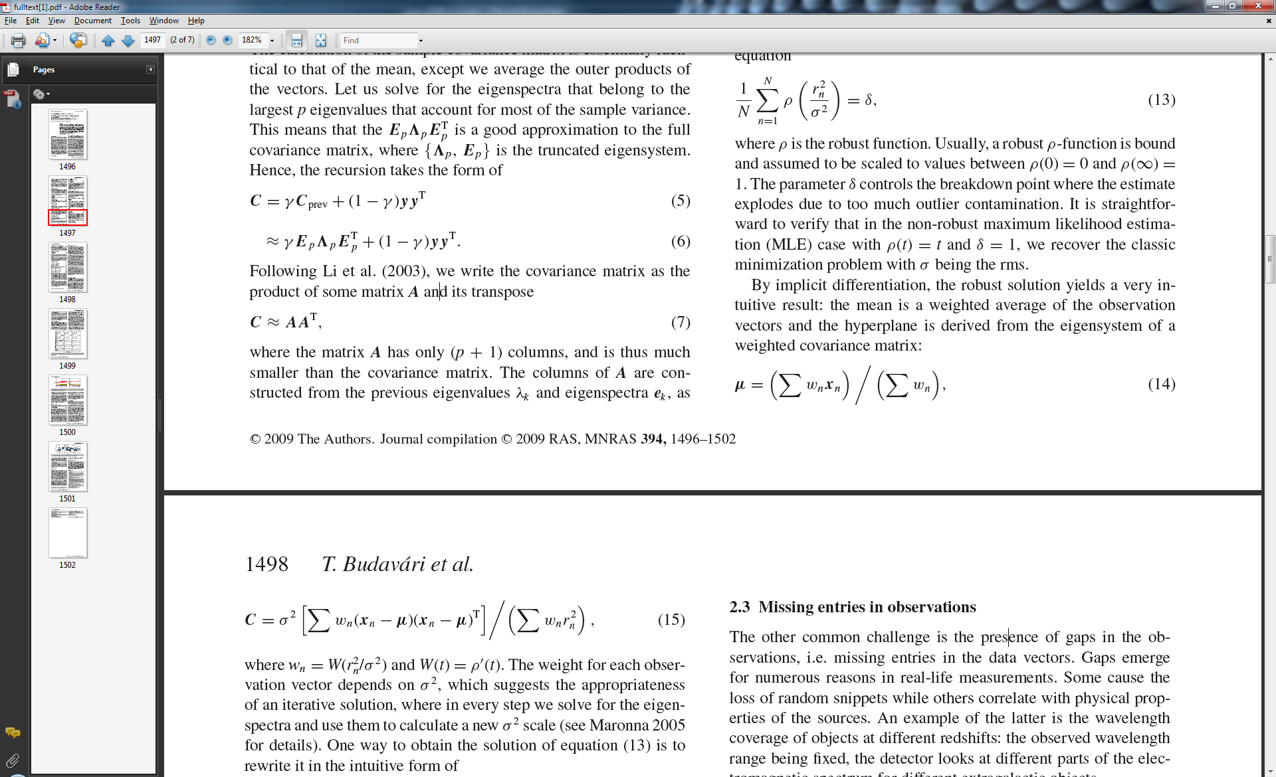
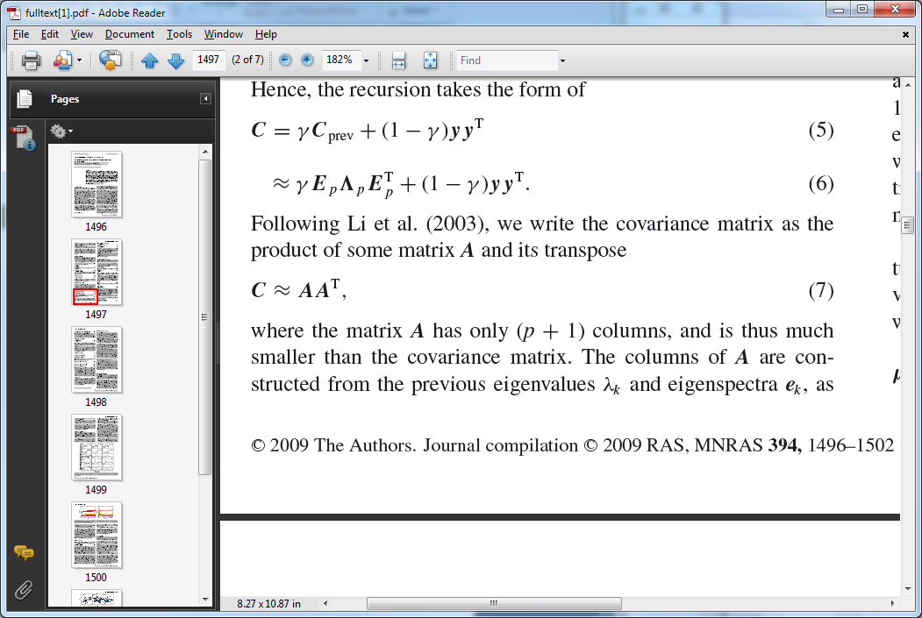
Streaming PCA
Initialization
  Eigensystem of a small, random subset
  Truncate at p largest eigenvalues
Incremental updates
  Mean and the low-rank A matrix
  SVD of A yields new eigensystem
Randomized sublinear algorithm!
Mishin, Budavari, Ahmad and Szalay (2012)

Slide 8
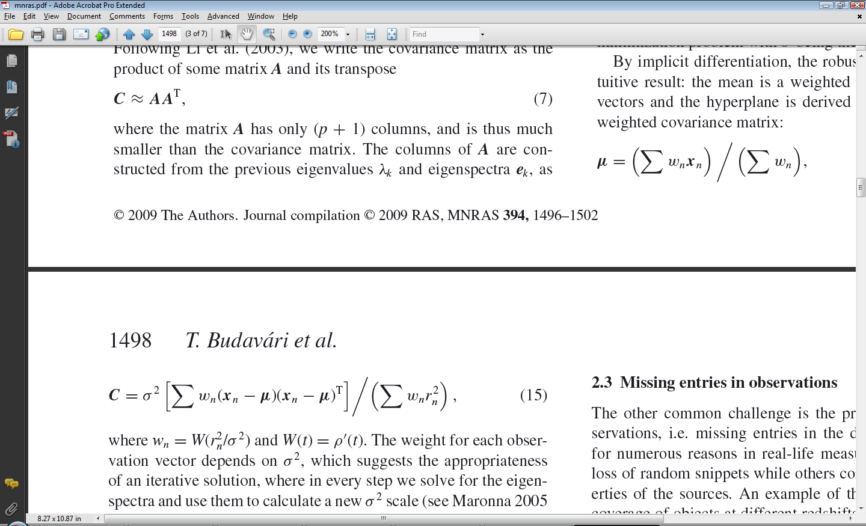
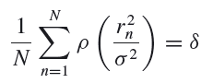
Robust PCA
PCA minimizes σ_{RMS} of the residuals r = y – Py
  Quadratic formula: Σr² extremely sensitive to outliers
We optimize a robust M-scale σ² (Maronna 2005)
  Implicitly given by
Fits in with the iterative method!

Slide 9
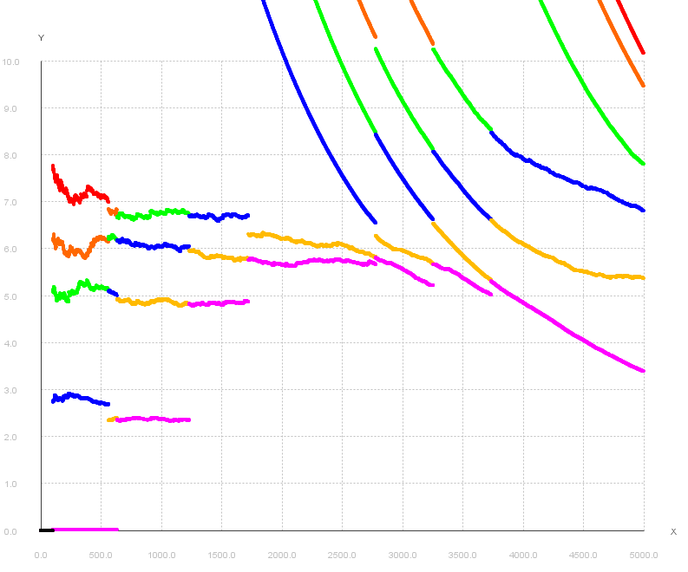
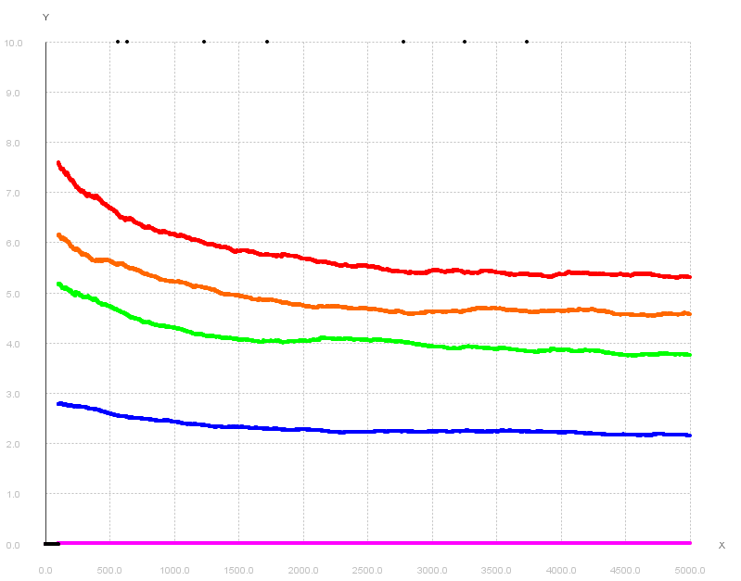
Eigenvalues in Streaming PCA
Classic
Robust

Slide 10
Principal component pursuit
Low rank approximation of data matrix: X
Standard PCA:
  works well if the noise distribution is Gaussian
  outliers can cause bias
Principal component pursuit
  “sparse” spiky noise/outliers: try to minimize the number
  of outliers while keeping the rank low
  NP-hard problem
The L1 trick:
  numerically feasible convex problem (Augmented Lagrange Multiplier)
* E. Candes, et al. “Robust Principal Component Analysis”. preprint, 2009.
Abdelkefi et al. ACM CoNEXT Workshop (traffic anomaly detection)

Slide 11
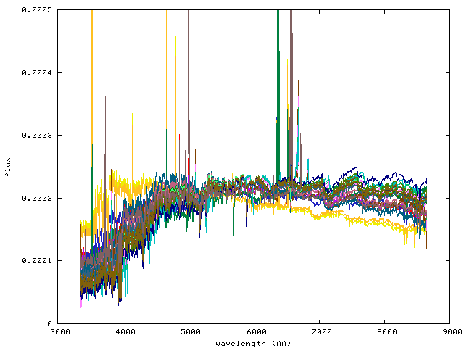
Testing on Galaxy Spectra
Slowly varying continuum + absorption lines
Highly variable “sparse” emission lines
This is the simple version of PCP: the position of the lines are known
  but there are many of them, automatic detection can be useful
  spiky noise can bias standard PCA
DATA:
Streaming robust PCA implementation for
galaxy spectrum catalog (L. Dobos et al.)
  SDSS 1M galaxy spectra
  Morphological subclasses
  Robust averages + first few PCA directions

Slide 12
Streaming PCA
Initialization
  Eigensystem of a small, random subset
  Truncate at p largest eigenvalues
Incremental updates
  Mean and the low-rank A matrix
  SVD of A yields new eigensystem
Randomized sublinear algorithm!
Mishin, Budavari, Ahmad and Szalay (2012)

Slide 13
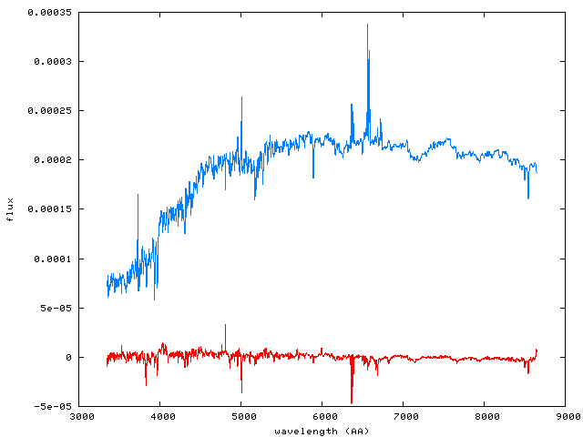
PCA
PCA reconstruction
Residual

Slide 14
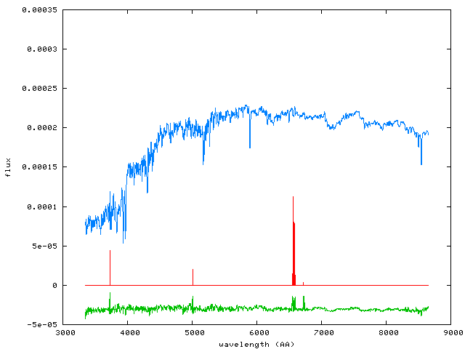
Principal component pursuit
Low rank
Sparse
Residual
λ=0.6/sqrt(n), ε=0.03

Slide 15
Numerical Laboratories
Similarities between Turbulence/CFD, N-body, ocean circulation and materials science
On Exascale everything will be a Big Data problem
Memory footprint will be >2PB
With 5M timesteps => 10,000 Exabytes/simulation
  Impossible to store
Doing all in-situ limits the scope of science
How can we use streaming ideas to help?

Slide 16
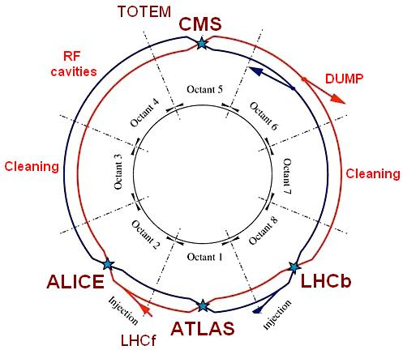
LHC Streams
LHC has a single data source, $$$$$
Multiple experiments tap
into the beamlines
They each use in-situ hardware
triggers to filter data
  Only 1 in 10M events are stored
  Not that the rest is garbage,
  just sparsely sampled
Resulting “small subset” analyzed many times off-line
  This is still 10-100 PBs
Keeps a whole community busy for a decade or more

Slide 17
Exascale Simulation Analogy
Exascale computer running a community simulation
Many groups plugging their own “triggers” (in-situ),
the equivalents of “beamlines”
  Keep very small subsets of the data
  Plus random samples from the field
  Immersive sensors following world lines or light cones
  Burst Buffer of timesteps: save precursor of events
Sparse output streams analyzed offline by broader community
Cover more parameter space and extract more realizations (UQ) using the saved resources

Slide 18
Applications of ML to Turbulence
Renyi divergence
?
Vorticity
clustering,
classification,
anomaly detection
Similarity between regions
with J. Schneider, B. Poczos, CMU

Slide 19
Summary
Large data sets are here
Need new approaches => computable statistics
It is all about systematic errors
Streaming, sampling, robust techniques
Dimensional reduction (PCA, random projections, importance sampling)
More data from fewer telescopes
Large simulations present additional challenges
  Breverman talk
Time domain data emerging, requiring fast triggers
New paradigm of analyzing large public data sets

