Slide 1
Bioinformatics and Supercomputing
Zachary Adda, Deema AlGhanim, Jacqueline Horsely, Daniel Sandrick

Slide 2
Bioinformatics
What are we trying to achieve?
Relationships between species
Periods of mutation
Origin of traits
How are we going to achieve these goals?
Supercomputing
Phylogenetic trees
Alu clustering

Slide 3
Supercomputing
Why use supercomputing?
Process huge data sets
Run sequence alignment
Create visualization aides
BigRed
Fastest Supercomputer owned and operated by a US university
23 Supercomputer in the world
Capability of 20.4 Trillion mathematical operations per second

Slide 4
Alus & Alu sequences
Video
Short stretch of DNA originally characterized by the action of the Alu ‘restriction’ endonucleous.
Discovery of Alu subfamillies led to hypothesis of master/ source genes.
AGCT
Reveal ancestry because individuals only share particular sequence insertion if the share an ancestor.
Can identify similarities of functional, structural, or evolutionary relationships between the sequences

Slide 5
Alus & Alu Sequences
Aligned sequences of nucleotide and amino acid residues are represented as rows with in a matrix. Gaps are inserted between these residues which helps align identical or similar characters.
If 2 sequences share a common ancestor, mismatches can be interpreted as mutations, gaps, or indels i.e. divergence.

Slide 6
Hypothesis
Compare and contrast ClustalW, Phylip, and Plot Viz applications to determine evolutionary and genetic relationships
What is the accuracy of these applications
Can they be a stand alone solution for determining evolutionary change?

Slide 7
ClustalW
Input .txt file:
>chr16_32847835_32848131_C_AluY
GGCCGGGTGCAGTGGCTTACGCCTGTAATCCC
Outputs .phy file:
Matches sequences and gives them identities which can be used to identify similarities and differences
Application that creates biological meaning from multiple sequence alignment

Slide 8
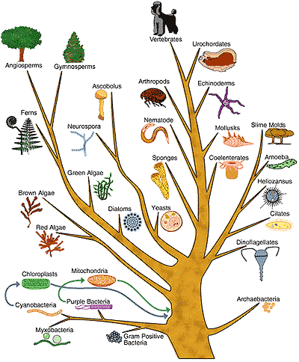
Phylip
PHYLogeny Inference Package
Package of programs for inferring evolutionary trees
Illustrate the evolutionary relationships among groups of organisms, or families of related nucleic acid or protein sequences
Help us predict which genes might have similar functions

Slide 9
Phylip Programs
Step 1: Seqboot
Bootstraps the input dataset and creates output datasets that can be used by Phylip
Step 2: Dnadist
Uses sequences to compute a distance matrix
 | Chr8_xxxxx | Chr2_xxxxxx | Chr12_xxxxxx
Chr8_xxxxx | 0 | 3 | 4
Chr2_xxxxx | 3 | 0 | 1
Chr12_xxxxx | 4 | 1 | 0

Slide 10
Phylip Programs
Step 3: Neighbor Tree
Creates clusters of lineages in the form of an unrooted tree
Step 4: Consense Tree
Arranges the data into monophyletic groups. If these groups appear more than 50% throughout the tree they are displayed in the consensus tree.

Slide 11
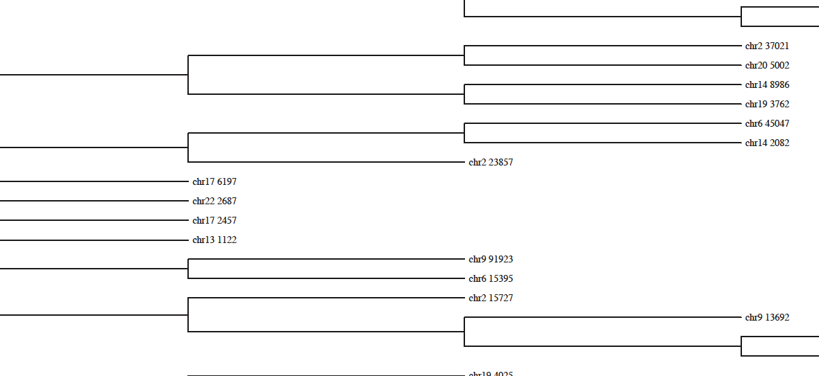
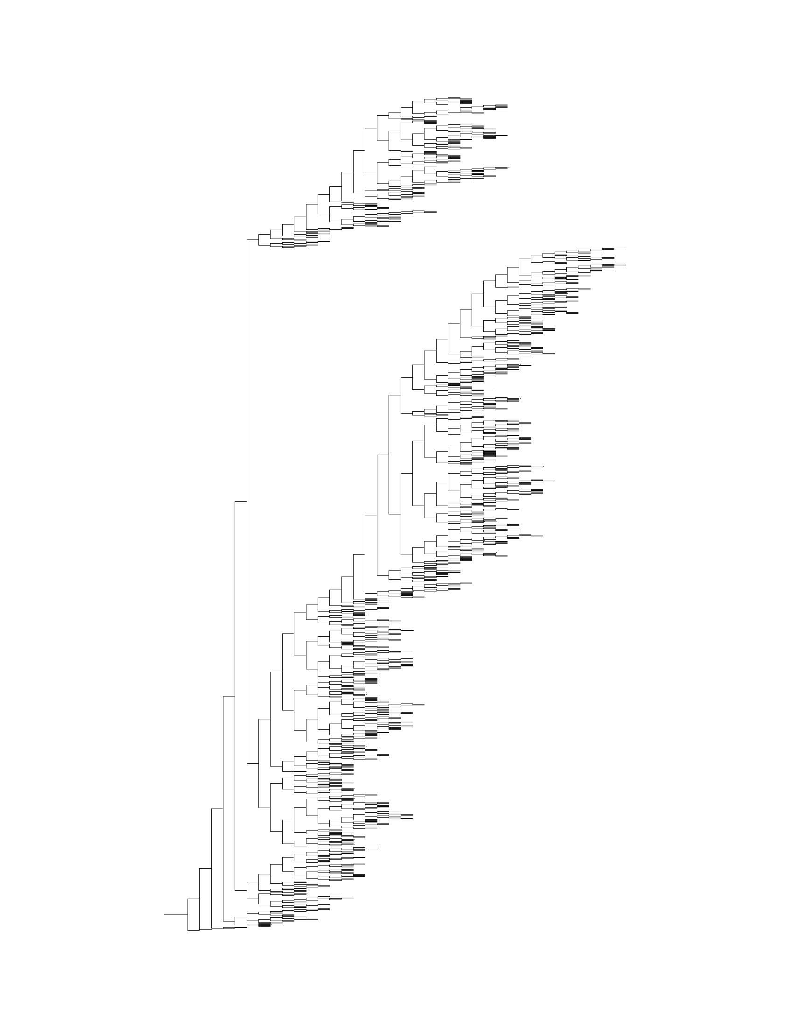
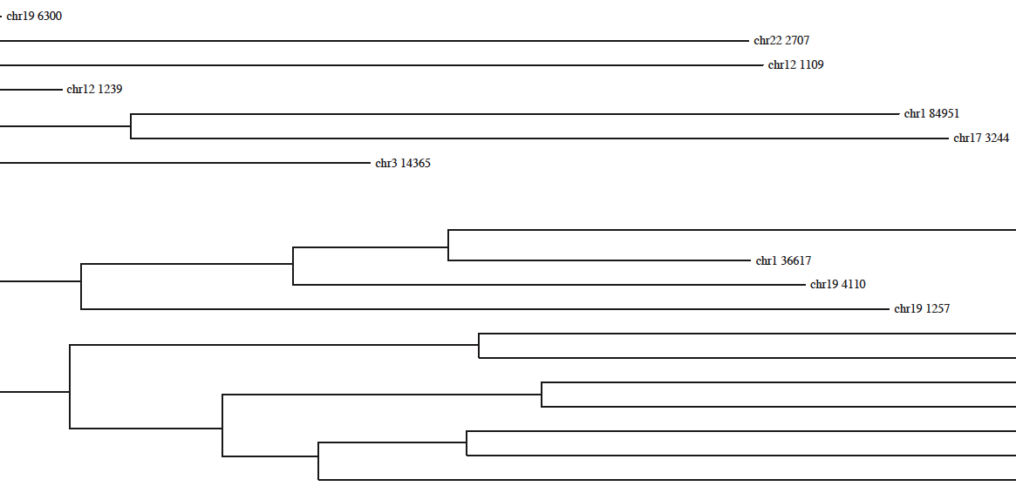
Phylip Programs

Slide 12
Clusters
Clustering is used to group homologous sequences into gene families. This is a very important concept in bioinformatics, and evolutionary biology in general.

Slide 13
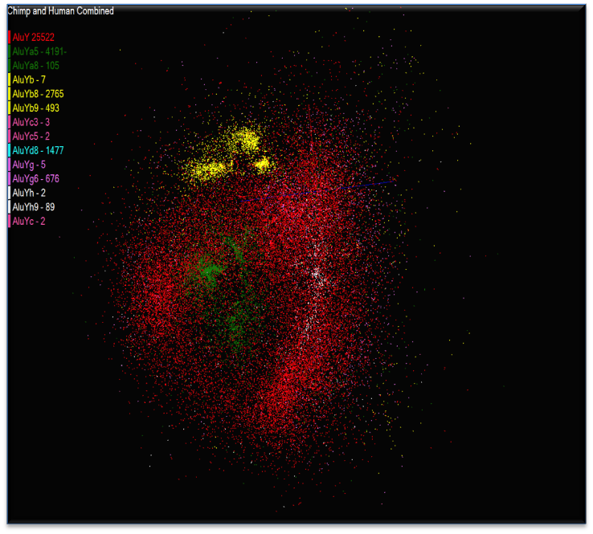
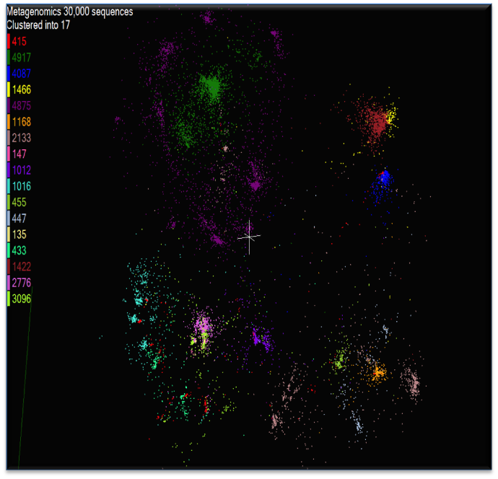
Clusters
Alu Families
This visualizes results of Alu repeats from Chimpanzee and Human Genomes. Young families (green, yellow) are seen as tight clusters. This is projection of MDS dimension reduction to 3D of 35399 repeats – each with about 400 base pairs
Metagenomics
This visualizes results of dimension reduction to 3D of 30000 gene sequences from an environmental sample. The many different genes are classified by clustering algorithm and visualized by MDS dimension reduction

Slide 14
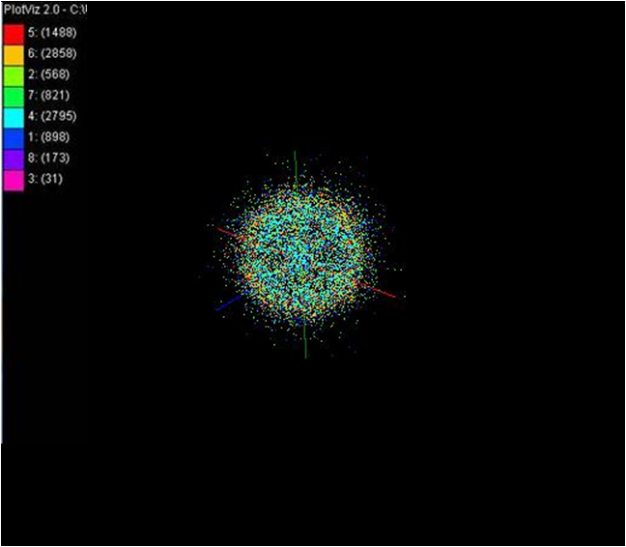
PlotViz
A 3-D visualization program that plots out Alu sequences in clusters.
Results for 8 clusters of the 10K Alu sequences

Slide 15
Conclusion
Phylogenetic Trees and Clustering are effective methods to support biology data analysis.
Using these tools, scientists can have a comprehensive understanding and comparison of results from different solutions
Should be used in conjunction with other scientific research and methods
Can fill in gaps where data is missing and support scientific theories

