Slide 1

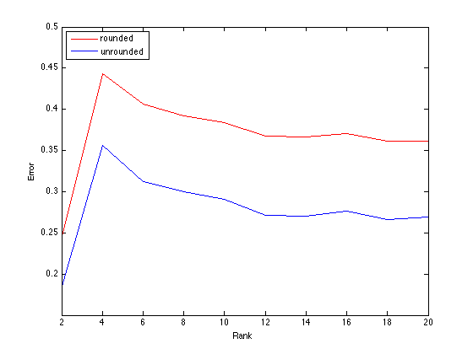
Do Integer Ratings Hinder Recommendation Systems?
By: Shi Hui Lim, Jimmy Bobowski, Amanda Lambert
Introduction
Problem: Do integer ratings hinder recommendation systems?
Use Matrix Completion algorithm to complete sparse matrices that come from the original Netflix training dataset
Compare matrices using RMSE (Root Mean Squared Error)
Determine how much error is inherent in Netflix’s rounded rating recommendation system
Methodology
Create five initial matrices:
M₀ = Create initial matrix from Netflix
training dataset
M = Add ‘noise’ to M₀ (i.e. a rating of
‘3’ becomes ‘3.212’)
M_{s} = Randomly remove entries from
M
M_{r} = Round the entries in M_{s}
M_{R} = Round the entries in M
Apply Matrix completion algorithm on M_{s} and M_{r} to obtain two complete matrices (M_{s~} and M_{r~})
Compare M_{s~} and M_{r~} to M and M_{R} using RMSE
Plot
Theory
Matrix Completion: works well for sparse matrices with a reasonable (~10%) amount of entries and can recreate a full matrix with high probability of success
RMSE:
Hypothesis
The higher the rank in a matrix, the less successful the Matrix Completion algorithm will be
When there are less entries in a matrix, the Matrix Completion algorithm will have more error
The Matrix Completion algorithm will be more successful in recreating matrices with unrounded numbers
Conclusion
We were able to show that there is a
certain amount of error in Netflix’s recommendation
We ran into problems with the Matrix Completion algorithm that we used and were unable to show some of our other hypotheses
Rounded user ratings will always have more error than unrounded data because in a recommendation system
sdfaasdfasdfasdfasdfasdfadfsdfsdfasdfsdfsdfasdfsdfsdfsdfsdfsdfsdfsdf
2s
m x n
Mentors: Brent Castle, Huijun Wang
I399 – Research Methods

