Slide 1

Do Integer Ratings Hinder Recommendation Systems?
Amanda Lambert
Jimmy Bobowski
Shi Hui Lim
Mentors: Brent Castle, Huijun Wang

Slide 2
What is Machine Learning?
A scientific discipline concerned with the design and development of algorithms that allow computers to evolve behaviors based on empirical data, such as from sensor data or databases, to extract patterns or trends in the data
Studies how to automatically learn to make accurate predictions based on past observations
Notes:
Add areas that use machine learning

Slide 3
Preliminary Research
Learned about data mining/machine learning topics
Informally reviewed Candes and Recht’sExact MatrixCompletion via ConvexOptimization
Familiarized ourselves with MATLAB

Slide 4
Netflix Competition
Competition to improve movie recommendation system
Released training dataset
  100,480,507 ratings from 480,189 users and 17,770 movies;
Competition is over, but dataset is still available for research purposes
Notes:
Netflix provided a training data set of 100,480,507 ratings that 480,189 users gave to 17,770 movies. Each training rating is a quadruplet of the form <user, movie, date of grade, grade>. The user and movie fields are integer IDs, while grades are from 1 to 5 (integral) stars.^{[2]}
See how well algorithm works on a separate data set (test).

Slide 5
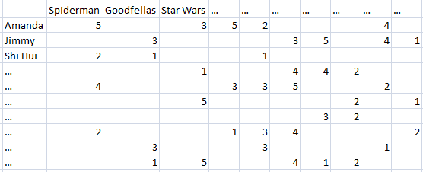

Movie Ratings Example

Slide 6
Research Problem
Hypothesis:
  Rounded user ratings cause an innate amount of error in recommendation systems
  We’re not advocating using real numbers, just studying how the numbers affect the systems.
Notes:
Not advocating using real number ratings, studying how the numbers affect recommendation systems

Slide 7
Matrix Completion
What does matrix completion have to do with our problem?
  Users rate movies they have seen, but obviously cannot rate movies they have not
  A matrix completion algorithm estimates how users would rate movies that they have never seen based on movies they have rated

Slide 8
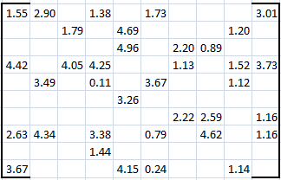
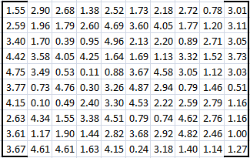
Matrix Completion
SparseMatrix
Full Matrix

Slide 9
Matrix Completion
A (good) matrix completion algorithm can take a sparse matrix with a small number of entries and return a completed matrix with high probability of successful recreation of the original matrix
In our case, 6% of entries

Slide 10
Our Solution
M₀ = Create initial matrix from Netflix training dataset

Slide 11
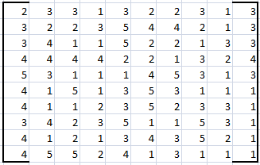
Our Solution

Slide 12
Our Solution
M₀ = Create initial matrix from Netflix training dataset
M = Add ‘noise’ to M₀ (i.e. a rating of ‘3’ becomes ‘3.212’)

Slide 13
Our Solution

Slide 14
Our Solution
M₀ = Create initial matrix from Netflix training dataset
M = Add ‘noise’ to M₀ (i.e. a rating of ‘3’ becomes ‘3.212’)
M_{s} = Randomly remove entries from M.

Slide 15
Our Solution

Slide 16
Our Solution
M₀ = Create initial matrix from Netflix training dataset
M = Add ‘noise’ to M₀ (i.e. a rating of ‘3’ becomes ‘3.212’)
M_{s} = Randomly remove entries from M.
M_{r} = Round the entries in M_{s} .

Slide 17
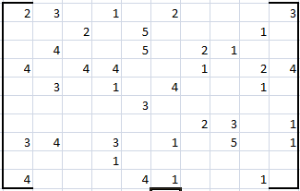
Our Solution

Slide 18
Our Solution
M₀ = Create initial matrix from Netflix training dataset
M = Add ‘noise’ to M₀ (i.e. a rating of ‘3’ becomes ‘3.212’)
M_{s} = Randomly remove entries from M.
M_{r} = Round the entries in M_{s} .
M_{R} = Round the entries in M.

Slide 19
Our Solution

Slide 20
Our Solution
Run matrix completion algorithm on M_{s}and M_{r}to create M_{s~}andM_{r~}

Slide 21
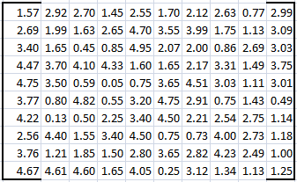
Our Solution
Sparse matrix
Completed matrix

Slide 22
Our Solution
Completed matrix
Original Matrix
Compare

Slide 23
Our Solution
Use Root Mean Squared Error (RMSE) to calculate the amount of error between the completed matrices and their already complete counterparts
2
m x n

Slide 24
Experiment – Testing Rank
Fixed matrices to 1000 x1000
Sparsity was set to 10%
Iterated ranks 2 to 20 by 2
Ran matrix completion algorithm for each rank 20 times

Slide 25
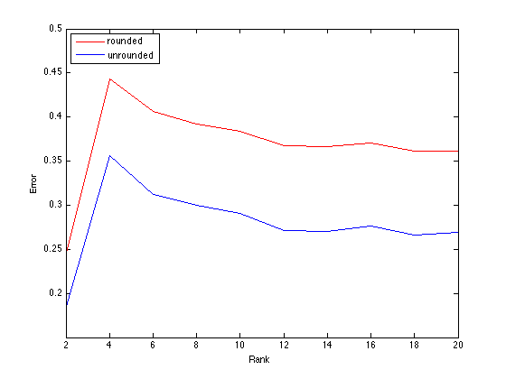
Results - Rank

Slide 26
So what?
We determined that there is a cap to how much better Netflix’s recommendation system can get (as well as otherrecommendation systems that use rounded user ratings)

Slide 27
So what?
This means that until the Matrix Completion technique is improved upon, that Netflix’s recommendation can’t get much better!

Slide 28
Questions?

