Slide 1
Usability of Google Wave
Kody Cummins
Adam Heleine
Jenn Hughes
Mike Roche

Slide 2
“No one can figure out how to use it effectively"
"overhyped disappointment for the first generation of users"
“dismal usability"
“Humans may not be able to comprehend"

Slide 3
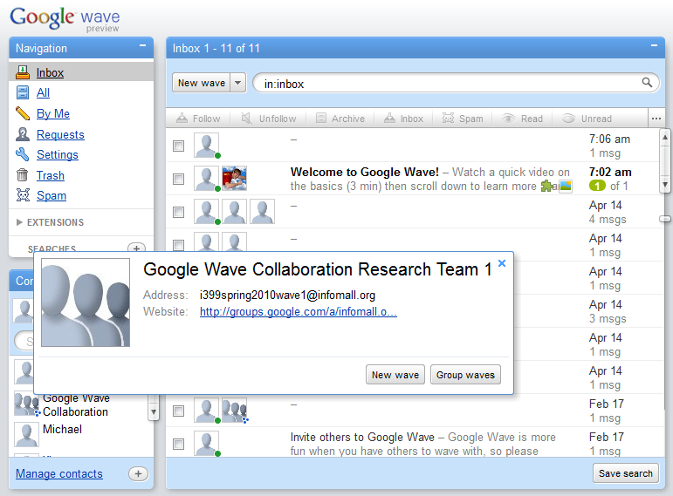
Follow-Up Procedure
Closing Thoughts

Slide 4
Comparison to Other Systems
Strengths and Weaknesses

Slide 5
Important Features of a Collaborative System
Based on Collaborative Needs
Archiving of Information
Group Conversation
Resource Sharing

Slide 6
Comparisons
 | Google Wave | Wiki | Email
Real Time | Yes | No | Medium
Information Archiving | Yes | Yes | Yes
Resource Sharing | Yes | Medium | Yes
Usability | Poor | Medium | Strong
Group Conversation | Strong | Weak | Medium

Slide 7
Usability Testing
Purpose of Usability Testing
We conduct these tests to measure the user's experience when interacting with a product or system-whether a Web site, a software application, mobile technology, or any user-operated device.

Slide 8
What are we able to Measure?
Ease of learning
Efficiency of use
Learning Curve
Error frequency and severity
Subjective satisfaction

Slide 9
Task List for Users
1
Add a contact to your contacts list
4
Open a message and attach a file to it.
5
Open a unread message and reply to it.
3
2
Open a message conversation with someone on your contacts list
Open a group message with 3 or more people from your contacts list.

Slide 10
Procedure for Test
Record User Path
Record User Time
Record User Comments
Start User at Home Page
Give User 1 of 5 Tasks

Slide 11
Follow-Up Procedure
Assistance Needed?
User Difficulty Rating (1-5)
Pass or Fail
Data Analysis
Closing Thoughts

Slide 12
The Data
OutlineUsa.xlsm

Slide 13
Findings
Task # | Average Time (seconds) | Average Rating (out of 5) | Minimum Steps required | Average Number of Steps of user
1 | 48s | 2.7 | 3 | 6
2 | 24s | 1.9 | 3 | 4
3 | 76s | 3 | 5 | 8
4 | 57s | 2.5 | 5 | 5
5 | 24.6s | 2.8 | 3 | 3

Slide 14
Google Wave Ratings
Ease of learning | Efficiency of use | Learning Curve | Error frequency and severity | Subjective satisfaction
73 | 74 | 81 | 80 | 71
Ability to Learn similar steps in tasks
Based on number of errors per task
Based on comparison of scores of a test taken this week
Based on count of Failures
Based on Participants Thoughts on Google Wave

Slide 15
Proposed Design Improvements
Message Notification
Document Collaboration
Draft Mode
Permissions

Slide 16
Proposed Google Wave Uses
Emergency System
Research Collaboration

Slide 17
Conclusion
Start User at Home Page
Although Google Wave has greatly advanced group collaboration tool, if the usability is not changed soon it could soon fall into the black hole of internet failures.
Give User 1 of 5 Tasks

