Slide 1
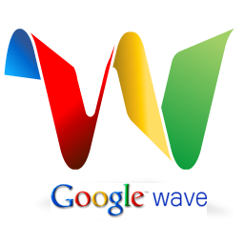
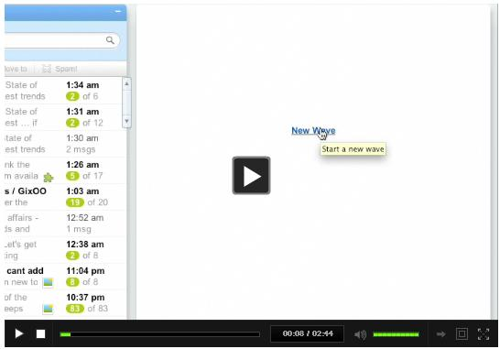



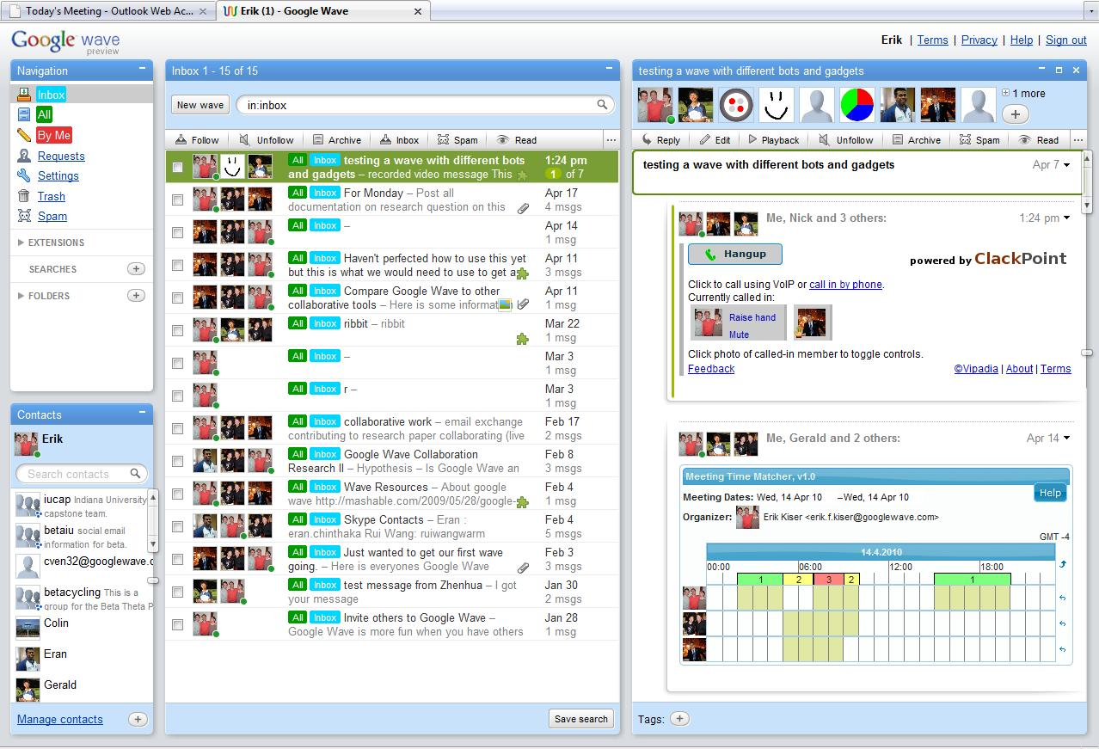
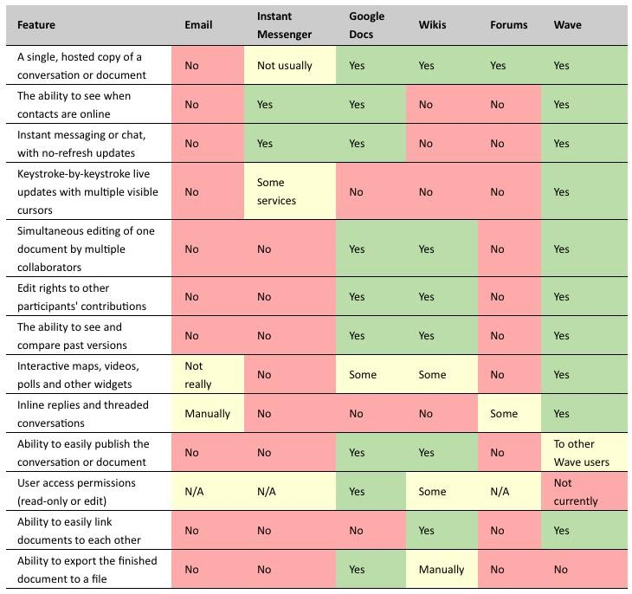
Exploring Google wave for Research Collaboration II
Is Google Wave an effective media to use when conducting a
collaborative research project?
INTRODUCTION
INDIVIDUAL RESULTS
OBSERVATION RESULTS
VIDEO
Google Wave is a collaborative tool developed by Google in order to solve the problem of electronic collaboration.
Our research was to specifically focus on the use of Google Wave in a collaborative research setting. Our question is: “Is Google Wave an effective media to use when conducting a collaborative research project.”
Google Wave offers many of the appropriate tools to support collaboration. Skype, SharePoint, Wikipedia, and email are all tools that current collaboration groups use when conducting research.
Google Wave has and continues to incorporate many of the needs of a collaborative research group into their platform. With specific user developed Gadgets, Bots and Imbeds, a wave can potentially support a group performing collaborative research. The development of these external modules can be focused primarily on supporting collaborative research and their availability continues to grow daily.
Through researching the six different question that interested us when looking at Google wave, we were enabled to dig deep into the tool and research methods to make a decision based on our findings.
Current collaborative tools in research are Google Docs, Skype, Microsoft SharePoint, Wikipedia, and email. These are the main resources for collaboration. We found that a big problem is that a group uses many different tools and doesn’t have one collaboration tool that incorporates many others. We feel that Google Wave can solve this problem by allowing third party programs to be incorporated into a wave.
Current built-in functionalities of Google wave that support collaboration are:
Real-time: In most instances, you can see what someone else is typing, character-by-character.
Embed ability: Waves can be embedded on any blog or website.
Applications and Extensions: Just like a Facebook application or an iGoogle gadget, developers can build their own apps within waves. They can be anything from bots to complex real-time games.
Wiki functionality: Anything written within a Google Wave can be edited by anyone else, because all conversations within the platform are shared. Thus, you can correct information, append information, or add your own commentary within a developing conversation.
Open source: The Google Wave code will be open source, to foster innovation and adoption amongst developers.
Playback: You can playback any part of the wave to see what was said.
Natural language: Google Wave can autocorrect your spelling, even going as far as knowing the difference between similar words, like “been” and “bean.” It can also auto-translate on-the-fly.
Drag-and-drop file sharing: No attachments; just drag your file and drop it inside Google Wave and everyone will have access.
It is important to realize that Google wave is an open source software. Being open source allows users to create tools to support their needs through wave. Currently, tools like email, Wikipedia, conference calling, whiteboards and charts have been added to the list of available extensions for a wave. As wave grows, there will be a continued effort to add more content that is relevant to collaborative research.
Collaborative research groups needs most importantly an effective form of communication. With all of the collaborative software available on the internet, it is easy to connect but very difficult to manage all of the information. Communication is important because a collaborative research group is made of two or more people who work together towards a common goal by sharing knowledge and information with each other. Without a mean to share information through collaboration, it would be very difficult to perform research electronically. Through collaborating, teams are allowed to achieve greater resources, recognition, and reward they might not be able to achieve on there own.
Through reviewing figure 1, one can notice the abundance of collaborative resources available through using Google wave as it compares to other collaborative research tools.
Our group exploited Google wave as a tool for us to manage this research project. See figure 2. Through using wave to support our research, we were able to use the functionalities of a wave to effectively communicate. We used pre-recorded videos, video conferencing, and email through wave to keep everyone updated and informed on the newest information pertaining to our research project.
During our group observation we found out a lot of useful information regarding how a collaborative research group currently functions. One of our main findings was that the main form of communication is through email lists and the tools they use beyond that is scattered all over internet; from wikis and blogs to Skype and SharePoint. We also found that this created a lack of central organization for the group . This did not appear to be a major issue to them but we thought differently since lack or organization negatively hurts the group and prevents them from working together as efficiently as possible.
3
ABSTRACT
The purpose of this project was to explore Google wave and determine if it is currently an effective media for collaborative research. The group consisted of three undergraduate students; Erik Kiser, Nick Swan, and Michael Keel. These students were lead under the supervision of two graduate/post-graduate students, Eran Chinthaka and Rui Wang who provided different resources and information to help aide the students throughout their research. This project took place during the Spring 2010 semester at Indiana University during Geoffrey Fox I399 class.
INTERACTIVE RESULTS
During the course of our project we directly used Google wave within our group as a source of primary data to use towards our research. Our initial thoughts of Google wave was that it was a fancier version of email , but as we got more familiar with the interaction of waves and new applications were developed, we started to notices that there was actually some useful tools that allowed us to collaborate effectively.
METHODS AND MATERIALS
Our primary sources of research was based off of three different methods; individual research, group observation, and user interaction.
Individual Research:
1. Current collaborative tools
2. Functionalities of Google wave
3. Needs of a collaborative research group
4. Collaborative tools needed in Google wave
5. Comparison of Google wave to other collaborative tools
6. Current performance of a collaborative research group
Group Observation:
Observed an interviewed a group of Doctoral students at the Innovation Center to better understand the needs of a collaborative research group and how they are currently conduct research.
User Interaction:
Our group created a wave to understand the use of Google wave for collaborative research and incorporated different gadgets bots and imbeds to support collaborative research.
CONCLUSIONS
Currently Google wave has a lot to offer for groups who are conducting collaborative research. It allows everyone who uses it a direct source of tools that are centrally located which can help keep a groups research more organized and efficient. It offers a variety of necessary tools needed in collaboration such as video/phone conferencing and document editing, but since it is a new product, not every essential application has been developed yet. As we talked to researchers, we found that they are primarily happy using a variety of different tools on a large range of platforms, but we feel that this is due to there inexperience and unfamiliarity to Google wave. Within our own research group, we found this exact acceptance and as time went on and more applications and tools were developed, we were able to collaborate and work better together as a whole. In conclusion, we have determined that Google wave is an effective media to use when conducting a
collaborative research project and only see necessary and useful improvements coming in the future.
CONTACT
Erik Kiser: ekiser@indiana.edu
Nick Swan: nswan@indiana.edu
Michael Keel: mjkeel@indiana.edu
REFERENCES
http://cache.gawker.com/assets/images/17/2010/01/500x_wave-vs-rest-update.jpg
Snapshot taken of researchers current wave
http://video.ribbit.com/corporate_site/wave/ribbitwaveGB.html
2
1

