Slide 1
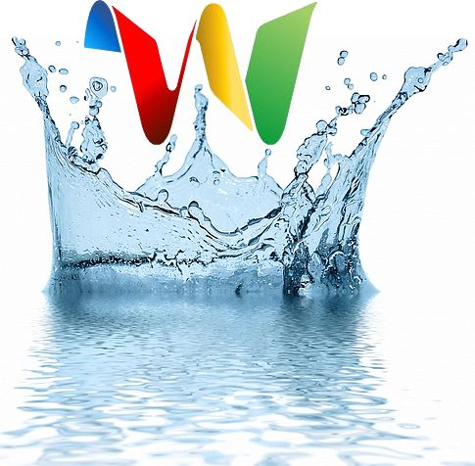
Introduction
Current Problems With Research Collaboration
What Is Google Wave?
Research Methods
What We Found
Recommendations/Conclusions
Google Wave Research Collaboration Group II
Erik Kiser
Nicholas Swan
Michael Keel

Slide 2
Research Team
Introduction
Current Problems With Research Collaboration
What Is Google Wave?
Research Methods
What We Found
Recommendations/Conclusions
Michael Keel
Nicholas Swan
Erik Kiser

Slide 3
Introduction
Current Problems With Research Collaboration
What Is Google Wave?
Research Methods
What We Found
Recommendations/Conclusions
Hypothesis
Can Google Wave be an Effective Medium for Group Research Collaboration?
Credit: Google Images

Slide 4
Introduction
Current Problems With Research Collaboration
What Is Google Wave?
Research Methods
What We Found
Recommendations/Conclusions
Current Problems?
Main form of communication
Email lists
Tools used varies all over the internet
Wikis, Blogs, Skype, SharePoint
No one uses the same tools

Slide 5
Introduction
Current Problems With Research Collaboration
What Is Google Wave?
Research Methods
What We Found
Recommendations/Conclusions
Organizational Factors
Organization is hard to control
Many different accounts or sites used
People are left off of email lists or information is overlooked by them
Information is scattered everywhere
Email messages get lost

Slide 6
Introduction
Current Problems With Research Collaboration
What Is Google Wave?
Research Methods
What We Found
Recommendations/Conclusions
What is Google Wave?
Google Wave is an online tool for real
time communication and collaboration.
Conversation
Documentation
Multi-Media
Shared
Live
http://wave.google.com/drwave.html

Slide 7
Introduction
Current Problems With Research Collaboration
What Is Google Wave?
Research Methods
What We Found
Recommendations/Conclusions
Still in “beta”
Only become a wave member through invitation, similar to the gmail release.
Internal
Google Development
Features
Usability
External
API
Open Source
New Tools
Gadgets

Slide 8
Introduction
Current Problems With Research Collaboration
What Is Google Wave?
Research Methods
What We Found
Recommendations/Conclusions
Gadgets, Embeds, Bots
Wave Gadget
Look & Feel
Wave Robot
Modify Information
Save Information
Display Information
Wave Embeds
Third Party Tool
Import New Functionality
example – youtube

Slide 9
Introduction
Current Problems With Research Collaboration
What Is Google Wave?
Research Methods
What We Found
Recommendations/Conclusions
Individual Research
Each group member was assigned 2 questions aligned with Google wave and collaborative research.
Current collaborative tools
Functionalities of Google wave
Needs of a collaborative research group
Collaborative tools needed in Google wave
Comparison of Google wave to other collaborative tools
Current performance of a collaborative research group

Slide 10
Introduction
Current Problems With Research Collaboration
What Is Google Wave?
Research Methods
What We Found
Recommendations/Conclusions
Group Observation
Who We Observed
- Use of Email in Group Collaboration
- No Universal Software

Slide 11
Introduction
Current Problems With Research Collaboration
What Is Google Wave?
Research Methods
What We Found
Recommendations/Conclusions
User Interaction
Used Google wave to manage our own project.
Assigned tasks
Group meetings
Document Upload and Storage
Meeting notes
Saved information from previous meetings and collaboration

Slide 12
Introduction
Current Problems With Research Collaboration
What Is Google Wave?
Research Methods
What We Found
Recommendations/Conclusions
Needs of Research Group
Central organization of all information
Scattered information is less productive
Wide variety of applications and extensions
Video Chat, Document Upload, Scheduling, etc.
Easy to use for all levels of experience
A simple design reduces time wasted learning a new program
Advanced options included for further development
A simple design shouldn’t limit ones use of features

Slide 13
Introduction
Current Problems With Research Collaboration
What Is Google Wave?
Research Methods
What We Found
Recommendations/Conclusions
Functionalities of Wave
Tools to Support Research Collaboration:
CheckWave (email notification)
TwiloBot (Click-to-Call phone number links)
Wavepedia Bot (Wikipedia to gateway bot)
StyleChart (Insert a chart into wave)
ClackPoint (Audio-conferencing to the wave)
Meeting Time Matcher (Schedule of users availabiltiy)
Nimbb Gadget (Record a video for the wave)
Scrummy (Planning tasks, deadlines and allocations)

Slide 14
Introduction
Current Problems With Research Collaboration
What Is Google Wave?
Research Methods
What We Found
Recommendations/Conclusions
How is a Wave different?
Incorporation of all resources for Collaborative
Research.
Real-Time
Embeddability (embed wave into blog)
Applications & Extensions
Wiki Functionality (Anything can be edited by anyone on the wave)
Open Source (growth!)
Playback (step through a wave to see exactly how the information was created)
Spell Check
Drag-and-Drop File Sharing

Slide 15
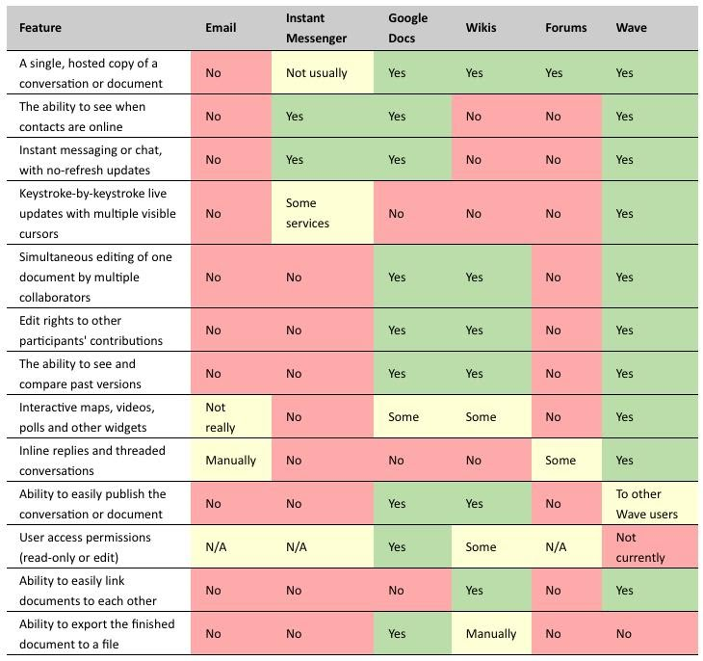
Introduction
Current Problems With Research Collaboration
What Is Google Wave?
Research Methods
What We Found
Recommendations/Conclusions
Functionalities

Slide 16
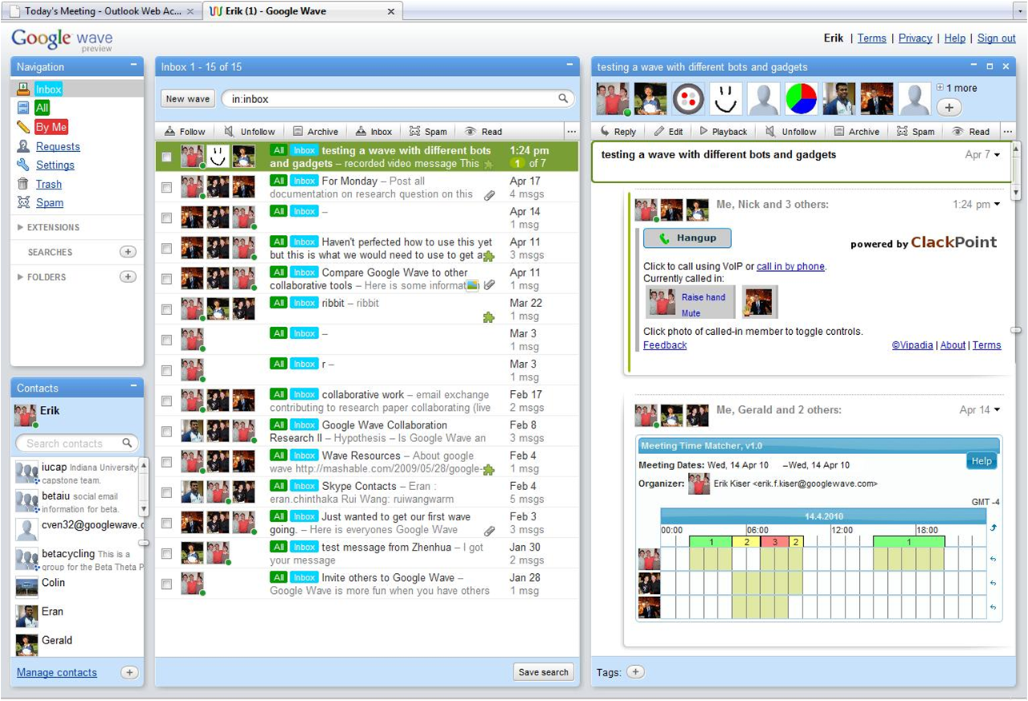
Introduction
Current Problems With Research Collaboration
What Is Google Wave?
Research Methods
What We Found
Recommendations/Conclusions
Use of Google wave
Show our wave and how we have used it throughout our collaboration

Slide 17
Introduction
Current Problems With Research Collaboration
What Is Google Wave?
Research Methods
What We Found
Recommendations/Conclusions
Current Additions
Initially Google wave did not support email notifications
Feature was added during this project
Uploading files was hard to figure out
Now it is a one click button to browse or provide a link
Important because Google wave is still in the development process
Realized its problems and have began to fix them

Slide 18
Introduction
Current Problems With Research Collaboration
What Is Google Wave?
Research Methods
What We Found
Recommendations/Conclusions
Potential
Waves have potential to grow into the premier
online tool for collaborative work.
Open Source
Ease of development
API
Source Code
Community
Need for ONE Collaborative Media

Slide 19
Introduction
Current Problems With Research Collaboration
What Is Google Wave?
Research Methods
What We Found
Recommendations/Conclusions
Needs of Research
Organization
Ease of Use
Many Different Tools
Voice
Notes
External Information
Charts, Graphs, Graphics, etc…

Slide 20
Introduction
Current Problems With Research Collaboration
What Is Google Wave?
Research Methods
What We Found
Recommendations/Conclusions
Wave Supports Collaborative Research
Integration of current research tools into wave
One place for a group to always look for information
Accurately store data
No “lost” information
Secure access to information

