Slide 1
Face To Face vs. Mediated Interaction
Joseph Miller Michael Osborn Jaclyn Duket Ohn’Jay Walker

Slide 2
Date | Description | Overview
2/1/10-2/7/10 | Week 1: Introduction to program, research | List several interesting topics
2/8/10-2/14/10 | Week 2: Narrow down to topic | 1 paper review
2/15/10-2/21/10 | Week 3: Analyzing Papers | Terminology
2/22/10-2/28/10 | Week 4: Tentative Abstract | Helped decide what we really wanted our question to say
3/1/10-3/7/10 | Week 5: Operationalization/ Conceptualization | Discussed how we were going to measure the factors we were studying
3/8/10-3/14/10 | Week 6: Research Instrument | Decided on scenario based questions
3/15/10-3/21/10 | Spring Break | Week off

Slide 3
Process
Topics of Research
Comparing Screen Based Media
Social acceptability on the internet
Sense of safety on the internet

Slide 4
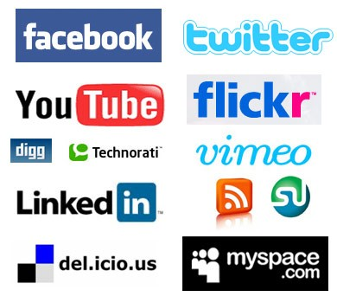
Process
What are the factors contributing to users’ sense of acceptable behavior within social media?

Slide 5
Process
Structured Interview
To conduct our research we decided on a structured interview to gauge acceptable behavior using social media

Slide 6
Methodology
Interview/Discussion
(lower amount of participants, more data)
Survey
(Large pool of participants, less data)
Ethno methodology
(Difficult to analyze, harder to implement

Slide 7
Methodology
Decided on Structured Interview
(quality info, time constraints)
How to come up with questions
(Out of the blue)
Likert scale vs. Rating System

Slide 8
Methodology
Scenarios based questions
Easier to put yourself in the situation instead of just asking
How would you respond?
Brainstormed borderline acceptable behavior
Revise survey

Slide 9
Running the Survey
Recruited 8 people
Recruited loosely
Asked them to rate from least to greatest
Very casual
20-30 minutes

Slide 10
Actual Survey

Slide 11
Analysis
Qualitative vs. Quantitative Analysis
Hypothesis vs. Findings
Drawing conclusions
(round table discussion)

Slide 12
Findings
We thought we would see a change in…
Subject matter
Terminology
Forwardness
Goals
Purpose
Privacy
Tone
Length of Response

Slide 13
Findings
What are the factors contributing to users’ sense of acceptable behavior within social media?
How does this differ from face to face interaction?
How does this differ between media?

Slide 14
Findings
There are distinct differences in social acceptability between different forms of media
“.…serious conversation is less acceptable through text messaging or Facebook.”
“It is not acceptable to stalk someone in person, but it is through Facebook.”

Slide 15
Findings
People still recognize face to face communication as the most personal and private way to communicate
“…it would be more personal than writing it on Facebook for everyone to see”
“…it is more personal than a text message…”
“…they can’t show a face to face conversation to someone else…”

Slide 16
Findings
While face to face is a more personal way of communicating, the different characteristics of each media draw people to use them.
Response time
“…if someone doesn’t respond right away, then you know they are avoiding you.”

Slide 17
Findings
While face to face is a more personal way of communicating, the different characteristics of each media draw people to use them.
Privacy
“…everyone can see what you post on someone’s Facebook wall.”

Slide 18
Findings
While face to face is a more personal way of communicating, the different characteristics of each media draw people to use them.
Professionalism
“…it is professional. I don’t use email casually.”

Slide 19
Difficulties
Difficulties we endured while making the survey included conceptualization and narrowing of individual terms we felt related to the question we were asking.
It was a difficult task finding the right term for comfortability and “social acceptance” relating to online interactions

Slide 20
Improvement of Study
In order to improve the study, the time period in which the survey and questioning would occur would need to be elongated.
Also other questions and possibly an analysis by a group member as to how interactions changed from face to face as opposed to online would need to be implemented
An online survey could be taken in the future during the time users are actually online conducting these interactions with people for a more instant response

Slide 21
Thank you!
Questions?

