Slide 1
I399
Mobile/Ubiquitous Computing
Adrian Juarez
Brad Becker
Peyman Hosseinzadeh
John Cabrera

Slide 2
What is Mobile/Ubiquitous Computing?
"Ubiquitous computing is the method of enhancing computer use by making many computers available throughout the physical environment, but making them effectively invisible to the user.”
Mark Weiser, the “father” of ubiquitous computing

Slide 3
What is a major issue facing IU students that a mobile solution could possibly solve?
Brainstormed various ideas: This included ideas unrelated to IU students. (one example was a app to log and monitor the daily habits of people trying to control a certain type of cancer.)
Decided to look at a more simple problem that affected a large majority of IU students.
Shared problem by all group members:
IU BUSES BEING ON SCHEDULE

Slide 4
Problem Overview
  What are the main issues that IU students are currently facing with the IU Bus system?
  What kind of information do students need to get motivated to ride the bus?
  How can we utilize mobile computing tools to improve the reliability of IU’s campus bus system?

Slide 5
Solution Overview
Smartphone Research
Survey & Analysis
IU Campus Bus Interview
Prototypes
Usability Testing
Final Prototype
Results

Slide 6
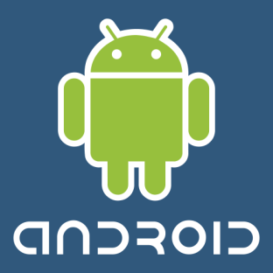
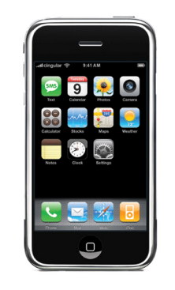
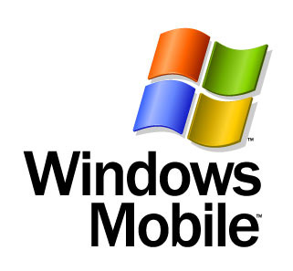


Smart Phone Research
  Open source vs. Close Sourced
  Informa Telecoms & Media research predicts Android will outsell iPhone by 2012
  Mobile Web Traffic – Apple and Android 81% (in U.S.)

Slide 7
Smart Phone Research

Slide 8
Smart Phone Trends
Company | 2009 Units | 2009 Market Share % | 2008 Units | 2008 Market Share %
Symbian | 80,878.6 | 46.9 | 72,933.5 | 52.4
Research In Motion | 34,346.6 | 19.9 | 23,149 | 16.6
Apple iPhone | 24,889.8 | 14.4 | 11,417.5 | 8.2
Microsoft Windows Mobile | 15,027.6 | 8.7 | 16,498.1 | 11.8
Linux | 8,126.5 | 4.7 | 10,622.4 | 7.6
Android | 6,798.4 | 3.9 | 640.5 | 0.5
Web OS | 1,193.2 | 0.7 | NA | NA
Other OS’s | 1,112.4 | 0.6 | 4,026.9 | 2.9
Total | 172,373.1 | 100.0 | 139,278.9 | 100.0

Slide 9
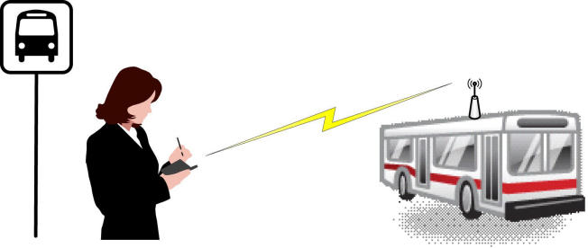
Tracking Technologies
GPS/RFID Tracking
Cost Efficiency
Networking Technologies (i.e. Delay Tolerant Networking, Campus Wi-Fi)

Slide 10
Demographics of Surveys

Slide 11
Survey Analysis
  Findings concluded that people weren't satisfied with reliability of the bus schedule and looking for a solution.
  People were overwhelmingly in support of an app that would give them real time location of IU campus buses.
  We found that the most widely used smart phones were the BlackBerry and iPhone at IU.
74.1%

Slide 12
Conclusions from Surveys
over-whelming support for creation of app
Through comments, we found the desire for a real time map with bus locations related to the user’s location.
Almost no interest in text or email with bus location.
Next step: develop prototypes related to these suggestions and test them.

Slide 13
Prototype Testing
  Each of us developed our own paper prototype.
  After testing, we found certain attributes from each prototype that people liked best.
  It was clear that people wanted a map that showed buses as they moved along their route.

Slide 14
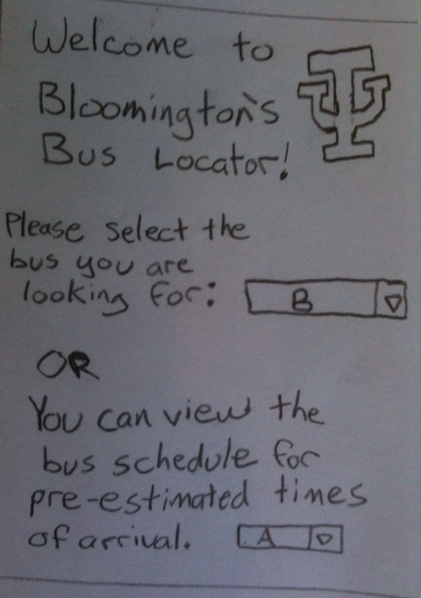
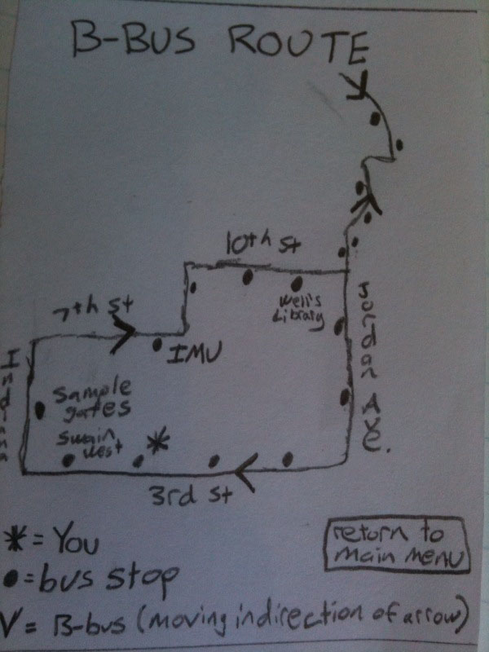
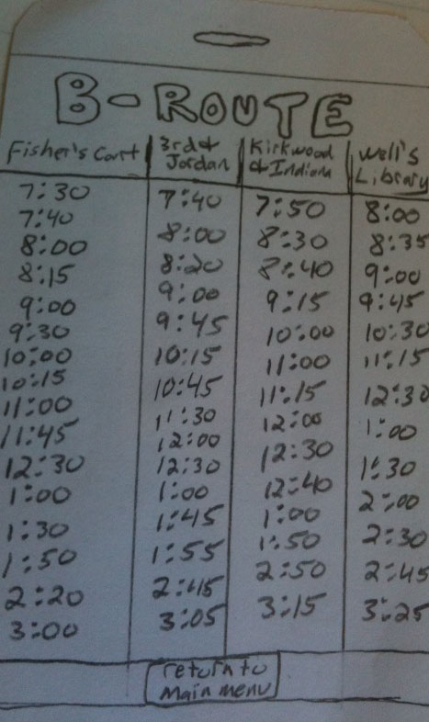
Prototype Testing

Slide 15
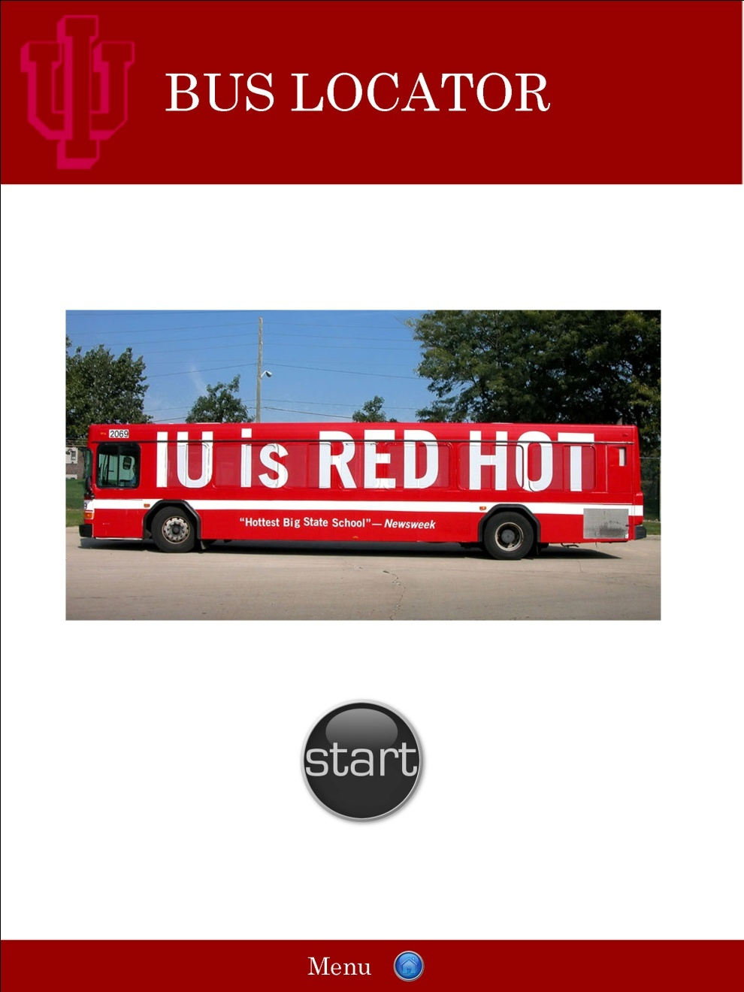
Results

Slide 16
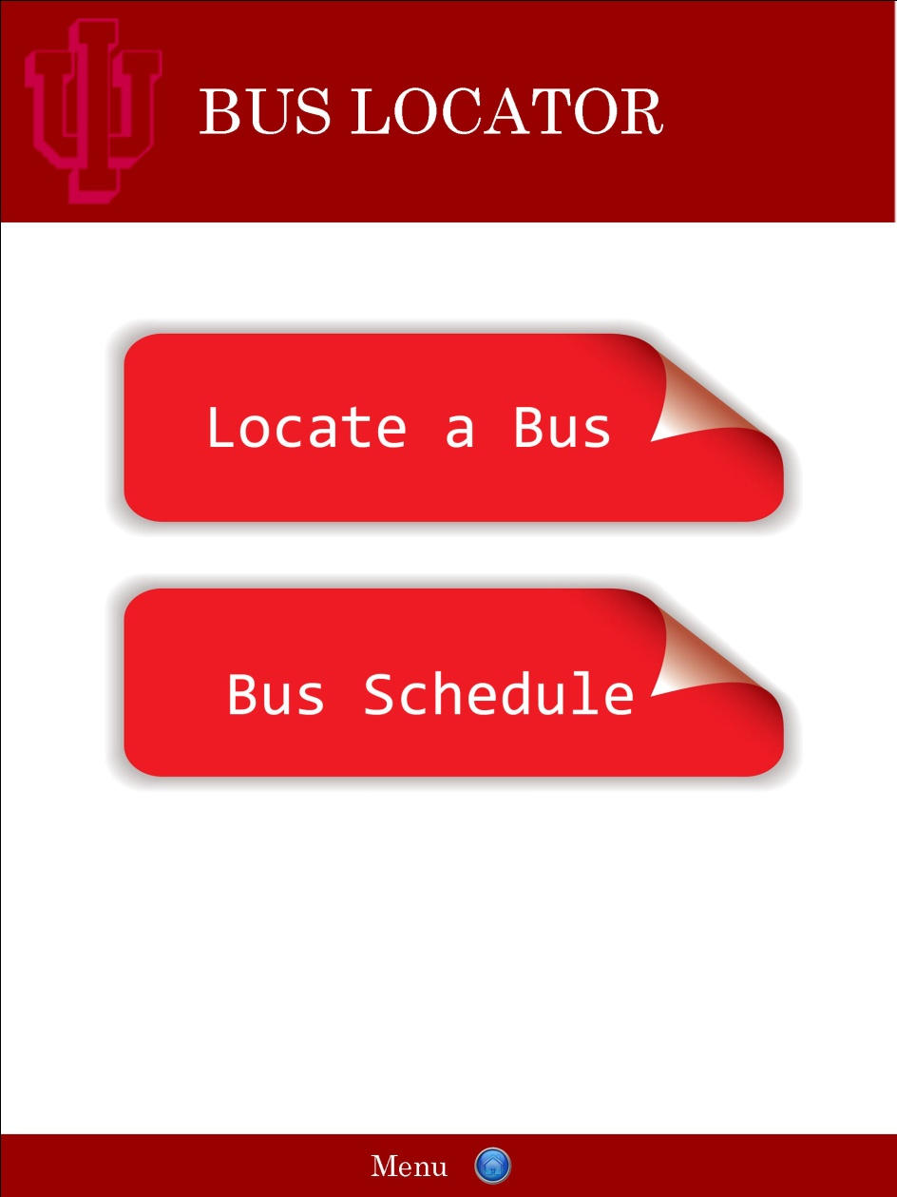
Results

Slide 17
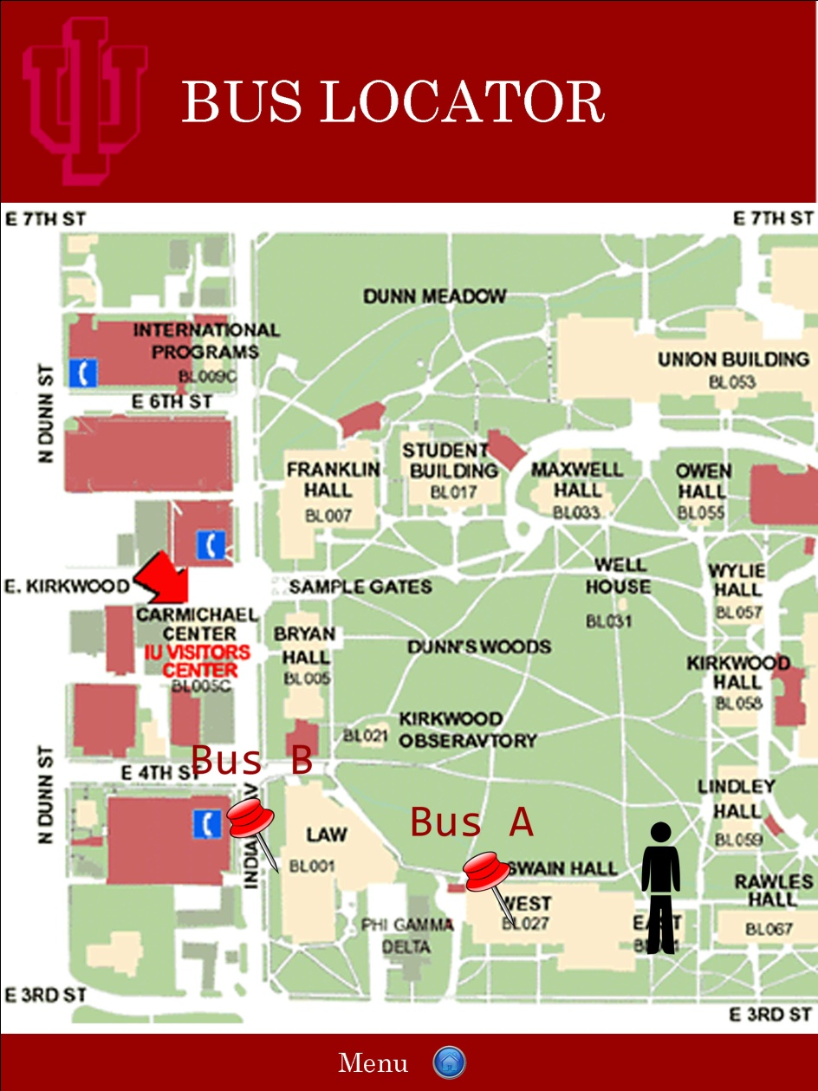
Results

Slide 18
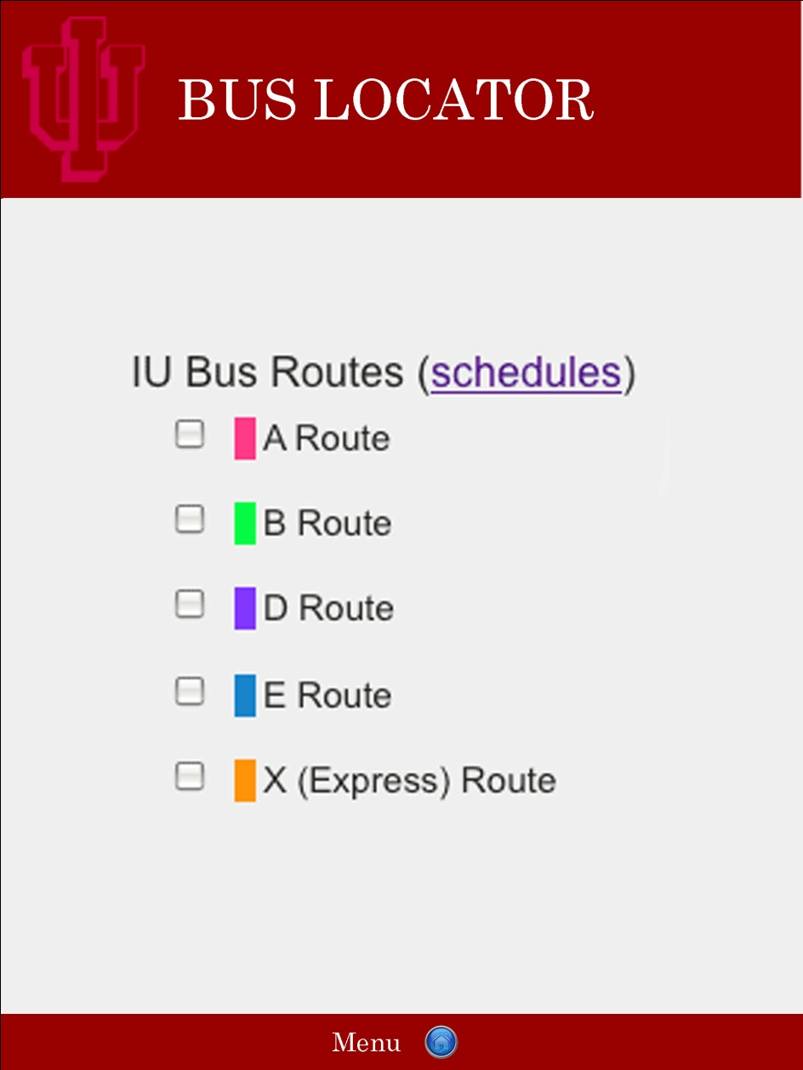
Results

Slide 19
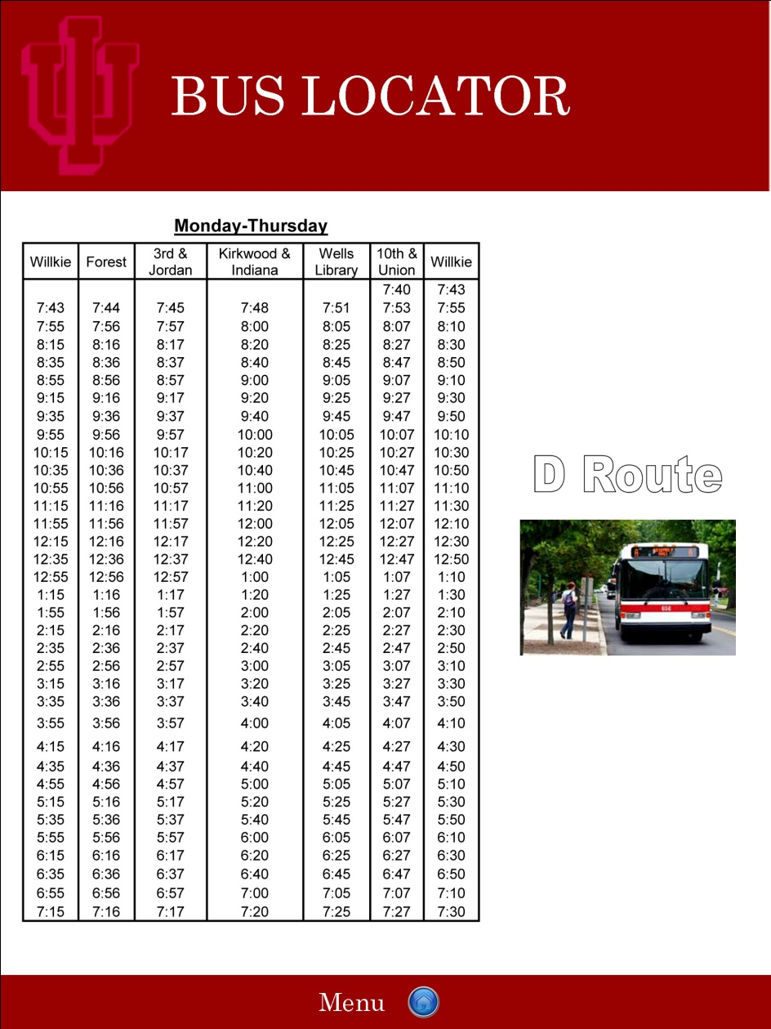
Results

Slide 20
Conclusion
Mobile / Ubiquitous is a rapidly expanding field.
Lots of room for research to be done.
Android will soon dominate the market.
App like ours have real potential in the coming years.

