Slide 1
SOIC Undergraduate Research Resource
By: Austin Graft, Veldez Joshua, and Kelsey Miller.
AI’s: Vaibhav Garg and Wyatt Clark

Slide 2
Overview
Our goal is to:
Provide a website informing Undergraduates and Incoming Freshmen about research opportunities
Assesse the various research opportunities already on campus that professors are currently seeking students’ assistance
Inform professors of students interests in different fields of research through student surveys

Slide 3
Methodology
Professor survey
Professor interviews
Student surveys
Website Development (Dreamweaver)

Slide 4
Methodology - Professor Survey
Compiled a listed of questions
What specific area of informatics are you in?
What are your research interests (including current research)?
Do you have opportunities for undergraduates (if so is funding available)?
What skills would you require from undergraduates?
What specific programming languages are required?
What specific software is required?
What kind of work could an undergraduate expect?
How many hours are expected from undergraduates doing research?
Formatted questions into a professional-looking word document to be sent to Informatics and Computing faculty and professors
Distributed the Professor Surveys
Collected surveys, so that we could incorporate results into research descriptions and listings of available research positions

Slide 5
Methodology – Professor Interviews
Established a list of Informatics and Computing faculty members/professors to contact, so as to schedule an interview
Met with faculty members/professors and interviewed with the Professor Survey document as a reference for questions
Took notes on interview responses
Used interview responses as tools for developing research descriptions and listings for available research opportunities

Slide 6
Methodology – Student Surveys
Compiled a list of questions to be formatted into a survey that is now available online: http://iu.qualtrics.com/SE/?SID=SV_egQvrac3kpxBSzq&SVID=Prod
Gender/ethnicity
Major/year in school
Skills/interest in Web Development, Programming, & Data Analysis
Familiarity/interest in various Informatics and Computing research fields
Factors influencing willingness to obtain a research position (pay, experience, etc.)
Made survey available online and sent out survey link to students in the School of Informatics and Computing
Gathered results and formatted data into graphs, so that the data could easily interpreted

Slide 7
Methodology – Website Development
Created multiple mock-ups for the proposed design of the website
Developed a functional version of the website based upon the best mock-up
Searched for and created content for the separate web pages
Utilized the data from the Professor Surveys to further develop the Research Fields content, as well as the Research Opportunities content
Created a facebook, twitter, and google group page, all which are linked from the website
Tested the website in different browsers and on different computers to ensure consistency in display

Slide 8
Professor Survey Results
There are many different fields in Informatics and Computing that are conducting research
Programming skills are preferred in undergraduate researchers; but not always required
There are usually summer positions available
A genuine interest in research is desired
Candidates should be willing to dedicate a fair amount of time to their research positions

Slide 9
Professor Interview Results
There is a lot of very interesting, and very exciting research going on in the School of Informatics and Computing
Faculty members/professors are generally willing to create and offer undergraduate research positions
Research positions are based on the availability of funding
Most positions do not necessarily require extensive programming and software skills, most research facutly and professors believe that it is most important that you are willing and motivated to learn new programming languages and software
Research positions are not always explicity available; it is recommended that you contact a research faculty member or professor directly, and they can give you more information about a research position that would fit your skills

Slide 10
Student Survey Results
Survey was completed by 80+ students from various majors on IU’s campus.

Slide 11
Student Survey Results (cont.)
75% Informatics Majors
15% Computer Science Majors
10% Other:
Political Science
Biology
Chemistry
Music Education
5% Freshmen
20% Sophomores
41% Juniors
31% Seniors
While the survey was evenly distributed among IU’s students, Juniors showed a greater interest in participating and general research.

Slide 12
Student Survey Results (cont.)

Slide 13
Student Survey Results (cont.)
Questions to ask:
Why are students familiar with certain fields than others?
Is there a trend between the familiar fields and the courses taught at IU?

Slide 14
Student Survey Results (cont.)

Slide 15
Student Survey Results (cont.)

Slide 16
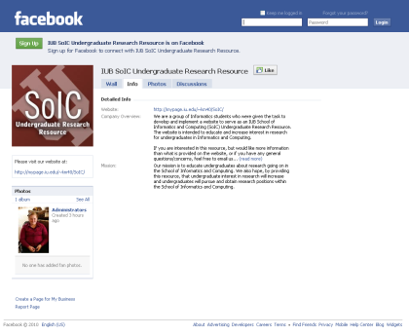
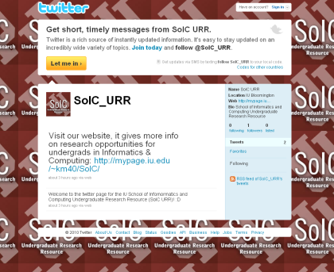
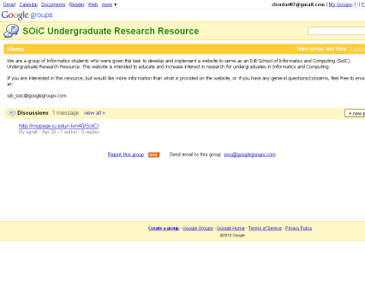
Website Results
SoIC Undergraduate Research Resource is a fully functioning website: http://mypage.iu.edu/~km40/SoIC/index.html
Design is user friendly and allows for easy editing (in Dreamweaver)
Provides connections to popular social networks such as facebook, twitter, and google groups

Slide 17
Future Work
Efforts needed from Professors, Site Managers, and Researchers to constantly update SoIC Undergraduate Research Resource Site
Insures information is up-to-date
Provides students with factual information of research already completed or in progress at Indiana University
Implement a login page, where faculty and professors can log in and automatically post research opportunity information to the website
Possibly improve aesthetic design to be more in keeping with the new Informatics and Computing web site
Conduct video interviews with faculty and professors to showcase on the website
Distribute Professor Surveys and Student Surveys more widely and collect the corresponding data for use in listing available research opportunities

Slide 18
Questions?

