Slide 1
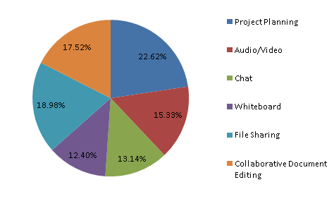
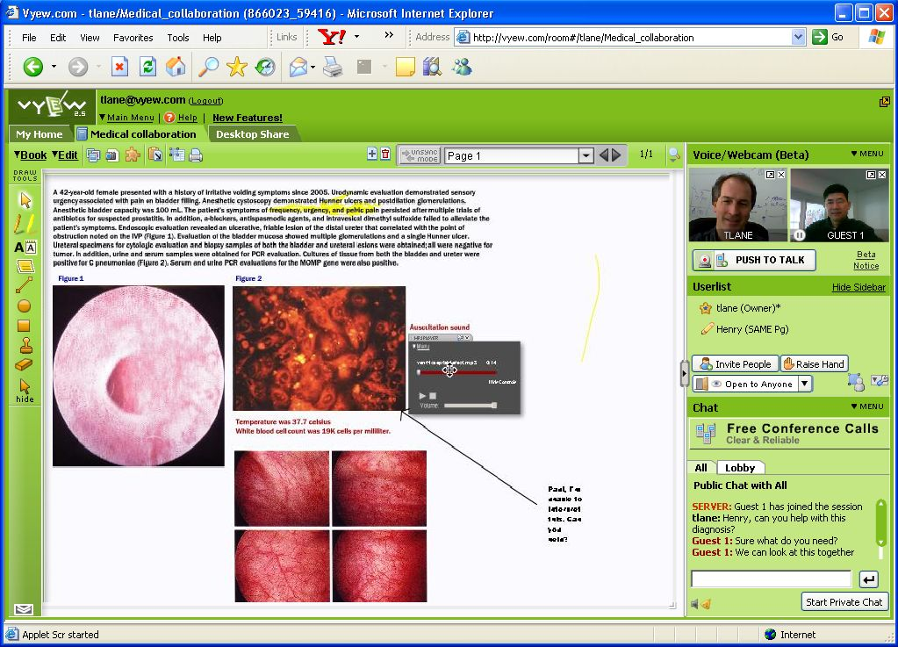
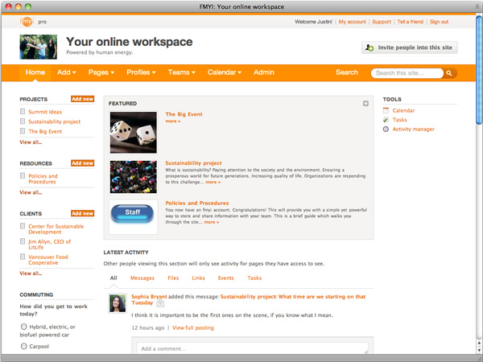
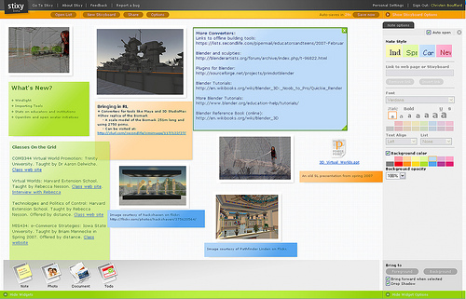
Enhancing Small
Team Collaboration
Joseph McGinn, Lucas Butler, Julian Chang
Indiana University
Purpose
Methods
Online Collaboration Tools
The purpose of this research is to find the most useful online collaboration tools for the use of student research groups. A research method course (i399) is currently being offered at Indiana University in the School of Informatics and Computing. Google Sites is the current online tool used for collaboration in this course. However, other tools exist that may be more efficient or appropriate based on various team dynamics. Providing the most optimal tool for team collaboration can enhance the group research experience.
Conducted literature review
Researched group dynamics on how to assign roles, allocate work, and ensure productive group work
Reviewed and analyzed over 30 online collaboration tools
Created and distributed collaboration surveys
Investigated useful features for online collaboration tools
Conducted interviews with individuals collaborating in small research groups
Evaluated collaboration tools based on survey results and interviews
Scribblar (http://www.scribblar.com/) Online whiteboard with live audio and text chat.
Timebridge (http://timebridge.com/) Meeting synchronizer.
Google docs (http://docs.google.com/) Document editing and chatting.
Stixy (http://www.stixy.com/) Online bulletin board.
Dabbleboard (http://www.dabbleboard.com/) Collaborative online whiteboard.
Vyew (http://vyew.com/s/) Features screen sharing, video conferencing, VOIP (with video chat) and whiteboarding.
Dropbox (https://www.dropbox.com/) FTP site, has a number of neat features for sharing files between people, including a desktop program that creates a virtual folder.
iLinc (http://www.ilinc.com) Emphasizes visual collaboration
FMYI (http://www.fmyi.com/) Private social network, free for up to 10 users and 100mb file size storage.
Mind42 (http://www.mind42.com/) Online collaborative brainstorming application.
Diigo (http://www.diigo.com/) Collaborative research tool. Mark links down, highlight things online, and share them.
Much more…
Survey Results
Recommended Collaboration Tools
Vyew
Whiteboard
Document Sharing
Video/Audio conferencing
FmyI (For My Innovation)
Blog-based
Project planning
Post text, links, files, events, tasks
Stixy
Bulletin board style
Post events and tasks
Project planning
Next Steps
Conduct further interviews with different collaboration tools
Distribute collaboration tool recommendations to small teams
Evaluate recommended tools usefulness after team use
Complete research paper

