Slide 1


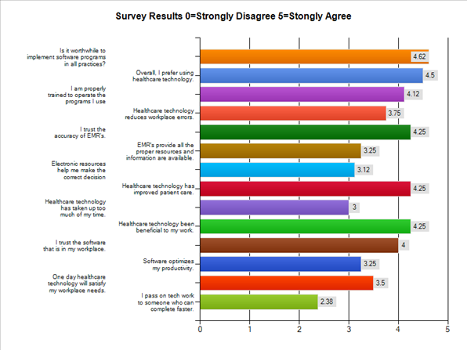
The Medicine Men
Garrett Kolb, Joshua Apkin, YoungkyuSo
Mentors: Beenish Chaundry Mudit Mittal
Results
Doctors feel that the implementation of software programs should be a requirement
Programs do not interface with each other when they ABSOLUTLELY MUST!
Overall, healthcare technology has been beneficial to doctor’s work
There is a talk of a program that will one day fulfill all of healthcare technology problems
We Trust Our Doctor With Our Life But What About Our Computer?
The
Research Question
What challenges are doctors facing with technology in their workplace?
Methodology
Surveyed twenty doctors
Face-to-face interviews with six doctors
Walk through of two healthcare programs
Motivation & Purpose
All of our group members are interested in pursuing healthcare related jobs.
Find the pros and cons of technology in hospital and practice settings.
Determine whether computers save time or not.
Do computers ensure the best quality of care for their patients?
Recommendations
Make EMR’s the focal point of healthcare technology considering they are the most commonly used technology in hospital settings.
Make programs geared towards doctors rather than the programmers
Force retraining for the doctors when new updates are released.
Give companies incentive to start making their software able to integrate with all programs in hospital and office settings
Notes:
IU, UC, TACC, UF, SDSC, ISI, UV, PU, Tennessee

