Slide 1
Designing A Better
Alarm System
Group Members:
Michael Spahn, Nathan Hall,
Marc London, Mike Buckman
Mentor: Shreyasee Chand

Slide 2
Research Summary
Survey & Interview
  Insights:
    Cell phone used most to wake up
      Alarm clock second
    Most use 1-2 Snoozes (over 80%)
    Alarms are too easy to snooze (58%)
      Annoying (38%)
    Would like to wake up more naturally (49%)
      Sounds /Music (26%)

Slide 3
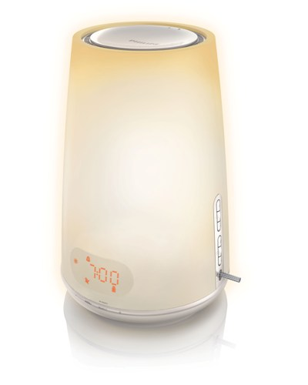
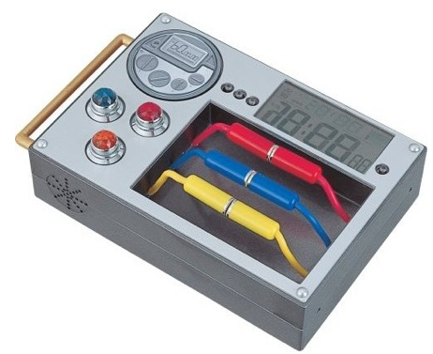
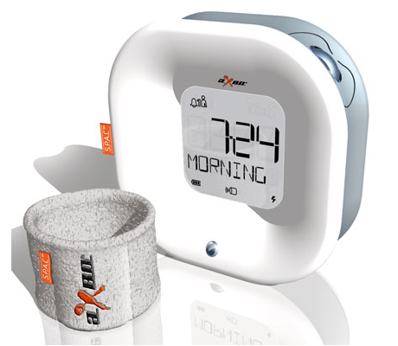
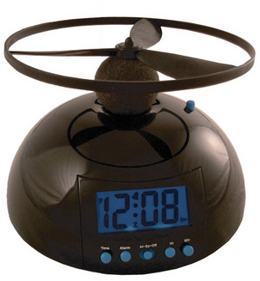
Research Summary Cont.
Ideas Drawn on to Come up With a Concept
  Found alarms that Incorporate vibration, activity, sounds, and lights.
Notes:
http://tonyvirtual.blogspot.com/2008/07/different-kind-of-alarm-clocks.html

Slide 4
Most Pleasurable Alarm on Market
Philips Wake Up Light
  The alarm can be set to gradually increase in light intensity 30 minutes prior to your desired wake-up time
  Simulates the sunrise
  Plays sounds at desired alarm time (Nature sounds, or any USB device)
  Want to incorporate this idea.

Slide 5
Original Design Idea
We wanted to integrate the alarm system into the bed itself.
  Touch screen Display built in the headboard
  Speakers and lights as well
  Shakers under the mattress
  Heating elements in the mattress
  Able to choose Alarm settings: sounds (music, talking, others), vibration, lights, temperature
Incorporate REM sleep cycle
  Set time period and wake when in lightest sleep state within the time frame.

Slide 6
Design Take Two
After presenting our original idea, and discussion, we wanted to alter our design.
Less features: focusing on light, sound
Not integrated into the bed directly: can hook on headboard, hang on wall, or stand alone.
More cost effective

Slide 7
Design Ideas
Light: comes on 15 min before alarm. Gradually gets brighter.
Sounds: Choice between different nature sounds (ocean, birds, rain, ect.)
Projects the time on the opposite wall when light bar pressed.
To stop the sounds, press light bar. Turn off alarm/light from switch on top.

Slide 8
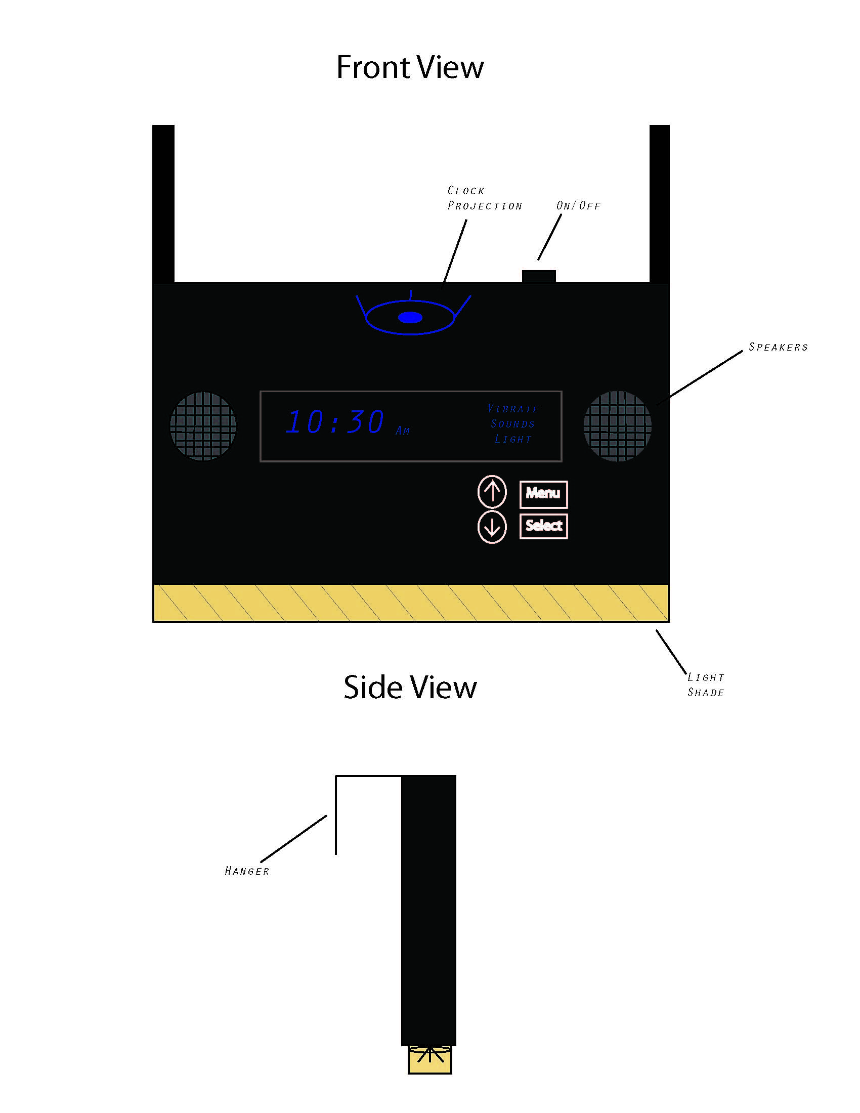
Alarm Design
Light bar/shade

Slide 9
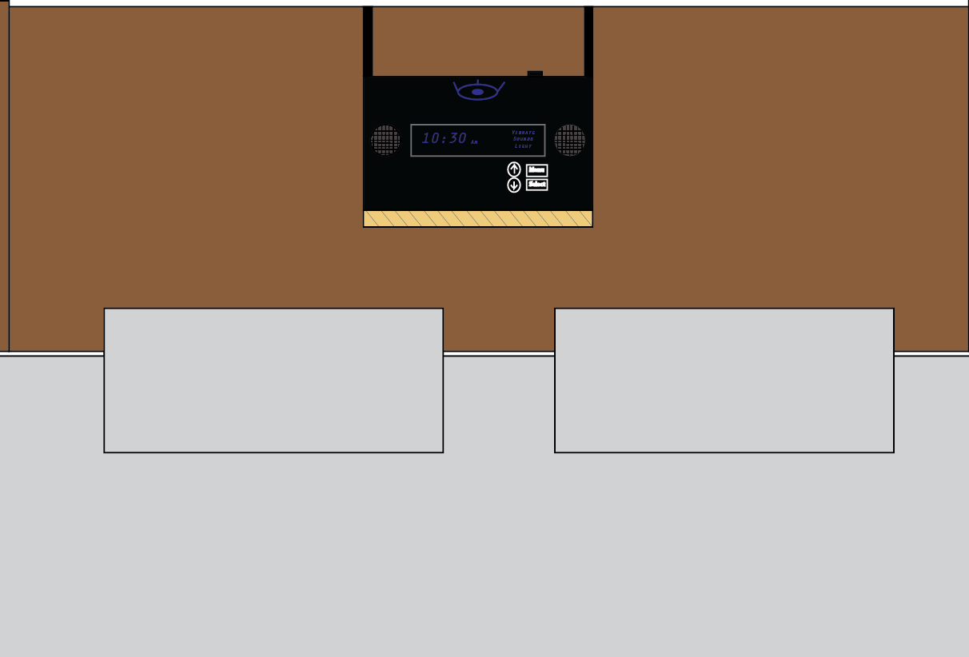
Alarm design

Slide 10
Our Video
http://www.youtube.com/watch?v=BDPa2rvtRzw

Slide 11
Reference
http://tonyvirtual.blogspot.com/2008/07/different-kind-of-alarm-clocks.html
http://www.usa.philips.com/c/light-therapy/hf3470_60/prd/en/

