Slide 1
IU’s eBook Transition
Tylend Dawson, Jongmin Lee, Elijah Moon, Rebecca Torrey

Slide 2
Objective
We aim to explore learning environments, the eco-friendliness and impact, specifically pertaining to IU, that would exist five years from now if we converted from paper textbooks to digital textbooks.

Slide 3
Motivation
With the growing use of digital devices, expensive prices of paper textbooks, while also considering the eco-friendliness of eBooks, make us question what seems to be an inevitable move toward the eBook revolution.

Slide 4
Methods
Research schools that have already converted
Surveyed 300+ IU students from all majors
Conducted interview with Chief of Staff of UITS
Examined costs and benefits of the digital switch

Slide 5
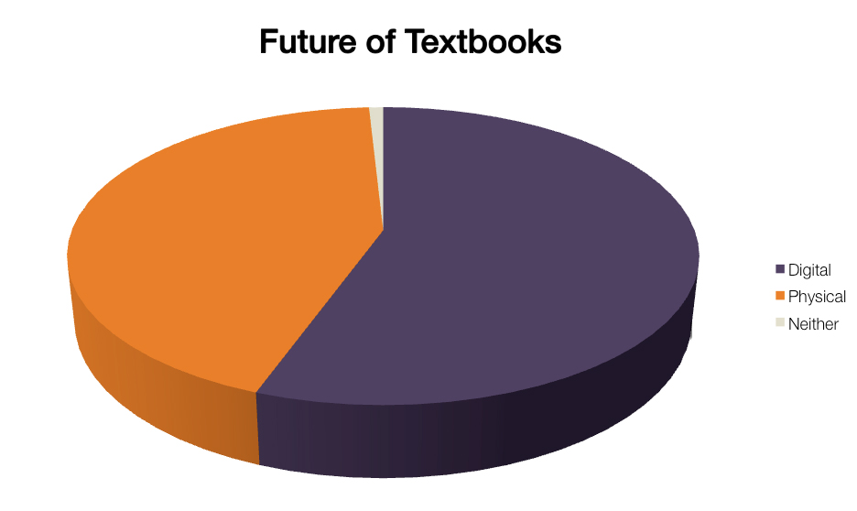
Results

Slide 6
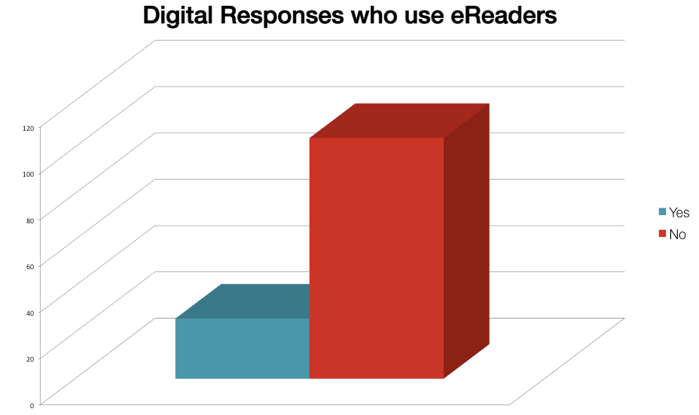
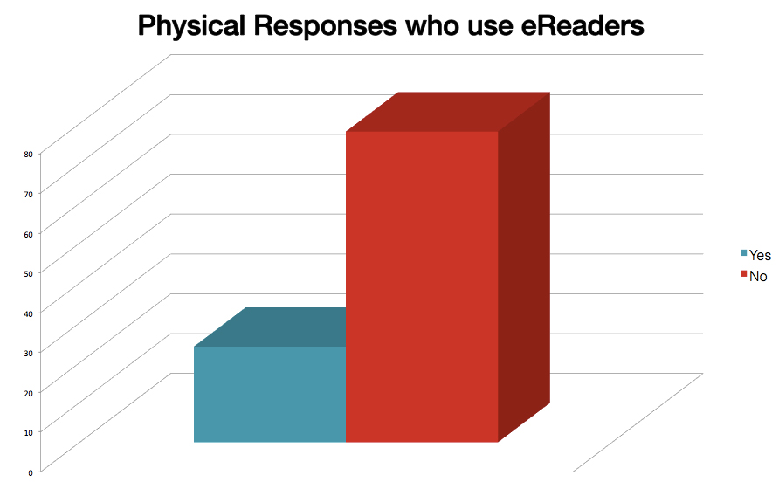
Results

Slide 7
Future Steps
IU will have to work with the textbook publishers and vendors to launch new models of eText delivery that will significantly reduce costs for students.

