Slide 1
Group 12: Exploring Copy Number Variation using Data from the 1000 Genomes Project
Members: Yuchen (Tony) Gao
Blaine Rothrock
Ryan Konz
Mentors: Andrew Younge
Yicheng Feng
Notes:
Ryan

Slide 2
Purpose
Exploring new approaches of human genome analysis
  Large scale use of data
  The restriction of CNV analysis to exonic regions
  Utilization of cloud computing to reduce time costs
Discover genes of high copy number variation within the Great Britain population.
Notes:
Blaine

Slide 3
Copy Number Variation
Genetic similarity among humans: 99.5%
Region of DNA with higher or lower copies than normal
Account for 10% of genes
CNVs have been implicated in physical appearance, disease, and drug susceptibility.
Notes:
Blaine

Slide 4

Thousand Genomes Project
Publicly available data for 1000s of individuals
Collection of genetic data of 27 ethnic populations
Notes:
Blaine

Slide 5
ExomeCNV
Calculates copy number using raw sequencing data from Thousand Genomes Project
Limits analysis to coding regions of DNA
Notes:
Blaine

Slide 6
FutureGrid
FutureGrid
  FutureGrid is a high-performance grid testbed that allows scientists to collaboratively develop and test innovative approaches to parallel, grid, and cloud computing.
Virtual Machines
  Ubuntu Image
OpenStack
  Registering Images
Notes:
Ryan

Slide 7
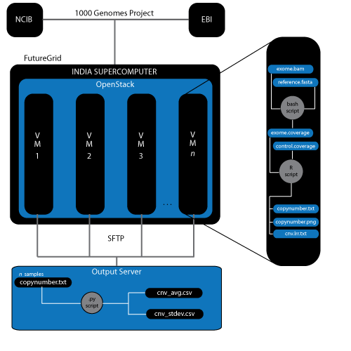
Workflow using FutureGrid
Notes:
Ryan

Slide 8
Obtaining Results
Python Script
  organized the genome into exon sample
  added the copy number to a list from each sample tested
  output two organized list sorted by mean and standard deviation of the exon regions.
Notes:
Ryan

Slide 9
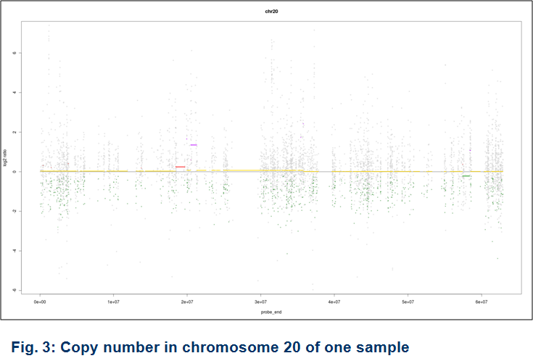
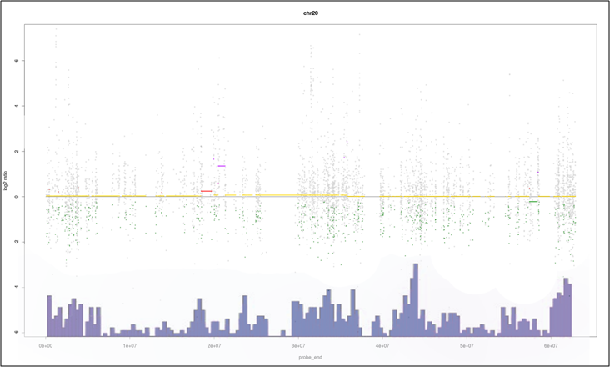
Sample Individual Output
Notes:
Tony

Slide 10
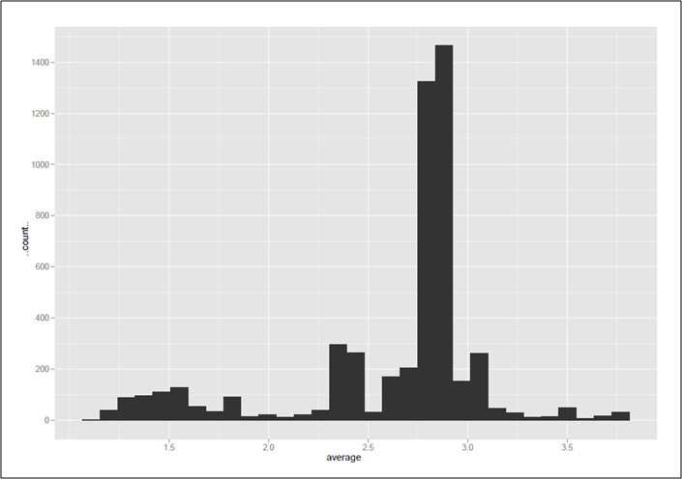
Population Results
Notes:
Tony

Slide 11
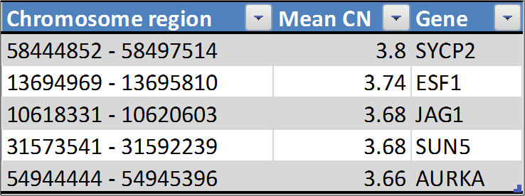
Exons with highest mean copy number
Notes:
Tony

Slide 12
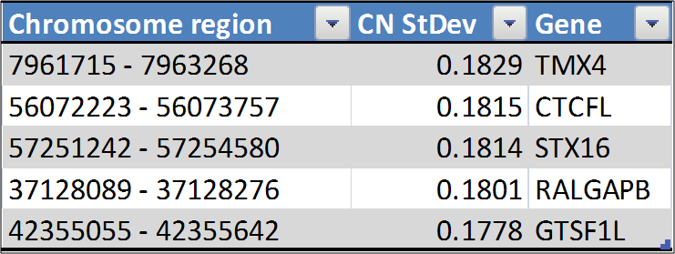
Exons with highest standard deviation
Notes:
Tony

Slide 13
Discussion
•The novelty of exome CNV analysis and lack of existing work was both liberating and limiting
•We were able to successfully implement our workflow for exome analysis
•Instability of the FutureGrid system limited our analysis to chromosome 20
•ExomeCNV is highly-dependent on coverage and may not be suited for large-scale analysis
•Our experimental results provide interesting, but potentially inaccurate findings
Notes:
Tony

