Slide 1
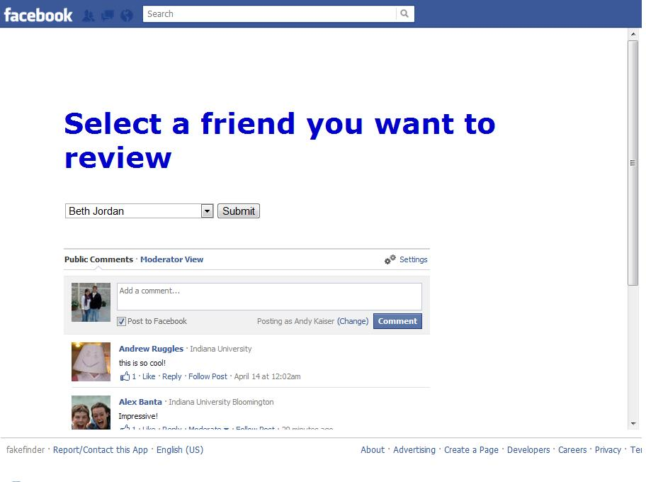
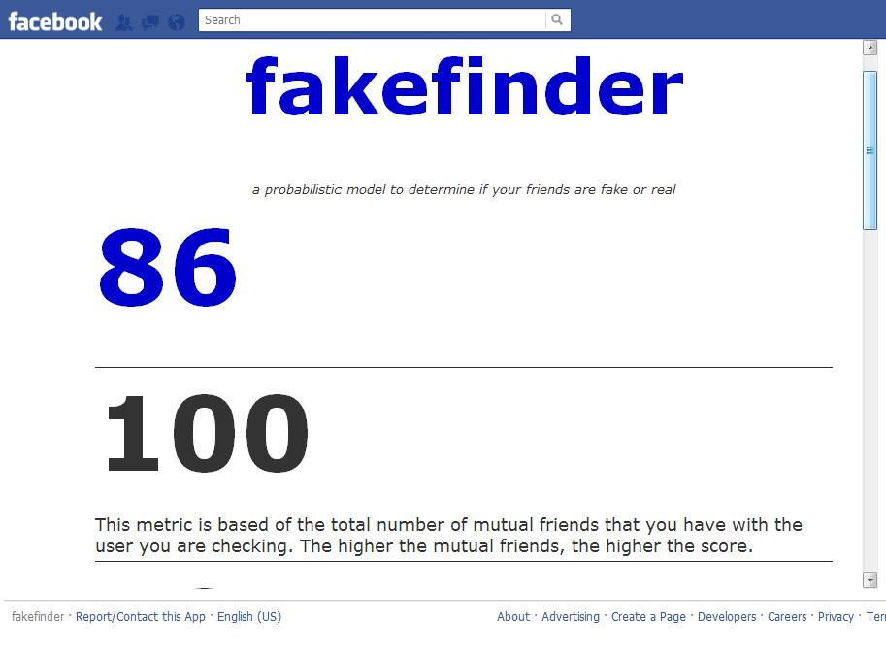
^{Facebook Fakefinder:} Determining If a Facebook Profile is Fake
Team Mentor
Kavin Sekaran
Team Members
Andrew Ruggles, Kyle Amerman, Riley Farrell, Andy Kaiser
Abstract
Introduction
Final Application
Results
Our goal for this project was to develop a program that could determine if a Facebook profile is fake. Currently the only way to do this is by just looking at a profile and using your own judgment. With our research we were able to find the most important things that people look at when they are deciding if a profile is fake, and then we used these criteria to create a Facebook application that would give the user a probability of a profile being fake.
Fakefinder is a Facebook application that uses a probabilistic model to determine whether or not a profile is fake. The application looks at multiple aspects of a person’s profile including, mutual friends, number of photos, geographic location and others to determine the probability that the profile is fake or not.
To help better describe our findings we created a survey at the end of the results page for people to take. This survey was used to determine how well people thought our app works and possibly tell us what we might need to improve. We found that our application was very easy to use and people could easily navigate and interpret the results. We did find that there are a few things that could be improved. We found the people would like us to test on more parameters to ensure the accuracy of the results is greater. We also found that people would like to have the friends names in alphabetical order so they can easily find a friend. Lastly we found that users wanted the application to look more professional with the design. Overall we received a lot of helpful feedback from the users.
Final Algorithm
After collecting data from the survey and testing the Graph API within Facebook we have revised our criteria to evaluate the probability of a fake profile. Below is our updated criteria.
1. Number of photo tags
2. Feed activity average per day
3. Number of mutual friends
4. Location relative to friend
5. Connection of different networks
a. college/coworker/high school/hometown 6. Familial Relationship to users
This is the first page of the Fakefinder application. On this page the user selects which friend that they would like to review from a drop down box
Methods
Conclusion
Determined what factors or techniques are most frequently used when someone is trying to determine if a profile is fake
Completed research by reading articles that mentioned ways to tell if profiles are fake or not
Sent out a survey asking people to rank how often certain criteria would be used to determine if a Facebook profile is fake.
Decided which criteria were the most important and ranked them
Wrote code for a Facebook application that looks at each of these criteria
In conclusion our team was able to create a successful application that can be used by people who aren’t sure if one of their friends are real. One of our team members had created a fake Facebook profile about two years ago, and we ran this profile on the FakeFinder application and got a score of 24. This is a very low score which tells you that there is a high probability that this profile is not real. This information shows that are application is accurate and if someone used our application on this fake profile it would allow them to make better decisions when it comes to accepting friend requests.
References
http://thinkdiff.net/facebook/php-sdk-3-0-graph-api-base-facebook-connect-tutorial/
PHP tutorial for Facebook API
http://www.lynda.com/search?q=facebook&x=0&y=0
PHP resources from Lynda
http://pewinternet.org/~/media//Files/Reports/2011/PIP%20-%20Social%20networking%20sites%20and%20our%20lives.pdf
Study by Pew about Facebook demographics and average profile statistics
https://developers.facebook.com/docs/reference/api/
Facebook Graph API
https://apps.facebook.com/myfnetwork/
application that graphically shows friend networks
http://www.photoweeklyonline.com/the-number-of-photos-on-facebook-is-exploding-infographic/
Study that found average number of photos a user has
http://blog.bozuko.com/2012/01/25/new-data-more-than-45-of-your-customers-facebook-friends-live-within-shopping-distance-of-your-business/
Study on geographic distribution of Facebook friends
This is a screenshot of the information that will be displayed to the user. A lower score means there is a higher probability that the person you are reviewing is fake.

