Slide 1

Info-I399
4/23/2012
Team JAR
Understanding the capabilities and applications of Google+ in contrast with Facebook
Richard Curtis
Jeff Pascus
Alex Sawa

Slide 2
Agenda
Project Objectives
Process & Methodology
Results
Conclusions
Future of Google+
Project Abstract

Slide 3
Abstract
Step1
The purpose of our research is to first examine how people currently use social networks in relation to what people actually want from their social network
Step2
Then we analyzed how Google+ & Facebook currently meets these needs, or if it is capable of satisfying the end user’s wants
Step 3
These results were then taken and used to formulate our results and findings on social networks and their future

Slide 4
Objectives
Current Makeup of Social Networks
  Our ultimate goal is to evaluate the effectiveness of each social network in collaborative, professional, and academic applications
  What advantages do each social network have over one another
Potential/Future of Social Networks
  Through this analysis we will be able to determine which of the two will become more dominant in the near future
  Which applications have good potential and where they will be most valuable

Slide 5
Process & Methodology
How people use their social networks?
Background research
  Foundation of information to build upon
  Figuring out what is possible for social networks to accomplish
Initial surveys
  Building our primary data
  Finding the common and strong opinions/thoughts on Google+ and Facebook
Interviews
  Designed off Survey findings
  Demo Google+ to Facebook users
  Specific and detailed examples of both the good and bad that comes with using social networks
  Different perspectives on why a certain social networks stands out to them

Slide 6
Process & Methodology
How people want to use their social networks?
Focused surveys
  Opinions on specific tools their potential
  Generating ideas on how users see social networking developing in the future
Interviews
  Feedback on multiple perspectives of the directions that social networking could be headed
  Leaned towards heavy users which were more knowledgeable on the subject and had stronger/more opinions on social networking
Focus groups
  Facebook vs. Google+ users
  Feedback on our ideas of the Future of social networking

Slide 7
Results
Most valuable insights came from personal interviews and focus groups
Demonstrating Google+’s capabilities to people who don’t use it
Positives responses to Google+ demos
Surveys were effective at understanding how people use their social networks
Positive and negative opinions
Secondary Research was less valuable as Google+’s latest offerings are still under development

Slide 8
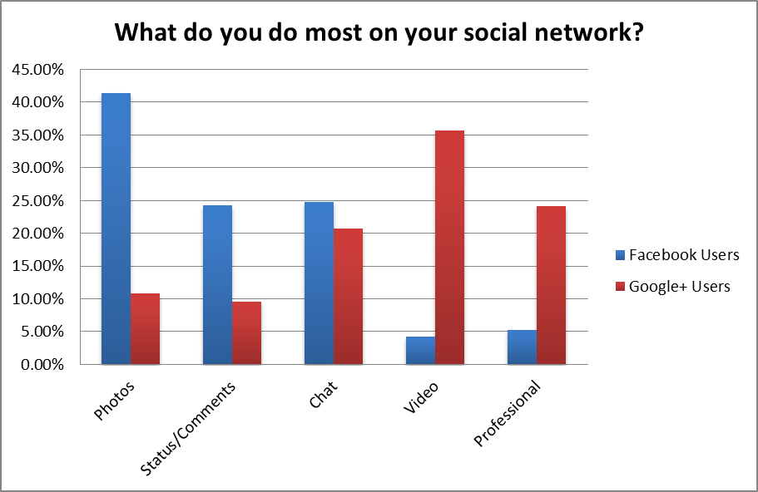
Results – Surveys: Use differences between social networks
Source: Team Primary Research

Slide 9
Results – Surveys: Top 5 negative qualities of Facebook
Users understand Facebook’s flaws & shortcomings but have become loyal and opposed to a new platform
Source: Team Primary Research

Slide 10
Conclusions: Effective
Google+ is a more effective collaboration tool and has a much higher potential than Facebook
Enhanced User Control & Privacy
Integration with various Google services
Collaboration through Google hangout

Slide 11
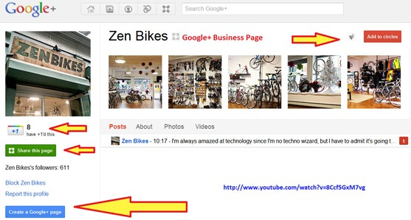

Conclusions: Innovative
Although Facebook has many more users, Google+ is setting a new precedent for the way groups can collaborate via social networks as well educational applications.
Professional legitimacy
Academic capabilities
Teamwork facilitation

Slide 12
The big picture
Google Service Integration
Academic
Professional
Social
Continuous Development
As Google+ continues establishing itself in the social network market, more users will realize the value of their innovative approach to social networking consequently securing Google+’s position as a leader in social networking

Slide 13
Future of Google +
Facebook is already established as the leading social network
Google still attempting to find its place in the market
Google Hangouts could be the way to do this
Third party developers now able to create apps
App Marketplace?
Allow for Google hangout without gmail account
  Easier to persuade people to use it without signing up for things

Slide 14
Education
Integrating its other tools with Google+ makes it a viable educational option
Valuable tools that teachers and students can take advantage of
Potential new apps and ideas
  Online classes and tutoring sessions
  OnCourse integration
  Dropbox
  Graphing calculators
  Foreign Language learning
  Troubleshooting help or learning a new technology

Slide 15
Professional/Business World Collaboration
Today’s business world has more and more meetings and conferences online
Other programs out there that allow for this
  Google is free and very accessible
  Has the ability to meet a wide variety of needs
Potential new apps and ideas
  Voice Translator
  Craigslist/E-bay
    Meet the buyer
  Budget Management
  Calendar
  Job interviews
    Linkedin

Slide 16
Social
Facebook is already leading social network
Google has the ability to do things that Facebook cannot
  Circles easier to manage that Facebook groups
Potential new apps and ideas
  View sports matches online with your friends
  Numerous games that can be played with others
  Integrate other social networks such as Twitter or Pintrest
  Celebrity hangouts with fans

