Slide 1
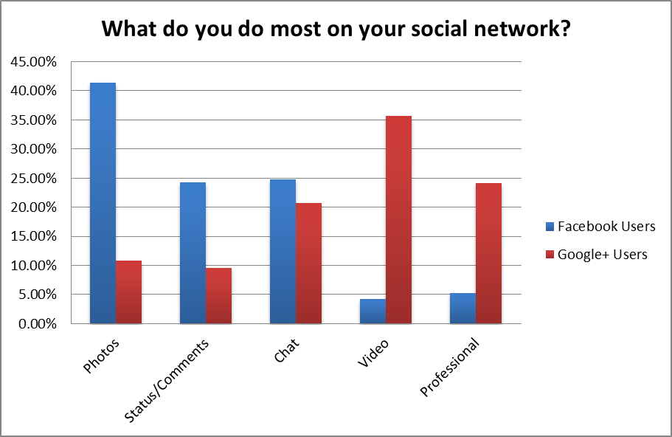
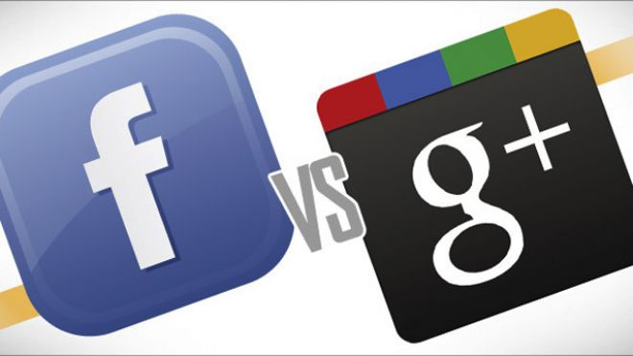
Understanding the capabilities and applications of Google+ in contrast with Facebook
Undergraduates: Ricky Curtis, Jeff Pascus, Alex Sawa
Mentor: Minqi Luo
Abstract
Process & Methodology
Results
Future of Google+
Project Overview
The purpose of our research is to first examine how people currently use social networks in relation to what people actually want from their social network. Then we analyze how Google+ & Facebook currently meets these needs, or is capable of satisfying the end user’s wants.
How People User their social networks?
Background research
Initial surveys
Interviews
During our primary research the results we were used to help design the interviews/surveys we conducted after.
How people want to use their social networks?
Focused surveys
Interviews
Focus groups
Education
Google’s strategy of integrating their other tools with Google+ makes education through a social network a realistic possibility. Google just released new apps which can be used during Hangouts. These apps can help give teachers the tools they need in order to facilitate an educational atmosphere online.
Professional Collaboration
Business meetings and processes are being dealt with online more and more frequently. There are other programs that seek to facilitate this online collaboration but Google is at the front of the pack and is free/easily accessible to everyone. Google also has the assets to meet a wide variety or needs. As more apps are created to facilitate collaboration the possibilities for professional uses are endless.
Social
Users who currently use Google+ spend a lot less time aimlessly browsing through profiles and pictures than Facebook users. Google+ has the abilities to do everything that Facebook does , however users are already familiar and well connected in Facebook so a switch which would also involve losing some friends is a difficulty Google must overcome.
Objectives
Our ultimate goal is to evaluate the effectiveness of each social network in collaborative, professional and academic applications. Through this analysis we will be able to determine which of the two will become more dominant in the near future as well as where their applications will be most valuable.
Conclusions
Through our research, we’ve come to the conclusion that Google+ is a more effective collaboration tool and has a much higher potential than Facebook. Although Facebook has many more users, Google+ is setting a new precedent for the way groups can collaborate via social networks as well educational applications. As Google+ continues establishing itself in the social network market, more users will realize the value of their innovative approach to social networking consequently securing Google+’s position as a leader in social networking.
Notes:
Simple easy communication on basic level (facebook), but when you want tog et more ind epth with collaboration it is lacking in a lot of areas. Google+ improves on a lot of these aspects with google hangout, the chat, better collaboration with slideshare, googles docs, screen share, among may other apps. A lot on the horizon for google+ because hangout is in early stages. Just opened up google apps to third party developers, lots of new apps. Only downside if not a lot of people use google+ right now, but as the use base increase the advantages do. Doesn’t seem like its lacking anywhere where facebook is stronger. Facebook may have the numbers, but the future is looking very bright for google+ plus. Taking google+ in a different direction thatn facebook.

