Slide 1
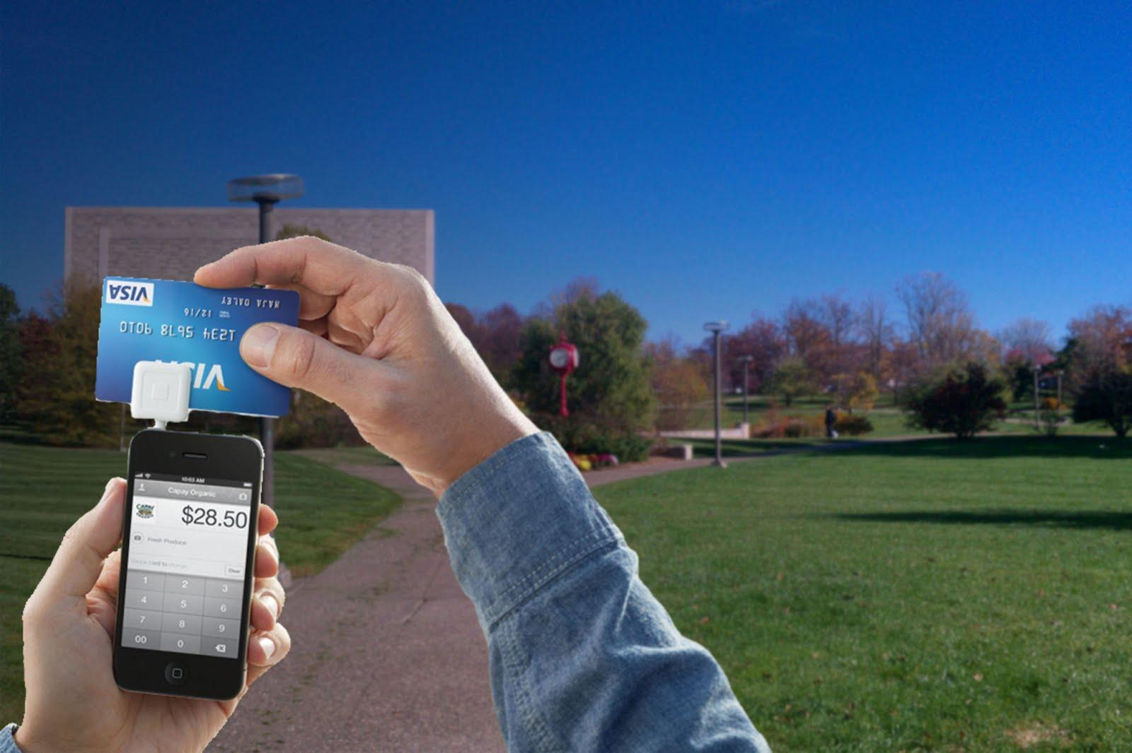
Using Smart Phones as Digital Wallets
Can the digital wallet replace the traditional wallet that we know today?
Insung Lee, Se Whan Park Tim Rast, Lindsay Thompson
School of Informatics and Computing, Indiana University
Notes:
Title, Subtitle, Authors & Affiliations

Slide 2
Definition of a "Digital Wallet"
A “digital wallet” refers to a mobile application for smart phones that allows users to replace their wallet with smart phone technology, by giving options like making payments and performing monetary transactions solely using the technology inside of the device, as well as providing valid forms of identification and containing other items that may be found in a wallet (such as customer affinity cards or coupon offers).
Notes:
Definition of a Digital Wallet

Slide 3
Current Examples of Digital Wallets
Square
Google Wallet
PayPal Mobile
Visa V.me
Notes:
Examples of digital wallets

Slide 4
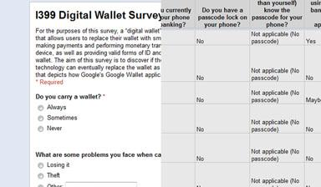
Methods | Survey

Slide 5
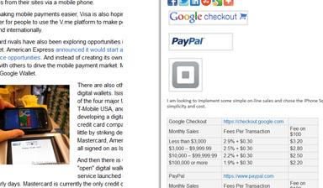
Methods | Literature Research

Slide 6
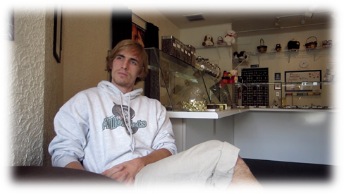
Methods | Interview

Slide 7
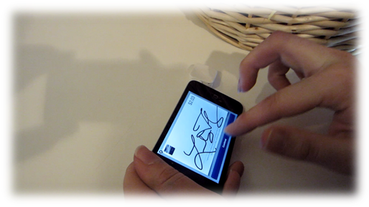
Methods | Observation

Slide 8
Video

Slide 9
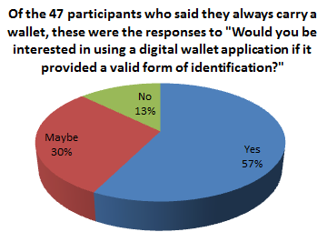
Data and Results | Ease of Use
By examining mobile applications with similar missions (to make a tangible object obsolete; such as smart phone cameras, smart phone GPS systems, etc.), it is necessary that digital wallet applications must contain all basic features of the tangible object to be truly successful.
If this is true, the next step for digital wallet applications has to be a convenient, valid form of identification which is presumably the next most common item found in a wallet that is not currency.

Slide 10
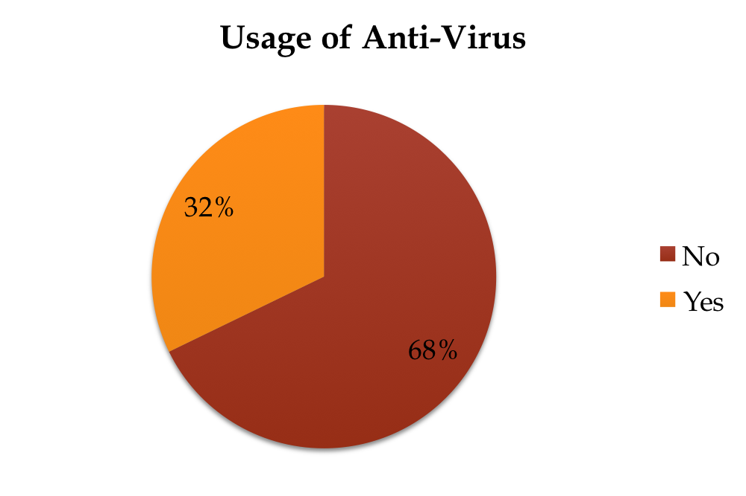
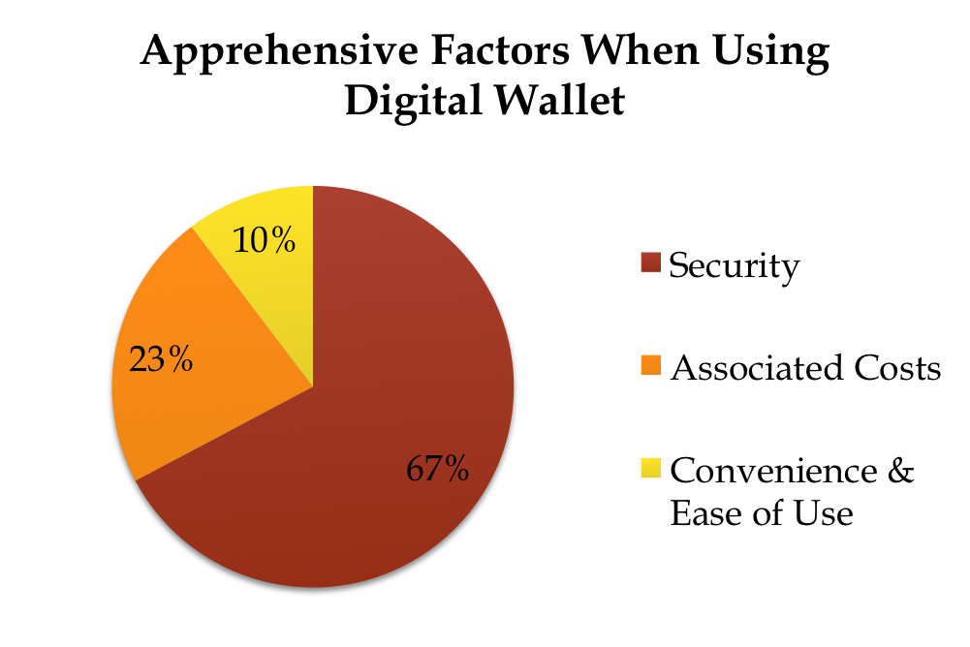
Data and Results | Security
      Security was the main concern of participants when using digital wallet.
      More than Half of the participants are not using any kind of anti-virus. If people are not using anti-virus, the digital wallet itself needs to be secured or recommend users to use anti-virus software.
      Participants of the survey were not physically securing their phone. With incorporation of digital wallet people will need to get into a habit of securing their phone.

Slide 11
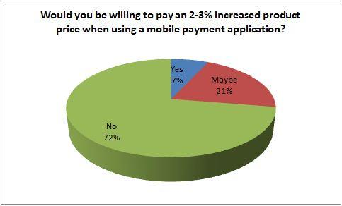
Data and Results | Cost
When examining mobile applications that allow people to make transactions, when purchasing an item most people would not be willing to paying an extra fee. For these mobile applications are to succeed they need to have a more competitive price when purchasing goods with the application.
For these applications to succeed with replacing a wallet, they need to become more cost efficient. Most mobile applications charge over a 2.5% service fee.
Most people who completed the survey did not say cost was their main concern when it comes to digital wallet applications, but since most said that they would not be willing to pay an extra price when making a transaction that could pose a problem for the growth of digital wallets.

Slide 12
Conclusions and Future Work
We have made several recommendations based upon our research areas.

Slide 13
Recommendations | Ease of Use
Shift focus of development to valid form of identification
  Must work with businesses and possibly government to make this a more realistic possibility
  PropID currently working on this
Start promotions to convince merchants to adopt this technology (some sort of benefit for the merchant employing digital wallet technology)
  Primarily boosts applications, but makes the applications themselves more convenient if they are more widely accepted as a form of currency

Slide 14
Recommendations | Security
      Security was the main concern of participants when using digital wallet.
      More than Half of the participants are not using any kind of anti-virus. If people are not using anti-virus, the digital wallet itself needs to be secured or recommend users to use anti-virus software.
      Participants of the survey were not physically securing their phone. With incorporation of digital wallet people will need to get into a habit of securing their phone.

Slide 15
Recommendations | Cost
Digital wallet application needs to be more cost efficient to decrease price of use.
  People would rather use the cheaper method to make transactions.
These applications need to create a competitive advantage over others forms of transaction.
  Create some kind of coupon or discount when using mobile application
  Create some kind of rewards program for using the mobile application to make transactions.

Slide 16
References
Picture of hands using Square dongle: www.square.com accessed on 4.12.12

