Slide 1
Research Methods for Informatics and Computing
A: Introduction
Geoffrey Fox
gcf@indiana.edu
http://www.infomall.org/I399-12
Associate Dean for Research and Graduate Studies, School of Informatics and Computing
Indiana University Bloomington
Director, Digital Science Center, Pervasive Technology Institute

Slide 2
Basic Plan
Form teams so students learn about collaboration in research.
Each team is nominally 4 students and mentor(s) and will do a project in a research area assigned to/agreed by team.
The team will deliver overview of research field at mid term and research results at end of semester
Results documented by Poster, Video placed on Youtube and usual research output (presentations, papers, web)
Your team will work together electronically (that’s how its done in major research project) with class interactions and other team meetings
  Meet in and outside class time

Slide 3
Grading Philosophy
Occasional Weekly Homework – total 15%
Midterm Project Review (Presentation, Paper) – 15%
Individual final report – total 20%
Team final activities (Poster, Youtube Video, Paper) – 40%
Attendance – total 10%

Slide 4
Assignment 1: I399 Research Methods for Informatics and Computing
Due Saturday January 14 Midnight
Choose top 5 Research Topics (list in order of preference) chosen from those in this talk repeated at
http://www.infomall.org/I399-12/Materials/slides/I399-12A.pptx
At least 3 of 5 topics must be from those on slides 14-17 of this talk

Slide 5
Assignment 2: I399 Research Methods for Informatics and Computing
Due Saturday January 21 Midnight
1) Summarize some areas/research topic(s) of interest to you based on information found on Internet (one or more topics. About one page material)
2) If you have done Undergraduate Research already and have summaries you are willing to share, please upload these

Slide 6
Things we will do
Discuss/Summarize School of Informatics and Computing Research
How to do a Poster/Presentation
How to write a paper/proposal
  Tools like EndNote
Process of Research including Ethics, Acknowledgements and dealing with related work
  How to learn from research supervisor
  Getting IRB approval
Collaboration and Teamwork
Graduate Student round tables; applying to graduate school

Slide 7
Near Term Course Activities
Find out about you
  Your experience and interests
  What would you like to get out of class
  Any questions today?
Pose first Homework – which is overview one area of SOIC research and rank your top 5 interests
  Faculty Research
  Previous Projects
  Mentor Suggestions
  These three are all in this presentation
January 9, 11; discussions of research in general and topics in SOIC
January 18 discussion of team projects
By January 23, form teams with chosen topics

Slide 8
Research
From web dictionaries:
Diligent and systematic inquiry or investigation into a subject in order to discover or revise facts, theories, applications, etc.
Scholarly or scientific investigation or inquiry. See Synonyms at inquiry.
Close, careful study.
Root: 1577, "act of searching closely," from M.Fr. recerche (1539), from O.Fr. recercher "seek out, search closely," from re-, intensive prefix, + cercher "to seek for" (see search). Meaning "scientific inquiry" is first attested 1639. Phrase research and development is recorded from 1923
I will define as “Thoughtful study of well posed interesting/important question taking account of other relevant studies”

Slide 9
Previous year Student Projects
Spring 2011
Business Informatics
Collaboration: Enhancing Small Team Collaboration
Complex Systems: Analyzing Social Patterns
Cyberinfrastructure / Bioinformatics: Analysis of Protein from the Thousand Genomes Project
HCI : How Rumors Influence Us
Health Informatics: The New Era of Healthcare Technology
Music Informatics/HCI: Music Database Visualization
Security: Permission System Evaluation on the Android Mobile Platform
Security: Spam – A Battle For The Inbox
Ubiquitous Computing
Spring 2010
Bioinformatics: Bioinformatics and Supercomputing
Data Mining: Do Integer Ratings Hinder Recommendation Systems?
Google Wave: Usability of Google Wave
Google Wave: Exploring Google wave for Research Collaboration
HCID : The Fine Line Of Acceptable Behavior - Face to Face vs. Mediated Interaction
Health Informatics: Health Recommender System
Mobile/Ubiquitous Computing
Research Website: SOIC Undergraduate Research Resource
Security: Solutions to Mobile Security for the Android Operating System

Slide 10
Projects with some detail 2011-I
Business Informatics
  How does Informatics improve business with case studies
Collaboration: Enhancing Small Team Collaboration
  Review collaboration tools to support this type of “small” (4-6) team research
Complex Systems: Analyzing Social Patterns
  What can you determine from social network of I-399 participants
Cyberinfrastructure / Bioinformatics: Analysis of Protein from the Thousand Genomes Project
  Protein structure dependence across countries
HCI : How Rumors Influence Us
  Does professional success mean that you need to clean up your Facebook page!

Slide 11
Projects with some detail 2011-II
Health Informatics: The New Era of Healthcare Technology
  Survey healthcare professionals on value of informatics
Music Informatics/HCI: Music Database Visualization
  Evaluate existing personal music systems iTunes, Winamp, Windows Media Player and suggest improvements
Security: Permission System Evaluation on the Android Mobile Platform
  Evaluate the way Android (smartphones) checks that you allow applications permissions on your machine
Security: Spam – A Battle For The Inbox
  Nature of Spam – in what circumstances is it serious
Ubiquitous Computing
  How to automate Android settings with context sensitive settings

Slide 12
Projects with some detail 2010-I
Bioinformatics: Bioinformatics and Supercomputing
  Look at Phylogenetic Trees and Clustering on supercomputers to improve biology understanding
Data Mining: Do Integer Ratings Hinder Recommendation Systems?
  How accurate do ratings need to be?
Google Wave: Usability of Google Wave
  Examine ease of use of Google Wave (Google closed mainly due to poor user interface)
Google Wave: Exploring Google wave for Research Collaboration
  Examine how Google Wave can improve team work (promising but opportunity gone as closed by Google)

Slide 13
Projects with some detail 2010-II
HCID : The Fine Line Of Acceptable Behavior - Face to Face vs. Mediated Interaction
  Interview people to delineate appropriate interactions on Facebook, Twitter, LinkedIn, Flickr etc.
Health Informatics: Health Recommender System
  Look at web based health recommendation systems (e.g. what to buy)
Mobile/Ubiquitous Computing
  Survey and prototype Smart phone app to help users of IU bus system
Research Website: SOIC Undergraduate Research Resource
  Design and prototype a undergraduate research web site
Security: Solutions to Mobile Security for the Android Operating System
  Look at vulnerabilities of current Android smart phones and suggest ways of addressiing

Slide 14
Projects Suggested by 2012 Mentors – I
Social Media Area
Address fake profiles in Facebook by designing a way to decide whether a profile is fake or not based on the list of friends and level of activity
Evaluate and suggest improvements to Facebook and Google+; how can they be used in I399? In science?
Identify the most influential people on Twitter and discover who try to fool others?
Use social media in crises (e.g. tsunami, hurricane. earthquake). The government has failed to keep victims informed; only hope is bottoms up system. Prototype OpenQuake community environment
Managing the different friends and contacts in different social media systems

Slide 15
Projects Suggested by 2012 Mentors – II
Smart Phone (Ubiquitous Computing) Area
Using smart phones as digital wallets
Design of effective health related mobile applications.
HCI issues for multiplayer online games on mobile phone
Impact of interactive systems ( mobile phone, computer, sensors) on users' daily behavior to foster a healthier life .
Searching for a missing item with the camera on Android phones using image matching app
Study and improve Android permission system (see 2011-II project)
Evaluate smartphones comparing iOS, Android and WP7?
Design better Phone apps aiming at mobile (as opposed to fixed) users

Slide 16
Projects Suggested by 2012 Mentors – III
HCI and Informatics Policy Area
How should Human Resources practices be changed in light of the new information economy which should value web and social media skills
Identify, assess and envision entrepreneurial opportunities in informatics
Examine how entrepreneurs use information technology in new business development.
Design better alarm system that will enhance the wake up experience.
Study "human-object relationship" aiming to investigate how function and form may play a role in acquisition of digital products
Future of books in education as we develop technology for better learning environments

Slide 17
Projects Suggested by 2012 Mentors – IV
Somewhat more technical
Identify how sugars are involved in disease using sugar abundance data from healthy and cancer patients. Integrate multiple streams of information in a framework which can be utilized by a biologist to elucidate the complex nature of sugars in an appealing, easy to access way.
Extend last year’s top prize winning Analysis of Protein from the Thousand Genomes project
Study errors in genome sequences deposited in genebank
Improve drug discovery with machine learning algorithms applied to NIH open PubChem data
Use machine learning techniques to build a spam email detection system.
Use large tiled display wall in SOIC for visualization
Build Applications using Cloud Computing on FutureGrid
Develop Web Map (Traffic) Service Application
Develop Chat service using Jabber interoperating between the dominant systems

Slide 18
Research in School of Informatics and Computing
http://www.soic.indiana.edu/research/index.shtml
Can divide research into 3 broad areas
  Largely Informatics at IU
  Largely Applied Computer Science
  Traditional Core Computer Science
As in most fields, there are more opportunities and greater growth in areas outside core although latter remains critical

Slide 19
Largely Informatics at IU
Security
Bioinformatics
Cheminformatics
Health Informatics
Music Informatics
Complex Networks and Systems
Human Computer Interaction Design
Social Informatics
Only last topic definitely not part of CS

Slide 20
Largely Applied Computer Science
Cyberinfrastructure and High Performance Computing
Data, Databases and Search
Image Processing/ Computer Vision
Ubiquitous Computing
Robotics
Visualization and Computer Graphics
These are fields you will find in many computer science departments but are focused on using computers

Slide 21
Largely Core Computer Science
Computer Architecture
Computer Networking
Programming Languages and Compilers
Artificial Intelligence, Artificial Life and Cognitive Science
Computation Theory and Logic
Quantum Computing
These are traditional important fields of Computer Science providing ideas and tools used in Informatics and Applied Computer Science

Slide 22
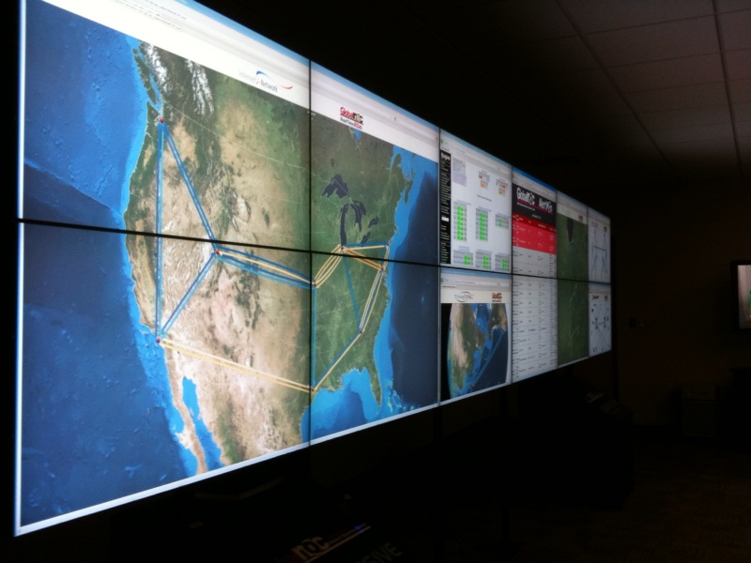
IU Research areas in a nutshell -- Security
Importance of security is obvious from discussion of Internet viruses and need to login to everything
Center CACR headed by Fred Cate of Law School has a policy emphasis
  Airport Security processes
  Implications of Cyber attacks on banks
  Privacy issues for Health records
CSC studies mathematical foundations and implications for networks and computers e.g.
  Viruses on cell phones
  Anonymizing networks
  Use of incidental information (e.g. size of message) to break security

Slide 23
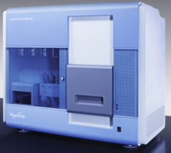
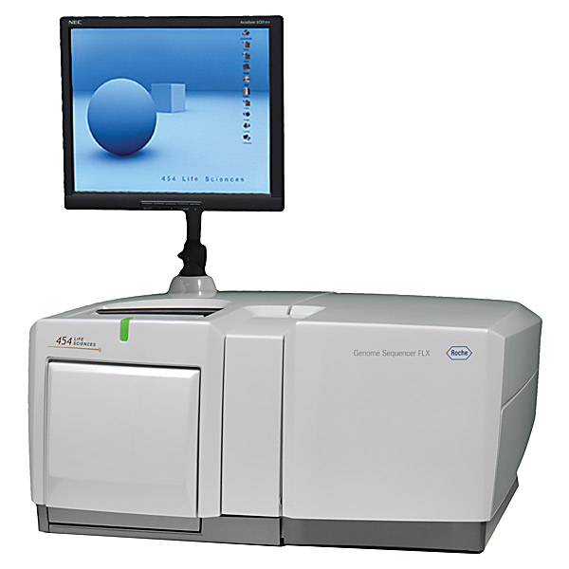
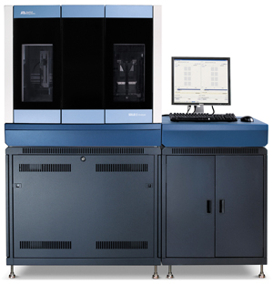

Bioinformatics
This is field that researches algorithms and processes to analyze biology data
Center for Genomics and Bioinformatics is centered in Biology and responsible for several machines that analyze biology data. (new generation of DNA sequencers)
School Bioinformatics faculty collaborate with biology and chemistry helping them draw conclusions from data
  Proteomics studies structure of proteins
  Text mining from Internet reports
  Metagenomics – studies of samples with many different genes present
  Linking genes to disease
  Study of gene sequence structure and methods to asemble fragments (produced by high throughput instruments) into full genes
Note computing applications in other sciences typically performed in discipline (see Cyberinfrastructure and HPC)
Illumina/Solexa Roche/454 Life Sciences Applied Biosystems/SOLiD
Internet
~300 million base pairs per day leading to
~3000 sequences per day per instrument
? 500 instruments at ~0.5M$ each
Read Alignment
Pairwise
clustering
Form block
Pairings
Sequence
alignment
Dissimilarity
Matrix
N(N-1)/2 values
Visualization
Plotviz
FASTA File
N Sequences
Blocking
MPI
MDS
MapReduce

Slide 24
Chemical Informatics
Cheminformatics studies small molecules that are used in areas such as Pharmaceutical Industry (chemical are drugs interacting selecting with biological compounds) or Energy where they are often catalysts
Indiana University studies interface between chemistry and Biology
  Often with Lilly – major state company
Algorithms to help identify chemicals that might be promising drugs (follow up with expensive experiments)
  PubChem has over 60 million compounds

Slide 25
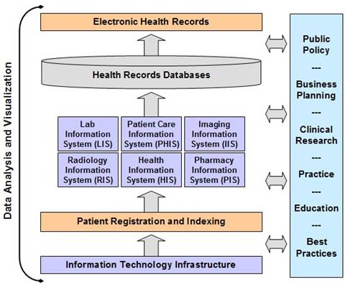
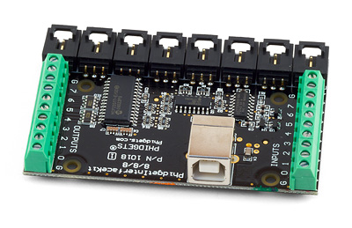
Health Informatics
Bioinformatics studies complex molecules; Cheminformatics studies smaller molecules; Health informatics studies medical information issues at level of people and populations (collections of people)
  All of these (plus study of imaging) can be called Medical Informatics
Ethos project looks at uses of devices to help elders manage their life and retain privacy
Studies of medical records – their management and structure
  Major efforts at IU Medical School Indianapolis
Epidemiology is the study of factors affecting the health and illness of populations

Slide 26
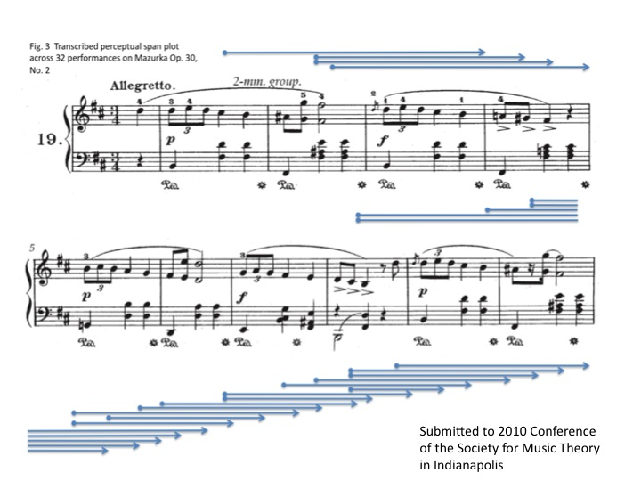
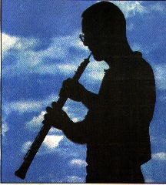
Music Informatics
Studies structure of music
Electronic generation of music
Crosses fields of Computer Science, Statistics, Acoustics, and Electronic Music
Techniques similar to Bioinformatics in that both fields use “data mining” extensively
Notes:
We present a novel method of measuring the perceptual present from performance timing data by reframing the question of the duration of the perceptual present to a related inquiry: at a given location in the piece, how many previous beats are sufficient to predict the duration of the current beat? We address this by building and testing probabilistic graphical models that include different ranges of pervious beats in predicting the current. We compute the likelihood for each model with timing data across all performers and perform statistical tests on each pair of those models to exclude those seem to arise by chance. We choose the model that has uncompromised predicting power but incorporates a smaller range of previous beats. A perceptual span plot across 32 performances on Mazurka Op. 30, No. 2 is shown as an example

Slide 27
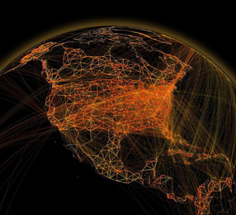
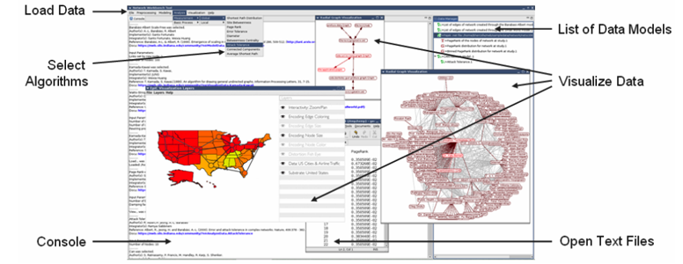
Complex Systems and Networks
Physics and Chemistry studies systems with known equations of motion (those from Newton, Einstein and Dirac)
There is a growing interest in systems that have no obvious equations
  Internet, transportation systems, stock market, biological systems as in collections of cells
And Epidemics such as H1N1 spread via movement of people especially by air (at long distance)
Web Science is the study of the socio-technical relationships that are implied by the Web. Understanding the Web involves not only an analysis of its architecture and applications, but also insight into how the dynamic interactions among people, organizations, policies, and economics are shaped by it and in turn affect its usage and evolution

Slide 28
TeraGrid Web of Science

Slide 29
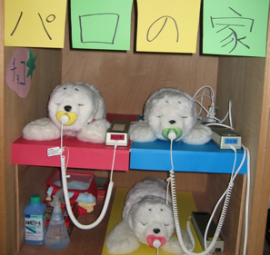
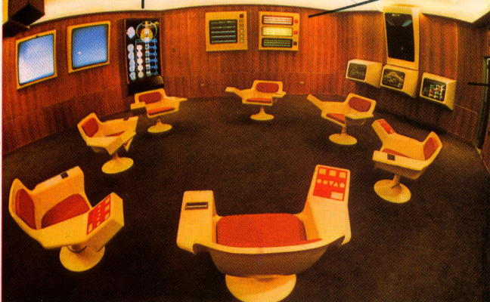
Social Informatics
Applications of Information Technology to Social Science OR application of Social Science to Information Technology
Can use different methodology to other parts of SOIC – gather data from interviewing people rather than machines (as in recording data from colliding particles at CERN accelerator)
Topics include social issues in scientific teams, role of information technology in government and how people interact with robots.
Notes:
Japanese toy robots (Selma)
This photo depicts the Cybersyn Opsroom - the control center envisioned by British cybernetician Stafford Beer and constructed in Santiago between 1971-1973.

Slide 30
Human Computer Interaction Design
Interactions of Information technology with people
Designing usable electronic products that do what you want e.g. control systems to encourage energy conservation
Theory behind virtual reality as in Interaction of people in Second Life and Gaming
Building usable software systems
Organization of Digital artifacts

Slide 31
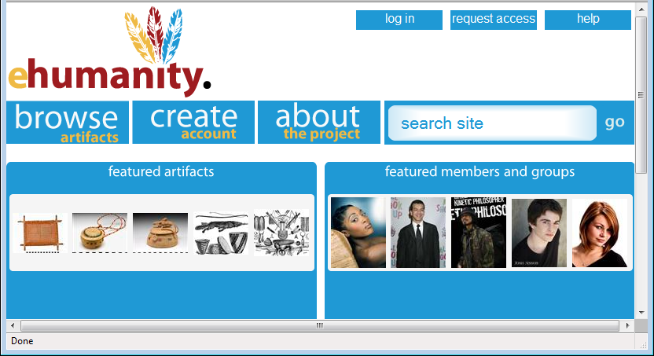
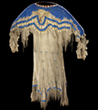
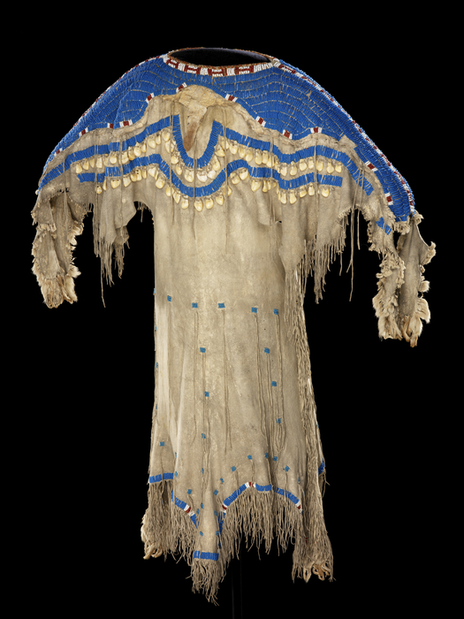














Girl's dress
e-Humanity
Culture/People:
Date Created: | circa 1850
Place: | South Dakota; USA (inferred)
Media/Materials: | Glass pony beads, deerhide/deerskin, elk tooth/teeth, wool cloth, sinew
Techniques: | Sewn, lazy/lane stitch beadwork
Collection History/ Provenance: | Collection history unknown; said to have been collected circa 1850; purchased by MAI in 1916 from an unknown source, possibly with funds donated by Mrs. George (Thea) Heye.
Dimensions: | 112 x 151 cm
Catalog Number: | 5/3776
Source: | National Museum of the American Indian
References: | http://en.wikipedia.org/wiki/Sioux
Return to Home
Sioux
Related Artifacts
Total: 2
Total: 5
beads blue dress
girl's dress long sinew
Sioux South Dakota
tan wool 1800’s
Comments / Ratings: 2
My grandmother has a dress just like this in her attic. 10.19.2009 9:38AM MST
I love this design. Where can I buy one? ☺ 10.18.2009 1:37PM MST
Average Rating:
(4.0/5.0)
Created by K. Wilson
Notes:
Feedback/Suggestions:

Slide 32
Cyberinfrastructure and
High Performance Computing
Generalizes to Computer Systems or Distributed Systems and can include Sensor nets
Cyberinfrastructure is worldwide electronic fabric supporting science research (such as simulate early universe) or development (stewardship of nuclear stockpile in era when testing forbidden – simulate aging of nuclear devices)
High Performance Computing includes algorithms and software for parallel computers where one could use 200,000 cores simultaneously
Collaborate with many application areas such as particle physics, weather and climate, polar science (melting of glaciers), earthquake forecasting as well as all areas of Medical Informatics
Indiana strong in this area with collaboration with UITS – the University Information Technology Support Organization as part of TeraGrid

Slide 33
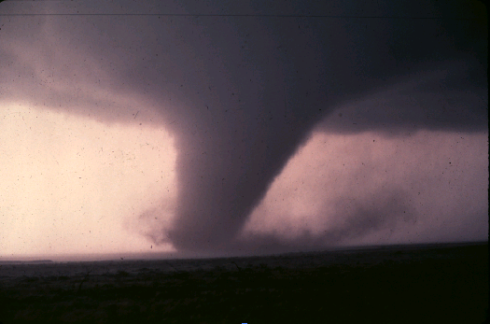
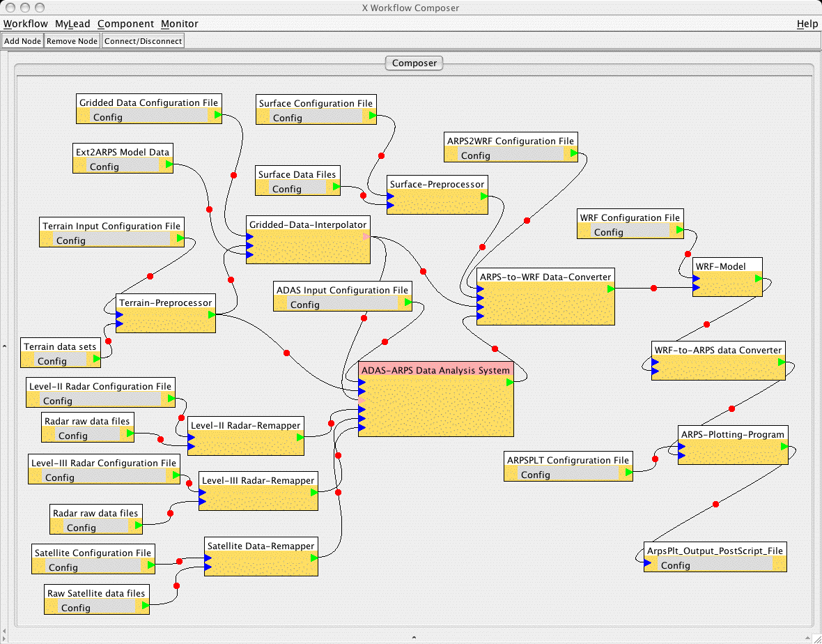
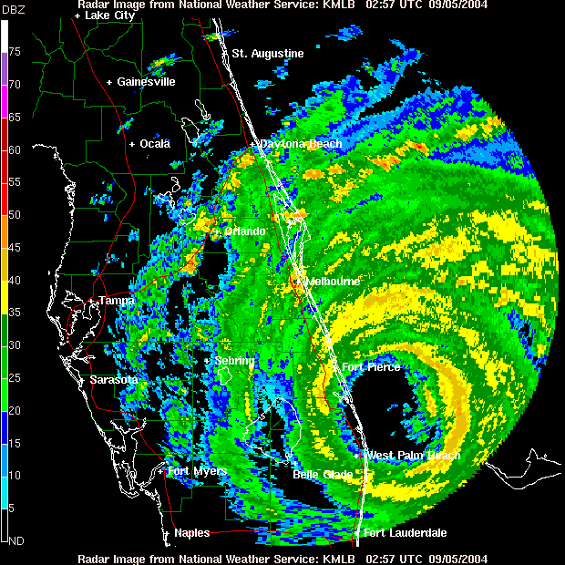
Data, Databases and Search
A striking feature of many areas is the “Data Deluge” where we see the Internet and data from scientific instruments increasing exponentially in size
http://research.microsoft.com/en-us/collaboration/fourthparadigm/
Bioinformatics and Cheminformatics “high throughput” devices illustrate data deluge
One needs to store , access and manage data (databases are large CS area) including adding metadata (data describing data)
One needs to “mine” data (machine learning, data mining ..)
One needs to query data (from indices) or search it in Google style

Slide 34
SS

Slide 35
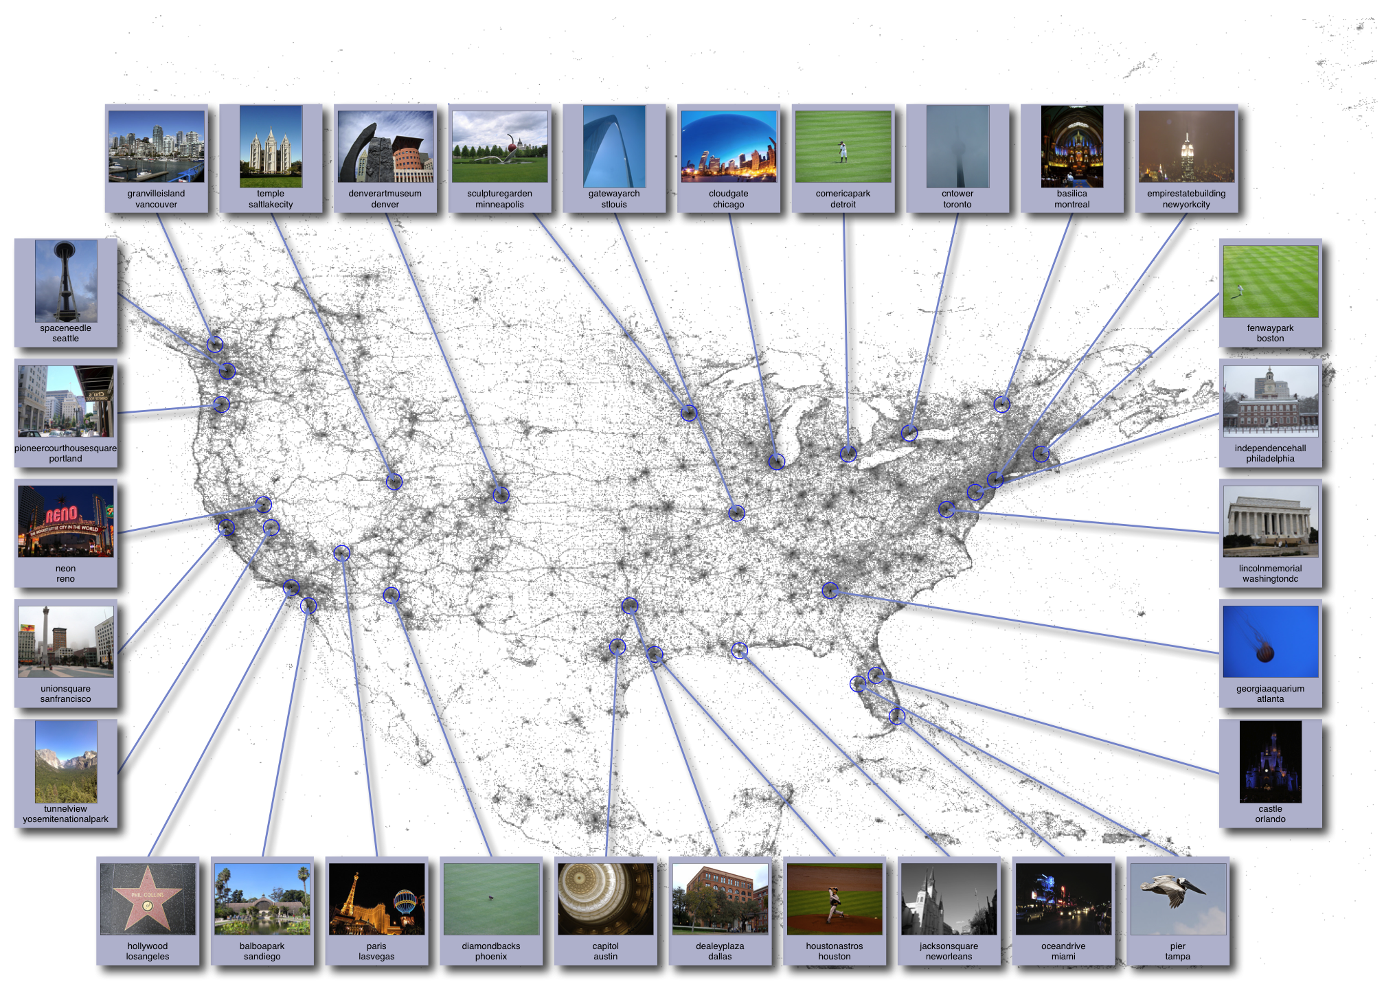
Image Analysis
http://www.cs.cornell.edu/~crandall/photomap/
Image processing has been a well studied area with classic studies from “handwriting recognition” “recognizing targets in military applications” and “robotic’ (interpret images to aid navigation)
The Internet with Flickr and Image search has re-invigorated field
First example from Crandall in SOIC is Organizing geo-tagged images from Flickr
Second example is automating determination of glacier beds

Slide 36
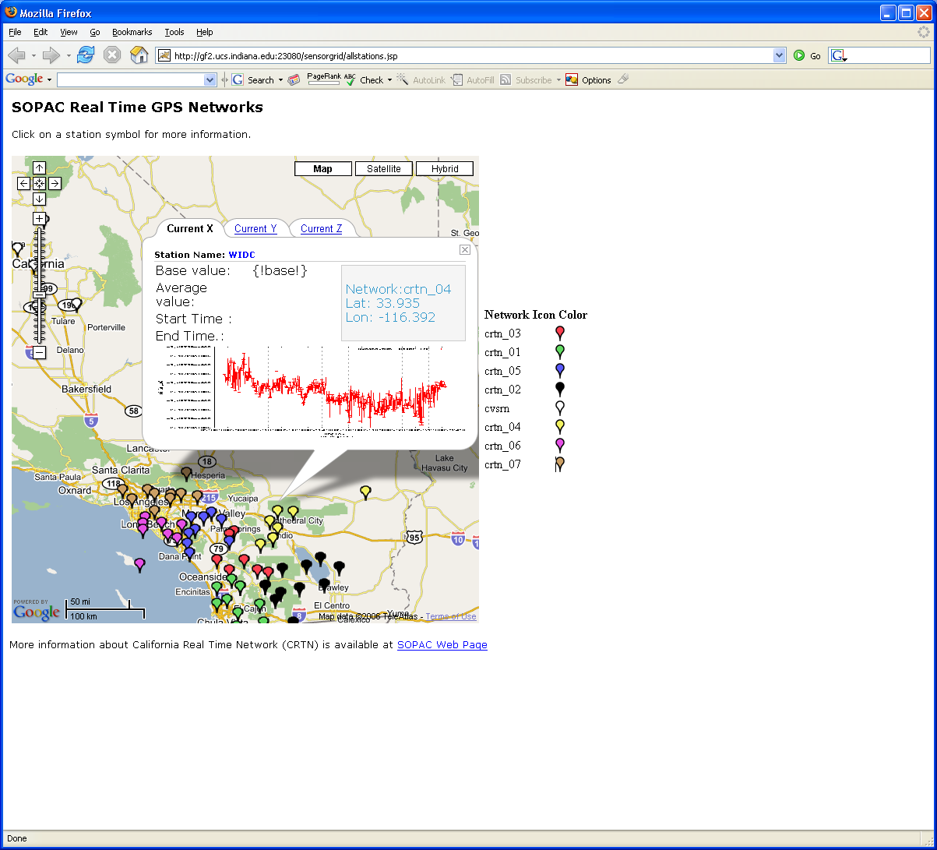
Ubiquitous Computing
As chips get smaller and cheaper, there are more and more entities with computers in them
  4.6 Billion cell phones at end of 2009
You can sprinkle your home and indeed your body with devices
  Ubiquitous City project in Korea studies implications of this trend including needed Cyberinfrastructure
Health Science advances from devices on body
Earthquake forecasting uses network of GPS and Seismic sensors

Slide 37

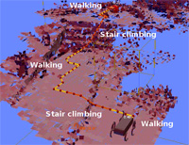
Robotics
This is study of computer controlled “machines” such as
  Vehicles (say on Mars) or human-formed robots
  Surgical instruments
Involves areas such as image processing to disentangle what Robot sees and “artificial intelligence” to make decisions
Interactions between Humans and Robots
  Natural Language understanding
  How do humans react to robots rather than people!

Slide 38

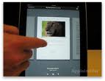
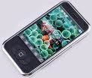








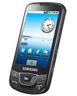










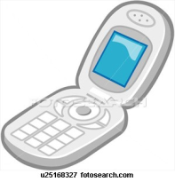
Sensors as a Service
Cell phones are important sensor/Collaborative device
Other Services
Sensors as a Service
Clients
Sensor Processing as a Service (MapReduce)

Slide 39
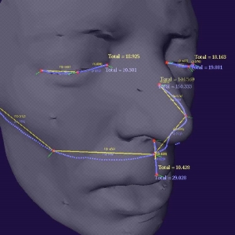
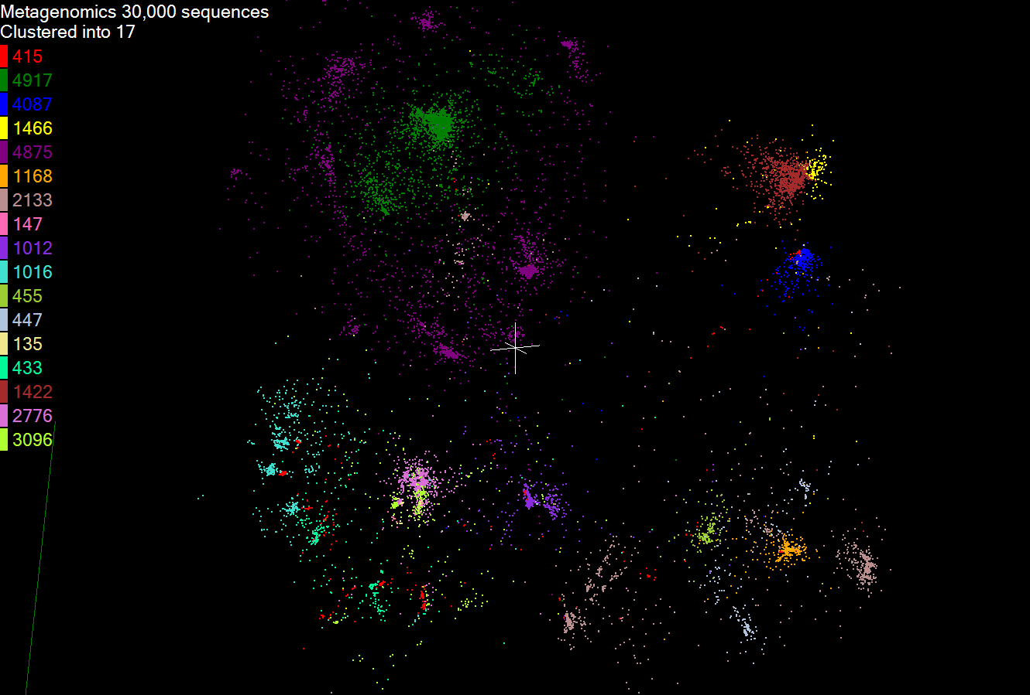
Visualization and Computer Graphics
Computer Graphics underlies gaming and Pixar movies and involves visualizing computer constructed objects/scenes
  Elegant theory of lighting
  This is very compute intensive and uses farms of computers
Visualization more broadly is trying to add power of human eye to increase discovery
  Many challenges when one is looking at something not easily mapped to 2D screen (such as a three dimensional flow of plasma at center of universe)
  Mapping abstract data (“information visualization”) such as genes that are lists of base pairs
  Interesting devices include 3D glasses and sophisticated environments such as caves

Slide 40
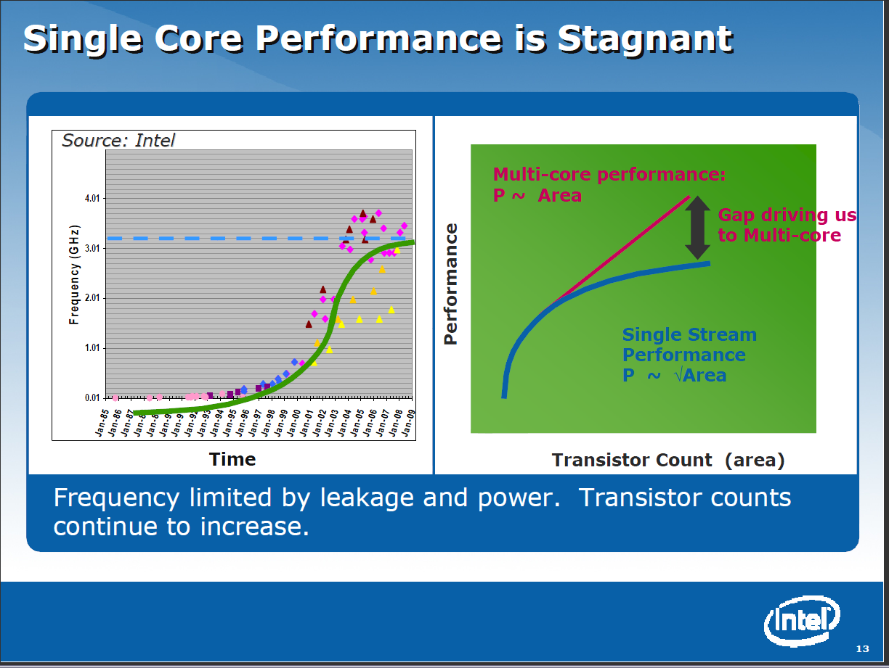
Computer Architecture
This field studies designs of computer and in particular the CPU
This field has tended to move from universities to industry as chips have become complicated and the infrastructure to produce them so expensive.
There is still a lot of innovation with discussion of number of cores in a single chip – this is 4-8 for mainline Intel/AMD chips but GPU’s have an order of magnitude more
Other specializations interesting including those for particular languages such as Scheme

Slide 41

Computer Networking
Computer hardware studies the computers; computer networking their links; Cyberinfrastructure/Computer systems the software on top of computer hardware and networking
New Internet architecture design – the current approach will not have enough addresses as we get flood of small devices connected to internet
Performance analysis of IPSec and optimizations (network message protocol)
Several areas on intersection of networking and secrity
  Distributed reputation systems
  DNS configuration and security
  Malware in peer-to-peer
  applications
  Prevention of IP source address
  forgery (IP Spoofing)
  Routing and trust
  Network security for mobile devices

Slide 42

Programming Languages and Compilers
This studies the expression of a problem to put on a computer (Language) and the conversion of this Language into machine executable form (Compilers)
There are many styles of Languages and different compiler challenges (such as targeting parallel computers)
Some languages address subsets of
problems (The Internet, Physics)
Indiana University pioneers in Scheme
Language and aspects of parallel
computing
  Compilers need “run-time” to support
  code execution (as OpenMPI for parallelism)

Slide 43
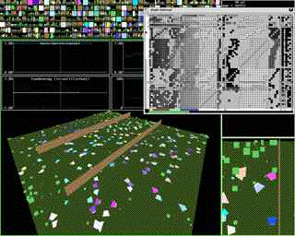
Artificial Intelligence, Artificial Life and Cognitive Science
Here are areas that look at developing computing systems that “think” i.e. make decisions similar to humans
Some model how people work together and others how brains (many neurons) function
Cognitive science is the interdisciplinary study of mind and the nature of intelligence. Centered in College of Arts and Science with strong School of Informatics and Computing collaboration
  error-making, creative translation, scientific discovery, musical composition, the comprehension and invention of jokes, the nature of sexist language and default imagery, philosophy of mind, and foundations of artificial intelligence

Slide 44
Computation Theory and Logic
Quantum Computing
Validation of imperative, declarative, and object-oriented programs
Program feasibility certification
Typing disciplines and monads for functional and object-oriented programs
Automatic support and logical foundations of syntactic theories
Non-classical logics and their computational contents
Models of information and computation
Computational and mathematical foundations of linguistics
New logical paradigms (e.g. visual, parallel, hybrid) that transcend traditional sequential and symbolic formalisms

Slide 45
Some key aspects of “Research”
Becoming a researcher; Identifying and applying to graduate school; what jobs are there – industry, university, national laboratory
What is and isn’t Research (Research v Development)
Is your research novel?
Identification and elaboration of research topics
Methodologies of (scientific) study
Identification of “state of the art”
Mentoring, (Long term) Collaboration …
Patience and Hard work
Ethics, acknowledgements
(Multimedia) presentation of results from “PowerPoints” to posters/movies and papers

Slide 46
Research
From web dictionaries:
Diligent and systematic inquiry or investigation into a subject in order to discover or revise facts, theories, applications, etc.
Scholarly or scientific investigation or inquiry. See Synonyms at inquiry.
Close, careful study.
Root: 1577, "act of searching closely," from M.Fr. recerche (1539), from O.Fr. recercher "seek out, search closely," from re-, intensive prefix, + cercher "to seek for" (see search). Meaning "scientific inquiry" is first attested 1639. Phrase research and development is recorded from 1923
I will define as “Thoughtful study of well posed interesting/important question taking account of other relevant studies”

Slide 47
Short Motivation
I did research as an undergraduate each summer
It not only interested me in Science but inspired an interest in computers which at time had little coverage in courses – they were very mathematical
My first summer, I learnt Fortran and carried programs for Crystallography research group back and forth between Cambridge and London each day
Led to my first paper: Fox, G. C. and Holmes, K. C. ``An Alternative Method of Solving the Layer Scaling Equations of Hamilton, Rollett, and Sparks,'' Acta Cryst. 20, 886 (1966).
This model – do something modest in an exciting research area – is still a good way to get started

Slide 48
Some key aspects of “Research”
Becoming a researcher; Identifying and applying to graduate school; what jobs are there – industry, university, national laboratory
What is and isn’t Research (Research v Development)
Is your research novel?
Identification and elaboration of research topics
Methodologies of (scientific) study
Identification of “state of the art”
Mentoring, (Long term) Collaboration …
Patience and Hard work
Ethics, acknowledgements
(Multimedia) presentation of results from “PowerPoints” to posters/movies and papers

Slide 49
Short Motivation
I did research as an undergraduate each summer
It not only interested me in Science but inspired an interest in computers which at time had little coverage in courses – they were very mathematical
My first summer, I learnt Fortran and carried programs for Crystallography research group back and forth between Cambridge and London each day
Led to my first paper: Fox, G. C. and Holmes, K. C. ``An Alternative Method of Solving the Layer Scaling Equations of Hamilton, Rollett, and Sparks,'' Acta Cryst. 20, 886 (1966).
This model – do something modest in an exciting research area – is still a good way to get started
Informatics and Computing School can help you with such “Research Experiences for Undergraduates”

Slide 50
Implementation
Summer REU opportunities (Research Experience for Undergraduates)
  Official NSF REU Sites – typically 10-20 students per year – each site has a focus and advertise nationally http://www.nsf.gov/crssprgm/reu/reu_search.cfm
  Supplements to NSF grants – typically 1 or 2 students per grant (per faculty member) and advertise locally
  CRA http://cra-ccc.org/ugresearchopps/
E.g. I am part of a NSF REU Site in Cyberinfrastructure for Polar Science and usually have REU supplement for FutureGrid NSF grant
Summer REU’s pay modest salary and travel
Academic year Research opportunities
  AY version of Summer opportunities
  Independent Study with faculty (credit not money)
  Maureen Biggers Program in SOIC

Slide 51
Approaches
Undergraduate Student does either/or Software, Paper Reading, Hardware, Algorithm work
Undergraduate Student works directly with faculty
Undergraduate Student work as a team (2-4 students) supervised by faculty, staff, graduate student
Graduate students (or staff) can give more personal interaction
Note need to preserve faculty link as recommendations typically must to come from faculty
  School had difficulty recently in nominating students for awards as some excellent research had no clear faculty to give recommendation

Slide 52
Things students can learn
Of course what is research and a new deeper interest in computer science
A commitment to a research career
How to apply to graduate school
How to do a Poster/Presentation
Writing a paper/proposal
How to learn from research supervisor
Choosing a research topic
Ethics, Acknowledgements and dealing with related work
Working in a team

Slide 53
Icing on the Cake
The research is presumably the main topic but many believe that successful research experiences involve other activities
Lectures on how to prepare applications for graduate school and how to take GRE’s
Lecture on job opportunities in industry
Lectures on research process as described earlier
Regular seminars by mentors/faculty and undergraduate students
Distinguished and useful (e.g. industry) speakers
Poster session locally or at conferences/workshops – often small community meetings are suitable
Submission of papers to (national) undergraduate events
Parties, food etc.; create a bonding between several students in an REU site
Visits to interesting research related laboratories
Some consider these other activities as distractions in a (short) research experience

