Slide 1
I399
How Entrepreneurs Use IT to help with New Business Development

Slide 2
Mobile Technology
In New Business Development

Slide 3
Objective
Discover how entrepreneurs can utilize IT, specifically mobile technology in new business development and its effect on the small businesses
Hypothesis:
The use of Mobile Technology in new business development strongly increases productivity, client relations/communication, marketing and sales and product development.

Slide 4
Methods
Scholarly reviews
Professional Surveys
Personal Surveys
Interviews

Slide 5
Important Findings
Scholarly Research:
Mobile Technology helps businesses with…
Productivity → allows businesses to access work documents on the go, integrate system with mobile devices and use company resources from anywhere
Client Relations/Communication → allows real time communication with office and interactive order processing
Marketing and Sales → Mobile apps, advertisements
Product Development → Allow clients to feel they have more impact on product/service

Slide 6
Important Findings
Professional Survey of Small/New Business Owners
Significant potential:
68% Communication, 31% CRM, 21% Order Processing, 40% GPS, 35% Marketing, 23% Project Management
Biggest Barriers:
33% Few Relevant Uses for Business, 25% Cost, 14% Making time to learn, 11% lack of technical expertise, 7% Security Concerns
Who can benefit:
83% Individuals/Entrepreneurs
83% Small Businesses
76% Mid-Sized Companies
74% Large Companies

Slide 7
Important Findings
Personal Surveys
Conducted survey of peers and classmates
If you were starting a new business, how big of an emphasis would you put on utilizing mobile technology?
Notes:
Emp

Slide 8
Conclusion Why Mobile Tech Should be Used
Productivity
Flexibility
Profitability
Control
Connectivity

Slide 9
Conclusion How Mobile Technology Is Utilized
My advice to an entrepreneur looking to utilize Mobile Technology:
Define Goals
Different Mobile Technologies can be utilized to accomplish different business goals
Mobile advertisements → Marketing vs. Mobile CRM → Productivity
Weigh Pros vs. Cons
Example: Increased Productivity/Profitability vs. Time/People needed to implement and maintain
Develop a Strategy
Once you have defined goals of the business, you can then develop a mobile strategy based on what technologies you will be implementing

Slide 10
E-Commerce
In New Business Development

Slide 11
Objective
Discover how entrepreneurs can utilize IT, specifically e-commerce in new business development and the effects of e-commerce on the small business
Hypothesis:
Use of an e-commerce platform is extremely beneficial in new development

Slide 12
Methods
Scholarly reviews
Interviews
Survey
Case Study

Slide 13
Important Findings
Scholarly Research:
The basics. Definitions, history, ideals, opinions
Importance of e-commerce to new business dev.
Small and new businesses that sell online, 64% said the internet increased revenues or sales
Like many other areas in IT, e-commerce is rapidly developing and ever-changing
New start-ups for quicker, simplified buying/selling
B2B, B2C, C2C
Notes:
At first, a lot of research was done to find the correct definitions and stats, and sort them out from opinions and unwanted information as our research is relatively broad.

Slide 14
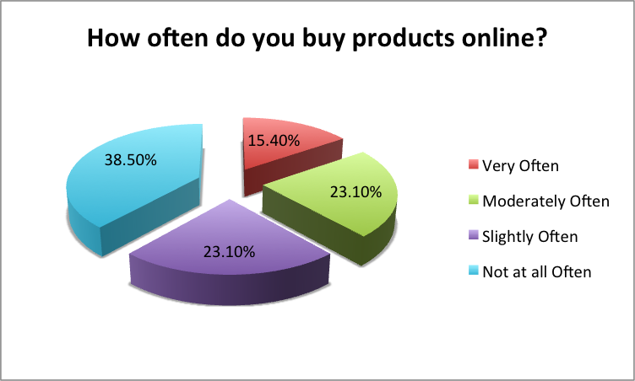
Important Findings
Survey
Brief online survey of peers, co-workers, and team members in order to discover opinions and use level of e-commerce
Every participant had bought something online at some point

Slide 15
Important Findings
Case Study
Analyzed and Review Oracle E-Commerce Survey, as well as a study on rural and small business’ utilizing e-commerce
From Oracle:
“most-effective B2B e-commerce initiatives will be those that enable organizations to successfully use the right technologies… to engage customers and enhance their decision-making abilities”
E-commerce is powerful, if you implement it in a way that is satisfying for the customer
Finally, SEO will become a key factor in driving users to utilize your online selling ability

Slide 16
Important Findings
Case Study
From Case Studies of E-Commerce Activity in Rural and Small Town Businesses:
Study of 25 of new rural/small businesses
Location is not relevant to E-Commerce
E-Commerce can vary from simple HTML to professionally developed websites with similar success rates
“Effective learning tool can be the experiences of other business owners”

Slide 17
Conclusion Why E-Commerce Should be Used
Powerful
Increase potential customers, Introduce your newly developed business
Efficient
A cheap way to get your new product or new service out
Future
As e-commerce continues to develop, having an online outlet will be extremely important
Notes:
So from all of my research, the reasons e-commerce should be used are…

Slide 18
Conclusion How E-Commerce Is Utilized
My advice to an entrepreneur looking to utilize E-Commerce
Do your research
Depending on what is being sold, a different type of e-commerce utility will be appropriate
New vs. Old (Simple shopping cart solution or new, 3rd party buy/sell like Ribbon, Chirpify)
What kind of business?
If you sell something very complex and unique, your e-commerce platform should express that
Simple merchandise sales online should reflect a simple shopping experience in real life (Shopping Cart, One-Click orders)

Slide 19
E-Marketing
In New Business Development

Slide 20
Objective
Define how Entrepreneurs use Digital Marketing to help with new business development.
Digital marketing is an important aspect to consider in order to develop a new business.
Also, Digital Marketing is extremely effective in new business development.
Hypothesis
Digital Marketing is the cheapest and most effective way for a new business to advertise

Slide 21
Methods
Scholarly Reviews
Survey
Interviews

Slide 22
Scholarly reviews
Social media gives marketers an opportunity to listen to the customers and encourages customers to get involved with their brands.
90% of marketers use Facebook.
70% of marketers use mobile apps.
89% of marketers use Twitter.
Social media has helped businesses to develop a strong customer base and engage with their customers.

Slide 23
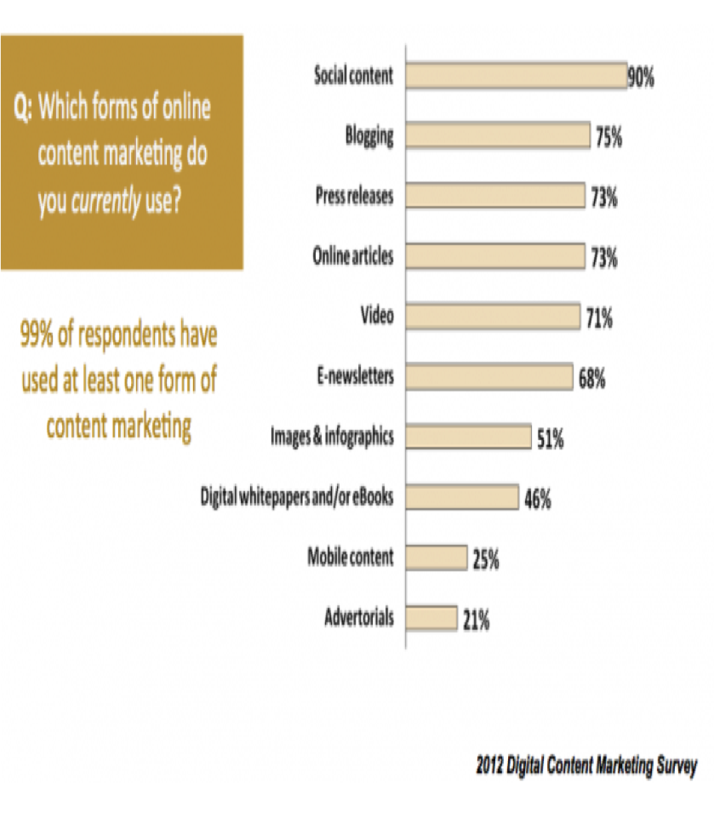
Survey
Which forms of online content marketing do you currently use?
90% uses social media.
75% uses Blogging
71% uses videos.
According to a digital content marketing article, there is increasing number of new businesses using digital tools to market.

Slide 24
Conclusion Why digital marketing should be used?
Powerful:
It is encouraging new businesses to develop a customer base.
To understand what the customer wants and is thinking.
Efficient:
Using social media is the cheapest way to target customers.
Easy to create and manage
Future:
Social media allow new businesses to engage with their customers. This will continue and grow.

Slide 25
Questions?

