Slide 1
Restaurant Technology
Lena smith, Na hae kim,
seung han paik, seonghyun lee

Slide 2
topic
“Technology when compared to other fields has had very limited impact on restaurants. Come up with a design to incorporate technology more into restaurants and help the customers have a better dining experience.”

Slide 3
Preliminary Research Methods
Prior to creating and defining our concept and focus, we conducted preliminary research in order to gauge current restaurant technology used and get feedback from people who work and visit restaurants.
We focused our preliminary research on:
Surveys
Customer and Employee
Research Articles
Focused on current and future technology used in restaurants
Visiting restaurants
Documentation of observations relating to focus

Slide 4
Preliminary Research findings
SURVEY
VISITING RESTUARANTS
The type of restaurant visited most often is casual dining.
The lack of technology affecting customers the most is waiter response time, with waiting time a close second.
The layout of the restaurant increases wait time
Host system efficiency directly affected by the level of business
The majority of restaurants either have methods lacking technology or nothing at all.

Slide 5
focus
After conducting our preliminary research, we decided to focus our project on creating and improving on current technology in order to provide the following functionality to both customers and employees:
More accurate wait time
Improved communicating with waiter/waitress
Quicker payment options
Ability to access and order from menu at own convenience
Orders sent instantly to kitchen staff

Slide 6
Secondary research methods
After narrowing down the focus of our project, we conduced more research specific to our newly defined focus and with individuals directly related to our field.
We focused our secondary research on:
Interviews
Personal interviews with restaurant employees
Research Articles specific to our focus
How to improve on current technology used in restaurants

Slide 7
Secondary Research findings
INTERVIEWS
RESEARCH ARTICLES
More use of technology in restaurants would be beneficial to both customers and employees
Less hassle
Better communication
Increased satisfaction
The following technologies can be found at certain restaurants:
Table Management System
Table Tracker
Waiter Paging System

Slide 8
Incorporating research to concept
After conducting our preliminary research and secondary research, we determined that in order to create the most efficient technology for restaurants, we would need to incorporate several functions into one software. This software would be used by:
Host/Hostess
Increased wait time accuracy
Customer
Instant access to menu and payment
Ability to get waiter/waitress attention instantly
Waiter/Waitress
Ability to communicate better with customers
Less time focused on payment and ordering

Slide 9
Concept: Host/Hostess
Table Management
This is a look at what the software would look like when it was placed that the hostess station.
1
2
5
6
3
4
7
8
9
10
11
12
Seating Time: 8:05 pm
Order Time: 8:30 pm
Delivery Time: 8:55 pm
Dessert? No
Est. Time of Departure: 9:25 pm
19
13
14
15
19
16
17
18
20
To view table details, click on table number.
Purpose: More accurate wait time

Slide 10
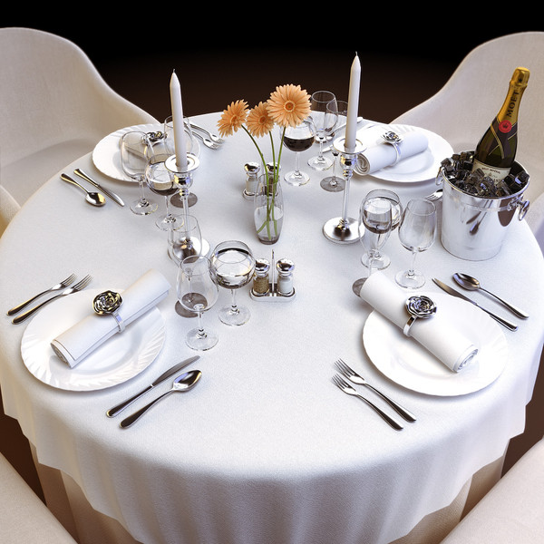
Concept: customer
This image shows how the call system would look for the customer. A button would be placed at each table, and the customer would be able to press this button if service was needed from the customer.
The waiter/waitress would see:
You have been paged
Time paged: 8:25 pm
Time responded: 8:27 pm
Notes: The table had a question about the menu
19
http://www.turbosquid.com/3d-models/tableware-
table-cloth-restaurant-3d-model/530772

Slide 11
Concept: waiter/waitress
This image shows how the waiter/waitress could keep an eye on all of their assigned tables and be able to respond efficiently.
Table Management
Your Tables
13
14
15
19
Seating Time: 6:32 pm
Order Time: 6:50 pm
Delivery Time: 7:14 pm
Dessert? No
Est. Time of Departure: 8:25 pm
20
16
17
18
20
Ready for Payment
Order Submitted to Kitchen
Order Ready for Delivery
Table Empty
This customer has indicated that he/she is:
Ready for Payment
Payment Total: $38.52
Tip Total: $7.00
Grand Total: $45.52
Payment Type: Cash
Payment Accepted.

Slide 12
outcomes
By including all of the above technologies into one software which can communicate between employees and customers, the satisfaction will be increased by all. We anticipate that by implementing this software, all of the focuses that we determined in the earlier stages of this project will be met.

