Slide 1
Research Methods for Informatics and Computing Fall 2012
A: Introduction
Geoffrey Fox
gcf@indiana.edu
http://www.infomall.org/I399-Fall12
Associate Dean for Research and Graduate Studies, School of Informatics and Computing
Indiana University Bloomington
Director, Digital Science Center, Pervasive Technology Institute

Slide 2
Basic Plan
Form teams so students learn about collaboration in research.
Each team is nominally 3-4 students and mentor(s) and will do a project in a research area assigned to/agreed by team.
Mentor (a graduate student) is a “manager” and not a researcher
The team will deliver overview of research field at mid term and research results at end of semester
Results documented by Poster, Video placed on Youtube and usual research output (presentations, papers, web)
Your team will work together electronically (that’s how its done in major research project) with class interactions and other team meetings
  Need to meet in and outside class time

Slide 3
Grading Philosophy
Occasional Weekly Homework – total 15%
Midterm Project Review (Presentation, Paper) – 15%
Individual final report – total 20%
Team final activities ( YouTube Video, Paper) Grader, Professor Evaluation– 16%
Team final Poster Event Evaluation - 16% (more variance)
Peer final Assessment - 3% (large variance)
Mentor final Assessment - 5% (large variance)
Attendance – total 10%

Slide 4
Assignment 1: I399 Research Methods for Informatics and Computing
Due Saturday August 25 Midnight
Choose top 8 Research Topics (list in order of preference) chosen from those in this talk slides 17-26 and expanded at
http://www.infomall.org/I399-Fall12/Materials/I399Fall2012-Projects.docx
Then list any constraints in allocating you to a project
  e.g. I want to be on same project as another student
  Or I certainly don’t like a certain area

Slide 5
Assignment 2: I399 Research Methods for Informatics and Computing
Due Tuesday September 4 Midnight
1) Summarize some areas/research topic(s) of interest to you based on either SOIC faculty research activities discussed in class or what you think is interesting.
2) If you have done Undergraduate Research already and have summaries you are willing to share, please upload these

Slide 6
Things we will do
Discuss/Summarize School of Informatics and Computing Research
How to do a Poster/Presentation
How to write a paper/proposal
  Tools like EndNote
Process of Research including Ethics, Acknowledgements and dealing with related work
  How to learn from research supervisor
  Getting IRB approval
  Doing surveys
Collaboration and Teamwork
Graduate Student round tables; applying to graduate school

Slide 7
Near Term Course Activities
Pose first Homework – which is rank your top 8 interests from mentor suggestions
Discuss Faculty Research, Previous Projects, Mentor Suggestions
August 20,22,27; discussions of research in general; topics in SOIC and possible team projects
By August 29, propose teams with chosen topics
September 5 “final teams” initial meetings

Slide 8
Research
From web dictionaries:
Diligent and systematic inquiry or investigation into a subject in order to discover or revise facts, theories, applications, etc.
Scholarly or scientific investigation or inquiry. See Synonyms at inquiry.
Close, careful study.
Root: 1577, "act of searching closely," from M.Fr. recerche (1539), from O.Fr. recercher "seek out, search closely," from re-, intensive prefix, + cercher "to seek for" (see search). Meaning "scientific inquiry" is first attested 1639. Phrase research and development is recorded from 1923
I will define as “Thoughtful study of well posed interesting/important question taking account of other relevant studies”

Slide 9
Projects Spring 2012-I
Facebook FakeFinder: Currently, we are able to determine whether or not facebook profiles are real based on content of images and posts, number of mutual friends, and the sorts of networks that the profile is involved in...
Differences between Facebook and Google+: Our project seeks to research and understand the differences between facebook and google+. We will identify the strengths and weaknesses of each as well as future capabilities of both. In addition to the social applications, we will be investigating the academic, collaborative, scientific, and research applications of both social networks. ...
Twitter: Real or Fake? We are looking at different Twitter accounts, real and parody accounts, while using Truthy, online surveys and reading about previous research already completed. We hope to find out what is the significance behind parody accounts and why certain people follow them.

Slide 10
Projects Spring 2012-II
#SocialQuake: We are researching the role that the Twitter has with earthquake detection, response, and relief. Generated a prototype web site comparing Tweets and Earthquakes
Using Smart Phones as Digital Wallets: We are focusing our project around the question: Is the digital wallet better than the wallet that we know today? We aim to answer this question by researching the topics of security issues, ease of use and possible associated costs.
Design of effective health related mobile applications & Impact of interactive systems (mobile phone, computer, sensors) on users' daily behavior to foster a healthier life: Today, tremendous number of health related mobile application exist and devices. Our research will focus on what are the roles of these apps and devices and compare the strengths and weaknesses of them.

Slide 11
Projects Spring 2012-III
HCI issues with multiplayer online games on mobile phone: Explore HCI problems or issues of multiplayer online games on mobile phone and design a new solution to solve the problems
User Experience with Android, iOS, and Windows Phone 7: We will be evaluating the different smartphone operating systems in order to gauge why people choose them and what it is people enjoy about using them
Design A Better Alarm System That Will Enhance The Wake Up Experience: Most wake up to the sound of an alarm from either a clock or a cell phone. We are researching to find out other ways to wake up in the morning and what way is the most pleasurable. This may include waking up to music instead of an alarm, waking up to the smell of something such as coffee or bacon, or waking up to movement, such as the bed or pillow vibrating.

Slide 12
Projects Spring 2012-IV
Social Media & The Entrepreneur: research how Entrepreneurs can use Information Technology for new business development.
Future of books in education as we develop technology for better learning environmen​ts: Implications of e-texts and related initiatives
Exploring Copy Number Variation with Data from 1000 Genome Project: We are interested in investigating exome-based copy number variation among different ethnicities. Copy number variation (CNV) is a form of DNA structural variation where a section of DNA one kilobase to several megabases in size exists in higher copies or lower copies in the genome than normal. They result from structural rearrangements in DNA such as duplication, deletion, inversions, and translocations.

Slide 13
Projects 2011-I
Business Informatics
  How does Informatics improve business with case studies
Collaboration: Enhancing Small Team Collaboration
  Review collaboration tools to support this type of “small” (4-6) team research
Complex Systems: Analyzing Social Patterns
  What can you determine from social network of I-399 participants
Cyberinfrastructure / Bioinformatics: Analysis of Protein from the Thousand Genomes Project
  Protein structure dependence across countries
HCI : How Rumors Influence Us
  Does professional success mean that you need to clean up your Facebook page!

Slide 14
Projects 2011-II
Health Informatics: The New Era of Healthcare Technology
  Survey healthcare professionals on value of informatics
Music Informatics/HCI: Music Database Visualization
  Evaluate existing personal music systems iTunes, Winamp, Windows Media Player and suggest improvements
Security: Permission System Evaluation on the Android Mobile Platform
  Evaluate the way Android (smartphones) checks that you allow applications permissions on your machine
Security: Spam – A Battle For The Inbox
  Nature of Spam – in what circumstances is it serious
Ubiquitous Computing
  How to automate Android settings with context sensitive settings

Slide 15
Projects 2010-I
Bioinformatics: Bioinformatics and Supercomputing
  Look at Phylogenetic Trees and Clustering on supercomputers to improve biology understanding
Data Mining: Do Integer Ratings Hinder Recommendation Systems?
  How accurate do ratings need to be?
Google Wave: Usability of Google Wave
  Examine ease of use of Google Wave (Google closed mainly due to poor user interface)
Google Wave: Exploring Google wave for Research Collaboration
  Examine how Google Wave can improve team work (promising but opportunity gone as closed by Google)

Slide 16
Projects 2010-II
HCID : The Fine Line Of Acceptable Behavior - Face to Face vs. Mediated Interaction
  Interview people to delineate appropriate interactions on Facebook, Twitter, LinkedIn, Flickr etc.
Health Informatics: Health Recommender System
  Look at web based health recommendation systems (e.g. what to buy)
Mobile/Ubiquitous Computing
  Survey and prototype Smart phone app to help users of IU bus system
Research Website: SOIC Undergraduate Research Resource
  Design and prototype a undergraduate research web site
Security: Solutions to Mobile Security for the Android Operating System
  Look at vulnerabilities of current Android smart phones and suggest ways of addressing

Slide 17
Assignments 1
1. Identify influential people on Twitter and discover who tries to fool others
Hencier, Margulis, Shriver
3. How Cloud computing will change the face of Social Media and Gaming Industry by eradicating the need of specific softwar and expensive hardware
  Coughlin, Kenworthy, Pugh, Lakstins

Slide 18
Assignments 2
4. Why Google+ is not as successful as Facebook?
  Babbs, Glass, Lewis, Shields
5. Evaluate how social networls affect an employee looking for a job as well as an employer making the decision? How is that going to change our career path?
  Dorsey, Lu, Miller, Zheng

Slide 19
Assignments 3
7. Impact of interactive systems (mobile phone, computer, sensors) on users' daily behavior to foster healthier lifestyle
  Deist, Jarvis, Mikiska, Qiu
"8. Technology when compared to other fields has had very limited impact on restaurants. Come up with a design to incorporate technology more into restaurants and help the customers have a better dining experience."
  Kim, Lee, Paik, Smith

Slide 20
Assignments 4
12. Studying and analyzing Recommender Systems (e.g. identifying best movie for you) including Collaborative filtering, Content Based filtering and Hybrid-Recommender methods
  Auble, Choi, Maurer, Richardson
17. Improved Voice Biometric Sytems using Kinect. Microsoft Xbox Kinect has been used more than just a sensor for xbox games. Latest Microsoft Kinect SDKs include the capability to track facial expressions. We can use the face tracking feature to monitor the lips and find whether it's the person speaking or a recorded playback.
  Johnson, Lakstins, Li

Slide 21
Assignments 5
18. Examine how entrepreneurs use information technology in new business development.
  Ostrom, Shwaber, Alharji, Shi
19. Comparison between Apple iOS and Android from users point of view. Students will form questionnaires and ask people how they use their cellphones/PDA's which either have ios or android as their operating system, what kind of activities are they doing on these devices and how the operating system is relevant.
  Barrett, Kecan, Sprinkle, Shi

Slide 22
Assignments 6
23. Subtle Changes Result in Great User Experience. This project is intended to encourage students to compare different designs aimed to solve the same problem, and perceive how subtle changes result in great user experience improvement. Students will learn WHAT, WHY, and HOW of good user experience
  Coddens, Hwang, Ogden, Perez
27. Compare and evaluate Android and iOS with respect to mobile security" such as Web-based attacks, Malware, Denial of resource and service, Data Integrity attacks and Social engineering attacks, Study how these are addressed in Android and IOS.
  West, Wilson, Li, Johnson

Slide 23
Fall 2012 Suggested Projects I: Network Science
1: Identify influential people on Twitter and discover who try to fool others. (Repeat last semester’s project 3)
2: "We know what's going on! How to auto-detect events from Twitter text stream?"
3: How Cloud computing will change the face of Social Media and Gaming industry by eradicating the need of specific software and expensive hardware.
4: Why Google+ is not as successful as Facebook? (See last semester project 2)
5: Evaluate How social network affects an employee looking for a job as well as an employer making the decision? How is that going to change our career path?

Slide 24
Fall 2012 Suggested Projects II:
Health Informatics
6: A mobile application to maintain healthy diet for good health.
7: Impact of interactive systems ( mobile phone, computer, sensors) on users' daily behavior to foster a healthier life.

Slide 25
Fall 2012 Suggested Projects II: Life-Style Informatics
8: Technology when compared to other fields has had very limited impact on restaurants. Come up with a design to incorporate technology more into restaurants and help the customers have a better dining experience.
9: "E-Wardrobe" this enables people to check how an item (like a dress etc.) looks on them without putting it on physically using computer vision techniques.
10: Detecting warning signs (traffic signs) in images using computer vision techniques.
11: Collision(accident) detection system. (Using computer vision techniques on a video). This can be used in the surveillance systems to instantly respond and send medical help.
12: Studying and analyzing Recommender Systems (e.g. identifying best movie for you) including Collaborative filtering, Content Based filtering and Hybrid-Recommender methods.

Slide 26
Fall 2012 Suggested Projects IV: Social Informatics
13: With the teenagers getting greater exposure to internet the instances of cyber-bullying has drastically increased. Propose a design to reduce or stop cyber-bullying. (The students will conduct survey and personal interviews to collect information. Contact organizations, check libraries and online resources to know what measures are taken at present.
14: An extension to the last year's top prize winner: Use social media in crises (e.g. tsunami, hurricane. earthquake). The government has failed to keep victims informed; only hope is bottoms up system. Prototype OpenQuake community environment .This time we want to make it portable for smartphones and develop a way to send alerts to various types of social media! See project 4 last year
Ubiquitous Computing
15: Use of smart phones as digital wallets: Today we use smart phones not only to make calls or send e-mails or text messages but also as a mini- computer. A smart phone today can be used as a Navigator, Gaming device, Music Player, Virtual Vault to store important documents and even as digital wallets. One example is the smartphone application- Lemon http://lemon.com. (See last year’s project 5)
16: Evaluate how smart phones affect the way we do research nowadays?

Slide 27
Fall 2012 Suggested Projects V: HCI Design
17: Improved Voice Biometric Sytems using Kinect. Microsoft Xbox Kinect has been used more than just a sensor for xbox games. Latest Microsoft Kinect SDKs include the capability to track facial expressions. We can use the face tracking feature to monitor the lips and find whether it's the person speaking or a recorded playback.
18: Examine how entrepreneurs use information technology in new business development. (See last semester’s project 9.)
19: Comparison between Apple iOS and Android from users point of view. Students will form questionnaires and ask people how they use their cellphones/PDA's which either have ios or android as their operating system, what kind of activities are they doing on these devices and how the operating system is relevant.
20: Comparison of various web services. This project will require students to study the various web services that exist. Analyze their pros and cons, suggest an improvisation if there could be any. It will help them learn how the web works and how applications run.
21: Comparison and analysis of the different versions of Android operating system. Identify bugs and new directions

Slide 28
Fall 2012 Suggested Projects VI: HCI Design
22: User Experience Everywhere. This project is intended to help student discover user experience existence in our daily life, cultivate their design ideology, and think over how to improve such user experience. Through learning and observing events such as a shopping process in shopping mall, or a catering process in a food court, students will learn how to perceive even subtle problem that may greatly impair user experience, which could be ignored by most of others.
23: Subtle Changes Result in Great User Experience. This project is intended to encourage students to compare different designs aimed to solve the same problem, and perceive how subtle changes result in great user experience improvement. Students will learn WHAT, WHY, and HOW of good user experience
24: Mobile devices: promoting or obstructing communications? This project is intended to encourage students to rethink if mobile devices are promoting or obstructing the communications between each other.
25: Evaluation and difference between mobile sites/apps and desktop websites. We shall be talking about the differences of them with regard to Design, Content, Graphics, look and feel and what are the modifications that have to be done for a traditional website to make it compatible for smart phones.
26: Case study about persuasive design with technology. Find out one exemplar that can prove a successful persuasive design in information technology and analyze how it succeeds. Generate tips for designers about how to make a product successful in persuading people to change their habits/attitudes/behaviors or belief.

Slide 29
Fall 2012 Suggested Projects VII: Security
27: Compare and evaluate Android and iOS with respect to mobile security" such as Web-based attacks, Malware, Denial of resource and service, Data Integrity attacks and Social engineering attacks, Study how these are addressed in Android and IOS.
28: Privacy in online social networks(OSNs) has got a lot of attention and it is still a problem. Although OSNs allow users to define fine-grained access control lists on their profiles and walls, it is difficult for most users to specify these detailed policies. In this project, we design a Facebook application that helps users to evaluate their privacy policies by showing them a score on how their current privacy settings are enforced and if they are consistent with their initial intentions. This application needs to get access to users’ privacy settings as well as their information on profiles and walls after being run by them. For evaluating the effectiveness of the privacy settings, some specific privacy metrics should be defined. By analyzing the collected information and based on the privacy metrics, the application provides a report on the possible privacy leakages, along with some warnings and suggestions.

Slide 30
Fall 2012 Suggested Projects VIII: Bioinformatics
29: Explore emergent properties of bio-inspired agent based models. Agent-based models (ABMs) use a population of agents endowed with some rules for their interactions (known as microscopic rules). While these microscopic rules may be simple, they often result in complex population behaviors. ABMs are used to describe phenomena observed in the social sciences, economics, molecular biology, evolutionary biology, and physics. Basic programming skills are required (at the level of I210).
30: Identifying control paradigms for gene regulatory networks. One complex dynamical network of particular interest for biological applications is the Boolean Network (BN). The ability for biological cells to function in complicated environments has been attributed to the coordinated interactions between large numbers of genes, proteins, and molecules. BN models use binary variables (on, off) to represent the state of a component and complex networks to capture the interactions between components. This project would explore various control paradigms for a BN. Results will be used to help predict new medical interventions for diseases and to formulate a theory of boolean network controllability
31: Performance and energy efficiency of using GPU to analysis of genome sequences. There is rapid growth in protein sequence database over 20 years. The contemporary CPU's have encountered a situation that it cannot meet the increasing throughput demands of computational biology. One promising solution for this issue is to utilize graphics processing units (GPU's) to perform high throughput genomic computation, which can give better performance, while delivering reasonable energy efficiency.

Slide 31
Fall 2012 Suggested Projects IX: Bioinformatics
32: Use Cheminformatics to identify new ways of screening the 10⁶⁰ possible organic compounds to see which would be possible useful drugs. This will use machine learning methods like Naive Bayes, decision trees and SVM.
33: Characterization of gene variants unique to different ethnicities represented by 1000 Genomes. This project involves identifying the unique genetic mutations seen in different human populations in 1000 Genomes and annotating these variants using the software package ANNOVAR. It includes a population-wise study describing the amino acid changes that contribute to the variant, identifying the potentially hazardous variants, studying about the level of conservation and other related information about the gene variants.
34: Investigation of bioinformatics mapping applications for Daphnia genome analysis on FutureGrid. This project will evaluate mapping efficiencies, read correctness, parallelization potential, and runtime parameter tuning of a number of genome mapping applications currently available on Daphnia. Next, an application will be deployed in a FutureGrid Cloud to look at specific gene families and gene pathways. These results will lead to novel detection of gene copy number variations contributing to an adapted phenotype in Daphnia populations historically exposed to cadmium contamination.

Slide 32
Fall 2012 Suggested Projects X: Other
35: Use of 3D modeling to understand Science better: We can easily make 3D models using one of the many modeling tools available to us today. A 3D model can help us understand some of the intricate concepts of Science better and these models can be reused later for educational purposes.
36: Develop new features for the Wombat IDE used by around 500 students in C211CS course every year. This involves Java programming. One particular project is synchronized text editing.

Slide 33
Research in School of Informatics and Computing
http://www.soic.indiana.edu/research/index.shtml
Can divide research into 3 broad areas
  Largely Informatics at IU
  Largely Applied Computer Science
  Traditional Core Computer Science
As in most fields, there are more opportunities and greater growth in areas outside core although latter remains critical

Slide 34
Largely Informatics at IU
Security
Bioinformatics
Cheminformatics
Health Informatics
Music Informatics
Complex Networks and Systems
Human Computer Interaction Design
Social Informatics
Only last topic definitely not part of CS
Most security and all Bioinformatics faculty are in CS

Slide 35
Largely Applied Computer Science
Cyberinfrastructure and High Performance Computing
Data, Databases and Search
Image Processing/ Computer Vision
Ubiquitous Computing
Robotics
Visualization and Computer Graphics
These are fields you will find in many computer science departments but are focused on using computers

Slide 36
Largely Core Computer Science
Computer Architecture
Computer Networking
Programming Languages and Compilers
Artificial Intelligence, Artificial Life and Cognitive Science
Computation Theory and Logic
Quantum Computing
These are traditional important fields of Computer Science providing ideas and tools used in Informatics and Applied Computer Science

Slide 37
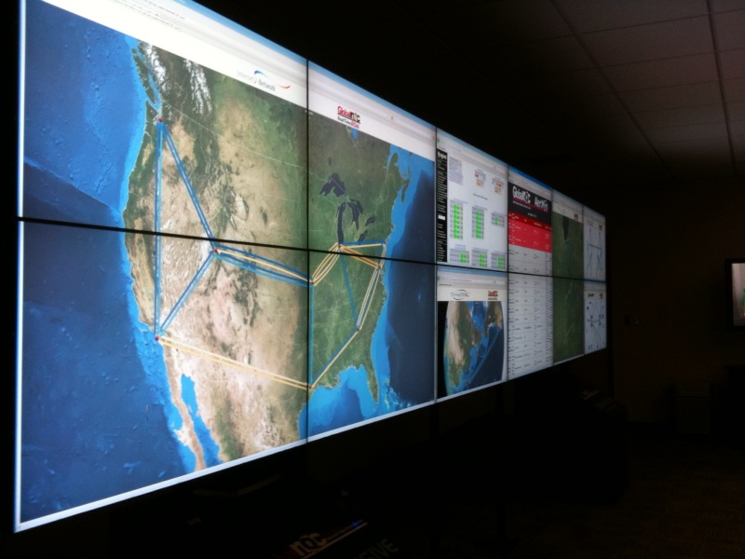
IU Research areas in a nutshell -- Security
Importance of security is obvious from discussion of Internet viruses and need to login to everything
Center CACR headed by Fred Cate of Law School has a policy emphasis
  Airport Security processes
  Implications of Cyber attacks on banks
  Privacy issues for Health records
CSC studies mathematical foundations and implications for networks and computers e.g.
  Viruses on cell phones
  Anonymizing networks
  Use of incidental information (e.g. size of message) to break security

Slide 38
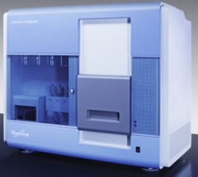
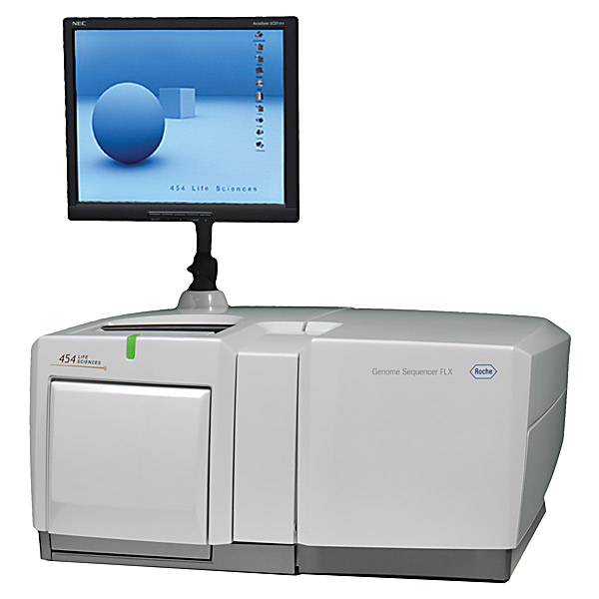
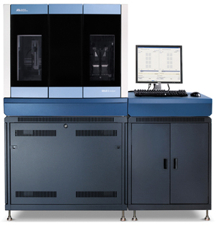

Bioinformatics
This is field that researches algorithms and processes to analyze biology data
Center for Genomics and Bioinformatics is centered in Biology and responsible for several machines that analyze biology data. (new generation of DNA sequencers)
School Bioinformatics faculty collaborate with biology and chemistry helping them draw conclusions from data
  Proteomics studies structure of proteins
  Text mining from Internet reports
  Metagenomics – studies of samples with many different genes present
  Linking genes to disease
  Study of gene sequence structure and methods to asemble fragments (produced by high throughput instruments) into full genes
Note computing applications in other sciences typically performed in discipline (see Cyberinfrastructure and HPC)
Illumina/Solexa Roche/454 Life Sciences Applied Biosystems/SOLiD
Internet
~300 million base pairs per day leading to
~3000 sequences per day per instrument
? 500 instruments at ~0.5M$ each
Read Alignment
Pairwise
clustering
Form block
Pairings
Sequence
alignment
Dissimilarity
Matrix
N(N-1)/2 values
Visualization
Plotviz
FASTA File
N Sequences
Blocking
MPI
MDS
MapReduce

Slide 39
Chemical Informatics
Cheminformatics studies small molecules that are used in areas such as Pharmaceutical Industry (chemical are drugs interacting selecting with biological compounds) or Energy where they are often catalysts
Indiana University studies interface between chemistry and Biology
  Often with Lilly – major state company
Algorithms to help identify chemicals that might be promising drugs (follow up with expensive experiments)
  PubChem has over 60 million compounds

Slide 40
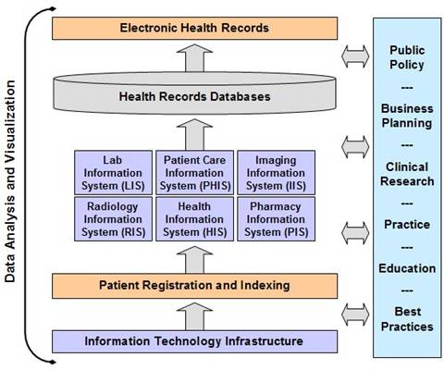
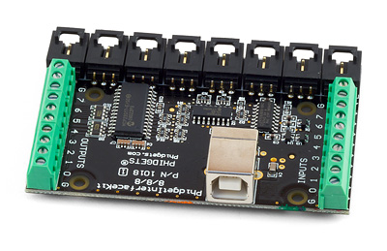
Health Informatics
Bioinformatics studies complex molecules; Cheminformatics studies smaller molecules; Health informatics studies medical information issues at level of people and populations (collections of people)
  All of these (plus study of imaging) can be called Medical Informatics
Ethos project looks at uses of devices to help elders manage their life and retain privacy
Studies of medical records – their management and structure
  Major efforts at IU Medical School Indianapolis
Epidemiology is the study of factors affecting the health and illness of populations

Slide 41
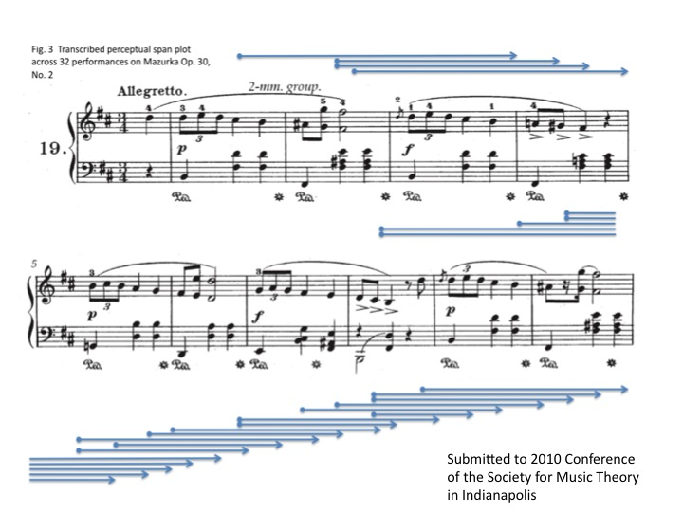
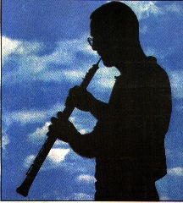
Music Informatics
Studies structure of music
Electronic generation of music
Crosses fields of Computer Science, Statistics, Acoustics, and Electronic Music
Techniques similar to Bioinformatics in that both fields use “data mining” extensively
Notes:
We present a novel method of measuring the perceptual present from performance timing data by reframing the question of the duration of the perceptual present to a related inquiry: at a given location in the piece, how many previous beats are sufficient to predict the duration of the current beat? We address this by building and testing probabilistic graphical models that include different ranges of pervious beats in predicting the current. We compute the likelihood for each model with timing data across all performers and perform statistical tests on each pair of those models to exclude those seem to arise by chance. We choose the model that has uncompromised predicting power but incorporates a smaller range of previous beats. A perceptual span plot across 32 performances on Mazurka Op. 30, No. 2 is shown as an example

Slide 42
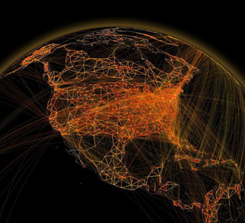
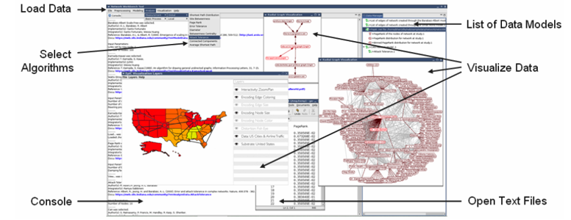
Complex Systems and Networks
Physics and Chemistry studies systems with known equations of motion (those from Newton, Einstein and Dirac)
There is a growing interest in systems that have no obvious equations
  Internet, transportation systems, stock market, biological systems as in collections of cells
And Epidemics such as H1N1 spread via movement of people especially by air (at long distance)
Web Science is the study of the socio-technical relationships that are implied by the Web. Understanding the Web involves not only an analysis of its architecture and applications, but also insight into how the dynamic interactions among people, organizations, policies, and economics are shaped by it and in turn affect its usage and evolution

Slide 43
TeraGrid Web of Science

Slide 44

Some Trends
  The Data Deluge is clear trend from Commercial (Amazon, e-commerce) , Community (Facebook, Search) and Scientific applications
  Light weight clients from smartphones, tablets to sensors
  Multicore reawakening parallel computing
  Exascale initiatives will continue drive to high end with a simulation orientation
  Clouds with cheaper, greener, easier to use IT for (some) applications
  New jobs associated with new curricula
    Clouds (15 million jobs)
    Data Analytics and Data Science (Important theme in academia and industry) (4 million jobs)
    Social Media, Network/Web Science – Life Style Informatics

Slide 45
Largely Informatics at IU
Security
Bioinformatics
Cheminformatics
Health Informatics
Music Informatics
Complex Networks and Systems
Human Computer Interaction Design
Social Informatics
Only last topic definitely not part of CS
Most security and all Bioinformatics faculty are in CS

Slide 46
Largely Applied Computer Science
Cyberinfrastructure and High Performance Computing
Data, Databases and Search
Image Processing/ Computer Vision
Ubiquitous Computing
Robotics
Visualization and Computer Graphics
These are fields you will find in many computer science departments but are focused on using computers

Slide 47
Largely Core Computer Science
Computer Architecture
Computer Networking
Programming Languages and Compilers
Artificial Intelligence, Artificial Life and Cognitive Science
Computation Theory and Logic
Quantum Computing
These are traditional important fields of Computer Science providing ideas and tools used in Informatics and Applied Computer Science

Slide 48
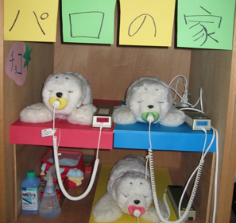
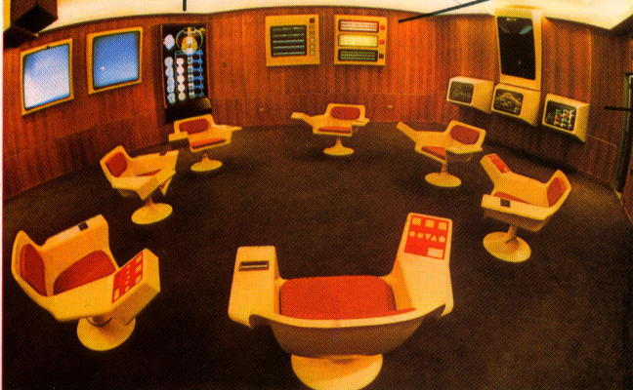
Social Informatics
Applications of Information Technology to Social Science OR application of Social Science to Information Technology
Can use different methodology to other parts of SOIC – gather data from interviewing people rather than machines (as in recording data from colliding particles at CERN accelerator)
Topics include social issues in scientific teams, role of information technology in government and how people interact with robots.
Notes:
Japanese toy robots (Selma)
This photo depicts the Cybersyn Opsroom - the control center envisioned by British cybernetician Stafford Beer and constructed in Santiago between 1971-1973.

Slide 49
Human Computer Interaction Design
Interactions of Information technology with people
Designing usable electronic products that do what you want e.g. control systems to encourage energy conservation
Theory behind virtual reality as in Interaction of people in Second Life and Gaming
Building usable software systems
Organization of Digital artifacts

Slide 50
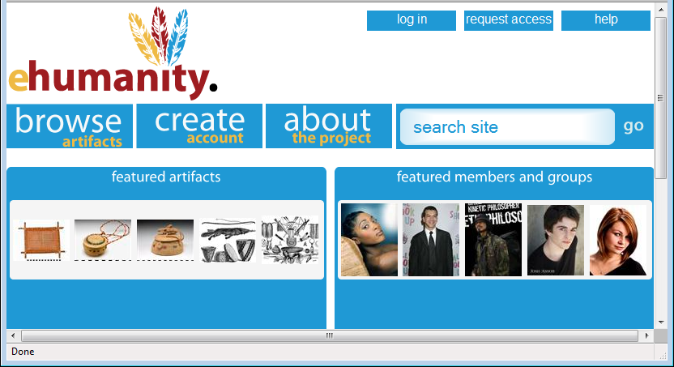
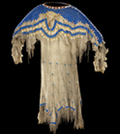
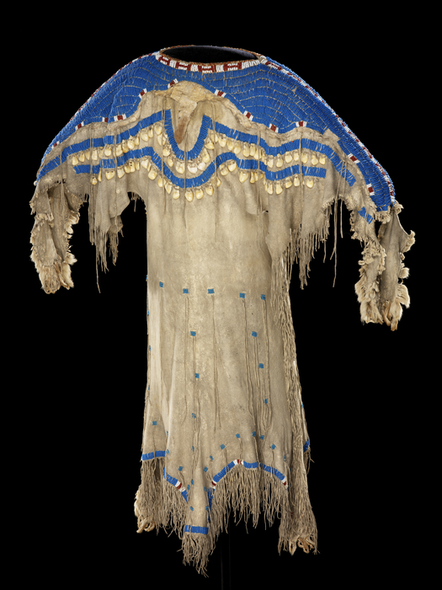














Girl's dress
e-Humanity
Culture/People:
Date Created: | circa 1850
Place: | South Dakota; USA (inferred)
Media/Materials: | Glass pony beads, deerhide/deerskin, elk tooth/teeth, wool cloth, sinew
Techniques: | Sewn, lazy/lane stitch beadwork
Collection History/ Provenance: | Collection history unknown; said to have been collected circa 1850; purchased by MAI in 1916 from an unknown source, possibly with funds donated by Mrs. George (Thea) Heye.
Dimensions: | 112 x 151 cm
Catalog Number: | 5/3776
Source: | National Museum of the American Indian
References: | http://en.wikipedia.org/wiki/Sioux
Return to Home
Sioux
Related Artifacts
Total: 2
Total: 5
beads blue dress
girl's dress long sinew
Sioux South Dakota
tan wool 1800’s
Comments / Ratings: 2
My grandmother has a dress just like this in her attic. 10.19.2009 9:38AM MST
I love this design. Where can I buy one? ☺ 10.18.2009 1:37PM MST
Average Rating:
(4.0/5.0)
Created by K. Wilson
Notes:
Feedback/Suggestions:

Slide 51
Cyberinfrastructure and
High Performance Computing
Generalizes to Computer Systems or Distributed Systems and can include Sensor nets
Cyberinfrastructure is worldwide electronic fabric supporting science research (such as simulate early universe) or development (stewardship of nuclear stockpile in era when testing forbidden – simulate aging of nuclear devices)
High Performance Computing includes algorithms and software for parallel computers where one could use 200,000 cores simultaneously
Collaborate with many application areas such as particle physics, weather and climate, polar science (melting of glaciers), earthquake forecasting as well as all areas of Medical Informatics
Indiana strong in this area with collaboration with UITS – the University Information Technology Support Organization as part of TeraGrid

Slide 52
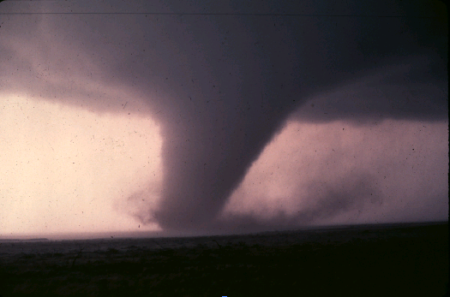
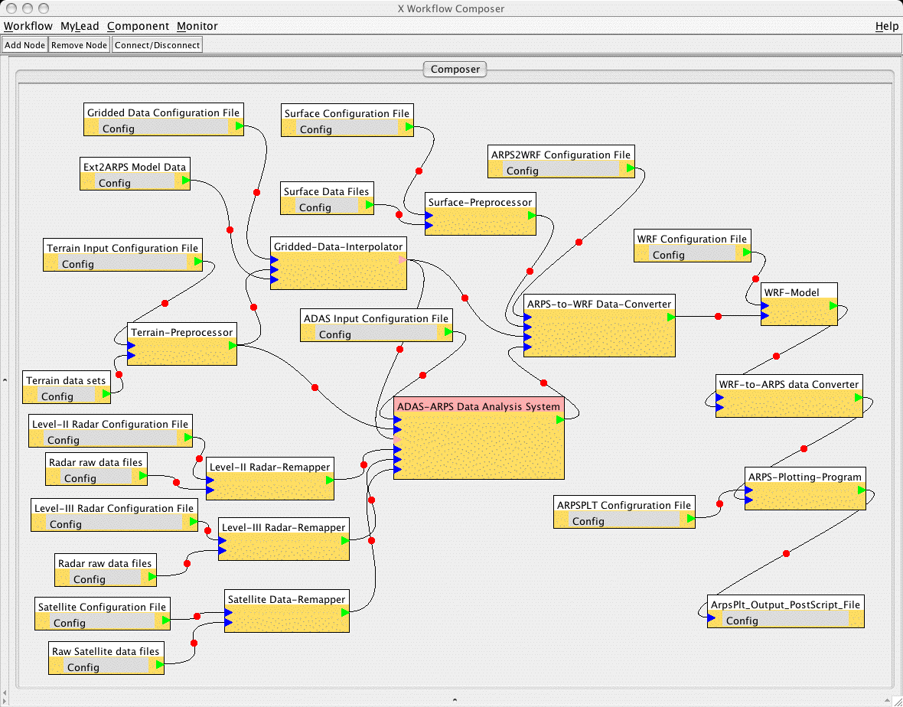
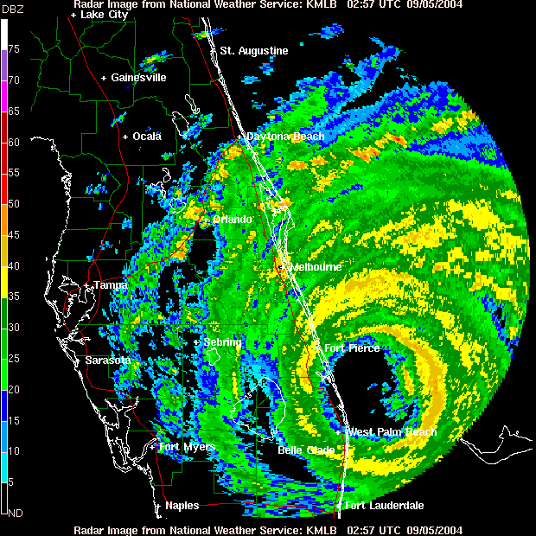
Data, Databases and Search
A striking feature of many areas is the “Data Deluge” where we see the Internet and data from scientific instruments increasing exponentially in size
http://research.microsoft.com/en-us/collaboration/fourthparadigm/
Bioinformatics and Cheminformatics “high throughput” devices illustrate data deluge
One needs to store , access and manage data (databases are large CS area) including adding metadata (data describing data)
One needs to “mine” data (machine learning, data mining ..)
One needs to query data (from indices) or search it in Google style

Slide 53
SS

Slide 54
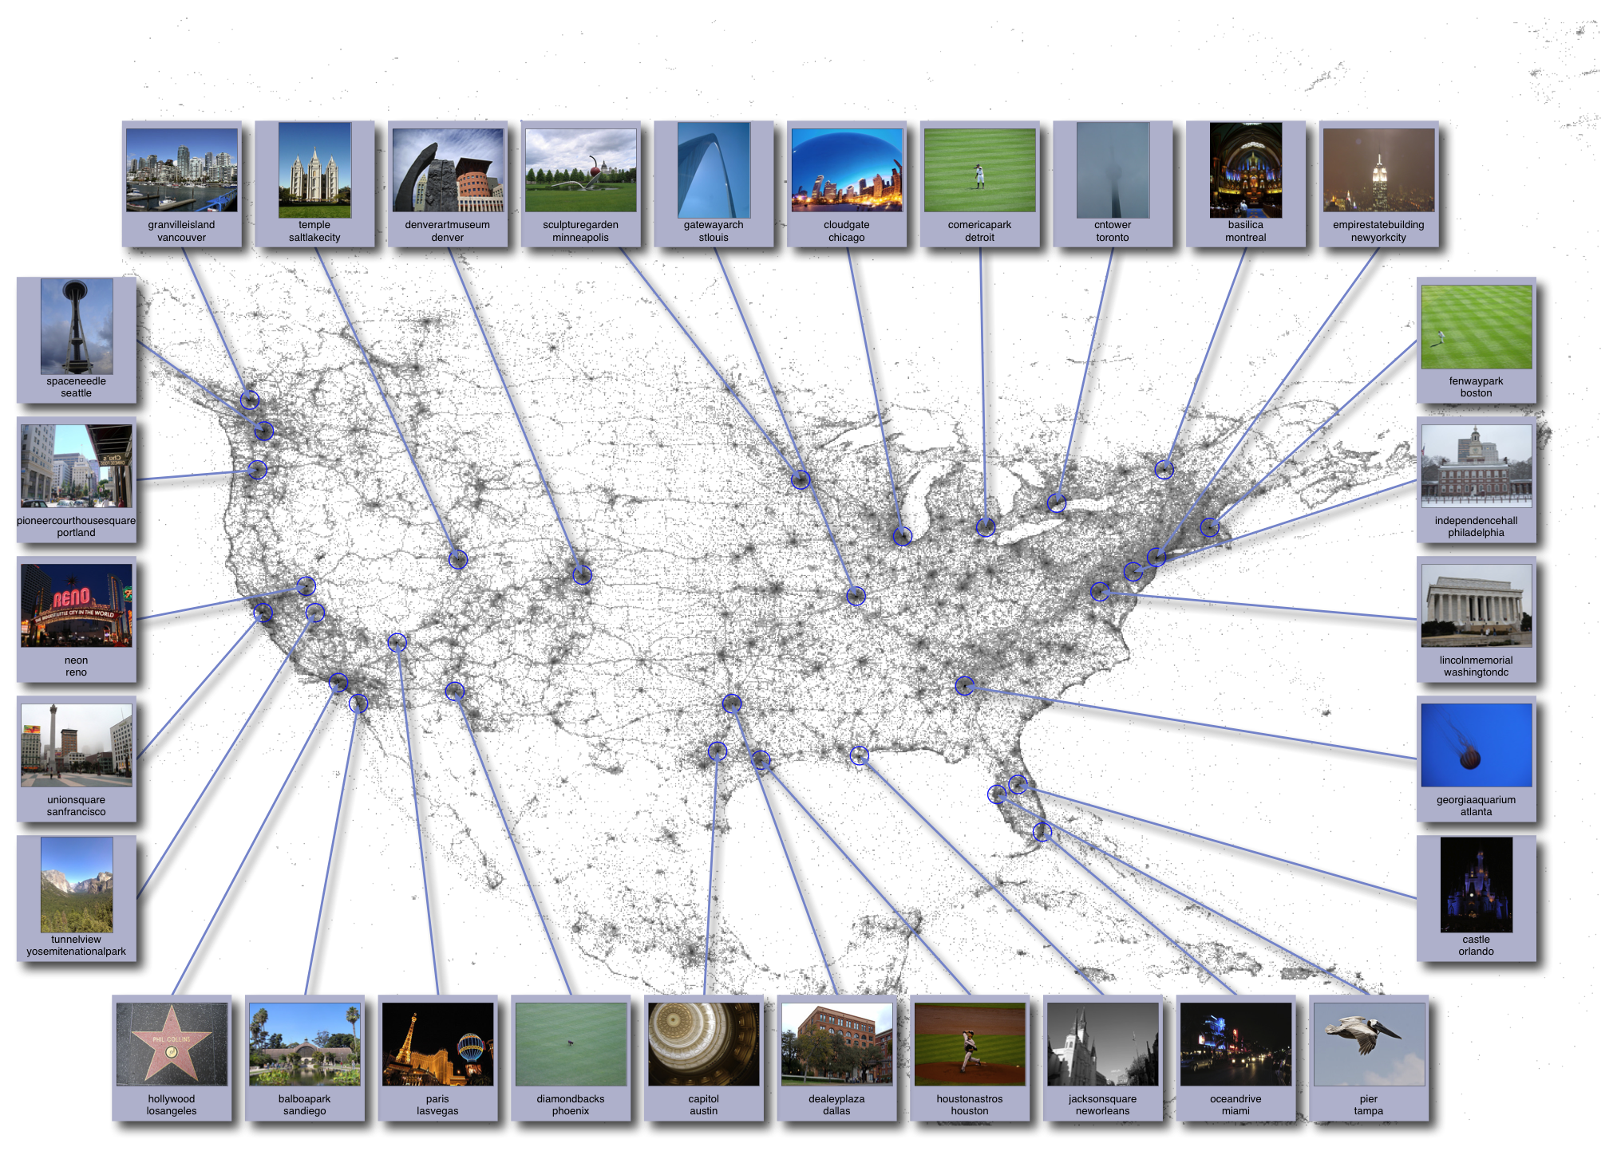
Image Analysis
http://www.cs.cornell.edu/~crandall/photomap/
Image processing has been a well studied area with classic studies from “handwriting recognition” “recognizing targets in military applications” and “robotic’ (interpret images to aid navigation)
The Internet with Flickr and Image search has re-invigorated field
First example from Crandall in SOIC is Organizing geo-tagged images from Flickr
Second example is automating determination of glacier beds

Slide 55
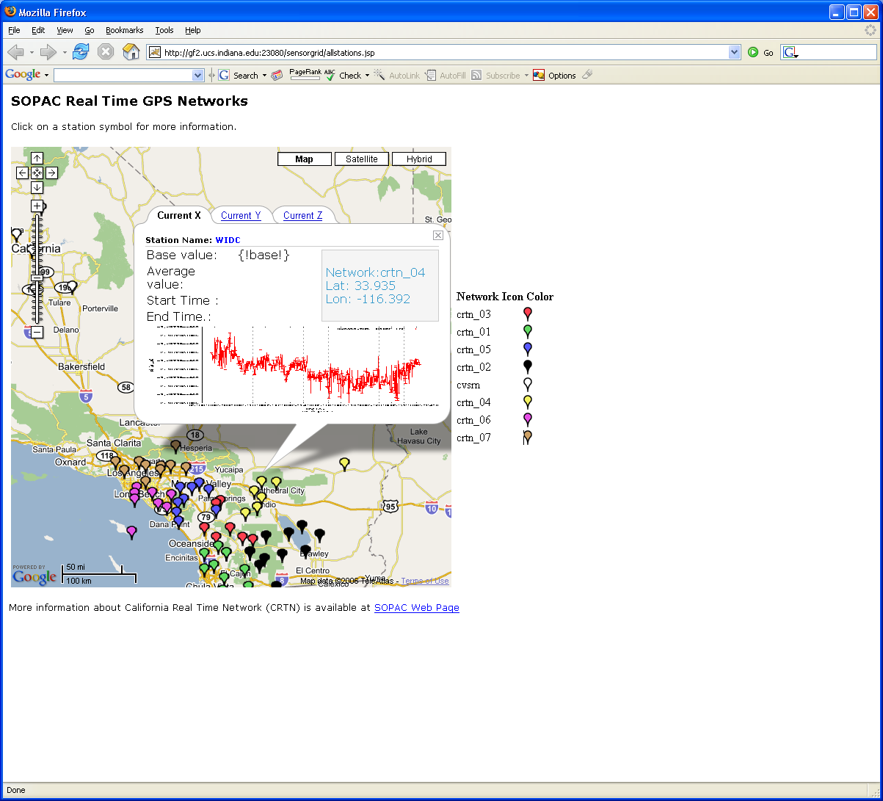
Ubiquitous Computing
As chips get smaller and cheaper, there are more and more entities with computers in them
  4.6 Billion cell phones at end of 2009
  24 billion devices on the Internet by 2020. Most will be small sensors that send streams of information into the cloud where it will be processed and integrated with other streams and turned into knowledge that will help our lives in a multitude of small and big ways.
You can sprinkle your home and indeed your body with devices
  Ubiquitous City project in Korea studies implications of this trend including needed Cyberinfrastructure
Health Science advances from devices on body
Earthquake forecasting uses network of GPS and Seismic sensors

Slide 56

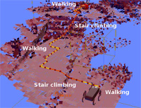
Robotics
This is study of computer controlled “machines” such as
  Vehicles (say on Mars) or human-formed robots
  Surgical instruments
Involves areas such as image processing to disentangle what Robot sees and “artificial intelligence” to make decisions
Interactions between Humans and Robots
  Natural Language understanding
  How do humans react to robots rather than people!
  Clouds are intelligence for robots

Slide 57

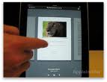
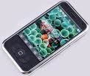








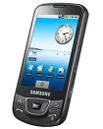










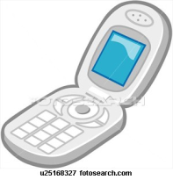
Sensors as a Service
Cell phones are important sensor/Collaborative device
Other Services
Sensors as a Service
Clients
Sensor Processing as a Service (MapReduce)

Slide 58
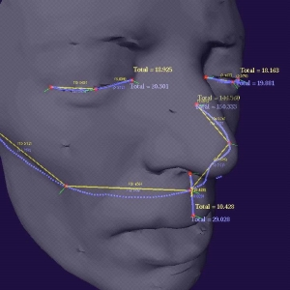
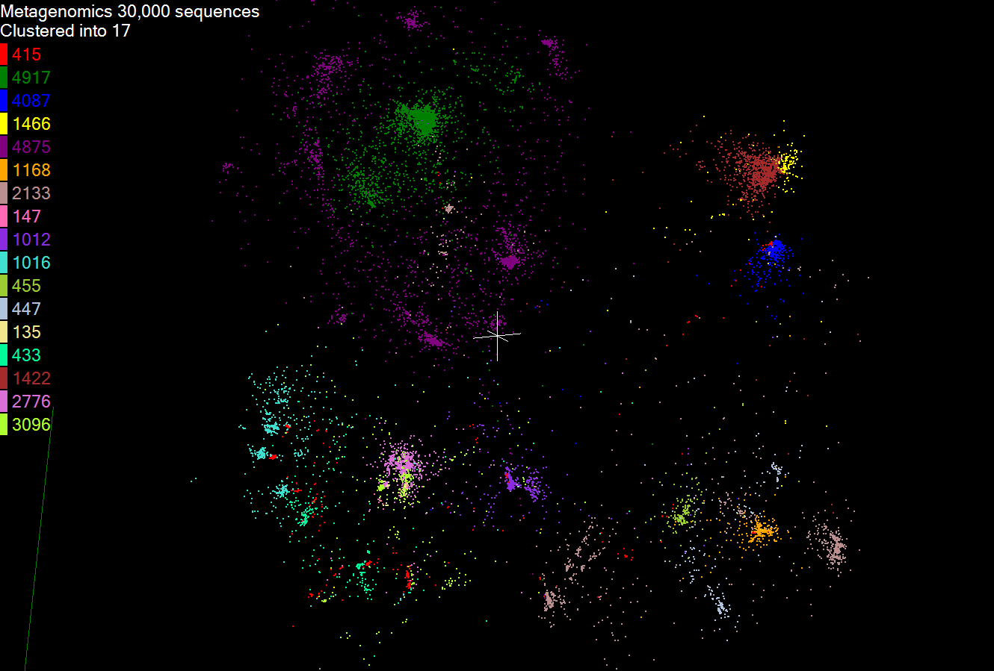
Visualization and Computer Graphics
Computer Graphics underlies gaming and Pixar movies and involves visualizing computer constructed objects/scenes
  Elegant theory of lighting
  This is very compute intensive and uses farms of computers
Visualization more broadly is trying to add power of human eye to increase discovery
  Many challenges when one is looking at something not easily mapped to 2D screen (such as a three dimensional flow of plasma at center of universe)
  Mapping abstract data (“information visualization”) such as genes that are lists of base pairs
  Interesting devices include 3D glasses and sophisticated environments such as caves

Slide 59
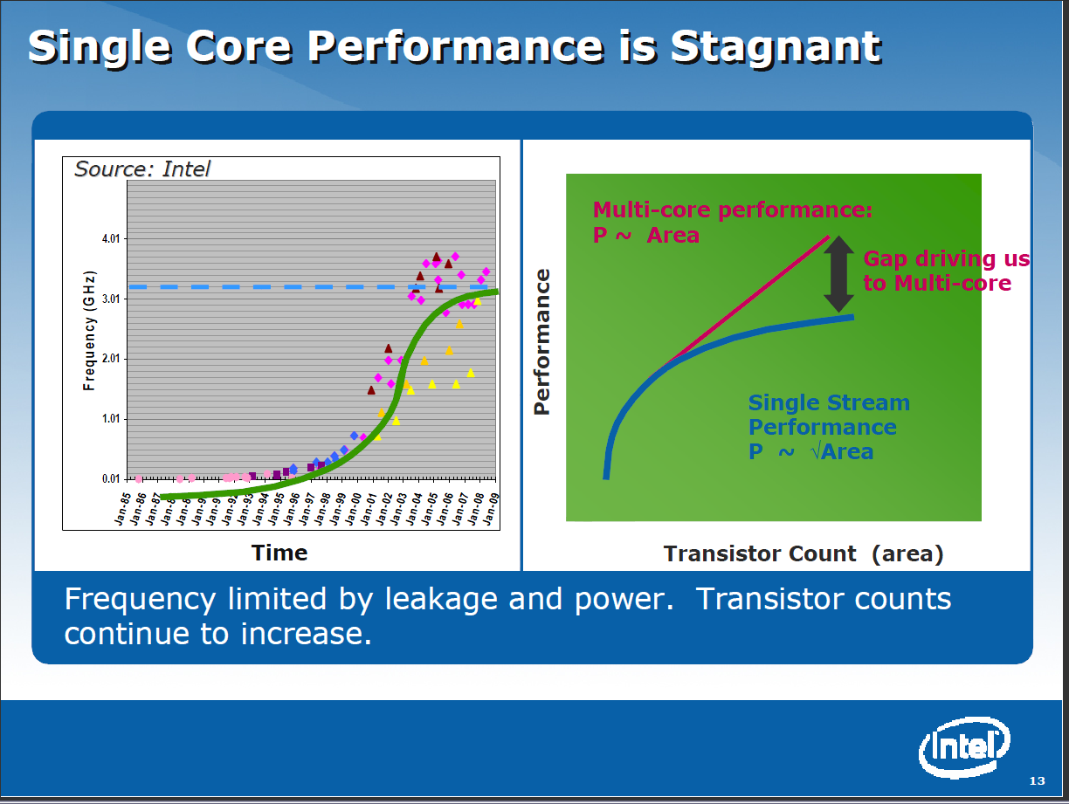
Computer Architecture
This field studies designs of computer and in particular the CPU
This field has tended to move from universities to industry as chips have become complicated and the infrastructure to produce them so expensive.
There is still a lot of innovation with discussion of number of cores in a single chip – this is 4-8 for mainline Intel/AMD chips but GPU’s have an order of magnitude more
Other specializations interesting including those for particular languages such as Scheme

Slide 60

Computer Networking
Computer hardware studies the computers; computer networking their links; Cyberinfrastructure/Computer systems the software on top of computer hardware and networking
New Internet architecture design – the current approach will not have enough addresses as we get flood of small devices connected to internet
Performance analysis of IPSec and optimizations (network message protocol)
Link clients to clouds via networks (fast)
Several areas on intersection of networking and security
  Distributed reputation systems
  DNS configuration and security
  Malware in peer-to-peer
  applications
  Prevention of IP source address
  forgery (IP Spoofing)
  Routing and trust
  Network security for mobile devices

Slide 61

Programming Languages and Compilers
This studies the expression of a problem to put on a computer (Language) and the conversion of this Language into machine executable form (Compilers)
There are many styles of Languages and different compiler challenges (such as targeting parallel computers)
Some languages address subsets of
problems (The Internet, Physics)
Indiana University pioneers in Scheme
Language and aspects of parallel
computing
  Compilers need “run-time” to support
  code execution (as OpenMPI for parallelism)

Slide 62
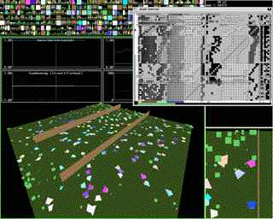
Artificial Intelligence, Artificial Life and Cognitive Science
Here are areas that look at developing computing systems that “think” i.e. make decisions similar to humans
Some model how people work together and others how brains (many neurons) function
Cognitive science is the interdisciplinary study of mind and the nature of intelligence. Centered in College of Arts and Science with strong School of Informatics and Computing collaboration
  error-making, creative translation, scientific discovery, musical composition, the comprehension and invention of jokes, the nature of sexist language and default imagery, philosophy of mind, and foundations of artificial intelligence

Slide 63
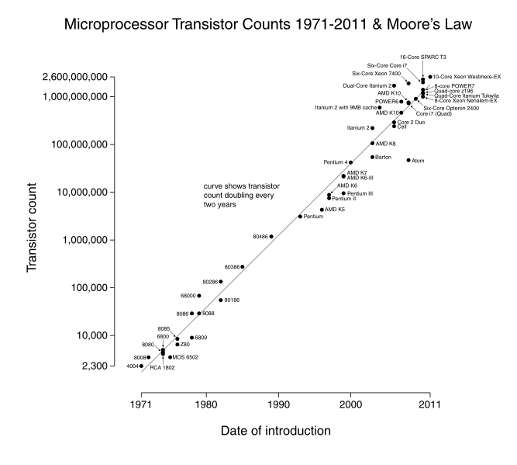
Computation Theory and Logic
Quantum Computing
Validation and Design of imperative, declarative, and object-oriented programs
Program feasibility certification
Non-classical logics and their computational contents
Models of information and computation
Computational and mathematical foundations of linguistics
New logical paradigms (e.g. visual, parallel, hybrid) that transcend traditional sequential and symbolic formalisms
Successor of Moore’s law – Quantum and DNA computing

Slide 64
Some key aspects of “Research”
Becoming a researcher; Identifying and applying to graduate school; what jobs are there – industry, university, national laboratory
What is and isn’t Research (Research v Development)
Is your research novel?
Identification and elaboration of research topics
Methodologies of (scientific) study
Identification of “state of the art”
Mentoring, (Long term) Collaboration …
Patience and Hard work
Ethics, acknowledgements
(Multimedia) presentation of results from “PowerPoints” to posters/movies and papers

Slide 65
Short Motivation
I did research as an undergraduate each summer
It not only interested me in Science but inspired an interest in computers which at time had little coverage in courses – they were very mathematical
My first summer, I learnt Fortran and carried programs for Crystallography research group back and forth between Cambridge and London each day
Led to my first paper: Fox, G. C. and Holmes, K. C. ``An Alternative Method of Solving the Layer Scaling Equations of Hamilton, Rollett, and Sparks,'' Acta Cryst. 20, 886 (1966).
This model – do something modest in an exciting research area – is still a good way to get started

Slide 66
Some key aspects of “Research”
Becoming a researcher; Identifying and applying to graduate school; what jobs are there – industry, university, national laboratory
What is and isn’t Research (Research v Development)
Is your research novel?
Identification and elaboration of research topics
Methodologies of (scientific) study
Identification of “state of the art”
Mentoring, (Long term) Collaboration …
Patience and Hard work
Ethics, acknowledgements
(Multimedia) presentation of results from “PowerPoints” to posters/movies and papers

Slide 67
Short Motivation
I did research as an undergraduate each summer
It not only interested me in Science but inspired an interest in computers which at time had little coverage in courses – they were very mathematical
My first summer, I learnt Fortran and carried programs for Crystallography research group back and forth between Cambridge and London each day
Led to my first paper: Fox, G. C. and Holmes, K. C. ``An Alternative Method of Solving the Layer Scaling Equations of Hamilton, Rollett, and Sparks,'' Acta Cryst. 20, 886 (1966).
This model – do something modest in an exciting research area – is still a good way to get started
Informatics and Computing School can help you with such “Research Experiences for Undergraduates”

Slide 68
Implementation
Summer REU opportunities (Research Experience for Undergraduates)
  Official NSF REU Sites – typically 10-20 students per year – each site has a focus and advertise nationally http://www.nsf.gov/crssprgm/reu/reu_search.cfm
  Supplements to NSF grants – typically 1 or 2 students per grant (per faculty member) and advertise locally
  CRA http://cra-ccc.org/ugresearchopps/
E.g. I am part of a NSF REU Site in Cyberinfrastructure for Polar Science and usually have REU supplement for FutureGrid NSF grant
Summer REU’s pay modest salary and travel
Academic year Research opportunities
  AY version of Summer opportunities
  Independent Study with faculty (credit not money)
  Maureen Biggers Program in SOIC

Slide 69
Approaches
Undergraduate Student does either/or Software, Paper Reading, Hardware, Algorithm work
Undergraduate Student works directly with faculty
Undergraduate Student work as a team (2-4 students) supervised by faculty, staff, graduate student
Graduate students (or staff) can give more personal interaction
Note need to preserve faculty link as recommendations typically must to come from faculty
  School had difficulty recently in nominating students for awards as some excellent research had no clear faculty to give recommendation

Slide 70
Things students can learn
Of course what is research and a new deeper interest in computer science
A commitment to (or against!) a research career
How to apply to graduate school
How to do a Poster/Presentation
Writing a paper/proposal
How to learn from research supervisor
Choosing a research topic
Ethics, Acknowledgements and dealing with related work
Working in a team
Experience that helps with job (interview)

