Slide 1
Development Workshop: Poster Design and Critiques
Maureen Biggers
Indiana University School of Informatics and Computing
NSF DUE-0920300; CNS 0837556

Slide 2
TARGETED SKILLS
Focus on poster design and content
Preparing a critique
Providing constructive feedback
Notes:
Ann
Include:
Practice being in an ARG
Understand the difference between an ARG and a traditional
research group.

Slide 3
Posters serve as….
An advertisement of your hard work
Stimulate interest and discussion
Receive feedback on research
Generate contacts
Kool, wow!, check
this out!,

Slide 4
First, you tell us!
Form mixed groups of 5, ensuring that at least one person has created a poster in the past
Assign roles
- Recorder
- Timekeeper
- Facilitator
- Presenter

Slide 5
FIRST STEPS
Task:
1: Identify the major components of a poster.
2: Establish and record criteria for evaluating a poster.
Time: 10 minutes
Presenter Reports

Slide 6
Questions a Poster Answers
What’s the research question?
Why is this question important?
What strategy is used?
What are the results?
Why are these results unique/important?
How does this relate to other research?
What comes next?

Slide 7
Step One:
Determine contents (not layout)
Title
Answer to research question
Method
Results
Images
Charts
Conclusion
Sources
Acknowledgements

Slide 8
Design
Dimensions
Balance
Text
Charts
Color
Order of Information
Software

Slide 9
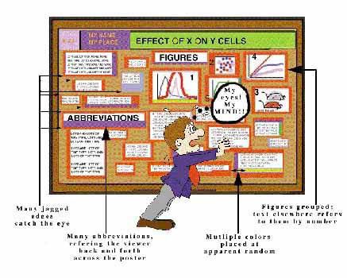
Easy for Eye to Follow
Utter chaos will make folks dizzy!

Slide 10
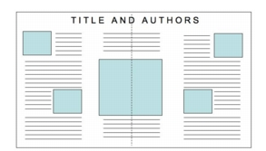
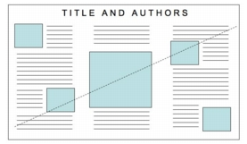
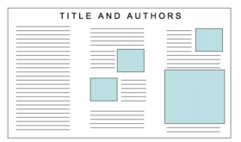
Balance
http://www.ncsu.edu/project/posters/NewSite/CreatePosterLayout.html

Slide 11
Poster Layout
Sketch your layout before you start
Title
Intro
Conclusion

Slide 12
It’s just an illustrated abstract

Slide 13
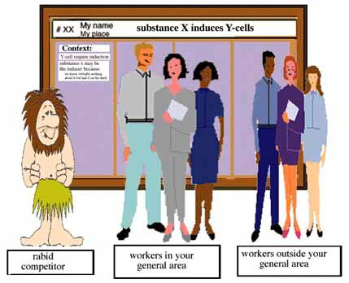
Who is My Audience??

Slide 14
Your Poster Title: think BIG! Really BIG!!
Your Biggest Impact! Boldface, not all caps

Slide 15
Put most important part first!
Short and to the point
Upper left hand corner

Slide 16
Avoid red-green combinations; many are color blind
Be consistent

Slide 18
Text
Minimize use – think VISUAL
Bulleted lists preferred over paragraphs
Should be readable from 1-2 m (3-6 ft)
Organize in blocks
Columns help organize the organization
Limit to 500-800 words maximum
Leave empty space and include graphics
Left align text
Some poster 'experts' suggest that if there is about 25% text, 40% graphics and 35% empty space, you are doing well.

Slide 19
Text Sizes:
Title: 85pt
Authors: 56pt
Sub-headings:36pt
Body Text: 24pt
Captions: 18pt

Slide 20
Preparing the critique

Slide 21
OVERVIEW OF CONSTRUCTIVE FEEDBACK
Give both positive and constructive feedback
Critique the product and not the person
Avoid labels
Avoid exaggeration
Restrict to things you know for certain
Be descriptive

Slide 22
POSTER CRITIQUE
Roles
Recorder
Checker 1: provide constructive feedback
Checker 2: ensure agreement from the group
Task
Get poster assignment.
Critique the poster using your criteria.
Come to agreement on the critique.
Time: 10 minutes

Slide 23
http://www.cns.cornell.edu/documents/ScientificPosters.pdf
http://www.kumc.edu/SAH/OTEd/jradel/Poster_Presentations/110.html
http://www.mitacs.ca/AC2005/index.php?section=tips
http://www.siam.org/siamnews/general/poster.htm
http://www.acm.org/crossroads/xrds3-2/posters.html

Slide 24
One MinUte Paper
What unanswered question do you have about research posters?
Any feedback about the design of this particular class session? What went well; what might you change next time??

