Slide 1
I399 Research Methods for Informatics and Computing
B: Typical Research Problem
Geoffrey Fox
gcf@indiana.edu
http://www.infomall.org/I399
Associate Dean for Research and Graduate Studies, School of Informatics and Computing
Indiana University Bloomington
Director, Digital Science Center, Pervasive Technology Institute

Slide 2
Grading Philosophy
Weekly Homework – total 25%
Midterm (report on progress) – total 25%
Final Project Report/presentation – total 50%
Grader Xinjun Zhang hsingjun.cheung@gmail.com
All material will be on Oncourse later today

Slide 3
Assignment 1: I399 Research Methods for Informatics and Computing
Due Wednesday January 20 Midnight
1) Choose top 5 Research Topics (list in order of preference) chosen from those at http://www.infomall.org/I399/SOICResearch.html
2) Summarize some areas/research topic(s) of interest to you based on information found on Internet
3) If you have done Undergraduate Research already and have summaries you are willing to share, please upload these

Slide 4
Finding Basic Areas
I have a list of Undergraduate Research areas in Security and aspects of Cyberinfrastructure
We need to persuade School to add more such topics!
We have sample posters from previous undergraduate projects

Slide 5
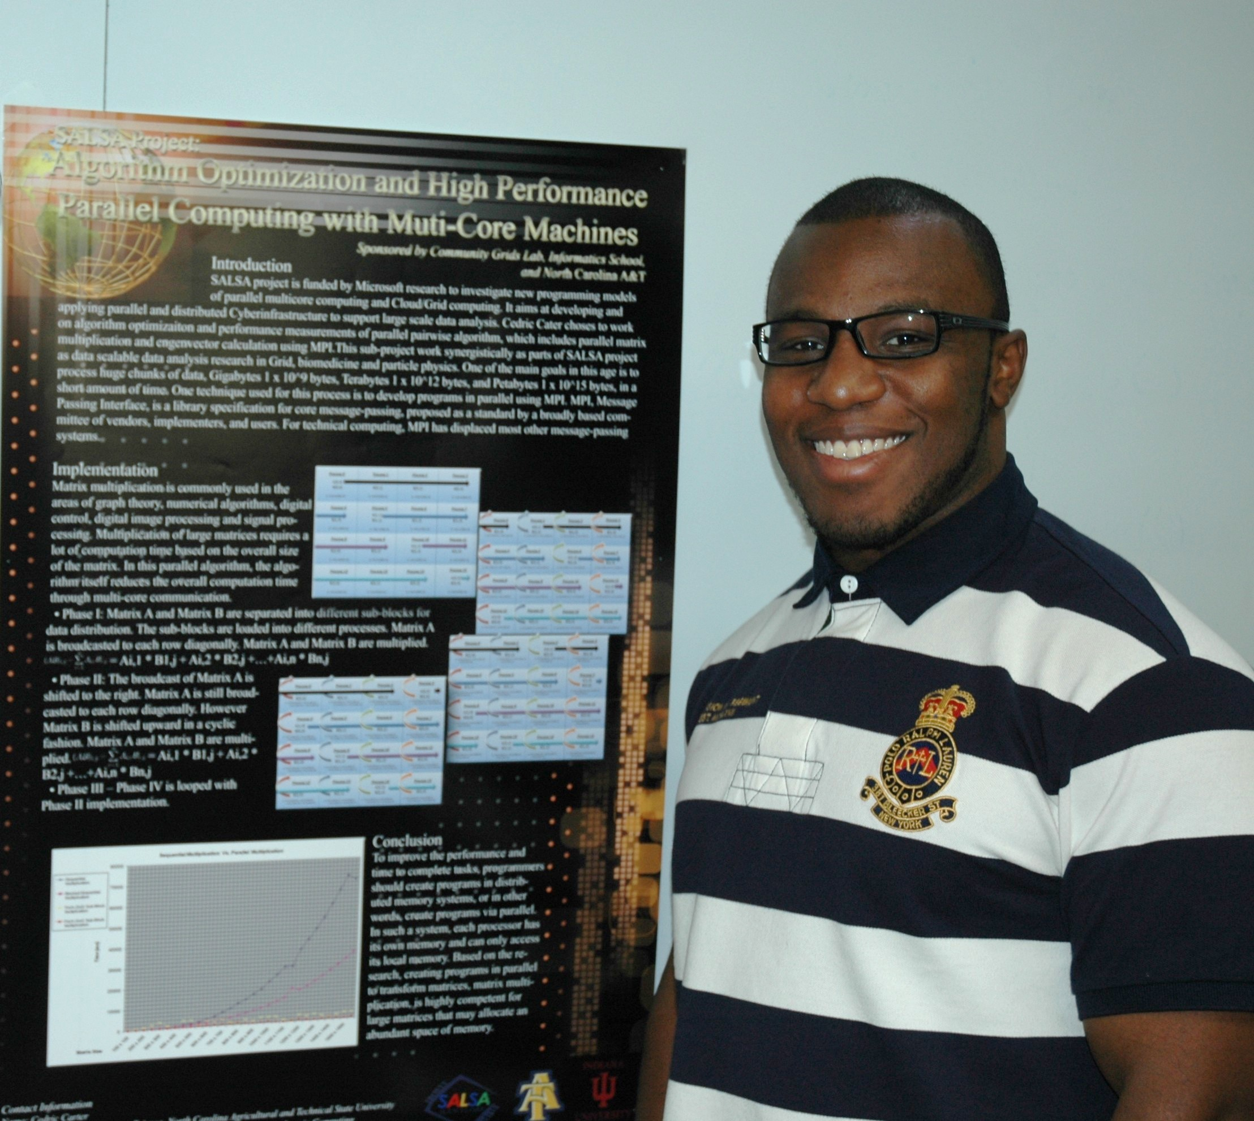
Cedric and Algorithm Optimization and High Performance Parallel Computing with Multi-Core machines

Slide 6
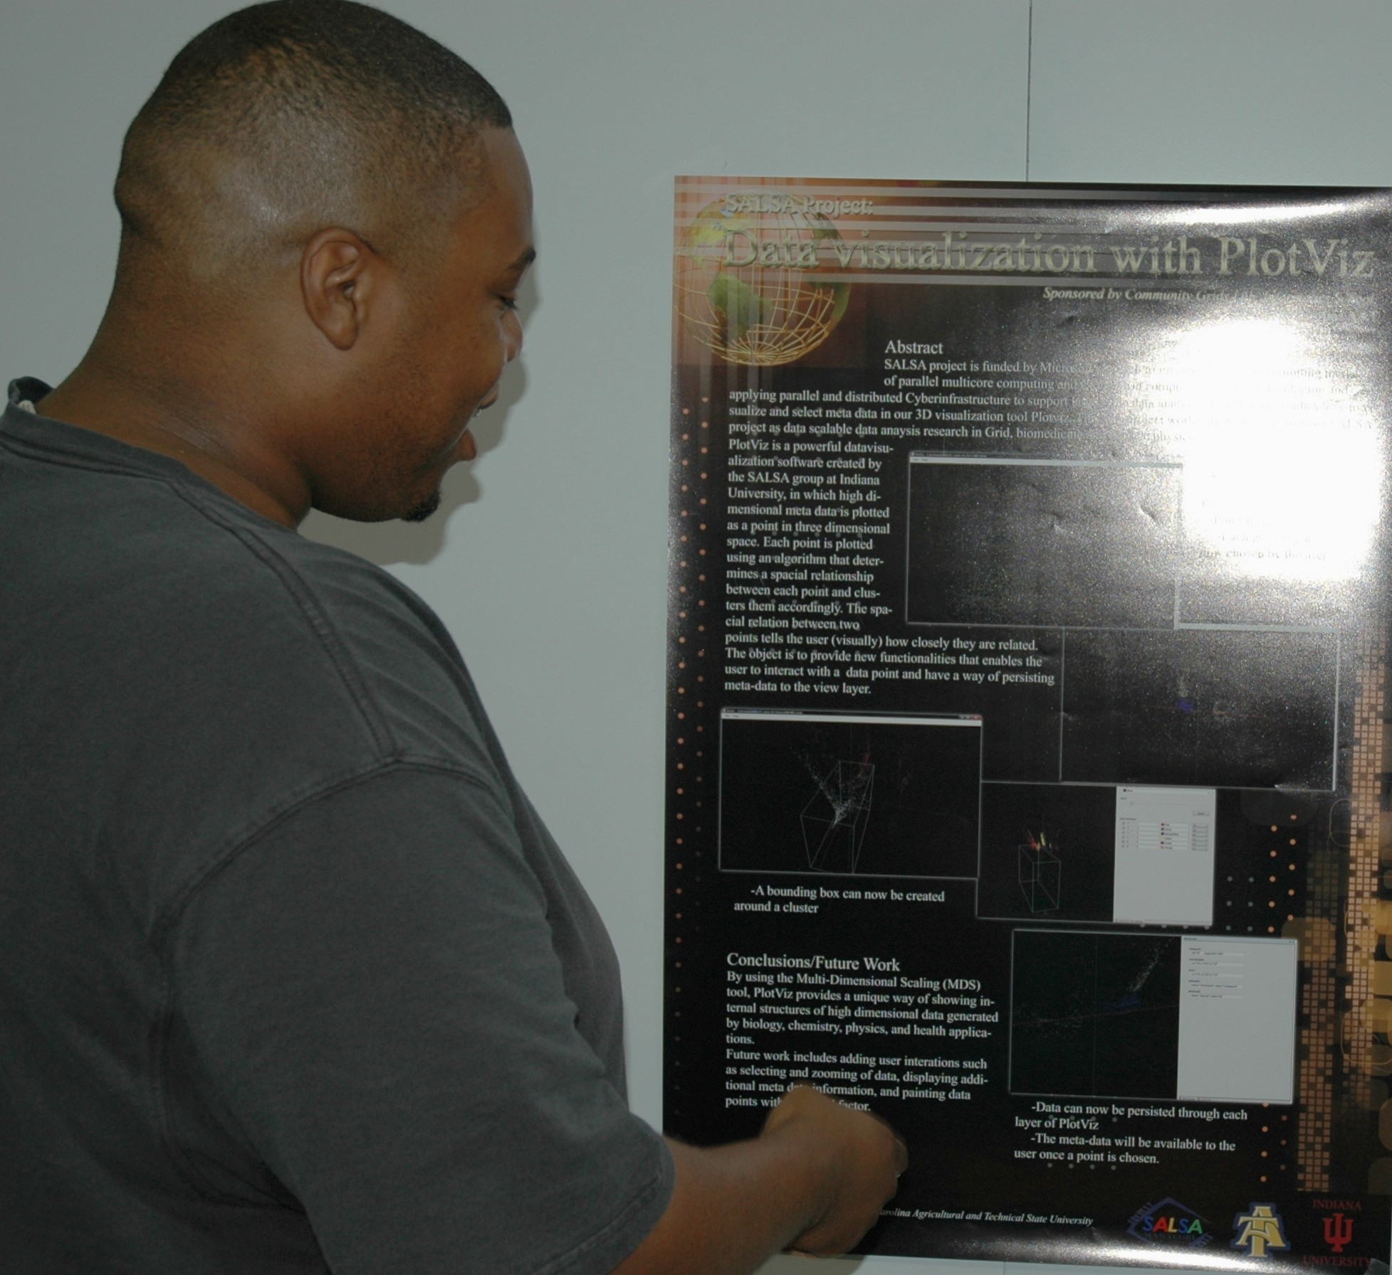
Tim and Data (genome sequences) Visualization with Plotviz

Slide 7
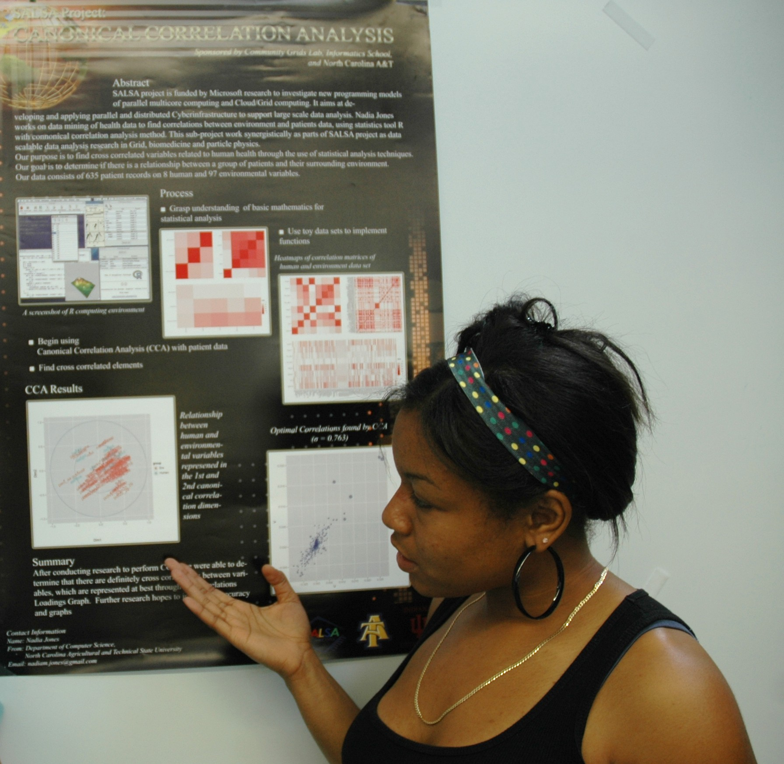
Nadia and “Canonical Correlation Analysis” – statistical analysis correlating data on obesity with where they live and environmental information

Slide 8
Security Topics
Net Trust
Health Security Informatics
Genome Privacy
Wireless Security @Home
Security and Privacy in Cloud and Web
Smartphone Security
Risk Communication
Elder and Caregiver Support
Improving Safety of Web Browsing
Privacy in Peer-to-Peer and Social Networks
Privacy Enhanced Online Human Subjects Data Collection

Slide 9
Sample Topic Description
Security and Clouds
Going to Security web site, we find at http://www.informatics.indiana.edu/xw7/, papers such “Peeping Tom in the Neighborhood: Keystroke Eavesdropping on Multi-user Systems” on dangers of eavesdropping on seemingly secure actions
  Looking at size of response to a query
  Looking at system calls in response to keystrokes
Going to Community Grids Laboratory web site we find many papers and presentations on clouds
  http://grids.ucs.indiana.edu/ptliupages/publications
  http://grids.ucs.indiana.edu/ptliupages/presentations
  Take presentation as “higher level” http://grids.ucs.indiana.edu/ptliupages/presentations/ISGADec10-09.pptx
Putting them together, we find new research topic “Security issues” in Clouds

Slide 10
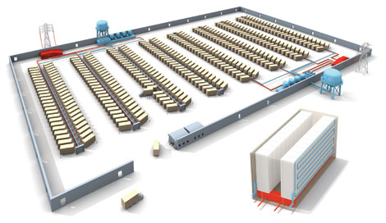
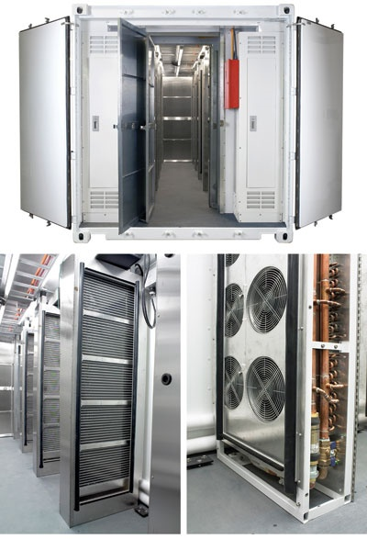
Clouds as Cost Effective Data Centers
Builds giant data centers with 100,000’s of computers; ~ 200
-1000 to a shipping container with Internet access
“Microsoft will cram between 150 and 220 shipping containers filled with data center gear into a new 500,000 square foot Chicago facility. This move marks the most significant, public use of the shipping container systems popularized by the likes of Sun Microsystems and Rackable Systems to date.”

Slide 11
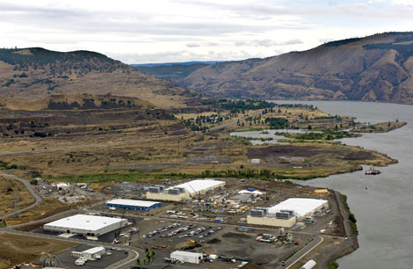
Clouds hide Complexity
SaaS: Software as a Service
IaaS: Infrastructure as a Service or HaaS: Hardware as a Service – get your computer time with a credit card and with a Web interaface
PaaS: Platform as a Service is IaaS plus core software capabilities on which you build SaaS
Cyberinfrastructure is “Research as a Service”
SensaaS is Sensors as a Service
2 Google warehouses of computers on the banks of the Columbia River, in The Dalles, Oregon
Such centers use 20MW-200MW
(Future) each
150 watts per core
Save money from large size, positioning with cheap power and access with Internet

Slide 12
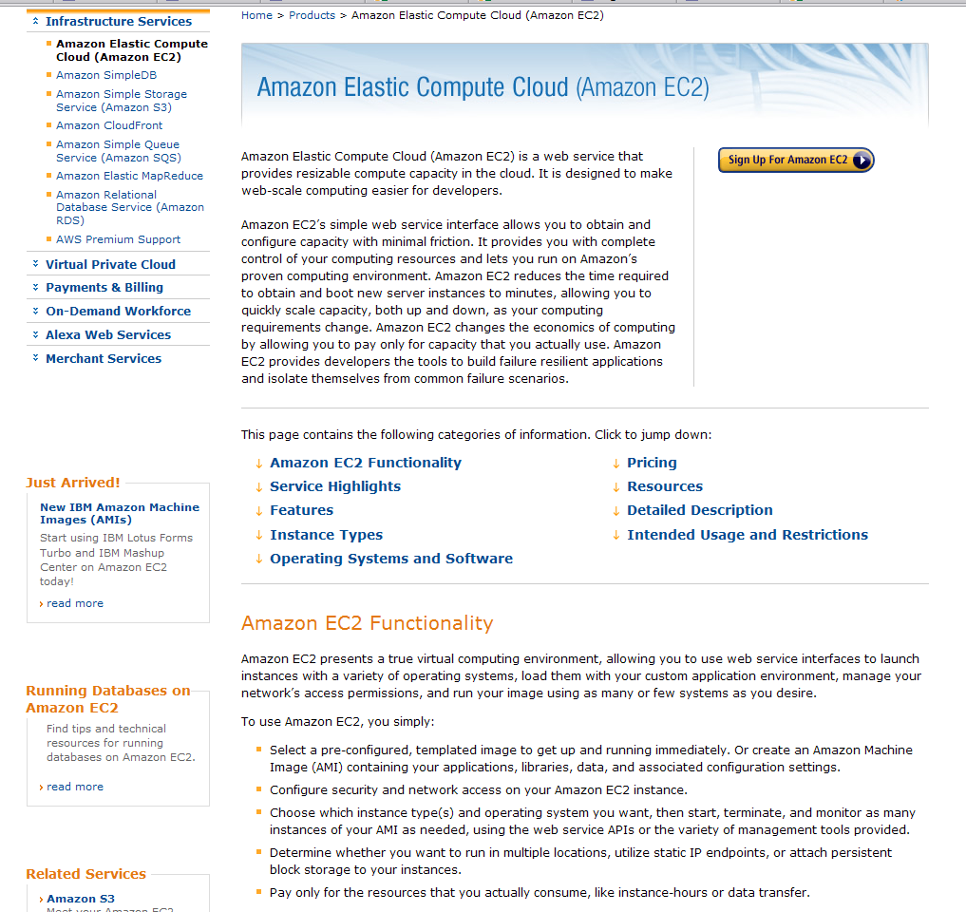

Slide 13
Philosophy of Clouds and Grids
Clouds are (by definition) commercially supported approach to large scale computing
  So we should expect Clouds to replace Compute Grids
  Current Grid technology involves “non-commercial” software solutions which are hard to evolve/sustain
  Maybe Clouds ~4% IT expenditure 2008 growing to 14% in 2012 (IDC Estimate)
Public Clouds are broadly accessible resources like Amazon and Microsoft Azure – powerful but not easy to optimize and perhaps data trust/privacy issues
Private Clouds run similar software and mechanisms but on “your own computers”
Services still are correct architecture with either REST (Web 2.0) or Web Services

Slide 14
Security and Clouds
Clouds consolidate computing in mammoth remote cost effective sites
  Used by Industry and Defense where security critical
But that means that programs from different organizations are running in same machine
  One of these programs could be an evil one snooping on other programs and data
Traditional security measures do not address “incidental effects reveal data on program”
  For example knowing that a Pharmaceutical company is sending queries about a particular chemical could be valuable to other drug companies
Research can identify problems and look at ways to address
  E.g. do not use packets of “correct” size – add junk

Slide 15
The 4 Major Research Methodologies
Theory: generate a “fundamental” description of problem and use it to make testable predictions
Experiment/Observation: Design thoughtful set of measurements and use to either compare to a theory or generate interesting deductions
Simulation: develop a compute based realization of a theory (Fundamental) or model (phenomenological) and use it to compare with existing observations and predict future measurements
Data Analysis: Take existing measurements – often from multiple experiments – and analyze to find new features or again to compare with Theory or Simulation

Slide 16
Example of Methodologies: Earthquake Forecasting I
Lets go to Quakesim web site http://quakesim.jpl.nasa.gov/
Earthquakes are caused by sudden slipping of plates that meet at faults e.g.
  “In California there are 2 plates: the Pacific Plate and the North American Plate. The Pacific Plate consists of most of the Pacific Ocean floor and the California Coast line. The North American Plate comprises most the North American Continent and parts of the Atlantic Ocean floor. These primary boundary between these 2 plates is the San Andreas fault. The San Andreas fault is more than 650 miles long and extends to depths of at least 10 miles.”
A theory could involve hypothesis as to nature of friction between plates – either “first principles/fundamental” (hard as don’t know enough about make up of plates) or a model
  Other (easier) theories allow one to predict ground movement after a quake
A simulation could allow prediction of such theories
  Involves converting theory to a form a computer stands – convert “differential equations” into a numerical form describing motion of earth or particles into something that can be efficiently run on computer
  Then you need to write software to implement numerical form
  Then you need to visualize results

Slide 17
Example of Methodologies: Earthquake Forecasting II
There are some problems where you can derive a theory to completely describe it
  This is characteristic of “old areas” as one didn’t have computers then
  Such as “Newton’s Laws” Force = Mass x Acceleration
There are some problems where you can derive a good theory but you need to rely on a simulation to derive consequences
  Computational Chemistry
  Predicting consequences of Earthquakes
There are some problems where there are only partial theories and no realistic simulation to reliably predict consequences
  Predicting occurrence of Earthquakes
  Nuclear Physics
  Stock Market
  “Life”
  The importance of these areas motivates “Complex Systems Research”

Slide 18
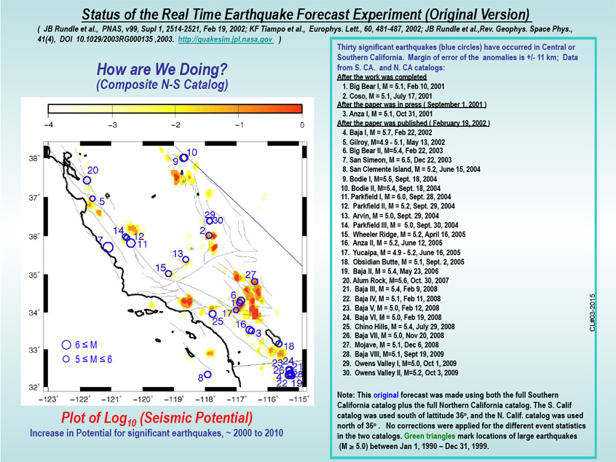
Earthquake Forecasting II
Datamining of existing earthquakes based on empirical theory checked by simulation
Other simulations could build on those that predict shaking to predict consequences on buildings with particular construction characteristics
  Why California safer than Haiti or Sichuan China hit by 7.9-magnitude quake in 2008
Experiments cover many areas
  Measurement of epicenter and scale (7.0 in Haiti) that relates to classification (theory/data analysis) introduced by Richter
  Designing Satellites such as DESDynl that will take large amounts of data (in this case InSAR) that can help forecast earthquakes
Data Analysis could involve correlating small quakes with large quakes as at http://quakesim.jpl.nasa.gov/scorecard.html

Slide 19
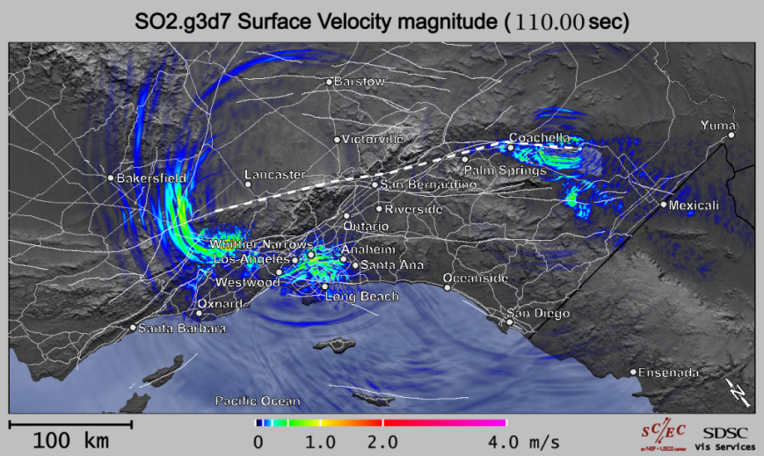
Simulation of Earth Movement
http://www.cs.indiana.edu/~jbollen/tera/
Combine with a model of response of building to shaking to derive consequences of Earthquake

Slide 20
Map of Journals and High end Computing
There is no theory or simulation here
It is pure data mining
See http://www.cs.indiana.edu/~jbollen/tera/

Slide 21
All the Journals

Slide 23
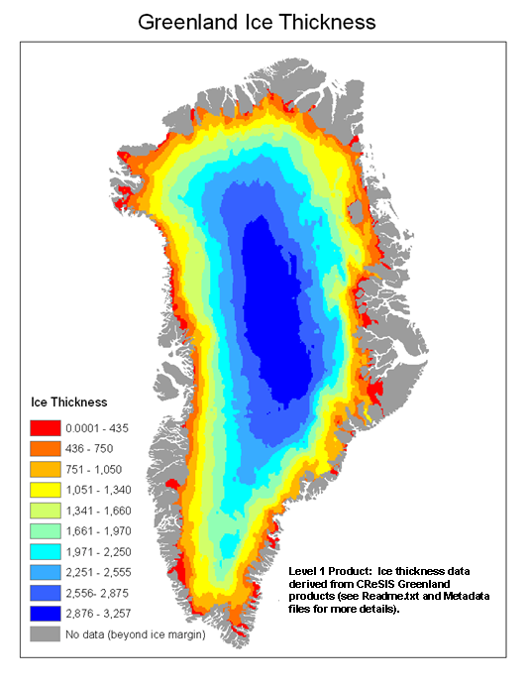

Slide 24
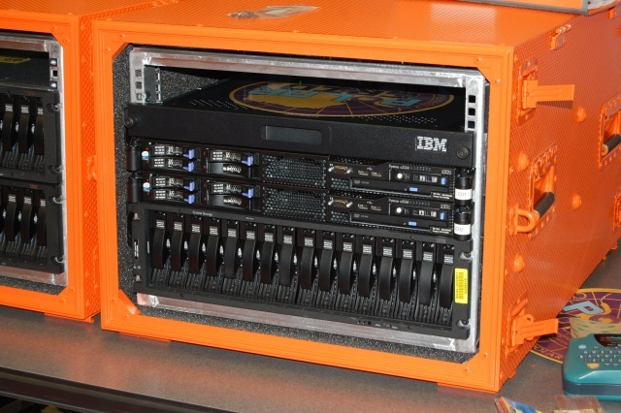
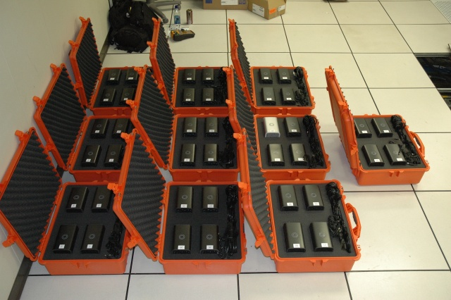
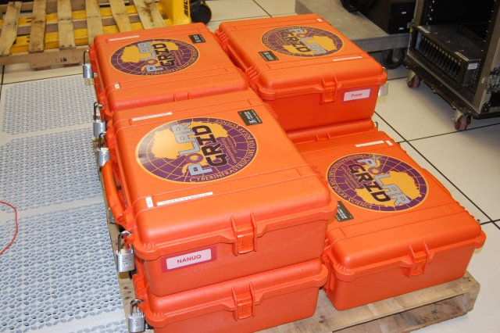
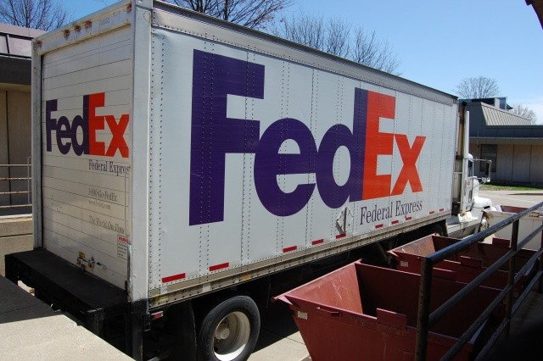
PolarGrid goes to Greenland

Slide 25
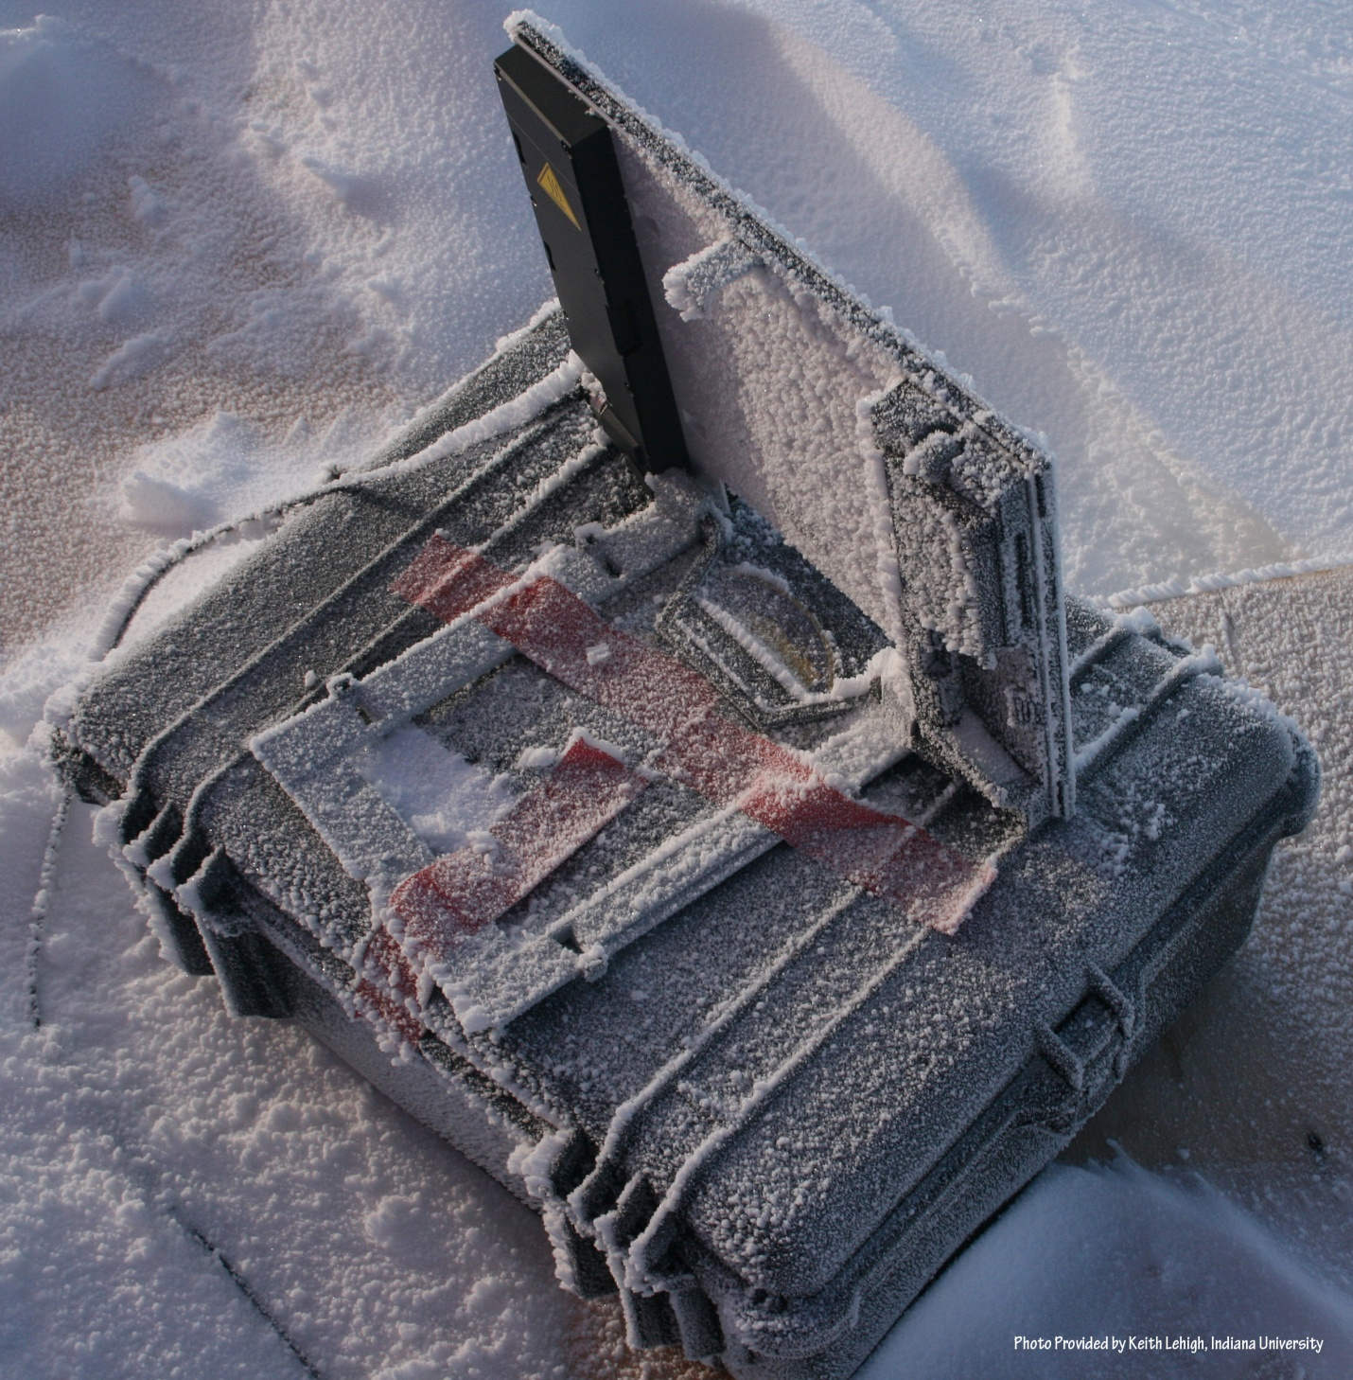
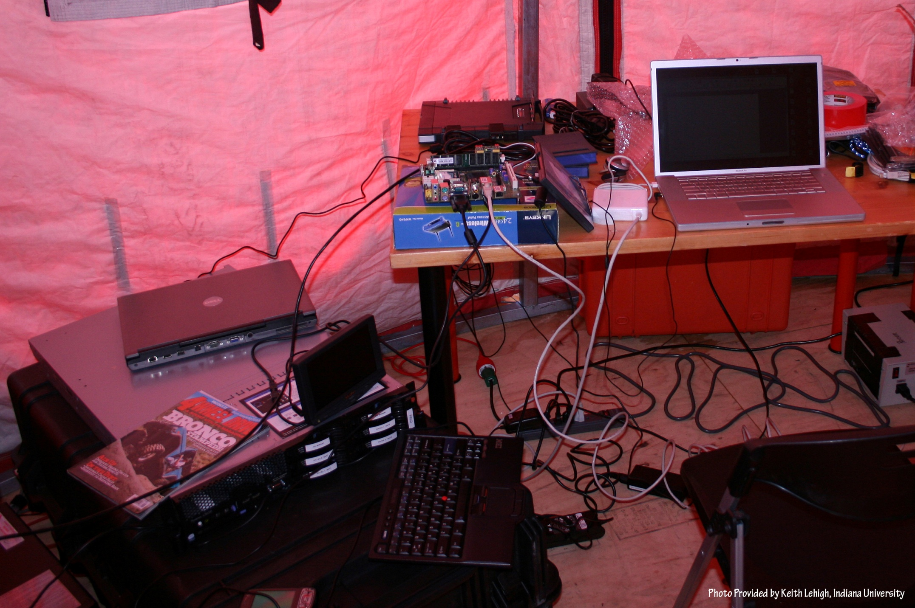
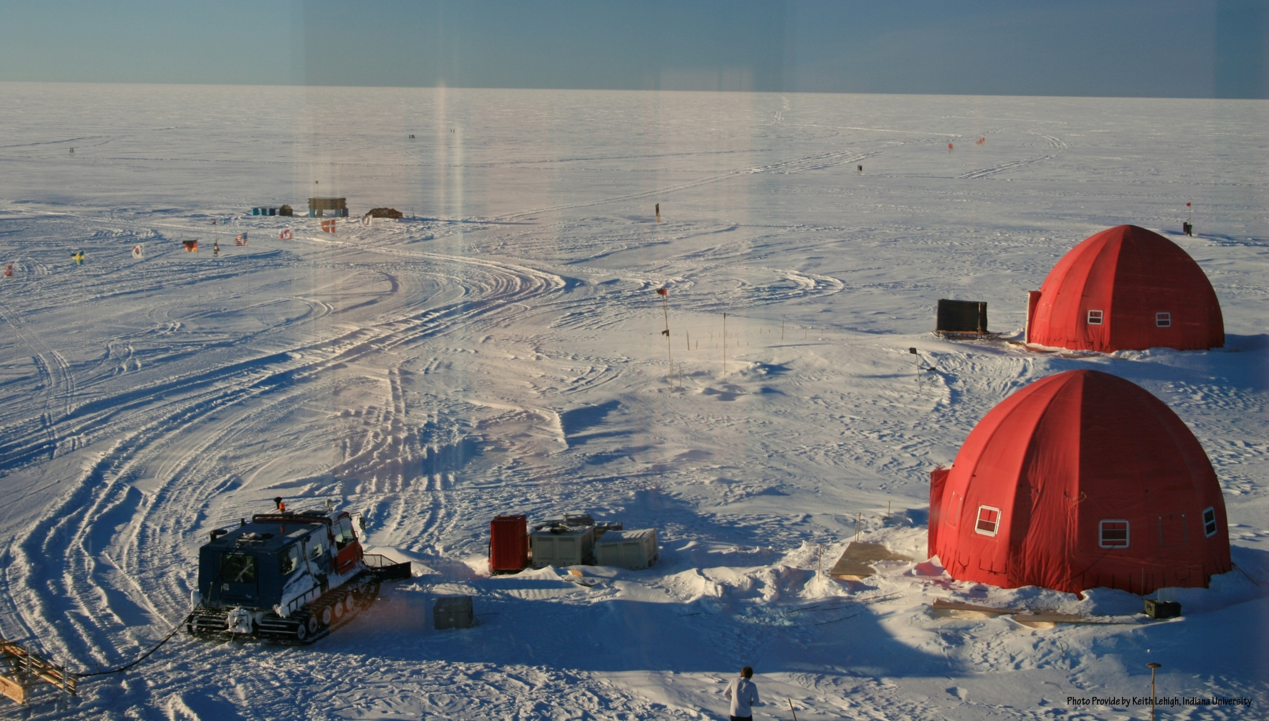
NEEM 2008 Base Station

Slide 26
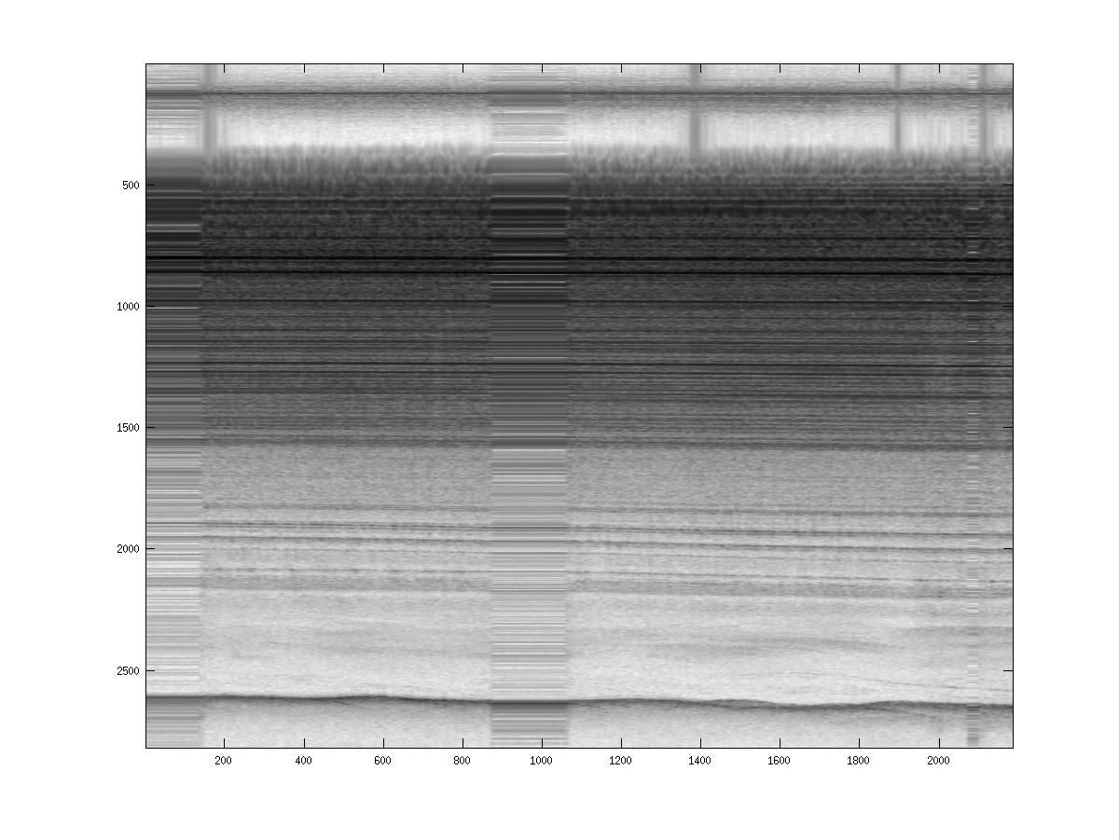
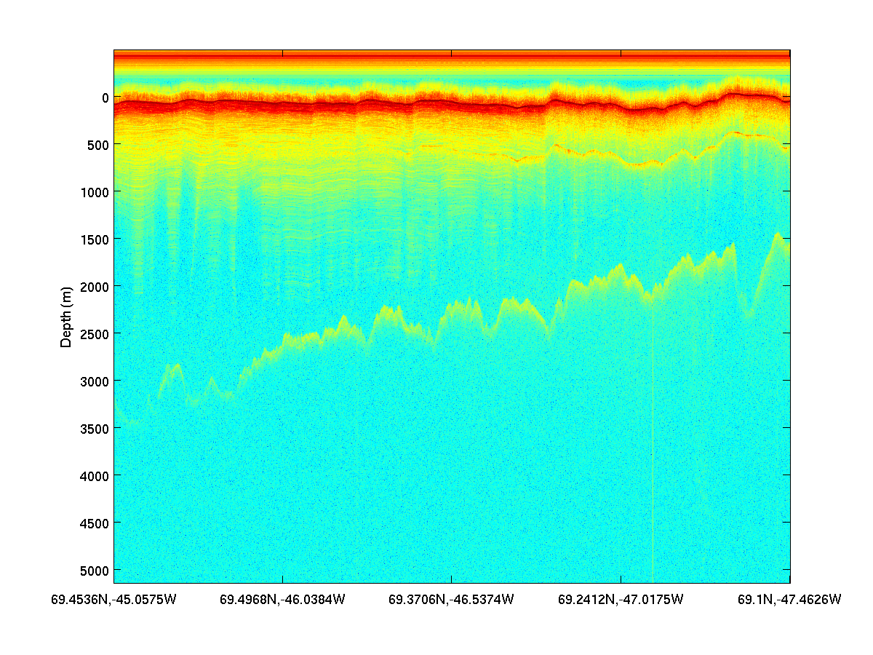
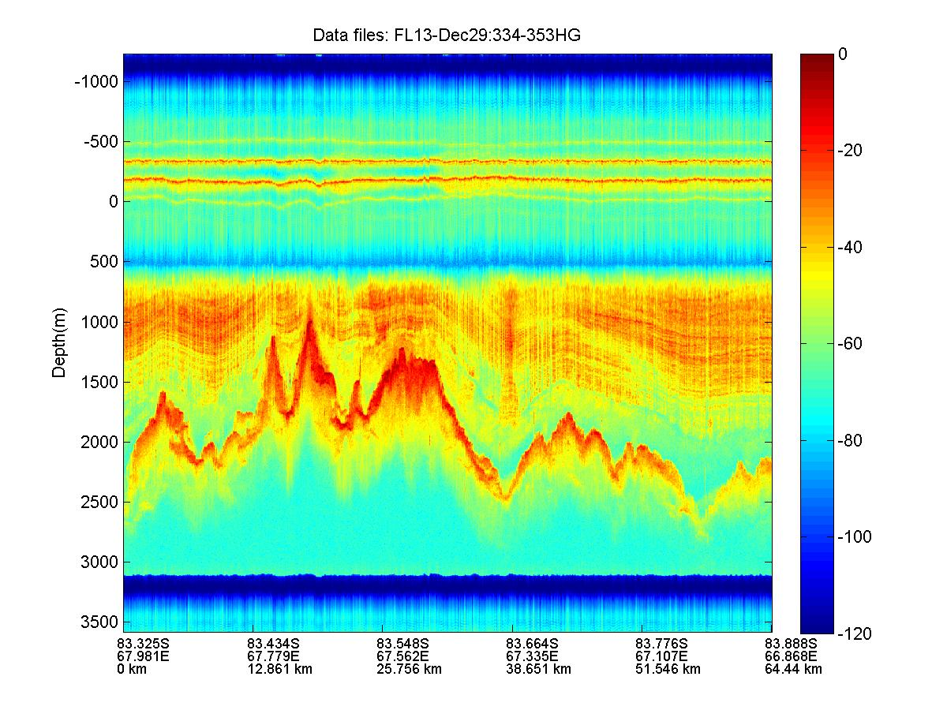
Field Results – 2008/09
“Without on-site processing enabled by POLARGRID, we would not have identified aircraft inverter-generated RFI. This capability allowed us to replace these “noisy” components with better quality inverters, incorporating CReSIS-developed shielding, to solve the problem mid-way through the field experiment.”
Jakobshavn 2008
NEEM 2008
GAMBIT 2008/09

Slide 27
What are Research Activities?
You might (correctly) think that all this stuff may have four categories but it is all too complicated for you
  That’s because I described each way of doing research as one step
Research involves a lot of steps including
  Literature Research
  Building hardware such as unmanned aircraft to fly radars to study glaciers
  Writing/modifying software for everything from analyzing data to simulating theory
  Building web pages
  Running data analysis codes
  Lots of mundane but essential work such as annotating data (being done by an Undergraduate at Kansas for PolarGrid)

Slide 28
Can simulations work?
Simulating weather, climate including hurricanes (and many other areas) is hard because the result is sensitive to details which are not well known
Simulating biological organisms is triply hard as we do not have and adequate theory of “life” (perhaps that’s good!)
Simulating nuclear forces is doubly hard as we have an excellent theory (quantum theory) but the problem is intractable on realistic computers
Simulating earthquake occurrence is triply hard as it is a “phase transition” and incredibly sensitive to detail
  Easier to simulate what a typical earthquake could look like

Slide 29
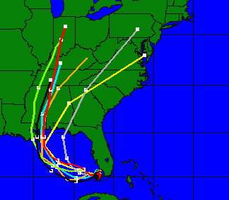
Ensemble Methods
Ensemble methods one approach to dependence on data
Another is over supplying data and forcing simulation to obey extra data – called data assimilation
Picture shows hurricane tracks from an Ensemble calculation

Slide 30
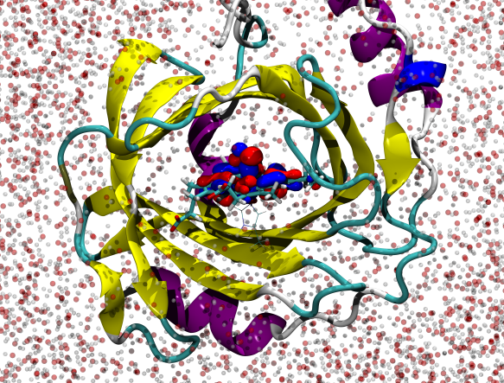
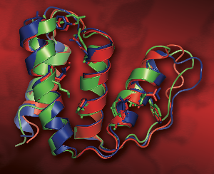
Quantum Mechanics and Molecular Dynamics
Left: A snapshot from a QM/MM simulation of the protein Nitrophorin-2 expressed in the triatome Rhodnius prolixus, a vector for Trypanosoma cruzi, and a key target for Chagas’ disease inhibitors. (Credit: Walker, SDSC, Roitberg, U. Florida)
Right: This image shows the blind prediction (blue) of a CASP7 target. Red shows the x-ray structure (released after the prediction was submitted) and green shows a low resolution NMR structure. The prediction was performed by Ross Walker (SDSC) and Srivatsan Raman (UW).
Important difficult but not impossible

Slide 31
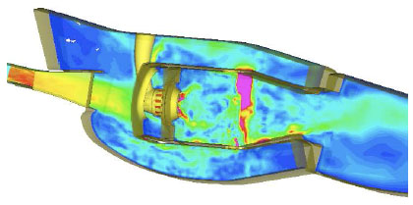
Computational Fluid Dynamics
Simulation of air flow in a Pratt and Whitney engine
This is nontrivial numerically (as sensitive to small viscosity) but still “deterministic” and “just” requires hard work
Velocity magnitude contours in P&W combustor

Slide 32
Data Deluge in Earth Science
Common Themes of Data Sources
Focus on geospatial, environmental data sets
  Data from computation and observation.
Rapidly increasing data sizes
Data and data processing pipelines are inseparable.

Slide 33

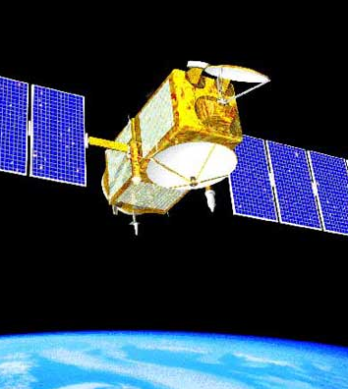
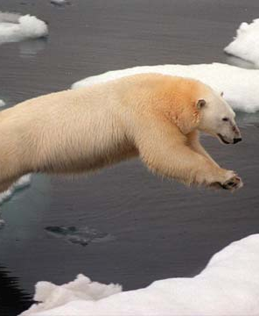
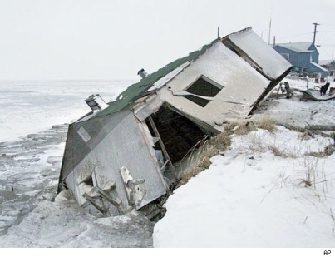
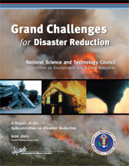
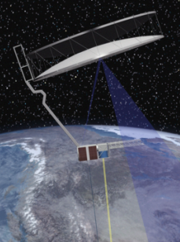
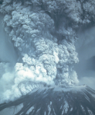
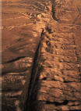
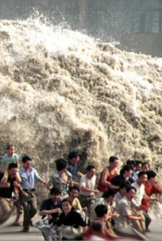
The Earth, its resources and inhabitants face challenges related to changing climate and natural disasters
Climate Change
How does our changing climate influence the oceans and ice sheets and how are they interacting?
Guided by: Intergovernmental Panel on Climate Change
Ocean temperature
atmospheric exchange
Changing sea ice
Rising sea level
Natural Disasters
How do the tectonic plates and fault systems interact to produce earthquakes?
Provide disaster information and understand potential for future events
Guided by: OSTP CENR Subcommittee for Disaster Reduction
Volcanoes
Earthquakes
Earthquakes

Slide 34

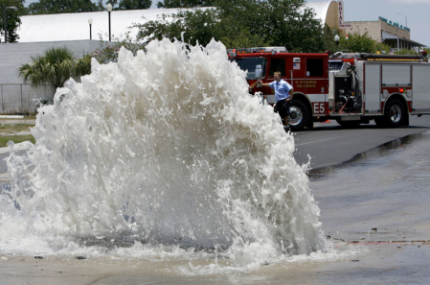
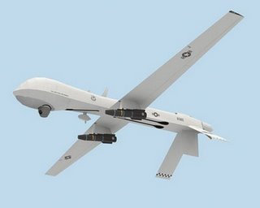
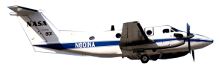
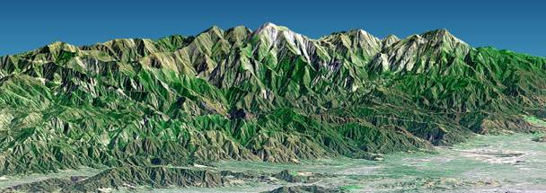
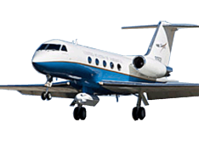
Enabling Repurposing of Data:
Applications to Civil Infrastructure and Crisis Management
Civil Infrastructure
Provide access to clean water
Restore and improve urban infrastructure
Develop carbon sequestration methods
Guided by: Grand Challenges for Engineering
Water pipe breaks
Crisis Management
Provide disaster information and understand potential for future events
Guided by: OSTP CENR Subcommittee for Disaster Reduction

Slide 35
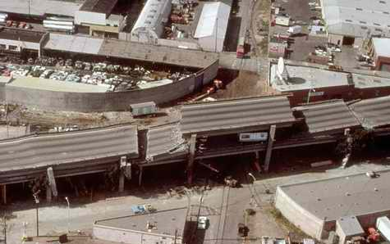
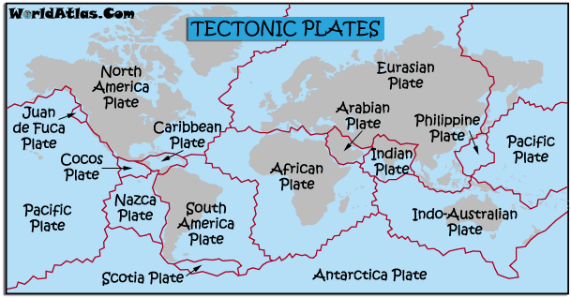
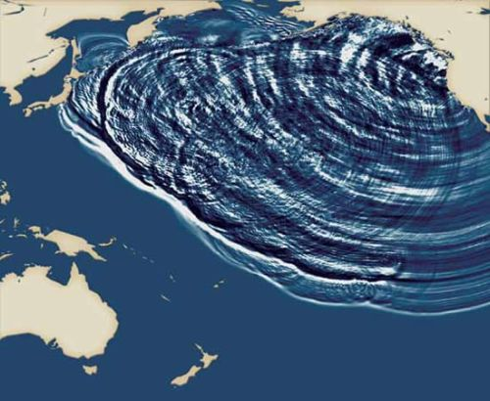
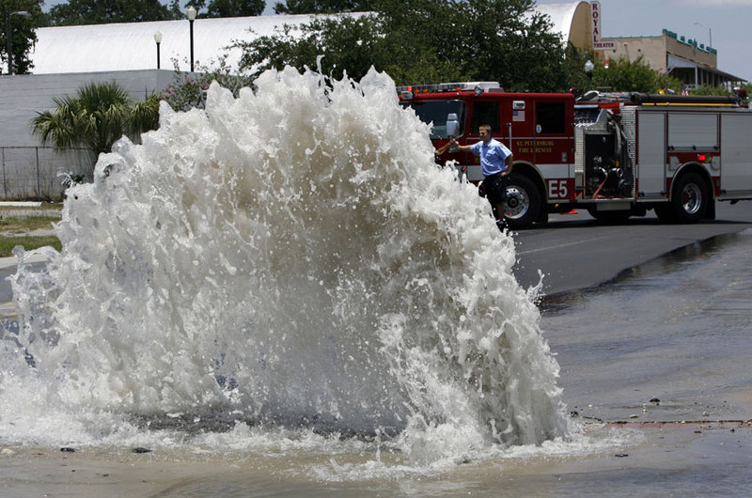
Natural Disasters
Earthquakes
Tectonics, Plate
Movement
Tsunamis
Broken Water Pipes (?)
Indicators of Changing Earth

Slide 36
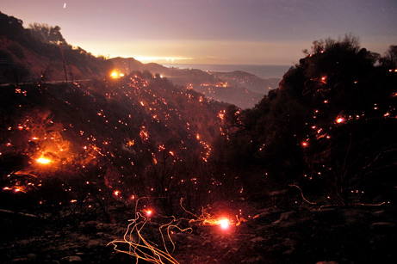
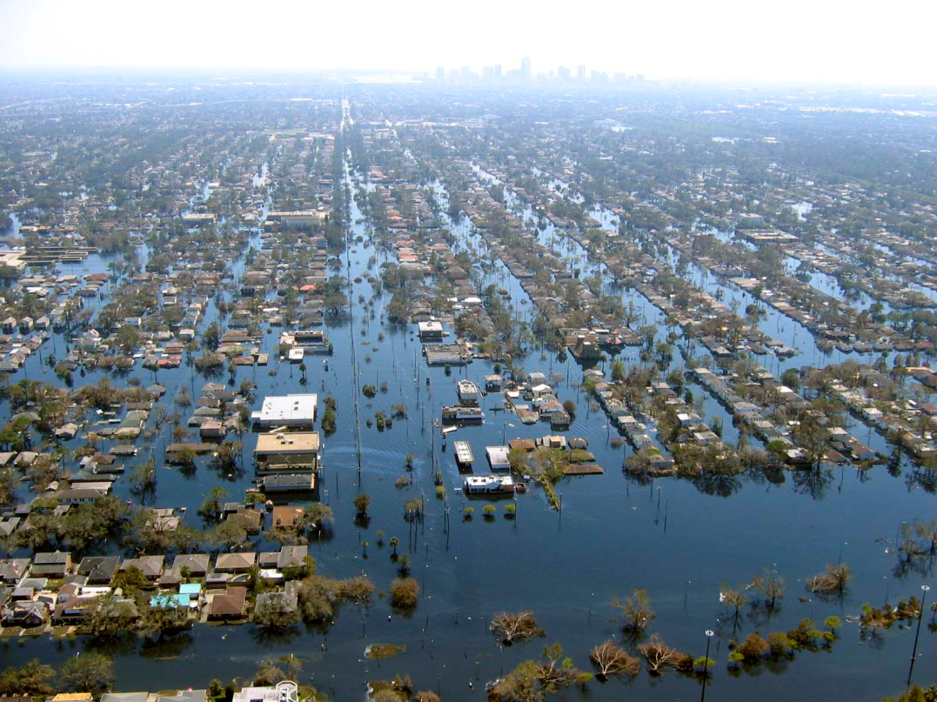
Crisis Management
Fires
Floods
Potential for future occurrences

