Slide 1
Bioinformatics/HPC
Students
Adda Zachary
Deema Al Ghanim
Horsley Jacqueline
Sandrick Daniel
Mentors
Xiaoming Gao
Xinjun Zhang
Thilina Gunarathne
Supervised by Dr.Judy Qiu

Slide 2
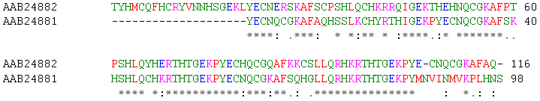
Sequence Alignment
A way of arranging the biological sequences to identify regions of similarity
Pairwise alignment
  Find the best matching alignments of two query sequences
Multiple Sequence Alignment
  Alignment of 3 or more biological sequences
  Computationally difficult

Slide 3
MDS
Sequences
Pairwise
Sequence Alignment
Dissimilarity Matrix
Visualization
Pairwise Clustering
http://salsaweb.ads.iu.edu/salsa/

Slide 4
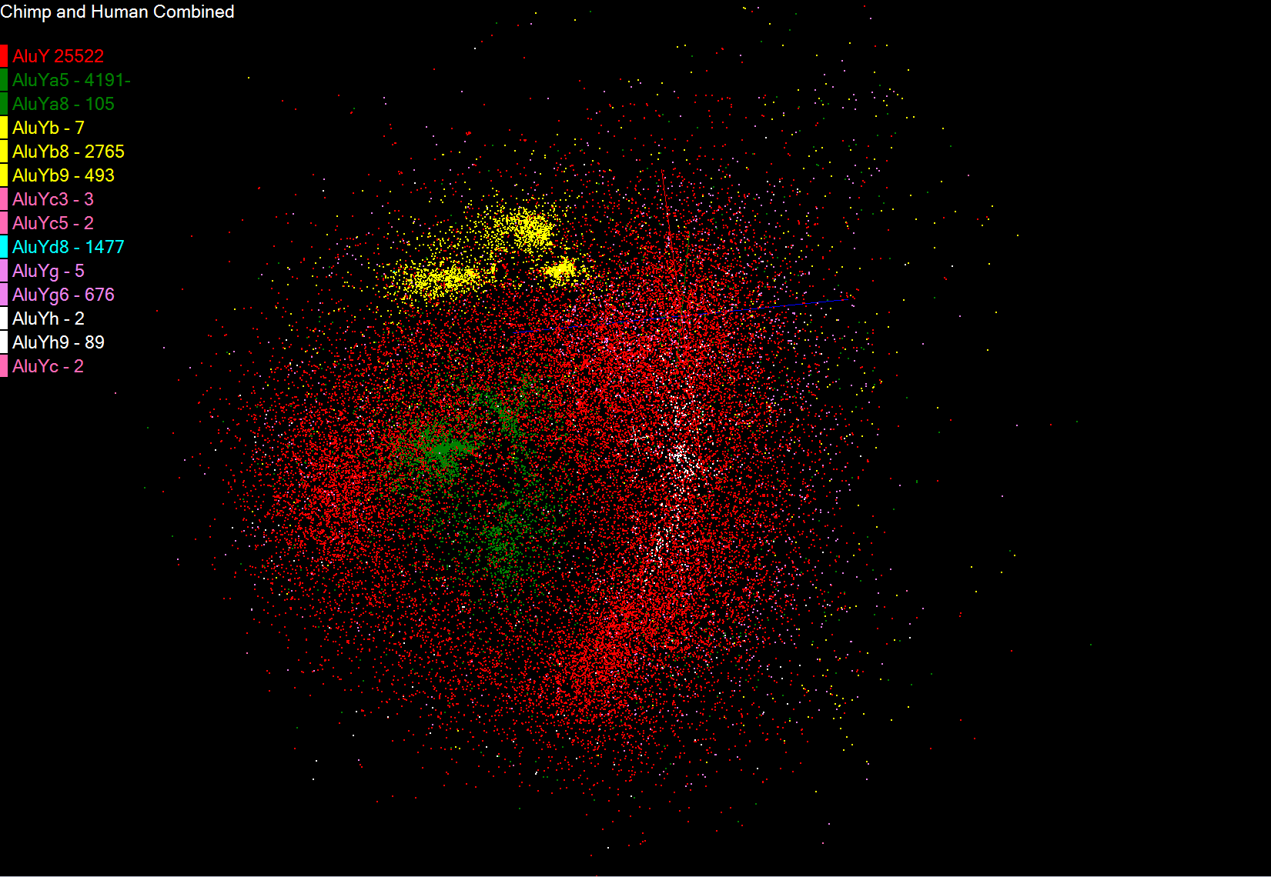

Slide 5
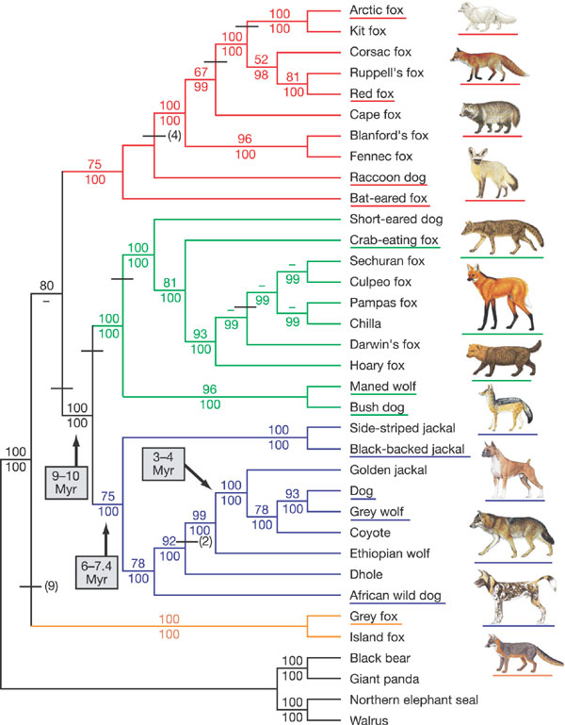
Phylogenetics
Study of evolutionary
relatedness among various groups of organisms
Phylogenetic tree
  Tree of life
Finding the correlations between Phylogenetic trees and the clustering approach

Slide 6
Additional Software
PHYLIP (PHYLogeny Inference Package)
  Software available in IU Quarry
  Inputs
    Distance Matrix
    Gene sequences
Clutalw
  Available in IU BigRed
  Multiple sequence alignment
  Can generate data files for PHYLIP

Slide 7
Thanks!!!

