Slide 1
Video Editing Workshop
by: Jonathan Morrison

Slide 2
So who is this guy anyway?
I’m Jonathan Morrison

Slide 3
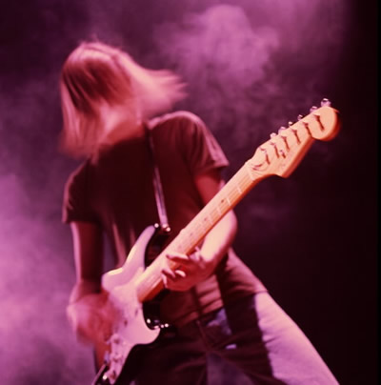
So who is this guy anyway?
I’m Jonathan Morrison
Undergraduate in Jacobs School of Music

Slide 4
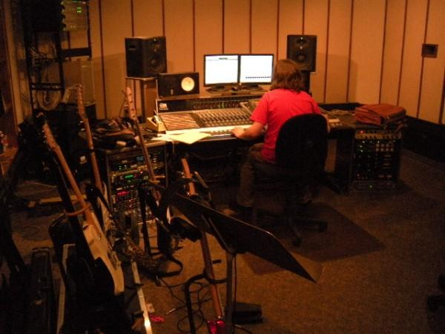
So who is this guy anyway?
I’m Jonathan Morrison
Undergraduate in Jacobs School of Music
Studying Recording Arts

Slide 5
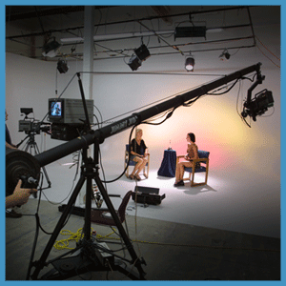
So who is this guy anyway?
I’m Jonathan Morrison
Undergraduate in Jacobs School of Music
Studying Recording Arts
Minor in Telecommunications (Videography & Production)
Notes:
Thus the videography skills.

Slide 6
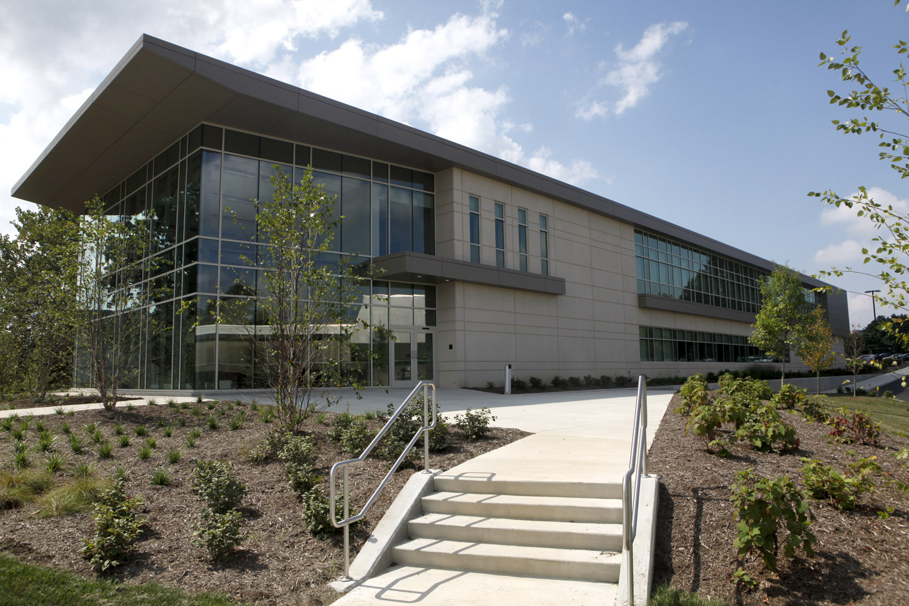
So who is this guy anyway?
I’m Jonathan Morrison
Undergraduate in Jacobs School of Music
Studying Recording Arts (Music Production & Recording)
Minor in Telecommunications (Videography & Production)
Currently employed by IU’s Pervasive Technology Institute.
Notes:
This is my connection to Geoffrey.

Slide 7
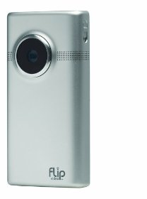
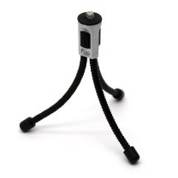
Equipment Basics
Flip Mino HD – Video Camera
Tripod
Small Tripod
USB Cable

Slide 8
Equipment Basics
Flip Mino HD – Video Camera
Tripod
Small Tripod
USB Cable

Slide 9
Equipment Basics
Flip Mino HD – Video Camera
Tripod
Small Tripod
USB Cable

Slide 10
Equipment Basics
Flip Mino HD – Video Camera
Tripod
Small Tripod
USB Cable

Slide 11
Equipment Basics
Flip Mino HD – Video Camera
Tripod
Small Tripod
USB Cable

Slide 12
Flip Mino HD
HD (High-Definition) Recording
Records to Internal Hard Drive – 120 Minutes of HD
Very user friendly. Lots of automatic features including: Assisted Lighting, Assisted Audio, Automatic White Balancing, etc.
Notes:
Some of the automatic features are things you would have to worry about on a less consumer friendly camera.

Slide 13
Flip Mino HD
Somewhat similar to an i-Pod

Slide 14
Flip Mino HD
Somewhat similar to an i-Pod
Power Button – Located on right side. Powers unit on and off.

Slide 15
Flip Mino HD
Somewhat similar to an i-Pod
Power Button – Located on right side. Powers unit on and off.
Record (Red) Button – Begins/Ends recording.

Slide 16
Flip Mino HD
Somewhat similar to an i-Pod
Power Button – Located on right side. Powers unit on and off.
Record (Red) Button – Begins/Ends recording.
+ & - Buttons – Zooms in and out

Slide 17
Flip Mino HD
Somewhat similar to an i-Pod
Power Button – Located on right side. Powers unit on and off.
Record (Red) Button – Begins/Ends recording.
+ & - Buttons – Zooms in and out
Arrows L & R – Used to navigate menus

Slide 18
Flip Mino HD
Somewhat similar to an i-Pod
Power Button – Located on right side. Powers unit on and off.
Record (Red) Button – Begins/Ends recording.
+ & - Buttons – Zooms in and out
Arrows L & R – Used to navigate menus
Play – Plays video stored on Flip

Slide 19
Flip Mino HD
Somewhat similar to an i-Pod
Power Button – Located on right side. Powers unit on and off.
Record (Red) Button – Begins/Ends recording.
+ & - Buttons – Zooms in and out
Arrows L & R – Used to navigate menus
Play – Plays video stored on Flip
Trash – Deletes videos stored on Flip

Slide 20
Tripod
Tripods are very fragile.

Slide 21
Tripod
Tripods are very fragile.
Make sure to loosen (unlock) the connections before moving anything on the tripod.

Slide 22
Tripod
Tripods are very fragile.
Make sure to loosen (unlock) the connections before moving anything on the tripod.
Lack of loosening the knobs will result in Tripod being unable to lock in and will become stripped.

Slide 23
Tripod
Tripods are very fragile.
Make sure to loosen (unlock) the connections before moving anything on the tripod.
Lack of loosening the knobs will result in Tripod being unable to lock in and will become stripped.
Use the level on the tripod to make sure your camera is level.

Slide 24
Mini Tripod
Cute little tripod.
Not hard to figure out.

Slide 25
Mini Tripod
Cute little tripod.
Not hard to figure out.
Best used on a table, chair, desk, etc.

Slide 26
Mini Tripod
Cute little tripod.
Not hard to figure out.
Best used on a table, chair, desk, etc.
Also, can be used to hold the camera with hands.
When a regular tripod is too large or unavailable these are great.

Slide 27
When Shooting
Following these simple rules will make your video production look much more professional.
Notes:
These are all basics, over the next slides we will talk about them more in-depth.

Slide 28
When Shooting
Following these simple rules will make your video production look much more professional.
Lighting and Audio - Make sure the area for shooting is well lit and quiet enough to hear the on-screen personnel speak.
Notes:
These are all basics, over the next slides we will talk about them more in-depth.

Slide 29
When Shooting
Following these simple rules will make your video production look much more professional.
Lighting and Audio - Make sure the area for shooting is well lit and quiet enough to hear the on-screen personnel speak.
Framing - Position your on-screen personnel (talent) in the proper manner.
Notes:
These are all basics, over the next slides we will talk about them more in-depth.

Slide 30
When Shooting
Following these simple rules will make your video production look much more professional.
Lighting and Audio - Make sure the area for shooting is well lit and quiet enough to hear the on-screen personnel speak.
Framing - Position your on-screen personnel (talent) in the proper manner.
Interviewing - Talk to your talent about what is expected of the interview.
Notes:
These are all basics, over the next slides we will talk about them more in-depth.

Slide 31
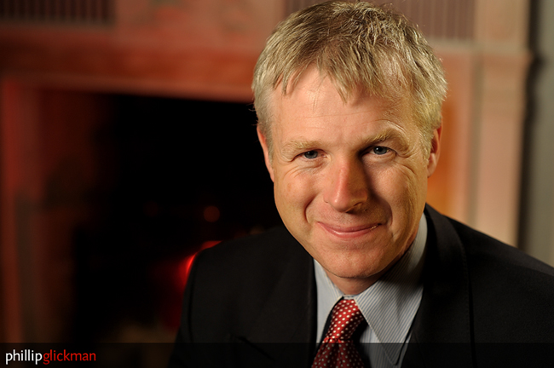
Lighting
Make sure that your talent’s face is lit well and that they are distinguishable from the background.
Notes:
Here is an example of a well lit interview.
His face is well lit from all sides. And He pops out from the background.

Slide 32
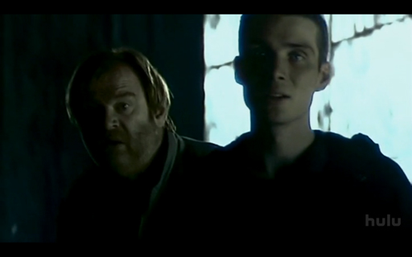
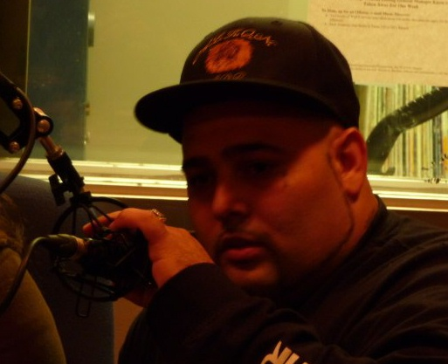
Lighting
If these were interviews, this would be considered bad lighting.
Notes:
Here is an example of badly lit interviews.
If they were interviews, they would be unacceptable.

Slide 33
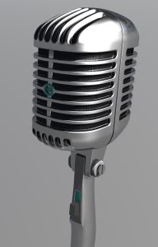
Audio
Audio can very important. If you cannot hear what the interviewee is saying, the interview is worthless.

Slide 34
Audio
Audio can very important. If you cannot hear what the interviewee is saying, the interview is worthless.
Make sure to choose a quiet place, without people talking in the background.

Slide 35
Audio
Audio can very important. If you cannot hear what the interviewee is saying, the interview is worthless.
Make sure to choose a quiet place, without people talking in the background.
Make sure there isn’t excessive background noise, i.e. a cappuccino machine, construction happening right outside, phones ringing, etc.

Slide 36
Audio
Audio can very important. If you cannot hear what the interviewee is saying, the interview is worthless.
Make sure to choose a quiet place, without people talking in the background.
Make sure there isn’t excessive background noise, i.e. a cappuccino machine, construction happening right outside, phones ringing, etc.
Make sure you can hear every word very clearly.

Slide 37
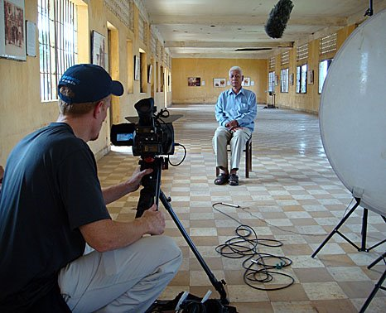
Types of Shoots
Interview – The talent is on-screen. The interviewer asks the talent questions from off-screen.
Discussion/Forum – The talent and interviewee (host) are both on-screen.
B-Roll/Extra Footage/Cutaway Footage – Footage that is shot to be inserted to reinforce what is being discussed. Also used to cover up jump cuts.
Notes:
Example of a professional interview. Your interviews will have less equip. and the camera should be a lot closer.

Slide 38
Types of Shoots
Interview – The talent is on-screen. The interviewer asks the talent questions from off-screen.
Discussion/Forum – The talent and interviewee (host) are both on-screen.
B-Roll/Extra Footage/Cutaway Footage – Footage that is shot to be inserted to reinforce what is being discussed. Also used to cover up jump cuts.

Slide 39
Types of Shoots
Interview – The talent is on-screen. The interviewer asks the talent questions from off-screen.
Discussion/Forum – The talent and interviewee (host) are both on-screen.
B-Roll/Extra Footage/Cutaway Footage – Footage that is shot to be inserted to reinforce what is being discussed. Also used to cover up jump cuts.

Slide 40
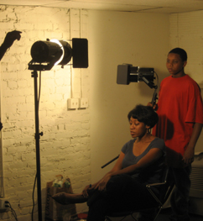
Interview Shooting Rules
Have the camera in a steady location next to you (the interviewer).

Slide 41
Interview Shooting Rules
Have the camera in a steady location next to you (the interviewer).
Have the interviewee in a steady location so that the talent stays in the shot you frame. Try not to give them a rolling or swivel chair.

Slide 42
Interview Shooting Rules
Have the camera in a steady location next to you (the interviewer).
Have the interviewee in a steady location so that the talent stays in the shot you frame. Try not give them a rolling or swivel chair.
Talk with the talent so that they know not to look at the camera. They should look/talk to you (the interviewer)

Slide 43
Interview Shooting Rules
Have the camera in a steady location next to you (the interviewer).
Have the interviewee in a steady location so that the talent stays in the shot you frame. Do not give them a rolling or swivel chair.
Talk with the talent so that they know not to look at the camera. They should look/talk to you (the interviewer)
Let them know to have a casual conversation with you (the interviewer). Tell them to act like the camera isn’t even there.

Slide 44
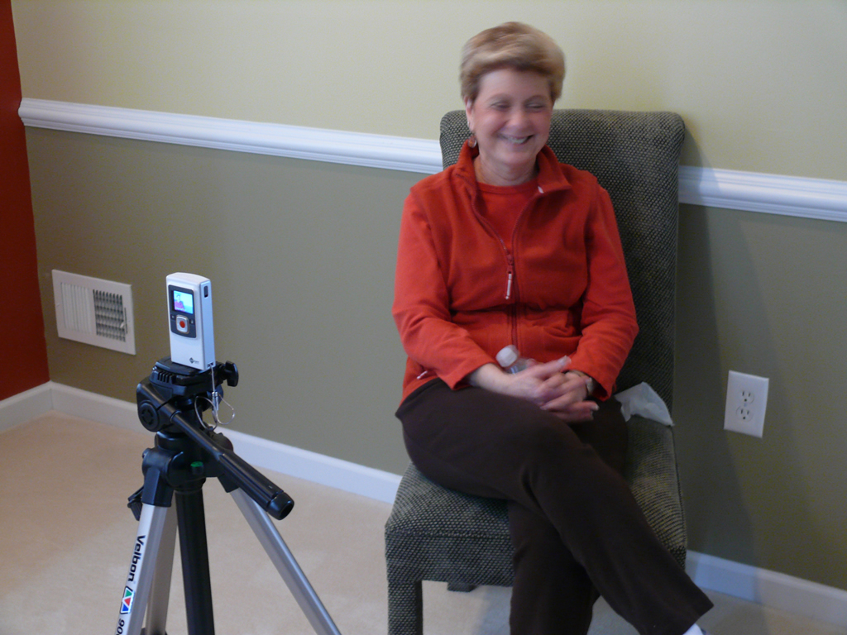
Interview Shooting Rules
Stage the interview so that the background is in a nice place (can be plain) or so that it pertains to the interview.
Notes:
Placing objects can be good or bad. They can clutter sometimes.
Also, a plain background such as a wall or curtain can work well.

Slide 45
Shooting Settings
Once the interviewee has been positioned, look at the shot and see how it is framed on the camera.

Slide 46
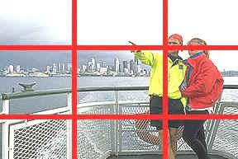
Rule of Thirds
The rule of thirds states that a person’s attention is drawn most to what is happening in the cross section of the frame.

Slide 47
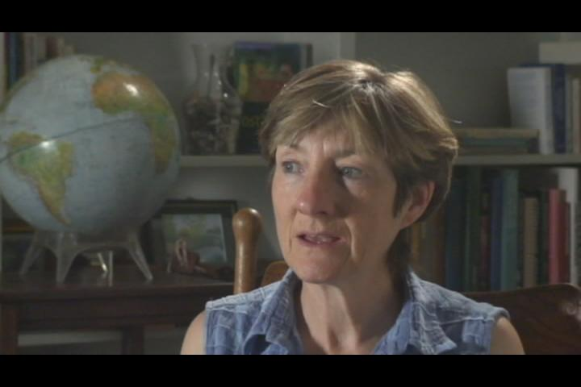
Rule of Thirds
When framing an interview make sure the talent’s face is placed in this “thirds” area. Not in the center.

Slide 48
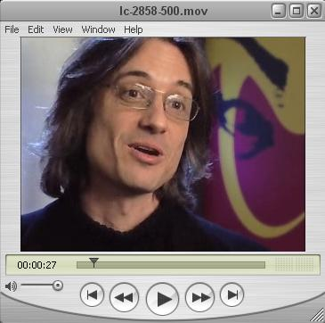
Lead Room/Framing
Make sure the talent is facing the proper direction and that they have good lead room.
Notes:
Lead room is the room in front of the direction the person is facing

Slide 49
Lead Room/Framing
Think about where the camera-person/interviewer is standing, so that the talent is framed properly and so that the talent looks in the correct direction.

Slide 50
Framing
Notes:
For both of these shots where would the camera-person/interviewer stand?

Slide 51
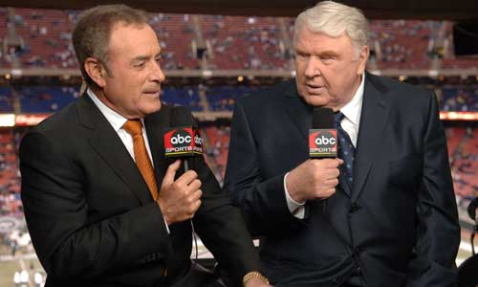
Discussion/Forum Shooting Rules
Both the talent and host appear on camera.
Notes:
This shot looks normal but in real life they are uncomfortably close to each other. When framing two person interviews as in discussion or forum videos, position the host and talent so close together that it feels uncomfortable. This may require small chairs, use your imagination.

Slide 52
Discussion/Forum Shooting Rules
Both the talent and host appear on camera.
The host will generally address issues/questions, so that the talent will talk about them.
Notes:
This shot looks normal but in real life they are uncomfortably close to each other. When framing two person interviews as in discussion or forum videos, position the host and talent so close together that it feels uncomfortable. This may require small chairs, use your imagination.

Slide 53
Discussion/Forum Shooting Rules
Both the talent and host appear on camera.
The host will generally address issues/questions, so that the talent will talk about them.
Position the talent and host as close together as possible.
Notes:
This shot looks normal but in real life they are uncomfortably close to each other. When framing two person interviews as in discussion or forum videos, position the host and talent so close together that it feels uncomfortable. This may require small chairs, use your imagination.

Slide 54
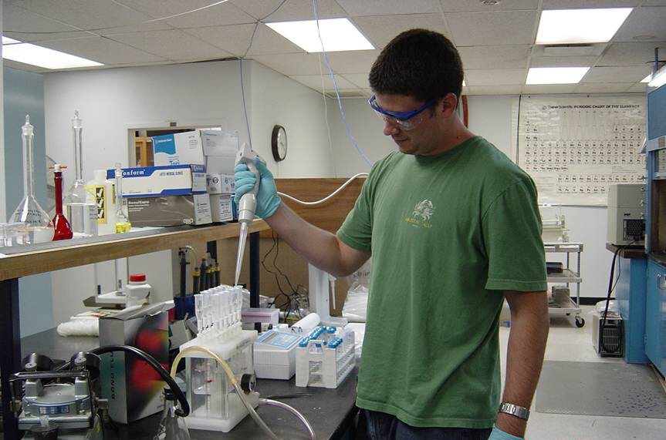
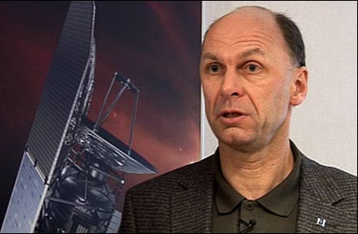
B-Roll, Extra & Cutaway Footage
B-roll is meant to reinforce what is being talked about on screen.
Notes:
Here we have a scientist being interviewed, it maybe helpful when telling the story to include footage from inside the lab to tell the story with more visuals, instead of what we refer to as talking heads up on the screen.

Slide 55
B-Roll, Extra & Cutaway Footage
B-roll is meant to reinforce what is being talked about on screen.
Very helpful for covering up transitions between two shots.

Slide 56
B-Roll, Extra & Cutaway Footage
B-roll is meant to reinforce what is being talked about on screen.
Very helpful for covering up transitions between two shots.
Bad transitions are known as jump cuts.

Slide 57
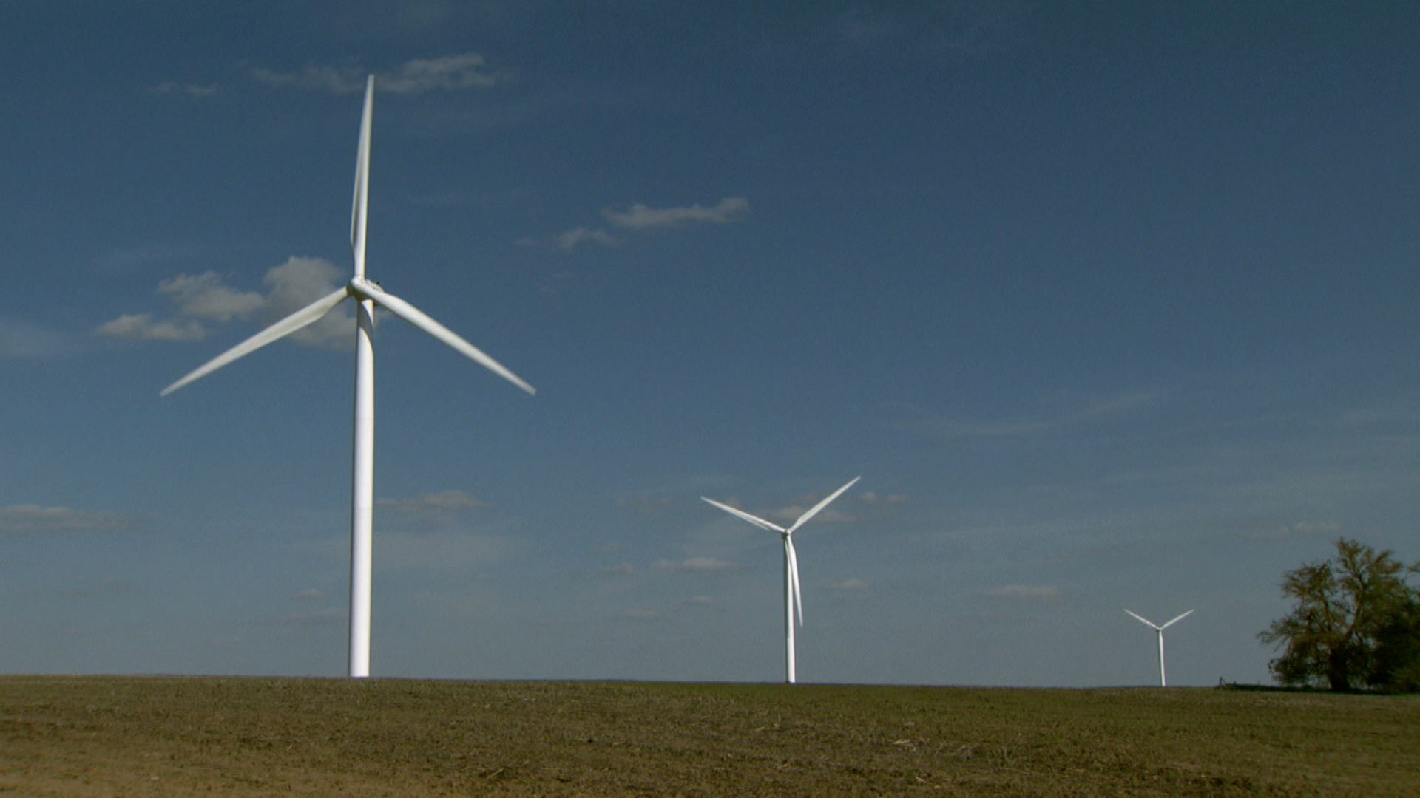
B-Roll, Extra & Cutaway Footage
B-roll can be screen captures from a computer, pictures, video, etc.

Slide 58
B-Roll, Extra & Cutaway Footage
B-roll can be screen captures from a computer, pictures, video, etc.
If it can be seen and pertains to what is being discussed you can make it into B-Roll

Slide 59
B-Roll, Extra & Cutaway Footage
B-roll can be screen captures from a computer, pictures, video, etc.
If it can be seen and pertains to what is being discussed you can make it into B-Roll.
Can spruce up a production a lot.

Slide 60
Helpful Links
http://www.cybercollege.com/tvp_ind.htm Click on TV Production Models. Gives a more in-depth view of the concepts discussed. Possibly too advanced.

Slide 61
Helpful Links
http://www.cybercollege.com/tvp_ind.htm Click on TV Production Models. Gives a more in-depth view of the concepts discussed. Possibly too advanced.
http://www.video101course.com/ Very helpful video guidelines.

Slide 62
Helpful Links
http://www.cybercollege.com/tvp_ind.htm Click on TV Production Models. Gives a more in-depth view of the concepts discussed. Possibly too advanced.
http://www.video101course.com/ Very helpful video guidelines.
http://ittraining.iu.edu/lynda/ Final Cut Pro tutorial/tons of other tutorials offered free from Lynda.com for IU students.

Slide 63
Where to edit?
The IC (Information Commons) at the Main Library has Final Cut Pro on the Macs. IC115
Also in these computer labs FA137, FA215, HP155, IC115, TV250, SB222-03, LH026-04, LH026-08

Slide 64
If you need more help?
Feel free to contact me: Jonathan Morrison at jormorri@indiana.edu
I offer videography tutoring and assistance

