Slide 1
Future Grid Early Projects
2010 User Advisory Board Meeting
Pittsburgh, PA

Slide 2
Note
Some of the work described was performed during the acceptance tests and before the resources were available to anybody but the individual resource owners.
Access to resources is only just coming broadly available

Slide 3
Project descriptions
University of Florida – ViNe, CloudBLAST, and virtual appliance
University of Virginia – Genesis II, UNICORE 6, g-lite
Indiana University – SALSA Group
LSU (Shantenu)

Slide 4
UF – FG activities
ViNe overlay network and CloudBLAST (both developed at UF) has been deployed and experimented on FG resources
ViNe and CloudBLAST are encapsulated in VM images and deployed through Nimbus
Large-scale experiments and demos:
CCGrid’2010: 150-node virtual cluster across 5 sites, connected through ViNe (including 2 FG sites UF and SDSC) and running CloudBLAST, demonstrated a large scale BLAST run in less than 1 hour (the same job takes over 17 days sequentially)
OGF’10: 457-node virtual cluster across 3 FG sites (UF, UC, SDSC) and 2 G5k sites (Rennes, Sophia) demonstrated the dynamic extension of a Hadoop cluster. A modified Nimbus, with faster VM deployment, was deployed on G5k. As new VMs became available on G5k, the Hadoop worker pool was increased speeding up the CloudBLAST throughput.
Researchers: Andréa Matsunaga, José Fortes (UF), Kate Keahey (UC/ANL), Pierre Riteau (UF/U of Rennes, France), Maurício Tsugawa (UF)

Slide 5
OGF’10 Demo
SDSC
Rennes
Grid’5000 firewall
UF
Lille
UC
Sophia
ViNe provided the necessary inter-cloud connectivity to deploy CloudBLAST across 5 Nimbus sites, with a mix of public and private subnets.

Slide 6
UF – educational virtual appliance
Created educational virtual appliance images and tutorials to get started on:
Deploying a virtual cluster
Nimbus @ FutureGrid (Xen)
Eucalyptus @ FutureGrid (Xen)
User’s own desktop/cluster resources (VMware, VirtualBox)
Pre-packaged middleware, zero-configuration scripts
MPI, Hadoop, Condor
Can be seamlessly deployed across domains and hypervisors
Desktop – can also serve as FutureGrid cloud client appliance to facilitate new users to access the infrastructure
GroupVPN for simple configuration of virtual private clusters for class environments
Web interface to create/manage user groups
Download GroupVPN credentials, deploy as input data at cloud provisioning
Dr. Renato J. Figueiredo; Arjun Prakash, David Wolinsky (U. Florida)

Slide 7
University of Virginia Goals/Tasks
Goals
Grid Standards
Grid Interoperability
Grid Applications
Grid Middleware testbed
Tasks
Acquire and learn Unicore and EGEE (both are open source and free).
Install on local (UVA) nodes.
Deploy Unicore and EGEE onto FutureGrid nodes as required.
Deploy and maintain Genesis II on FutureGrid nodes.
Bring up and maintain standard service endpoints for compliance testing.

Slide 8
Accomplishments
Guinea pig/ friendly user
Genesis II endpoint operational on XRAY and integrated into XCG (Cross Campus Grid)
UNICORE 6 endpoint up on XRAY

Slide 9
Next
Integrate UNICORE 6 “gridmap” file with FutureGrid CA
Genesis II/UNICORE 6 onto Linux clusters via Torque
Genesis II VM onto Eucalyptus, test/experiment with dynamic provisioning
G-lite

Slide 10
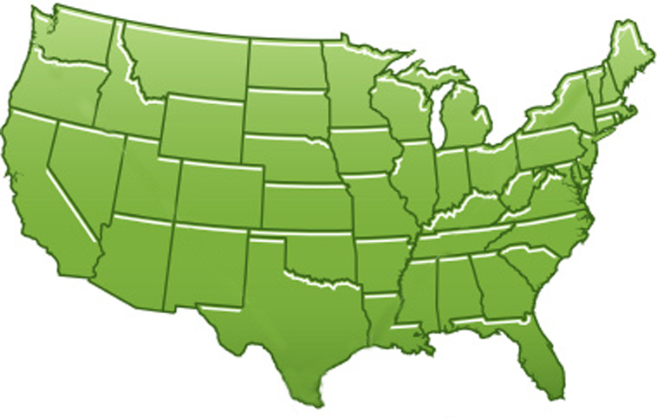
300+ Students learning about Twister & Hadoop
MapReduce technologies, supported by FutureGrid.
July 26-30, 2010 NCSA Summer School Workshop
http://salsahpc.indiana.edu/tutorial
Washington
University
University of
Minnesota
Michigan
State
Johns
Hopkins
Univ.Illinois
at Chicago
Iowa
State
Penn
State
IBM Almaden
Research Center
Notre
Dame
University of
California at
Los Angeles
Indiana
University
San Diego
Supercomputer
Center
University of
Texas at El Paso
University of
Arkansas
University
of Florida

Slide 11
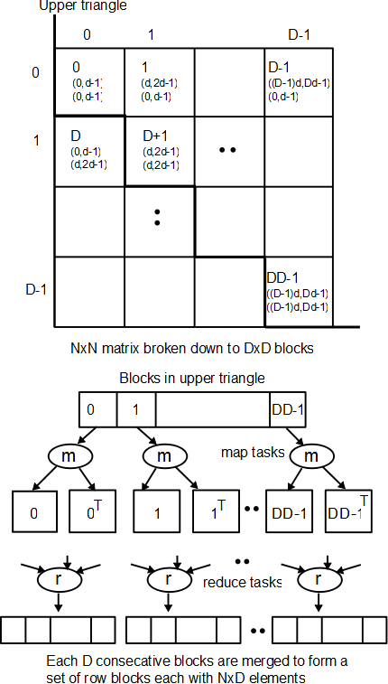
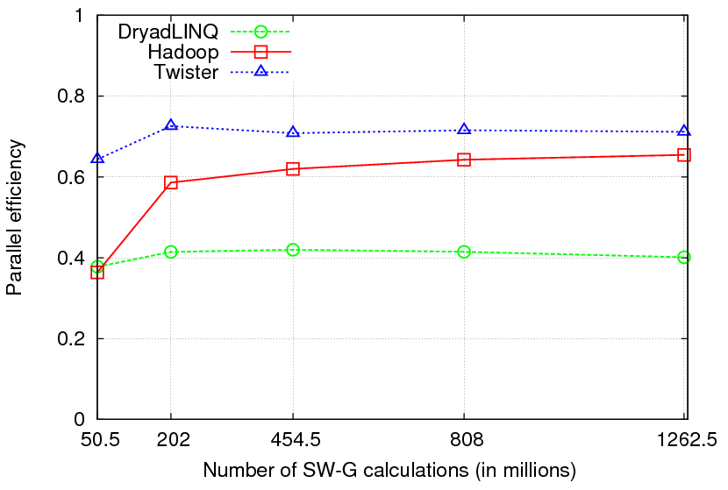
Pairwise Sequence Comparison using Smith Waterman Gotoh
Typical MapReduce computation
Comparable efficiencies
Twister performs the best
Xiaohong Qiu, Jaliya Ekanayake, Scott Beason, Thilina Gunarathne, Geoffrey Fox, Roger Barga, Dennis Gannon “Cloud Technologies for Bioinformatics Applications”, Proceedings of the 2nd ACM Workshop on Many-Task Computing on Grids and Supercomputers (SC09), Portland, Oregon, November 16th, 2009
Jaliya Ekanayake, Thilina Gunarathne, Xiaohong Qiu, “Cloud Technologies for Bioinformatics Applications”, invited paper submitted to the Journal of IEEE Transactions on Parallel and Distributed Systems (under review).

Slide 12
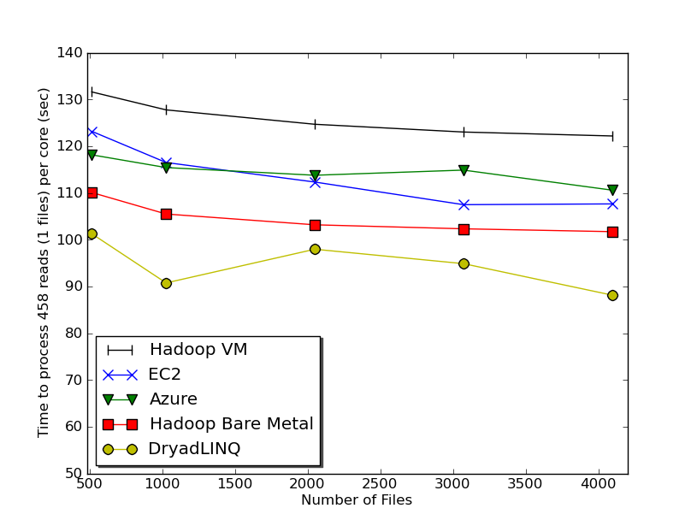
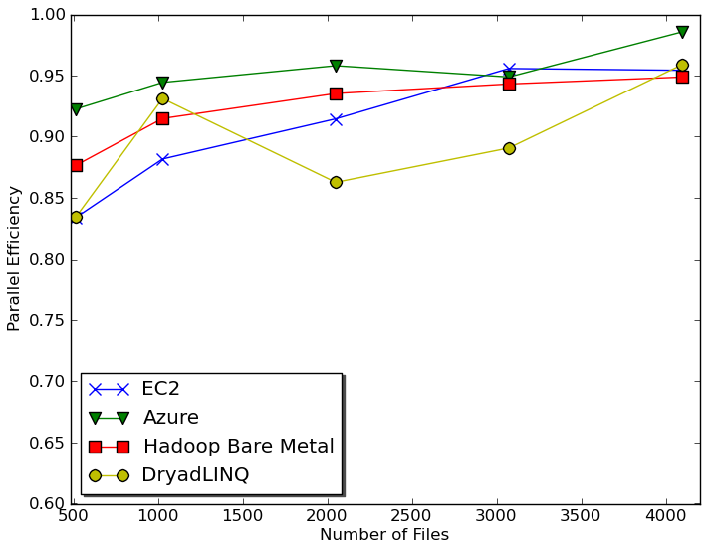
Sequence Assembly in the Clouds
CAP3 - Expressed Sequence Tagging
Input files (FASTA)
CAP3
CAP3
Output files
Cap3 parallel efficiency
Cap3 – Per core per file (458 reads in each file) time to process sequences
Thilina Gunarathne, Tak-Lon Wu, Judy Qiu, and Geoffrey Fox,
“Cloud Computing Paradigms for Pleasingly Parallel Biomedical Applications”, March 21, 2010. Proceedings of Emerging Computational Methods for the Life Sciences Workshop of ACM HPDC 2010 conference, Chicago, Illinois, June 20-25, 2010.

Slide 13
SAGA
Andre Luckow, Lukasz Lacinski, Shantenu Jha, SAGA BigJob: An Extensible and Interoperable Pilot-Job Abstraction for Distributed Applications and Systems, Center for Computation & Technology, Louisiana State University; Department of Computer Science, Louisiana State University; e-Science Institute, Edinburgh, UK
Used Nimbus on FutureGrid

Slide 14
FutureGrid Activities at U Chicago
Built the UC resource (hotel) and integrated it into the FutureGrid infrastructure + Nimbus installation
Nimbus releases containing FG-driven features:
Zero -> cloud installation process and user management tools (Nimbus 2.5, 07/30)
Nimbus installer (Nimbus 2.4, 05/05)
Web interface for credential distribution (Nimbus 2.3, 02/02)
Supported demonstrations, exploration, and early users of FG (see following slides)
Prepared documentation and tutorials for FG users
UC team: Kate Keahey, David LaBissoniere, Tim Freeman, Ti Leggett
Notes:
Hotel:
Both login nodes built
Torque/Moab online
Home and software filesystems
Half the computes built and in torque/moab and mounting /home and /soft
The other half built with Nimbus 2.5
In the future we plan to allow dynamic movement of nodes between these two pools
All machines above using the FG LDAP and keys all installed from LDAP

Slide 15
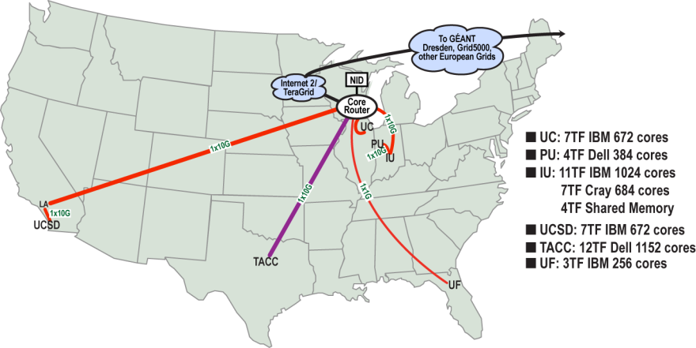
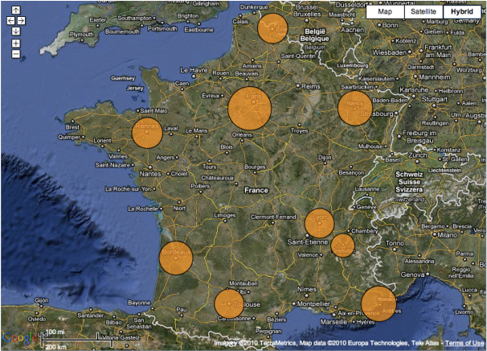
Sky Computing on FutureGrid
Pierre Riteau
M. Tsugawa, A. Matsunaga, J. Fortes, T. Freeman, D. LaBissoniere, K. Keahey
Combine resources obtained in multiple clouds
Integration of resources from Grid5000 and FutureGrid
Deployed a virtual cluster of over 1000 cores on Grid5000 and FutureGrid and used it for bioinformatics comps
Demonstrated at OGF 29
Poster to be presented at TeraGrid ‘10
SD
Rennes
Grid’5000 firewall
UF
Lille
Queue ViNe Router
UC
Sophia

Slide 16
Cumulus: a Storage Cloud for Science
John Bresnahan, University of Chicago
S3-compatible open source storage cloud
Component of Nimbus
Quota support for scientific users
Pluggable back-end to popular technologies such as POSIX, HDFS, Sector and BlobSeer
Initial performance studies
FutureGrid at U Chicago
Poster submitted to SC10

Slide 17
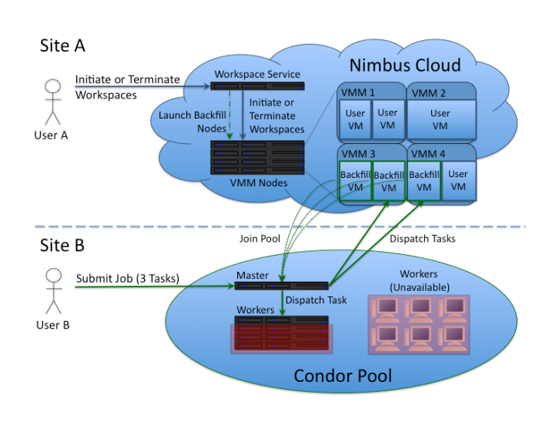
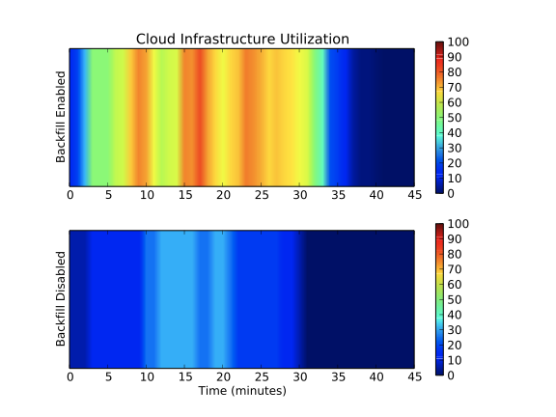
Clouds and HTC: a Match?
Paul Marshall, University of Colorado
Using HTC as “backfill” for on-demand clouds
Extension to Nimbus
Significant utilization improvement leading to lowering cost for cloud computing
Initial results on FG @ U Chicago
Preparing for running of production workloads on FG @ U Chicago
Poster submitted to SC10

Slide 18
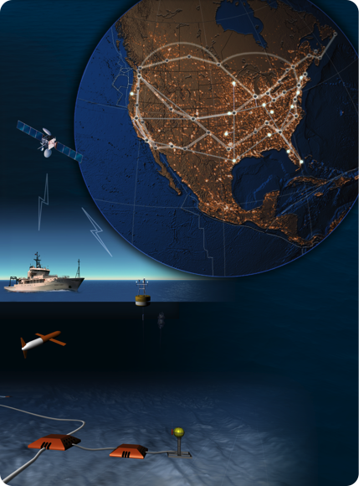
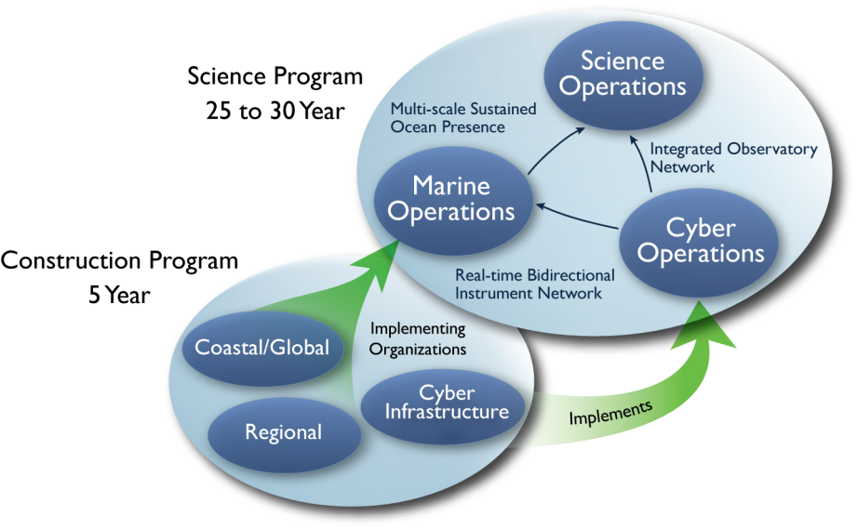
Cloud Bursting
Paul Marshall and the Nimbus team
HA service that provisions resources on clouds in response to need
Serving the needs of Ocean Observatory Initiative (OOI)
Initiated scalability and reliability tests on FutureGrid and Magellan resources
Work in progress

