Slide 1
FutureGrid: An Experimental Computing Grid and Cloud Test-Bed
Karolina Sarnowska-Upton
University of Virginia

Slide 2
Outline
FutureGrid Introduction
Getting Started
Cloud Services
Grid Endpoints

Slide 3
What is FutureGrid?
A high-performance test-bed for parallel, grid and cloud computing
One of two experimental systems part of TeraGrid
To support development and early use of new technologies at all levels of software stack
Notes:
TeraGrid : NSF's high-performance cyberinfrastructure
FutureGrid is one of two experimental systems part of the TeraGrid
FutureGrid environment mimics TeraGrid and/or general parallel and distributed systems
FutureGrid will build a robustly managed simulation environment or testbed
Will allow scientists to collaboratively develop and test innovative approaches to parallel, grid, and cloud computing.
employs virtualization technology to allow the test bed to support a wide range of operating systems.
The goal is to build a system that helps researchers identify cyberinfrastructure that best suits their scientific needs
An experimental computing grid and cloud test-bed
->Support research on the future of distributed, grid, and cloud computing
Support development and early use of new technologies at all levels of the software stack:
->from networking to middleware to scientific applications

Slide 4
General Project Goals
To understand the behavior and utility of cloud computing approaches
To enable scientists to develop and test new approaches to parallel, grid and cloud computing, and compare and collaborate with international efforts in this area
To provide a test-bed for middleware development
To develop of benchmarks appropriate for grid computing
Notes:
To understand the behavior and utility of cloud computing approaches.
->Researchers will be able to measure the overhead of cloud technology by requesting linked experiments on both virtual and bare-metal systems.
Enable scientists to develop and test new approaches to parallel, grid and cloud computing, and compare and collaborate with international efforts in this area.
->The FutureGrid project will provide an experimental platform that accommodates batch, grid and cloud computing, allowing researchers to attack a range of research questions associated with optimizing, integrating and scheduling the different service models.
To enable scientists to develop and test new approaches to parallel, grid and cloud computing
->compare and collaborate with international efforts in this area
To provide a test-bed for middleware development
->, because of its private network, allows middleware researchers to do controlled experiments under different network conditions and to test approaches to middleware that include direct interaction with the network control layer.
To develop of benchmarks appropriate for grid computing
-> including workflow-based benchmarks derived from applications in astronomy, bioinformatics, seismology and physics.

Slide 5
Education and Training Goals
Educational modules: networking, parallel computing, virtualization and distributed computing
Pre-packaged environments: configured for particular course
Community/repository of environments: develop once, share and reuse
Notes:
lower barrier to entry; zero-configuration technologies;

Slide 6
Project Members
Indiana University (Architecture, core software, Support)
Purdue University (HTC Hardware)
San Diego Supercomputer Center at University of California San Diego (INCA, Monitoring)
University of Chicago/Argonne National Labs (Nimbus)
University of Florida (ViNE, Education and Outreach)
University of Southern California Information Sciences Institute (Pegasus to manage experiments)
University of Tennessee Knoxville (Benchmarking)
University of Texas at Austin/Texas Advanced Computing Center (Portal)
University of Virginia (OGF, Advisory Board and allocation)
Technische Universtität Dresden Center for Information Services and GWT‐TUD (VAMPIR)
Notes:
The project partners will integrate existing open-source software packages to create an easy-to-use software environment that supports the instantiation, execution and recording of grid and cloud computing experiments.

Slide 7
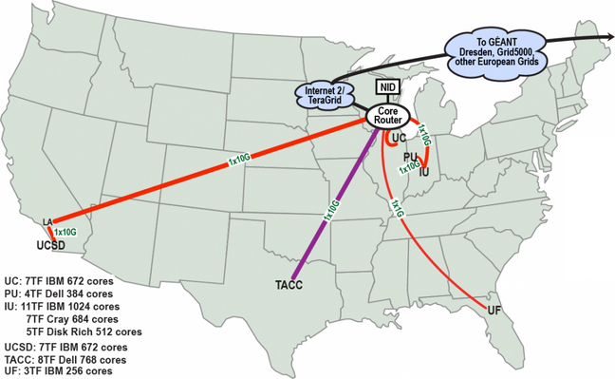
Resource Map
computing systems at 6 sites connected by dedicated* network (~5000 cores)
Notes:
composed of a high-speed network connected to distributed clusters of high-performance computers.
Includes 6 sites connected by a private network
Includes
a geographically distributed set of heterogeneous computing systems
a data management system that will hold both metadata and a growing library of software images
a dedicated network allowing isolatable, secure experiments.

Slide 8
Number of Cores per Partition Type
Notes:
FG Supports
virtual machine-based environments
native operating systems

Slide 9
Getting Started

Slide 10
Getting Started with FutureGrid
Create a portal account at https://portal.futuregrid.org/user/register
Apply for a project
Request HPC/cloud account(s)
Notes:
Will be redirected here from www.futuregrid.org

Slide 11
CLOUD SERVICES
Eucalyptus, Nimbus
Notes:
All FutureGrid users are automatically provided Nimbus credentials.
Cloud Accounts
The cloud accounts are handled in Phase I separately from the HPC account creation process. In fact the Eucalyptus clouds are disjunct on each machine and have their own user management. For Nimbus the situation is already a bit better as only one Nimbus account is needed for all Nimbus clouds in FG.

Slide 12
Eucalyptus
Eucalyptus EC2 Interface
Available on India (50 nodes), Sierra (21 nodes) clusters
Different Availability zones provide VMs with different compute and memory capacities:
Notes:
Each node supports up to 8 VMs.

Slide 13
Nimbus
Available on Hotel (41 nodes), Foxtrot (26 nodes), Sierra (18 nodes) clusters
Can upload own VM image or customize provided image
Users are limited to running 16 VMs simultaneously and claiming two cores per VM

Slide 14
Tutorials on Cloud Provisioning Platforms
Using Nimbus on FutureGrid
Nimbus One-click Cluster Guide
Using the Grid Appliance to run FutureGrid Cloud Clients
Using Eucalyptus on FutureGrid
Using OpenNebula

Slide 15
Tutorials on Cloud Run-time Platforms
Intro to Hadoop using the Grid Appliance
Running Hadoop on Eucalyptus
Running Twister on Eucalyptus

Slide 16
Current European Cloud Projects
Project Title (Lead) | Institution | Keywords
Cloud-Based Support for Distributed Multiscale Applications (K. Rycerz) | AGH, Krakow, Institute of Computer Science, Poland | multiscale computing, cloud computing, HPC
Sky Computing (P. Riteau) | Université de Rennes 1, IRISA, France | sky computing, federated clouds
SpeQulos: A Framework for QoS in Unreliable Distributed Computing Infrastructures using Cloud Resources (S. Delamare) | INRIA, Rhone Alpes, France | hybrid distributed infrastructure, cloud, desktop grid, QoS
Scalable Data Management for Cloud Services (A. Carpen-Amarie) | INRIA, Rennes-Bretagne Atlantique Research Center, France | Nimbus, Cumulus, BlobSeer
Notes:
36 cloud projects
112 total projects

Slide 17
Grid endpoints
UNICORE, Genesis II
Notes:
Maintained by FutureGrid team at UVA
for interoperability tests
for experimentation with middleware whether creating their own grid or connecting with existing endpoints

Slide 18
UNICORE 6 BES Endpoints
Two endpoints (India, Sierra)
Connection information at https://portal.futuregrid.org/unicore
Security
username/password authentication (as per HPC-BP)
X-509 based mutual client authentication (as per HPC-BP)
Access
using any standards-compliant middleware client
Notes:
Open Grid Services Architecture Basic Execution Service, Open Grid Forum
a specification for a service to which clients can send requests to initiate, monitor, and manage computational activities
Cores:
8 (Jobs submitted directly to machine)
320 (Jobs submitted to queue)
OS: Red Hat Enterprise Linux Server release 5.5
Arch: x86_64

Slide 19
Genesis II BES Endpoints
Three endpoints (India, Sierra, Xray)
Connection information at https://portal.futuregrid.org/manual/genesis
Security
username/password authentication (as per HPC-BP)
Access
using any standards-compliant middleware client
using a Genesis II client connected to the XCG

Slide 20
Conclusion

Slide 21
Take-Away Points
FutureGrid is a test bed for cloud and grid research
FutureGrid provides support for Eucalyptus and Nimbus clouds
Get started at www.futuregrid.org

Slide 22
Thank You! Any Questions?
This document was developed with support from the National Science Foundation (NSF) under Grant No. 0910812 to Indiana University for "FutureGrid: An Experimental, High-Performance Grid Test-bed." Any opinions, findings, and conclusions or recommendations expressed in this material are those of the author(s) and do not necessarily reflect the views of the NSF.

