Slide 1
Big Data Open Source Software and Projects ABDS in Summary IX: Level 11B
I590 Data Science Curriculum
August 15 2014
Geoffrey Fox
gcf@indiana.edu
http://www.infomall.org
School of Informatics and Computing
Digital Science Center
Indiana University Bloomington

Slide 2
HPC-ABDS Layers
Here are 17 functionalities. Technologies are presented in this order
4 Cross cutting at top
13 in order of layered diagram starting at bottom
Message Protocols
Distributed Coordination:
Security & Privacy:
Monitoring:
IaaS Management from HPC to hypervisors:
DevOps:
Interoperability:
File systems:
Cluster Resource Management:
Data Transport:
SQL / NoSQL / File management:
In-memory databases&caches / Object-relational mapping / Extraction Tools
Inter process communication Collectives, point-to-point, publish-subscribe
Basic Programming model and runtime, SPMD, Streaming, MapReduce, MPI:
High level Programming:
Application and Analytics:
Workflow-Orchestration:
NoSQL Technologies

Slide 3
Tools

Slide 4
Apache Lucene
http://lucene.apache.org/
Apache Lucene is an information retrieval software library. Lucene is of particular historical significance in the Apache Big Data Stack as the project that launched Hadoop, as well as other Apache projects such as Solr, Mahout and Nutch.
The Lucene Core subproject provides capabilities such as searching and indexing, spellchecking, hit highlighting and analysis/tokenization capabilities.
Lucene is very widely used in large scale applications, for example Twitter uses Lucene to support real-time search.

Slide 5
Apache Solr, Solandra
Solr http://lucene.apache.org/solr/ is the popular, blazing fast open source enterprise search platform from the Apache Lucene project.
Its major features include powerful full-text search, hit highlighting, faceted search, near real-time indexing, dynamic clustering, database integration, rich document (e.g., Word, PDF) handling, and geospatial search.
Solr is highly reliable, scalable and fault tolerant, providing distributed indexing, replication and load-balanced querying, automated failover and recovery, centralized configuration and more.
Solr powers the search and navigation features of many of the world's largest internet sites.
Solr is written in Java and runs as a standalone full-text search server within a servlet container such as Jetty.
Solr uses the Lucene Java search library at its core for full-text indexing and search, and has REST-like HTTP/XML and JSON APIs that make it easy to use from virtually any programming language.
Solr is essentially a powerful interface to Lucene
Solandra adds Cassandra to Solr http://www.datastax.com/wp-content/uploads/2011/07/Scaling_Solr_with_Cassandra-CassandraSF2011.pdf

Slide 6
NoSQL: Key-Value

Slide 7
Voldemort (LinkedIn)
Voldemort http://data.linkedin.com/opensource/voldemort http://www.project-voldemort.com/voldemort/ is a distributed open source Apache license key-value storage system (clone of Amazon Dynamo)
Data is automatically replicated over multiple servers.
Data is automatically partitioned so each server contains only a subset of the total data
Server failure is handled transparently
Pluggable Storage Engines -- BDB-JE, MySQL, Read-Only
Pluggable serialization is supported to allow rich keys and values including lists and tuples with named fields, as well as to integrate with common serialization frameworks like Protocol Buffers, Thrift, Avro and Java Serialization
Data items are versioned to maximize data integrity in failure scenarios without compromising availability of the system
Each node is independent of other nodes with no central point of failure or coordination
Good single node performance: you can expect 10-20k operations per second depending on the machines, the network, the disk system, and the data replication factor
Support for pluggable data placement strategies to support things like distribution across data centers that are geographically far apart.

Slide 8
Riak
Riak is an Apache licensed open source, distributed key-value database. Riak is architected for:
Low-Latency: Riak is designed to store data and serve requests predictably and quickly, even during peak times.
Availability: Riak replicates and retrieves data intelligently, making it available for read and write operations even in failure conditions.
Fault-Tolerance: Riak is fault-tolerant so you can lose access to nodes due to network partition or hardware failure and never lose data.
Operational Simplicity: Riak allows you to add machines to the cluster easily, without a large operational burden.
Scalability: Riak automatically distributes data around the cluster and yields a near-linear performance increase as capacity is added
Riak uses Solr for search
Riak is written mainly in Erlang and client libraries exist for Java, Ruby, Python, and Erlang.
Comes from Basho Technologies and based on Amazon Dynamo

Slide 9
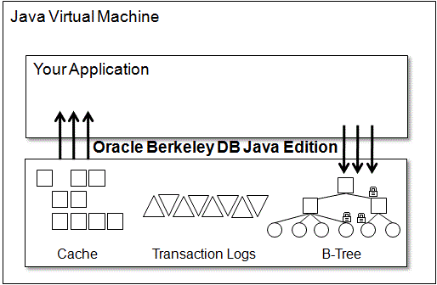
Oracle Berkeley DB Java Edition BDB-JE
Oracle Berkeley DB Java Edition is an open source, embeddable, transactional storage engine written entirely in Java. It takes full advantage of the Java environment to simplify development and deployment. The architecture of Oracle Berkeley DB Java Edition supports very high performance and concurrency for both read-intensive and write-intensive workloads.
It is not SQL and different from the majority of Java solutions, which use object-to-relational (ORM) solutions like the Java Persistence API (JPA) to map class and instance data into rows and columns in a RDBMS.
Relational databases are well suited to data storage and analysis, however most persisted object data is never analyzed using ad-hoc SQL queries; it is usually simply retrieved and reconstituted as Java objects.

Slide 10
Google Cloud DataStore
Public Cloud NoSQL stores
https://cloud.google.com/products/cloud-datastore/
Datastore is a NoSQL database as a cloud service
This is a schemaless database for storing non-relational data. Cloud Datastore automatically scales as you need it and supports transactions as well as robust, SQL-like queries.
See http://aws.amazon.com/dynamodb/ for Amazon equivalent and Azure Table http://azure.microsoft.com/en-us/documentation/articles/storage-dotnet-how-to-use-tables/ for Azure equivalent

Slide 11
NoSQL: Document

Slide 12
Espresso (LinkedIn)
Espresso http://data.linkedin.com/projects/espresso is a horizontally scalable, indexed, timeline-consistent, document-oriented, highly available NoSQL data store.
Expect to release it as an open-source project in 2014
As LinkedIn grows, our requirements for primary source-of-truth data are exceeding the capabilities of a traditional RDBMS system. More than a key-value store, Espresso provides consistency, lookups on secondary fields, full text search, limited transaction support, and the ability to feed a change capture service for easy integration with other online, nearline and offline data ecosystem.
To support our highly innovative and agile environment, we need to support on-the-fly schema changes, and for operability, the ability to add capacity incrementally with no downtime.
Espresso is in production today, and we are aggressively migrating many applications to use Espresso as the source-of-truth.
Examples include: member-member messages, social gestures such as updates, sharing articles, member profiles, company profiles, news articles, and many more.
Espresso is the source of truth for many applications and tens of terabytes of primary data.
As we support these applications, we are working through many interesting problems, such as consistency/availability tradeoffs, latency optimization, efficient use of system resources, performance benchmarking and optimization, and lots more.

Slide 13
CouchDB
Apache CouchDB is a database that uses JSON for documents, JavaScript for MapReduce indexes, and regular HTTP for its API
“CouchDB is a database that completely embraces the web”
CouchDB http://en.wikipedia.org/wiki/CouchDB http://couchdb.apache.org/ is written in Erlang.
Couch is an acronym for cluster of unreliable commodity hardware
Unlike in a relational database, CouchDB does not store data and relationships in tables.
Instead, each database is a collection of independent documents.
Each document maintains its own data and self-contained schema.
An application may access multiple databases, such as one stored on a user's mobile phone and another on a server.
Document metadata contains revision information, making it possible to merge any differences that may have occurred while the databases were disconnected.
CouchDB provides ACID (Atomicity, Consistency, Isolation, Durability) semantics using a form of Multi-Version Concurrency Control (MVCC) in order to avoid the need to lock the database file during writes.
Conflicts are left to the application to resolve.
Resolving a conflict generally involves first merging data into one of the documents, then deleting the stale one

Slide 14
NoSQL: Column Also see Apache Flink in Programming

Slide 15
Apache HBase
http://hbase.apache.org/
Hbase is an open-source NoSQL database, modeled after Google’s Bigtable distributed storage system.
Massively scalable, capable of managing and organizing petabyte size data sets with billions of rows by millions of columns.
Features presented in the Big Table paper which have been implemented in HBASE include in-memory operation and the application of Bloom filters to columns. HBase can be accessed through a number of APIs, including Java, REST, Avro or Thrift.
Developed for a natural language search engine, it first became a subproject of Apache Hadoop, became a top level project in 2010.

Slide 16
Apache Cassandra
http://cassandra.apache.org/
Apache Cassandra is an open source column oriented distributed NoSQL DBMS to handle large amounts of data for high availability and low latency, even over many servers or clusters spanning multiple datacenters.
Cassandra supports either synchronous or asynchronous replication, replication to multiple nodes eliminates points of failure and improves latency to clients.
Ranked as the most scalable data solution with highest throughput for largest number of nodes.
Originally developed at Facebook, became open source in 2008 and a top level Apache project in 2010

Slide 17
Apache Accumulo
https://accumulo.apache.org/
Accumulo is a distributed key/value store based on the same Google Bigtable design as Hbase and Cassandra.
Extends the BigTable model with additional functionality such as cell level security and server-side programming features.
Built on foundation of Apache Hadoop, Zookeeper, and Thrift
Accumulo is the third most popular wide column store after Cassandra and Hbase.
First developed in 2008, became part of Apache in 2011.
http://sqrrl.com/media/Rya_CloudI20121.pdf builds an RDF triple store on top of Accumulo

Slide 18
NoSQL: Graph

Slide 19
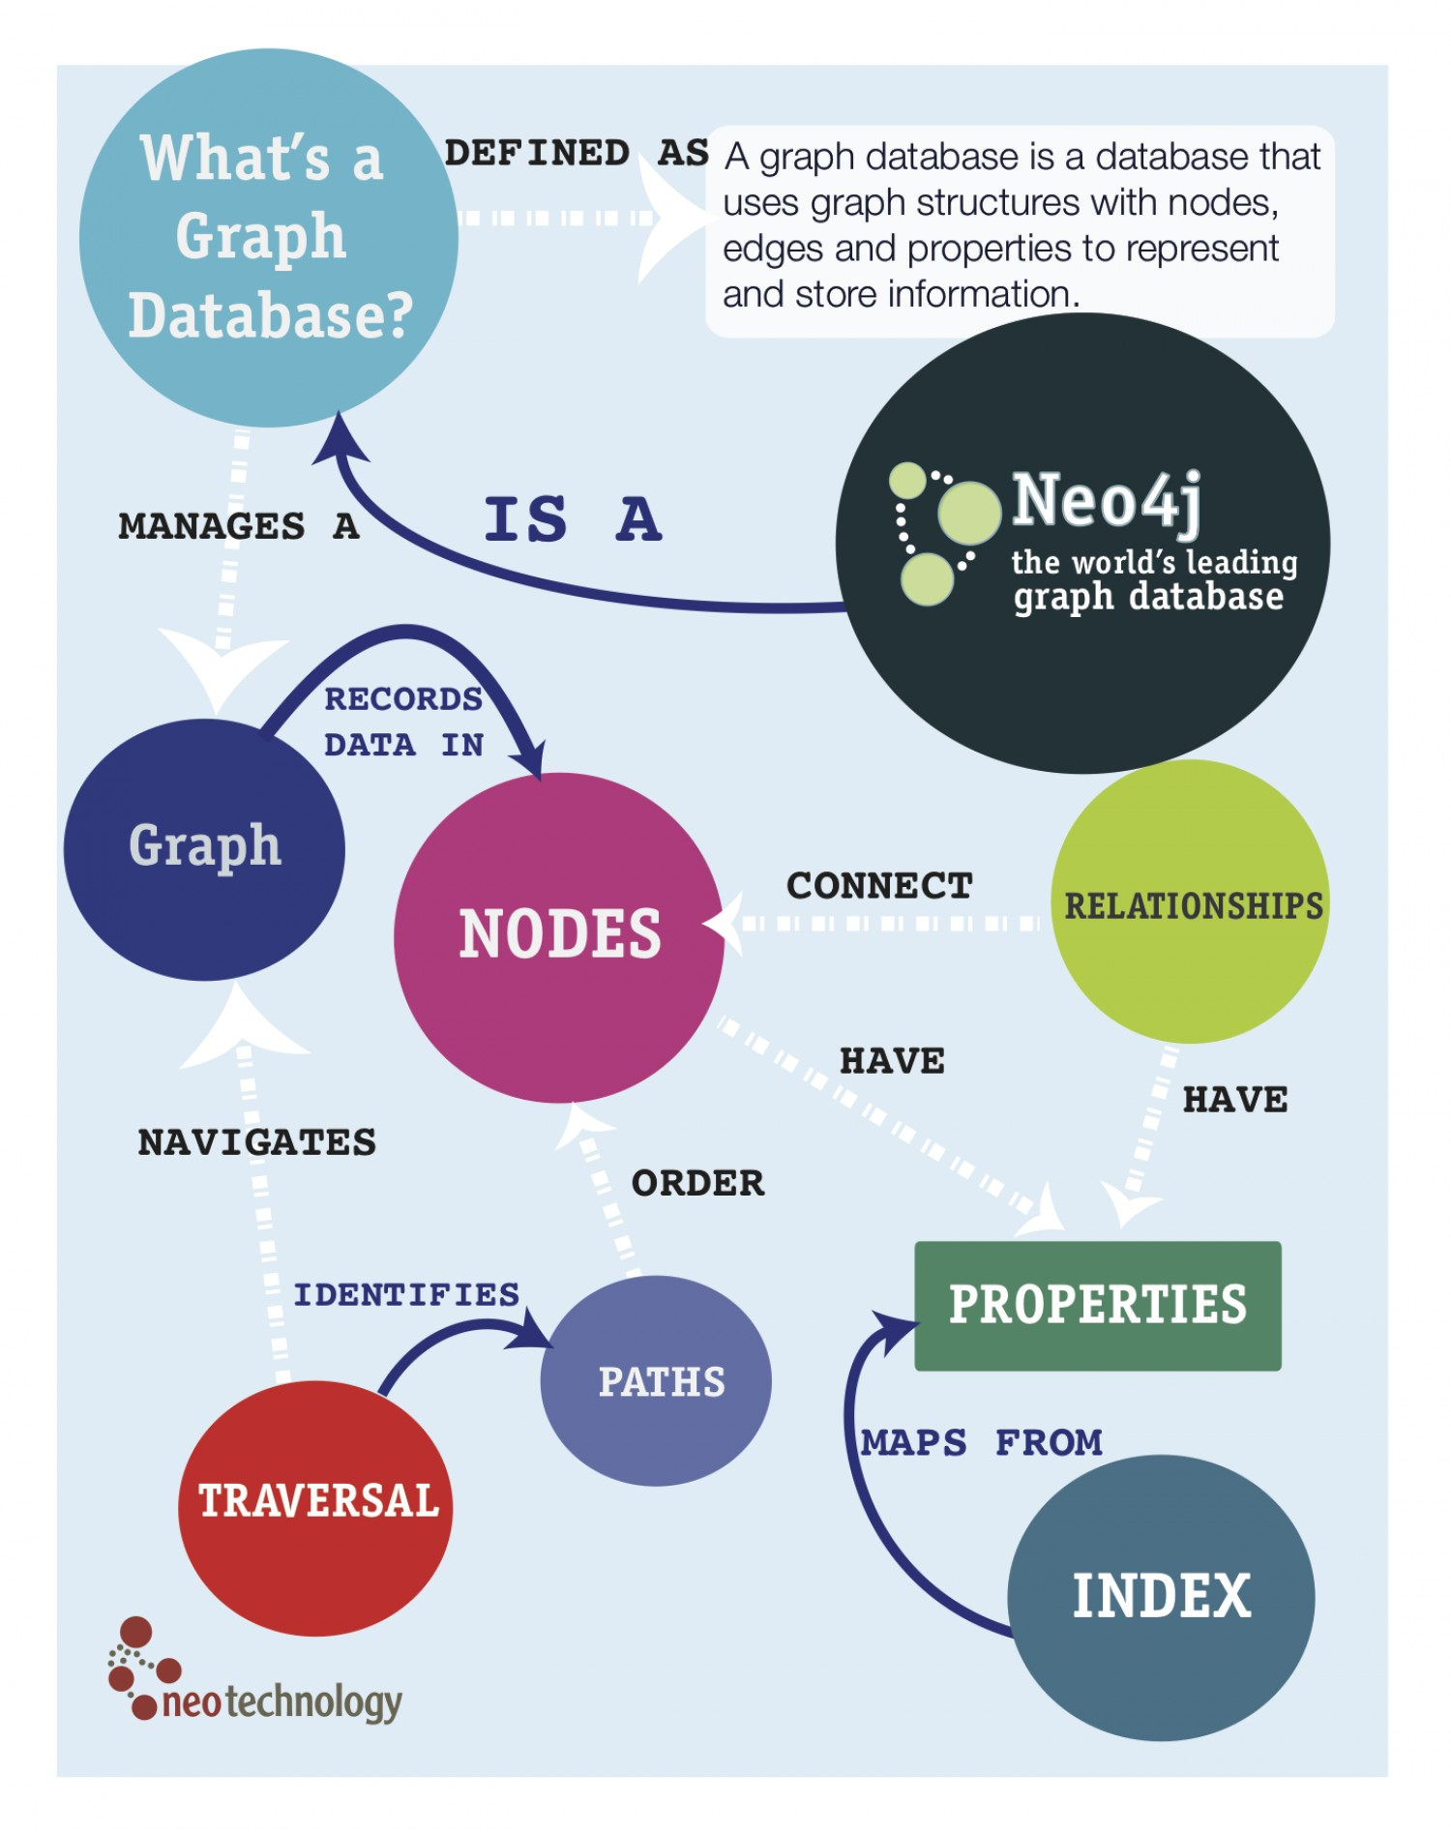
Neo4J
Neo4j open source GPLv3 license http://www.neo4j.org/ http://en.wikipedia.org/wiki/Neo4j
Neo4j is an embedded, disk-based, fully transactional Java persistence engine that stores data structured in graphs rather than in tables.
Query by SparQL, native Java API, JRuby
Neo4j is the most popular graph database

Slide 20
Yarcdata Urika
http://www.yarcdata.com/Products/
Partnership with Cray
Proprietary shared memory Graph Database
Urika’s schema-free architecture, large shared memory, massively multi-threaded processors, and highly scalable I/O fuses diverse data sets into a high-performance, in-memory data model ready to be queried…all ad-hoc and in real-time.
No need to first lay out the data or predict the relationships – or even know all the queries to make upfront.
Supports SPARQL queries
Access built-in graph function BGF’s that include
Community detection: finds groups of vertices that are more densely connected within the community than outside the community
Betweenness centrality: ranks vertices on how often they are on the shortest path between other pairs of vertices
S-t connectivity: determines how long the path is from a source to a sink, if one exists
BadRank: ranks vertices on how close they are to bad vertices

Slide 21
AllegroGraph
Franz Inc. Proprietary graph database written in: Common Lisp
http://en.wikipedia.org/wiki/AllegroGraph http://franz.com/agraph/allegrograph/
AllegroGraph is a modern, high-performance, persistent graph database.
AllegroGraph uses efficient memory utilization in combination with disk-based storage, enabling it to scale to billions of quads while maintaining superior performance.
SOLR and MongoDB Integration
AllegroGraph is 100 percent ACID, supporting Transactions: Commit, Rollback, and Checkpointing.
Quads are <subject> <predicate> <object> <context> where triples are first three
AllegroGraph supports SPARQL, RDFS++, and Prolog reasoning from numerous client applications.
Query Method: SPARQLand Prolog,
Libraries: Social Networking Analytics & GeoSpatial,
AllegroGraph was developed to meet W3C standards for the Resource Description Framework, so it is properly considered an RDF Database. It is a reference implementation for the SPARQL protocol.
See http://www.w3.org/wiki/SparqlImplementations

Slide 22
NoSQL: Triple Store

Slide 23
Apache Jena
http://jena.apache.org/ http://en.wikipedia.org/wiki/Jena_(framework)
Jena is an open source Semantic Web and linked data framework in Java. It provides an API to extract data from and write to RDF graphs. The graphs are represented as an abstract "model".
A model can be sourced with data from files, databases, URLs or a combination of these. A Model can also be queried through SPARQL and updated through SPARUL.
Jena is similar to Sesame; though, unlike Sesame, Jena provides support for OWL (Web Ontology Language).
The framework has various internal reasoners and the Pellet reasoner (an open source Java OWL-DL reasoner) can be set up to work in Jena.
TDB is a component of Jena for RDF storage and query.
It supports the full range of Jena APIs.
TDB can be used as a high performance RDF store on a single machine.

Slide 24
Sesame
http://www.openrdf.org/ http://en.wikipedia.org/wiki/Sesame_(framework)
Sesame is a de-facto standard framework for processing RDF data. This includes parsing, storing, inferencing and querying of/over such data. It offers an easy-to-use API that can be connected to all leading RDF storage solutions.
Sesame has been designed with flexibility in mind. It can be deployed on top of a variety of storage systems (relational databases, in-memory, filesystems, keyword indexers, etc.), and offers many tools to help developers to leverage the power of RDF and related standards.
Many other triplestores can be used through the Sesame API, including Mulgara, and AllegroGraph.
Sesame fully supports the SPARQL query language for expressive querying and offers transpararent access to remote RDF repositories using the exact same API as for local access.
Finally, Sesame supports all main stream RDF file formats, including RDF/XML, Turtle, N-Triples, TriG and TriX.
Sesame supports two query languages: SPARQL and SeRQL.
Another component of Sesame is Alibaba, an API that allows for mapping Java classes onto ontologies and for generating Java source files from ontologies.
This makes it possible to use specific ontologies like RSS, FOAF and the Dublin Core directly from Java.
Sesame is BSD licensed open software from Aduna – a Dutch company

