Slide 1
Big Data Open Source Software and Projects ABDS in Summary XVI: Level 16
I590 Data Science Curriculum
August 15 2014
Geoffrey Fox
gcf@indiana.edu
http://www.infomall.org
School of Informatics and Computing
Digital Science Center
Indiana University Bloomington

Slide 2
HPC-ABDS Layers
Message Protocols
Distributed Coordination:
Security & Privacy:
Monitoring:
IaaS Management from HPC to hypervisors:
DevOps:
Interoperability:
File systems:
Cluster Resource Management:
Data Transport:
SQL / NoSQL / File management:
In-memory databases&caches / Object-relational mapping / Extraction Tools
Inter process communication Collectives, point-to-point, publish-subscribe
Basic Programming model and runtime, SPMD, Streaming, MapReduce, MPI:
High level Programming:
Application and Analytics:
Workflow-Orchestration:
Here are 17 functionalities. Technologies are presented in this order
4 Cross cutting at top
13 in order of layered diagram starting at bottom

Slide 3
Apache Mahout
https://mahout.apache.org/
Apache Mahout provides scalable machine learning algorithms for three primary applications: classification, clustering and recommendation mining.
In each of these areas, multiple algorithms are provided. For example, within Classification, Mahout offers algorithms for Naïve Bayes, Hidden Markov Models, Logistic Regression and Random Forests.
Mahout is intended as a scalable, distributed solution, but also includes single node contributions. While many of the Mahout algorithms originally utilized the Apache Hadoop platform, the community has announced that for performance purposes, all future development will be done in a new Domain Specific Language for linear algebra designed to run in parallel on Apache Spark.
Mahout began as part of the Apache Lucene information retrieval project, and became an independent project in 2010. The original goal of Mahout (not yet complete) was to implement the 10 algorithms included in the paper “Map-Reduce for Machine Learning on Multicore” http://papers.nips.cc/paper/3150-map-reduce-for-machine-learning-on-multicore.pdf
25 April 2014 - Goodbye MapReduce: The Mahout community decided to move its codebase onto modern data processing systems that offer a richer programming model and more efficient execution than Hadoop MapReduce. Mahout will therefore reject new MapReduce algorithm implementations from now on. We will however keep our widely used MapReduce algorithms in the codebase and maintain them. We are building our future implementations on top of an interface in Apache Spark.

Slide 4
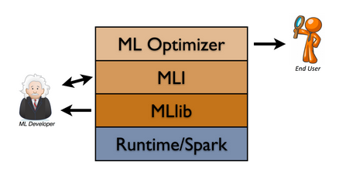
Mlbase, MLlib
These are Spark equivalents of Mahout and Mlbase http://www.mlbase.org/ has:
MLlib: A distributed low-level ML library written against the Spark runtime that can be called from Scala and Java. The library includes common algorithms for classification, regression, clustering and collaborative filtering.
MLI: An API / platform for feature extraction and algorithm development that introduces high-level ML programming abstractions.
ML Optimizer: This layer aims to simplify ML problems for end users by automating the task of model selection.
http://stanford.edu/~rezab/sparkworkshop/slides/xiangrui.pdf describes MLlib contents
MLlib uses the linear algebra package Breeze, which depends on netlib-java, and jblas.

Slide 5
MLlib contents
Data types
Basic statistics
summary statistics
correlations
stratified sampling
hypothesis testing
random data generation
Classification and regression
linear models (SVMs, logistic regression, linear regression)
decision trees
naive Bayes
Collaborative filtering
alternating least squares (ALS)
Clustering
k-means
Dimensionality reduction
singular value decomposition (SVD)
principal component analysis (PCA)
Feature extraction and transformation
Optimization (developer)
stochastic gradient descent
limited-memory BFGS (L-BFGS)

Slide 6
Apache DataFu (LinkedIn)
http://data.linkedin.com/opensource/datafu http://datafu.incubator.apache.org/
Included in Cloudera's CDH and Apache Bigtop.
Apache DataFu Pig is collection of User Defined Functions for Pig (Hadoop)
PageRank
Statistics (e.g. quantiles, median, variance, etc.)
Sampling (e.g. weighted, reservoir, etc.)
Sessionization
Convenience bag functions (e.g. enumerating items)
Convenience utility functions (e.g. assertions, easier writing of EvalFuncs)
Set operations (intersect, union)
Apache DataFu Hourglass is a library for incrementally processing data using Hadoop MapReduce. This library was inspired by the prevelance of sliding window computations over daily tracking data at LinkedIn.
Computations such as these typically happen at regular intervals (e.g. daily, weekly), and therefore the sliding nature of the computations means that much of the work is unnecessarily repeated.
DataFu's Hourglass was created to make these computations more efficient, yielding sometimes 50-95% reductions in computational resources

Slide 7
mlpy, scikit-learn , CompLearn
A sample of machine learning libraries outside R
mlpy - Machine Learning Python http://mlpy.sourceforge.net/ Python module for Machine Learning built on top of NumPy/SciPy and the GNU Scientific Libraries. Supports Regression, Classification, Clustering, Dimension reduction and wavelet methods.
scikit-learn http://en.wikipedia.org/wiki/Scikit-learn is an open source machine learning library for the Python programming language. It features various classification, regression and clustering algorithms including support vector machines, logistic regression, naive Bayes, random forests, gradient boosting, k-means and DBSCAN, and is designed to interoperate with the Python numerical and scientific libraries NumPy and SciPy.
PyBrain BSD license http://pybrain.org/ focusses on learning
CompLearn http://www.complearn.org/ is a suite of simple-to-use utilities that you can use to apply compression techniques to the process of discovering and learning patterns.

Slide 8
Caffe
Caffe BSD-2 license http://caffe.berkeleyvision.org/ is a deep learning framework developed with cleanliness, readability, and speed in mind.
It was created by Yangqing Jia during his PhD at UC Berkeley, and is in active development by the Berkeley Vision and Learning Center (BVLC) and by community contributors. Clean architecture enables rapid deployment. Networks are specified in simple config files, with no hard-coded parameters in the code. Switching between CPU and GPU is as simple as setting a flag – so models can be trained on a GPU machine, and then used on commodity clusters.
Readable & modifiable implementation fosters active development. In Caffe’s first six months, it has been forked by over 300 developers on Github, and many have pushed significant changes.
Speed makes Caffe perfect for industry use. Caffe can process over 40M images per day with a single NVIDIA K40 or Titan GPU. That’s 5 ms/image in training, and 2 ms/image in test. We believe that Caffe is the fastest CNN (convolutional neural net) implementation available.
http://ucb-icsi-vision-group.github.io/caffe-paper/caffe.pdf

Slide 9
R
R is GPL Open Source http://en.wikipedia.org/wiki/R_(programming_language) and many books and online resources and is widely used by statistics community
R provides a wide variety of statistical and graphical techniques, including linear and nonlinear modeling, classical statistical tests, time-series analysis, classification, clustering, and others. R is easily extensible through functions and extensions, and the R community is noted for its active contributions in terms of packages.
There are some important differences, but much code written for S runs unaltered. Many of R's standard functions are written in R itself, which makes it easy for users to follow the algorithmic choices made.
For computationally intensive tasks, C, C++, and Fortran code can be linked and called at run time. Advanced users can write C, C++, Java, .NET or Python code to manipulate R objects directly.
R is typically not best high performance implementation of an algorithm
R is highly extensible through the use of user-submitted packages for specific functions or specific areas of study. Due to its S heritage, R has stronger object-oriented programming facilities than most statistical computing languages. Extending R is also eased by its lexical scoping rules.
Another strength of R is static graphics, which can produce publication-quality graphs, including mathematical symbols. Dynamic and interactive graphics are available through additional package

Slide 10
Bioconductor
http://www.bioconductor.org/
Bioconductor provides tools for the analysis and comprehension of high-throughput genomic data (especially annotation). Bioconductor largely uses the R statistical programming language, and is open source and open development. It has (like R) two releases each year, 824 software packages in version 214, and an active user community.
GPL Open Source license (controversial Artistic license)
The project was started in the Fall of 2001 and is overseen by the Bioconductor core team, based primarily at the Fred Hutchinson Cancer Research Center, with other members coming from various US and international institutions.

Slide 11
ImageJ
ImageJ http://en.wikipedia.org/wiki/ImageJ is a public domain, Java-based image processing program developed at the National Institutes of Health.
ImageJ was designed with an open architecture that provides extensibility via Java plugins and recordable macros.
Custom acquisition, analysis and processing plugins can be developed using ImageJ's built-in editor and a Java compiler. User-written plugins make it possible to solve many image processing and analysis problems, from three-dimensional live-cell imaging to radiological image processing,[5] multiple imaging system data comparisons[6] to automated hematology systems.
ImageJ's plugin architecture and built in development environment has made it a popular platform for teaching image processing.
ImageJ can be run as an online applet, a downloadable application, or on any computer with a Java 5 or later virtual machine.
The project developer, Wayne Rasband, retired from the Research Services Branch of the National Institute of Mental Health in 2010 but continues to develop the software.

Slide 12
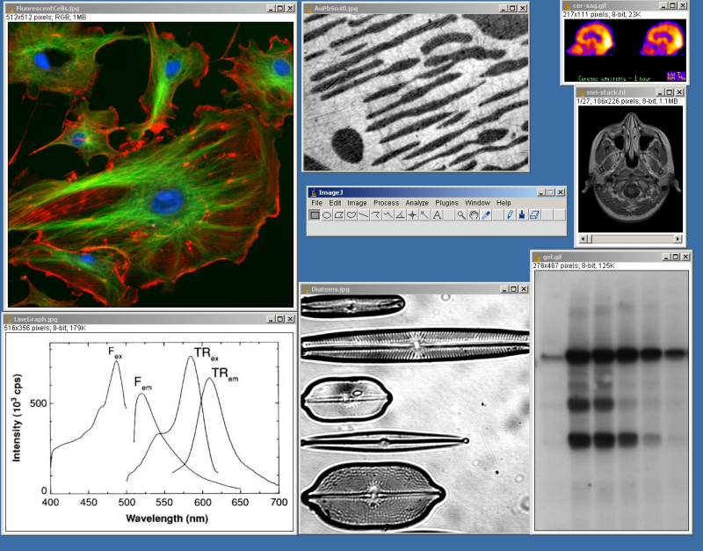
ImageJ Results

Slide 13
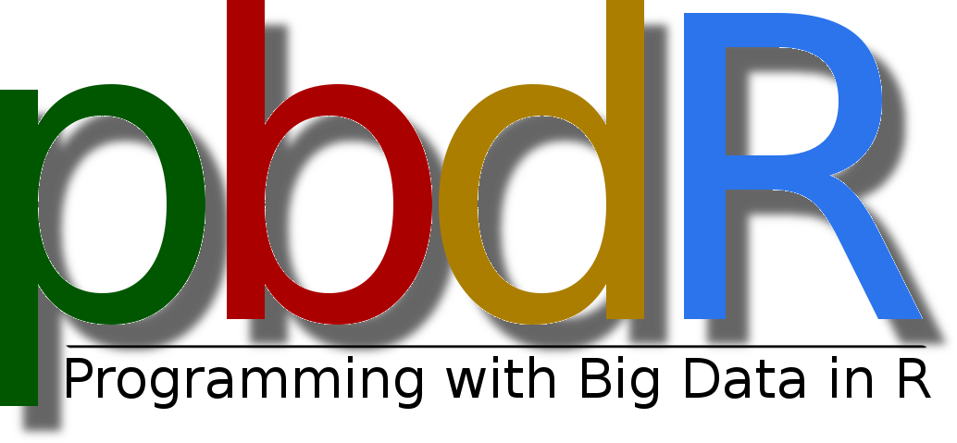
Scalapack
LAPACK (Linear Algebra Package) 1992 BSD license http://en.wikipedia.org/wiki/LAPACK is a standard software library for numerical linear algebra.
It provides routines for solving systems of linear equations and linear least squares, eigenvalue problems, and singular value decomposition.
It also includes routines to implement the associated matrix factorizations such as LU, QR, Cholesky and Schur decomposition.
The ScaLAPACK (or Scalable LAPACK) library http://en.wikipedia.org/wiki/ScaLAPACK includes a subset of LAPACK routines redesigned for distributed memory MIMD parallel computers.
It is currently written in a Single-Program-Multiple-Data SPMD style using explicit message passing MPI for interprocessor communication. It assumes matrices are laid out in a two-dimensional block cyclic decomposition
Includes famous Parallel LINPACK benchmark HPL
http://en.wikipedia.org/wiki/Programming_with_Big_Data_in_R http://r-pbd.org/ from Oak Ridge National Lab uses ScaLAPACK in R.
Also discusses MPI with R Rmpi (Master-worker) and pbdMPI (SPMD)

Slide 14
PETSc
The Portable, Extensible Toolkit for Scientific Computation PETSc is a suite of data structures and routines developed by Argonne National Laboratory for the scalable (parallel) solution of scientific applications modeled by partial differential equations.
It employs the Message Passing Interface (MPI) standard for all message-passing communication.
The current version of PETSc is 3.5; released June 30, 2014. PETSc is the world’s most widely used parallel numerical software library for partial differential equations and sparse matrix computations.
PETSc received an R&D 100 Award in 2009.
Applies to solution of Partial Differential equations and related computational science with characteristic sparse matrices coming from discretizing differential operators
PETSc includes a large suite of parallel linear and nonlinear equation solvers that are easily used in application codes written in C, C++, Fortran and now Python.
PETSc provides many of the mechanisms needed within parallel application code, such as simple parallel matrix and vector assembly routines that allow the overlap of communication and computation.
In addition, PETSc includes support for parallel distributed arrays useful for finite difference methods.

Slide 15
Azure Machine Learning Google Prediction API and Translation API
These are cloud data analytics offered as a service
Azure Machine Learning http://azure.microsoft.com/en-us/services/machine-learning/ Excel client possible; supports R and MapReduce (HDInsight)
Prediction API https://developers.google.com/prediction/ does not describe methods it uses http://stats.stackexchange.com/questions/6298/what-is-behind-google-prediction-api
Translation API https://developers.google.com/translate/ is an interface to Google Translate https://translate.google.com/

