Slide 1

Departamento de Física Teórica II. Universidad Complutense de Madrid
Dispersive analysis of ππ and πK interactions: Resonance poles and Regge behavior
J. R. Peláez
2017 International Summer Workshop on Reaction Theory
June 12-22, 2017, Bloomington, Indiana, USA

Slide 2
Motivation
π and K:
Pseudo-SCALARS. Simplest kinematics
QCD Goldstone Bosons. Test chiral symmetry breaking
Many resonances seen there
Lightest non-strange and strange mesons
Final products in almost all hadronic interactions
Their re-scattering is essential in many hadronic processes

Slide 3
Motivation
ππ and πK SCATTERING
π and K are unstable. Still, beams can be made.
But NOT luminous enough for ππ and πK collisions: Indirect measurements
1) From meson-Nucleon scattering
Chew-Low Extrapolation (see Gribov’s book Sect. 2.6.2)
Initial state not well defined, model dependent off-shell extrapolations
(OPE, absorption, A₂ exchange...).
Needs Meson- N-partial wave extraction. Problems with phase shift ambiguities, etc...
As a consequence… VERY LARGE SYSTEMATIC UNCERTAINTIES
π
π
π
π
N
N

Slide 4
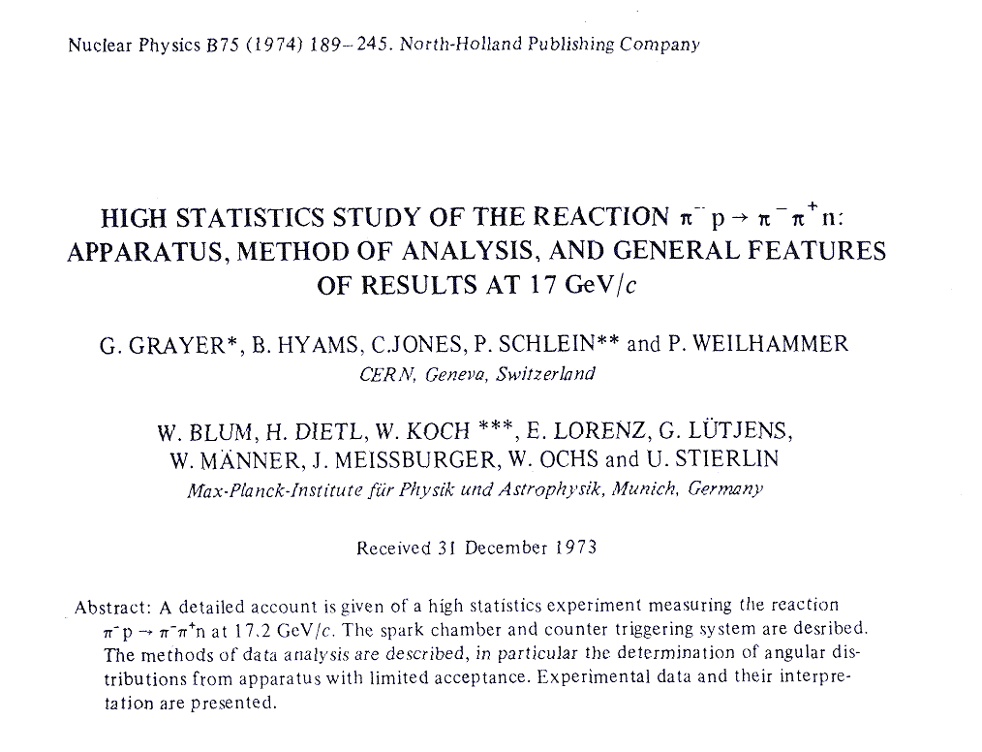
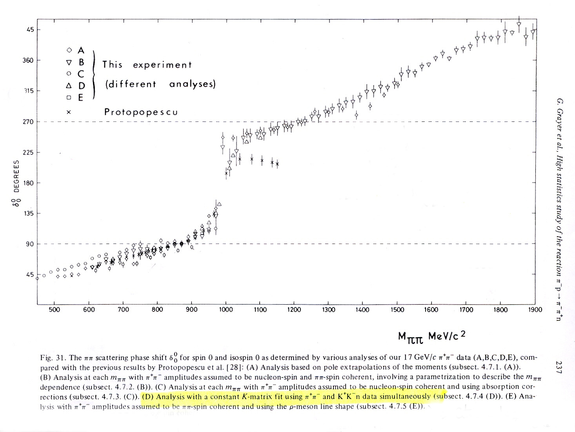
ππ scattering data. Example: CERN Munich Experiment
SYSTEMATIC uncertainties larger than STATISTICAL
Systematic errors of 10º !!
5 different ππ→ππ
analysis of same
πp→ππn data !!

Slide 5
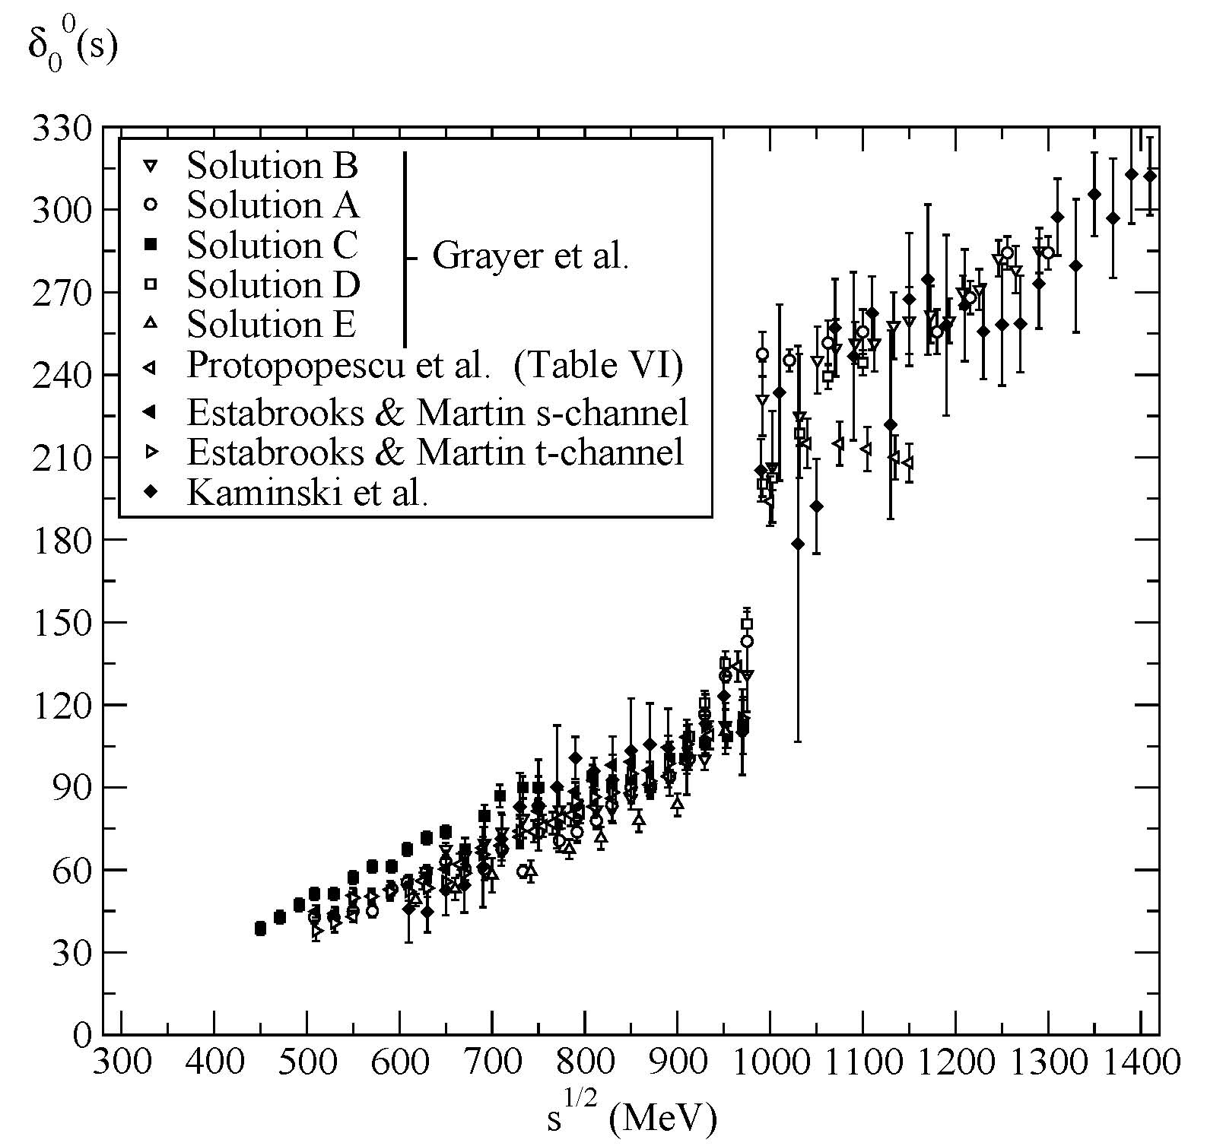
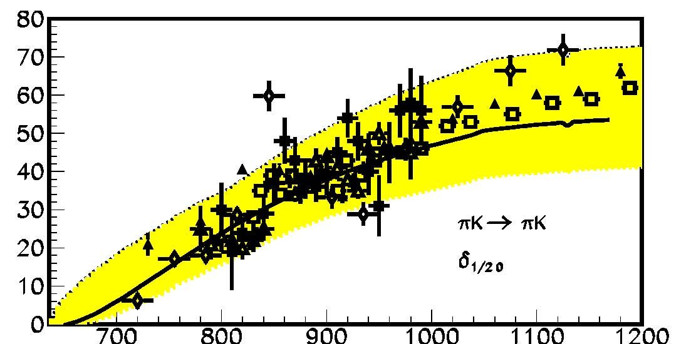
Motivation
First problem:
CONFLICTING DATA SETS
From meson- Nucleon
π π → π π
This lesson: how useful DISPERSION RELATIONS and ANALYTICITY can be

Slide 6
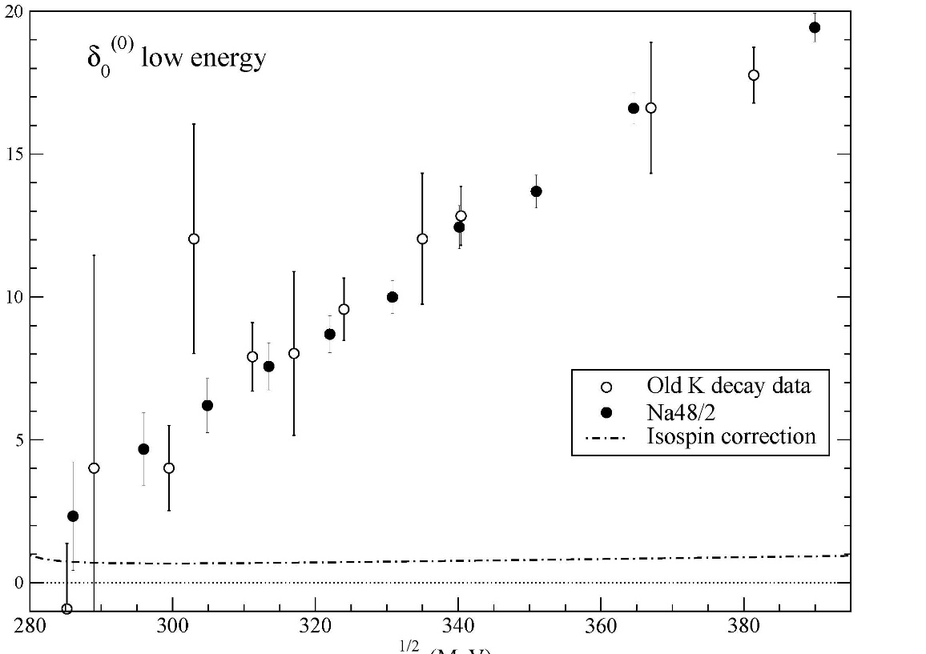
Motivation
ππ and πK SCATTERING
π and K are unstable. Still, beams can be made.
But NOT luminous enough for ππ and πK collisions: Indirect measurements
2) From K→ππeν (“K_{l4} decays”)
Geneva-Saclay (77), E865 (01), NA48/2 (2010)
Pions on-shell.
Very precise
Limited: only ππ→ππ
only δ₀₀-δ_{11.}
only E<M_{K}

Slide 7
Motivation: Why a dispersive approach?
It is model independent. Just analyticity and crossing properties
Determine the amplitude at a given energy even
if there were no data precisely at that energy.
Relate different processes
Increase the precision
Actual data parametrization irrelevant once inside in the integral.
A dispersive meson-meson scattering analysis can help us analyze the data, determine the existence of resonances and provide amplitudes for other processes

Slide 8

What is a dispersion relation.? Very Briefly and for π π
CAUSALITY:
Partial waves t(s) are ANALYTIC in complex s plane
with cuts due to thresholds (also in crossed channels)
Cauchy Theorem determines t(s) at ANY s,
from an INTEGRAL on the contour
If t->0 fast enough at high s, curved part vanishes
Otherwise, determined up to polynomial
(subtractions)
Left cut usually a problem
Good for:
1) Calculating t(s) where there is not data
2) Constraining data analysis
3) ONLY MODEL INDEPENDENT extrapolation to complex s-plane

Slide 9
Single variable Dispersion Relations (DR)
Fixed-t Dispersion Relations (or fixed-s) for T(s,t₀)
Simple analytic structure in s-plane, simple derivation and use
Left cut: With crossing may be rewritten in terms of physical region
Unphysical sheets inaccessible
Most popular: t₀=0, FORWARD DISPERSION RELATIONS
Partial-wave Dispersion Relations
Analytic structure complicated if unequal masses (Circular cuts)
Left cut: With crossing may be rewritten in terms of physical region.
But then different partial waves coupled.
In practice, limited to a finite energy. But Good for resonance poles
Most Popular: UNITARIZED ChPT or ROY-LIKE EQUATIONS

Slide 10
Roy Eqs. vs. Forward Dispersion Relations
They both cover the complete isospin basis
FORWARD DISPERSION RELATIONS (FDRs).
(Kaminski, Pelaez , Yndurain, Garcia Martin, Ruiz de Elvira, Rodas )
One equation per amplitude.
High Energy part very well known since Forward Amplitude~ Total cross section
Positivity in the integrand contributions, good for precision.
Calculated up to 1400 MeV (ππ) or 1.7 GeV (πK)

Slide 11
Forward dispersion relations.
Complete isospin set of 3 forward dispersion relations for :
Two s-u symmetric amplitudes. F₀₊≡ π⁰π⁺→π⁰π⁺, F₀₀ ≡π⁰π⁰ →π⁰π⁰
ONE SUBTRACTION
Only depend on two isospin states. Positivity of imaginary part
Additional sum rules SRJ, SRK if evaluated at s=2M_{π}² (Adler Zeros),
The I_{t}=1 s-u antisymmetric amplitude
At threshold is the Olsson sum rule

Slide 12
Roy Eqs. vs. Forward Dispersion Relations
They both cover the complete isospin basis
FORWARD DISPERSION RELATIONS (FDRs).
(Kaminski, Pelaez , Yndurain, Garcia Martin, Ruiz de Elvira, Rodas )
One equation per amplitude.
High Energy part very well known since Forward Amplitude~ Total cross section
Positivity in the integrand contributions, good for precision.
Calculated up to 1400 MeV (ππ) or 1.7 GeV (πK)
ROY-like EQS (1972)
(Roy, M. Pennington, Caprini et al. , Ananthanarayan et al. Gasser et al.,Stern et al. , Kaminski . Pelaez,,Yndurain, Descotes-Mousasallam,)
Coupled equations for all partial waves.
Limited to ~ O(1) GeV.
Good at low energies, interesting for ChPT and for resonance determination,
particularly light scalars f₀(500),K₀*(800), f₀(980).
ππ 2 subtractions: Roy Eqs.
ππ 1 subtraction: GKPY eqs.
πK: Roy-Steiner Eqs (also for πN and γγ→ππ)

Slide 13
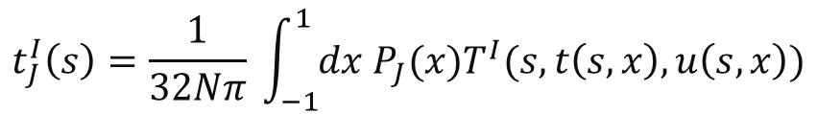
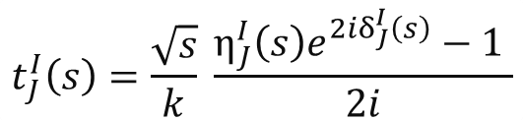
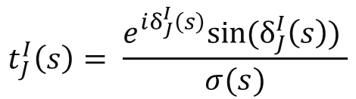


Brief reminder of partial waves.
$$t_{J}^{I}\left(s\right)=\frac{1}{32Nπ} \int_{−1}^{1}{dx P_{J}(x)T^{I}(s,t\left(s,x\right),u\left(s,x\right))}$$
N=1or 2
if identical particles
ππ:
Identical for strong interactions.
Bose symmetry IJ=00,11,02,22,20….=S0,P1,S2,D2,D0…
Kπ:
IJ=1/2 0,1/2 1, 3/2 0…
Phase shift and inelasticity:
$$t_{J}^{I}\left(s\right)=\frac{\sqrt{s}}{k} \frac{η_{J}^{I}\left(s\right)e^{2iδ_{J}^{I}\left(s\right)}−1 }{2i}$$
Elastic unitarity:
$${Im t}_{J}^{I}\left(s\right)=σ(s) {\left|t_{J}^{I}\left(s\right)\right|}^{2}$$
$$σ\left(s\right)=\frac{k}{2\sqrt{s}}$$
$$t_{J}^{I}\left(s\right)= \frac{e^{iδ_{J}^{I}\left(s\right)}sin⁡(δ_{J}^{I}\left(s\right)) }{σ(s)}$$
Elastic partial waves only depend on phase shift

Slide 14
Structure of Roy vs. GKPY Eqs.
Both are coupled channel equations for the infinite partial waves:
I=isospin 0,1,2 , l =angular momentum 1,2,3….
DRIVING
TERMS
(truncation)
Higher waves
and High energy
SUBTRACTION
TERMS
(polynomials)
KERNEL TERMS
known
ROY:
2nd order
More energy suppressed
Very small
Partial wave
on
real axis
GKPY:
1st order
Less energy suppressed
small
“OUT”
=?
“IN (from our data parametrizations)”

Slide 15
Several uses of Dispersion Relations
Checks of Data. Discard inconsistent data sets
Constrain data fits, relating different channels
Solve the DR for some energies given input from other channels or energies
For partial-wave DR:
Rigorous continuation to the second sheet and extraction of resonance parameters

Slide 16
Our series of works: 2005-2011
R. Kaminski, JRP, F.J. Ynduráin Eur.Phys.J.A31:479-484,2007. PRD74:014001,2006
JRP ,F.J. Ynduráin. PRD71, 074016 (2005) , PRD69,114001 (2004),
R. García Martín, R. Kaminski, JRP, J. Ruiz de Elvira, F.J. Ynduráin, Phys.Rev. D83 (2011) 074004,
R. García Martín, R. Kaminski, JRP, J. Ruiz de Elvira ,Phys.Rev.Lett. 107 (2011) 072001
Independent and simple fits
to data in different channels.
“Unconstrained Data Fits=UDF”
Check Dispersion Relations
Impose FDRs, Roy & GKPY Eqs
on data fits
“Constrained Data Fits CDF”
Describe data and are consistent with Dispersion relations
For resonance poles: Continuation to complex plane
USING THE DISPERIVE INTEGRALS

Slide 17
Our series of works: 2005-2011
R. Kaminski, JRP, F.J. Ynduráin Eur.Phys.J.A31:479-484,2007. PRD74:014001,2006
JRP ,F.J. Ynduráin. PRD71, 074016 (2005) , PRD69,114001 (2004),
R. García Martín, R. Kaminski, JRP, J. Ruiz de Elvira, F.J. Ynduráin, Phys.Rev. D83 (2011) 074004,
R. García Martín, R. Kaminski, JRP, J. Ruiz de Elvira ,Phys.Rev.Lett. 107 (2011) 072001
Independent and simple fits
to data in different channels.
“Unconstrained Data Fits=UDF”

Slide 18
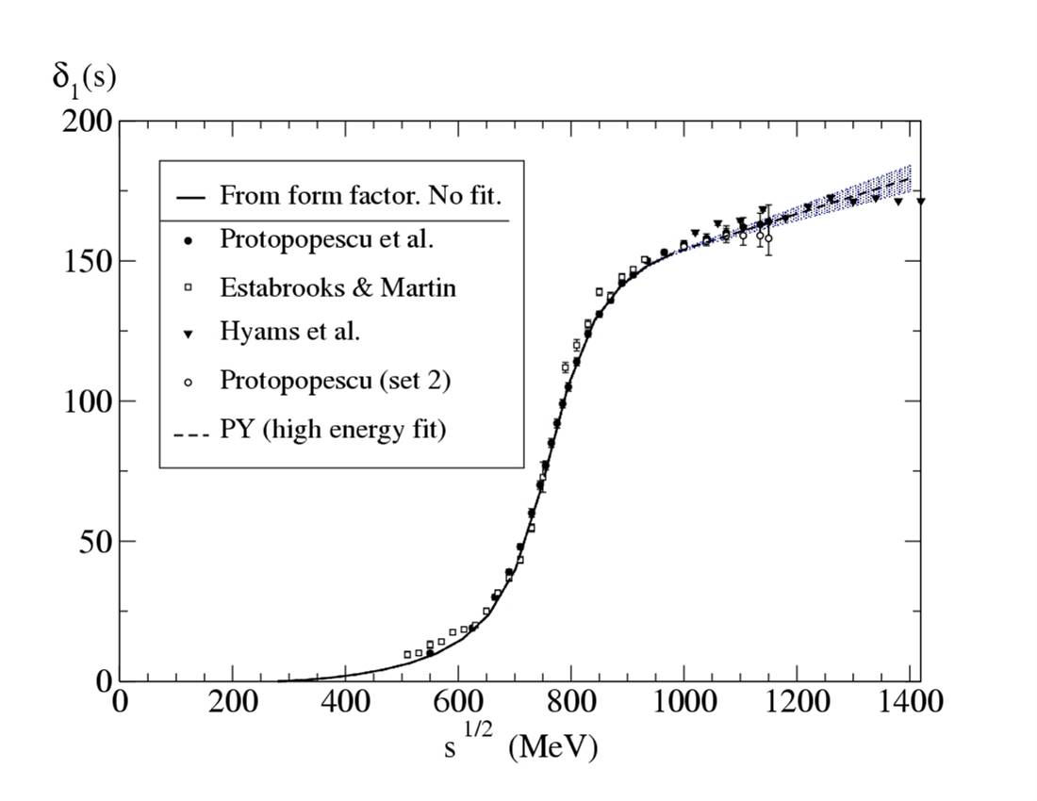
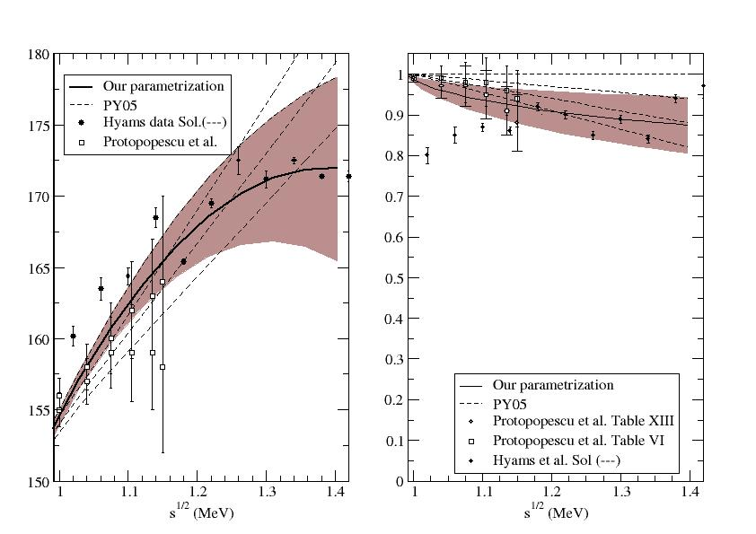
Simple UNconstrained Fits to Data: P wave, IJ=11
The ρ(779) IS A NICE BREIT-WIGNER Resonance!!
Above 1 GeV, polynomial fit
to CERN-Munich & Berkeley
phase and inelasticity
χ²/dof=1 .01
Up to 1 GeV This NOT a fit to ππ scattering
but to the FORM FACTOR
de Troconiz, Yndurain, PRD65,093001 (2002), PRD71,073008,(2005)

Slide 19
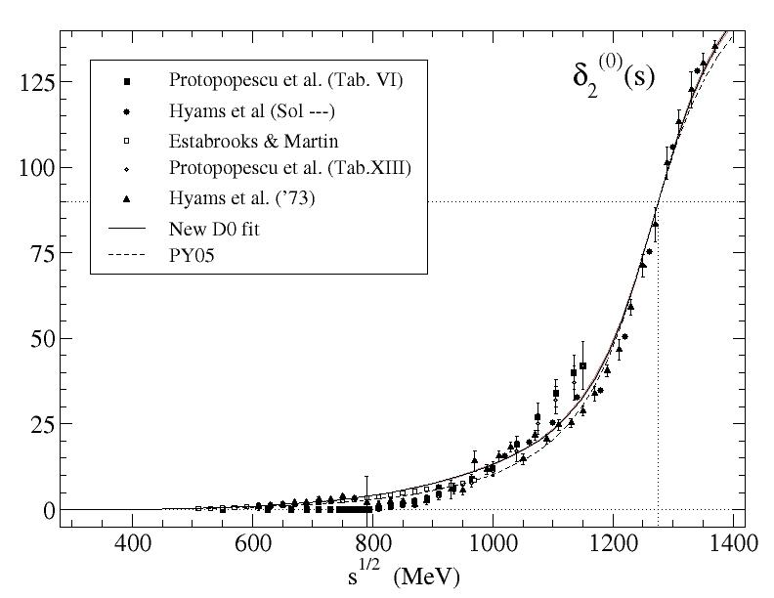
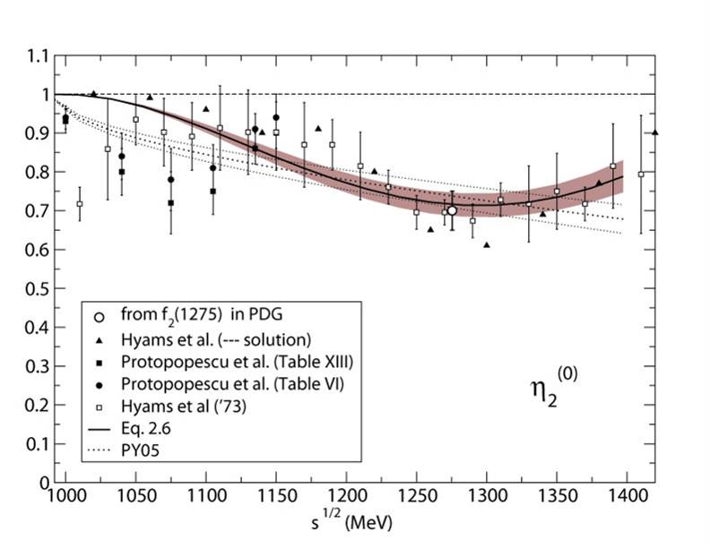
Simple UNconstrained Fits to Data: D0 wave
D0 DATA sets incompatible
We fit f₂(1250) mass and width
Inelasticity fitted empirically:
CERN-MUnich + Berkeley data
The f₂(1275) IS A NICE BREIT-WIGNER
Resonance !!
Matching at lower energies: CERN-Munich
and Berkeley data (is ZERO below 800 !!)
plus threshold psrameters from
Froissart-Gribov Sum rules
F wave contribution very small but included
Errors increased by effect of including one or two incompatible data sets
G wave contribution negligible

Slide 20
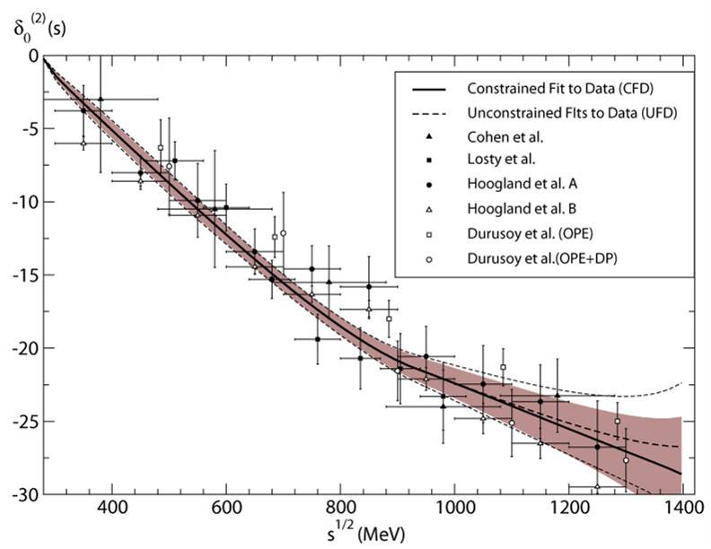
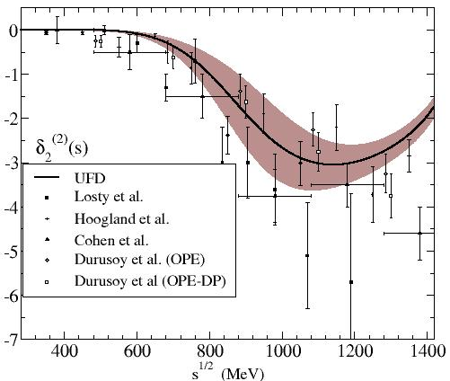
Simple UNconstrained Fits to Data: S2 and D2 waves (IJ=20 and 22)
Both repulsive
Very poor data sets
For S2 we include an Adler zero at M_{π}
- Inelasticity small but fitted
Phase shift should go to nπ at ∞
Elasticity above 1.25 GeV not measured
assumed compatible with 1
The less reliable. EXPECT LARGEST CHANGE
We have increased the systematic error

Slide 21
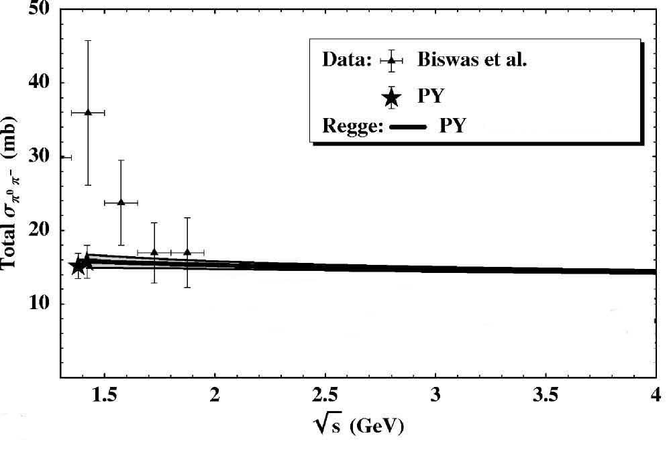
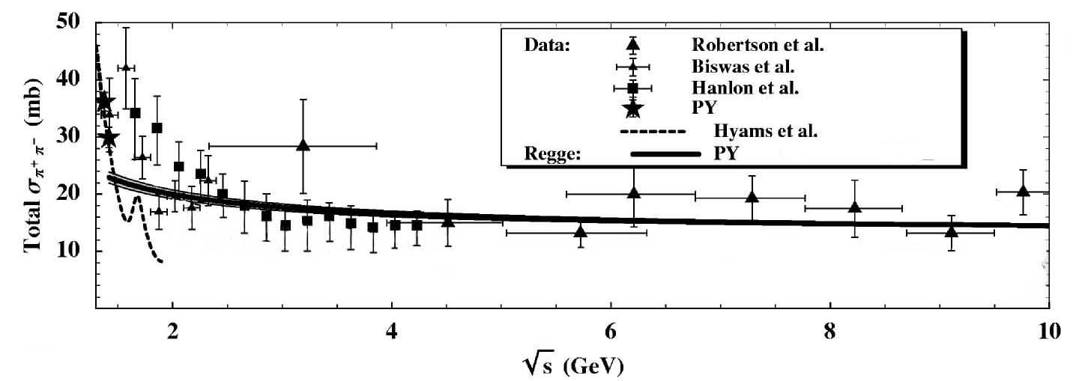
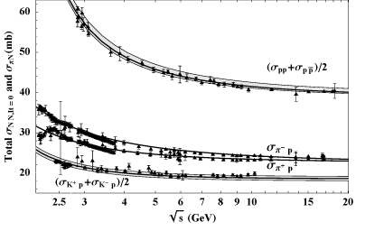
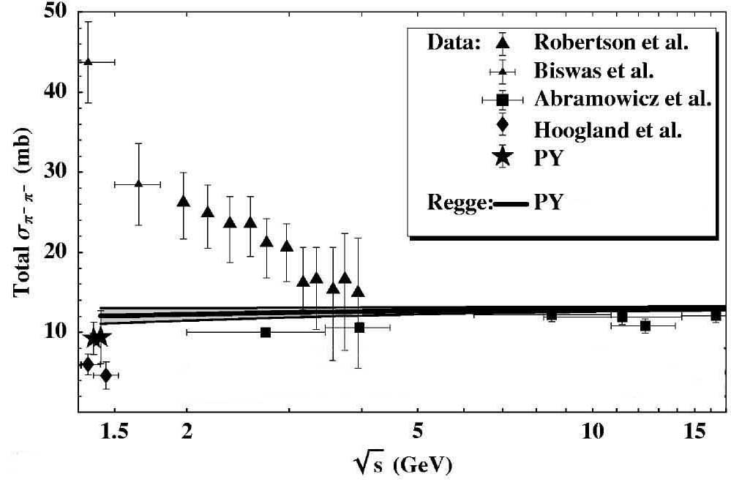
UNconstrained Fits for High energies
For simplicity we use
Regge parametrizations of data
JRP, F.J.Ynduráin. PRD69,114001 (2004)
Factorization
To be discussed later…

Slide 22

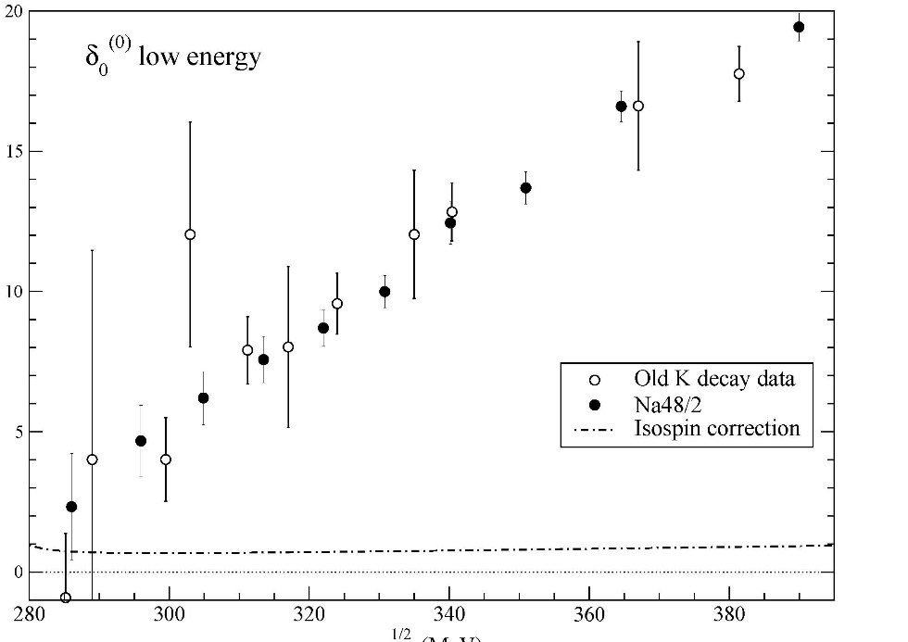
The complicated wave is the S0 wave (IJ=00)
We have already seen the data is a mess…. Only Kl4 reliable
Always include Kl4, but two possibilities:
Average data
Fit individual sets

Slide 23
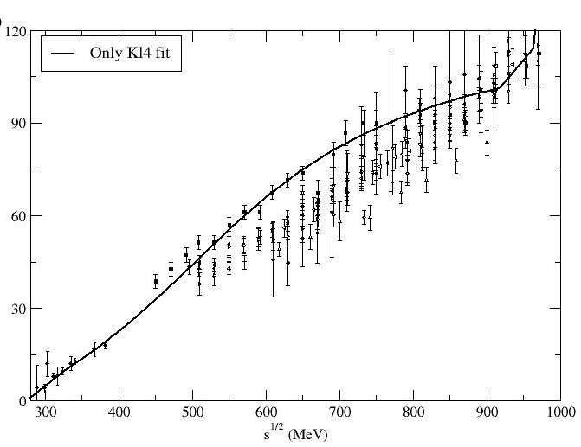
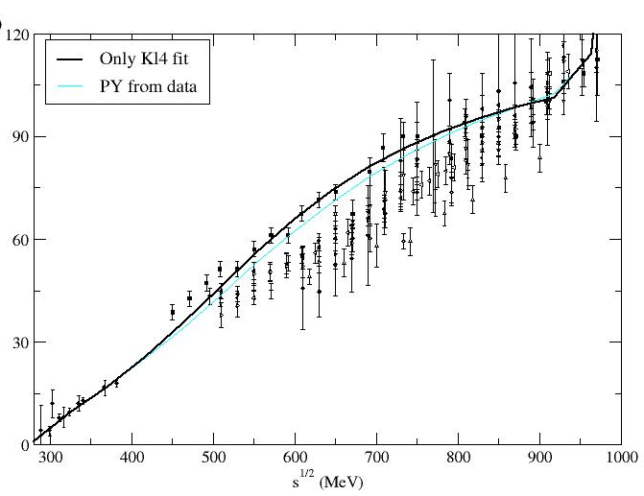
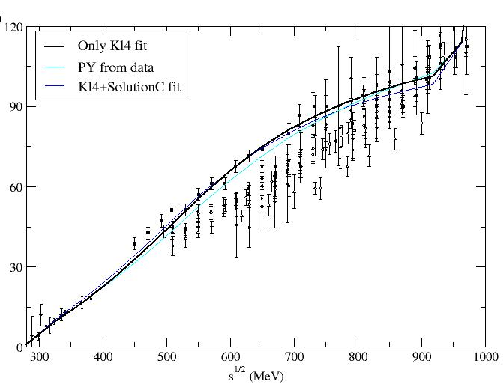
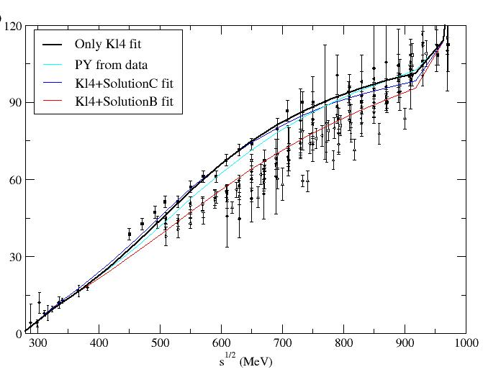
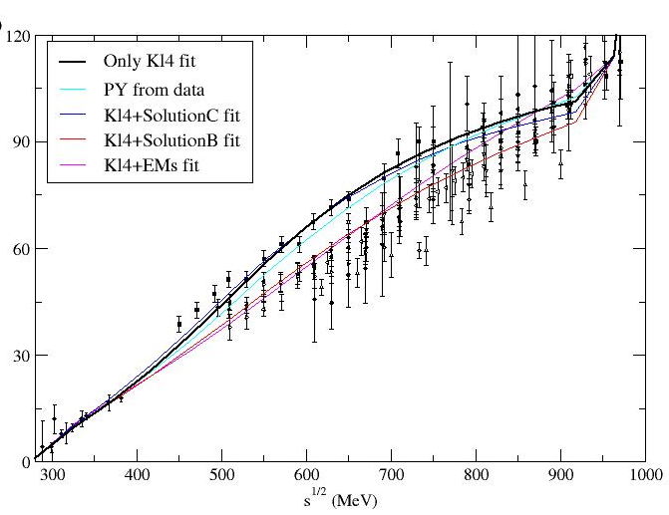
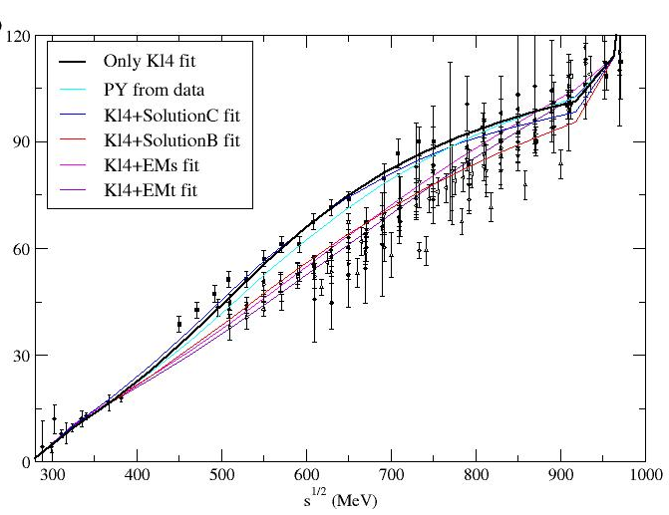
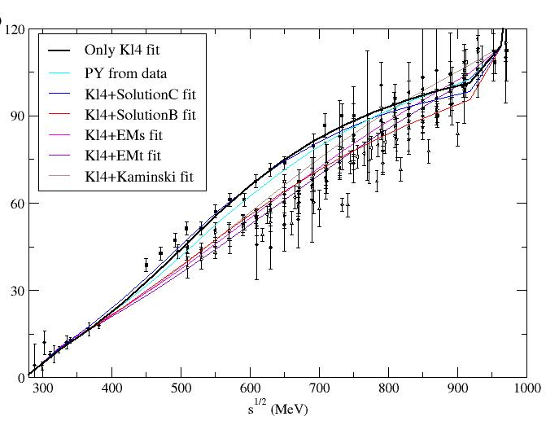
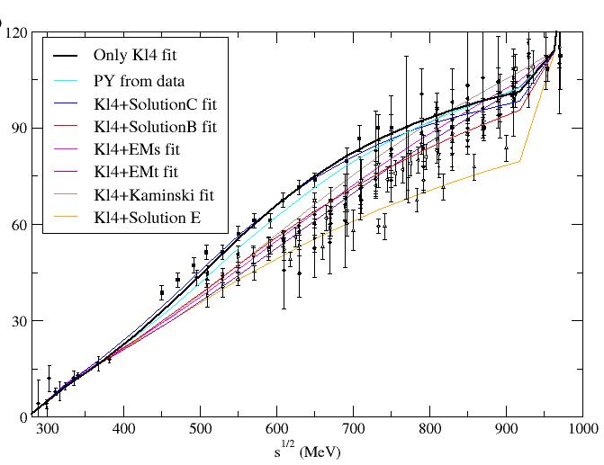
The S0 wave. Different sets
Fits to different sets including also K_{l4} data
Note size of
uncertainty
in data
at 800 MeV!!

Slide 24
S0 wave: UNconstrained fit to data (UFD).
Global fit, averaging all sets where they roughly coincide

Slide 25
S0 wave: DIP vs NO DIP inelasticity scenarios
Longstanding controversy for inelasticity : (Pennington, Bugg, Zou, Achasov….)
There are inconsistent data sets for the inelasticity above 1 GeV
near the f₀(980) region
Some prefer a “dip” structure…
... whereas others do not

Slide 26
Our series of works: 2005-2011
R. Kaminski, JRP, F.J. Ynduráin Eur.Phys.J.A31:479-484,2007. PRD74:014001,2006
JRP ,F.J. Ynduráin. PRD71, 074016 (2005) , PRD69,114001 (2004),
R. García Martín, R. Kaminski, JRP, J. Ruiz de Elvira, F.J. Ynduráin, Phys.Rev. D83 (2011) 074004,
R. García Martín, R. Kaminski, JRP, J. Ruiz de Elvira ,Phys.Rev.Lett. 107 (2011) 072001
Independent and simple fits
to data in different channels.
“Unconstrained Data Fits=UDF”
Check Dispersion Relations

Slide 27
How well the Dispersion Relations are satisfied by unconstrained fits
Every 25 MeV we look at the difference between both sides of the DR
divided by the uncertainty
We define an averaged χ² over these points, that we call d²
d² close to 1 means that the relation is well satisfied
d²>> 1 means the data set is inconsistent with the relation.
This is NOT a fit to the relation, just a check of the fits!!.

Slide 28
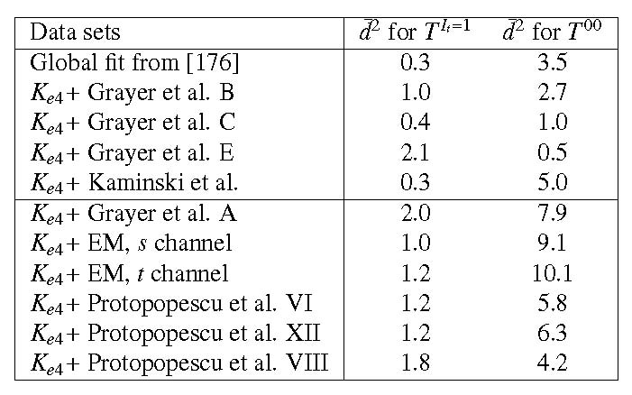
How well the Dispersion Relations are satisfied by unconstrained fits
Only TWO FDRs involve the S0 wave
The 00 FDR is very sensitive
Other sets, not so badly. Do not discad them but
ROOM FOR IMPROVEMENT
Some S0 data sets are very incompatible with FDR below 900 MeV
Considered clearly inconsistent and discarded
Lessons:
Dispersion Relations can be useful to discard conflicting data sets
Despite nice-looking fits, analytic properties WRONG.
Careful with extrapolations to complex plane

Slide 29
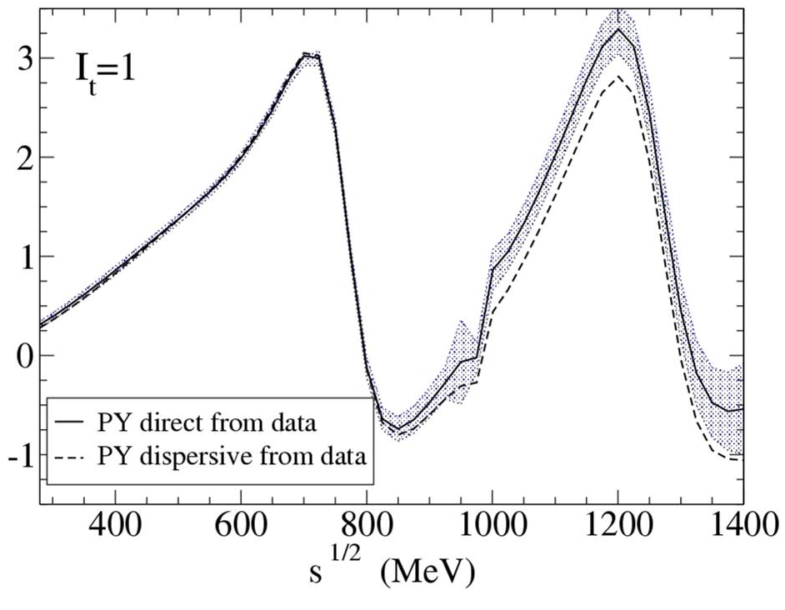
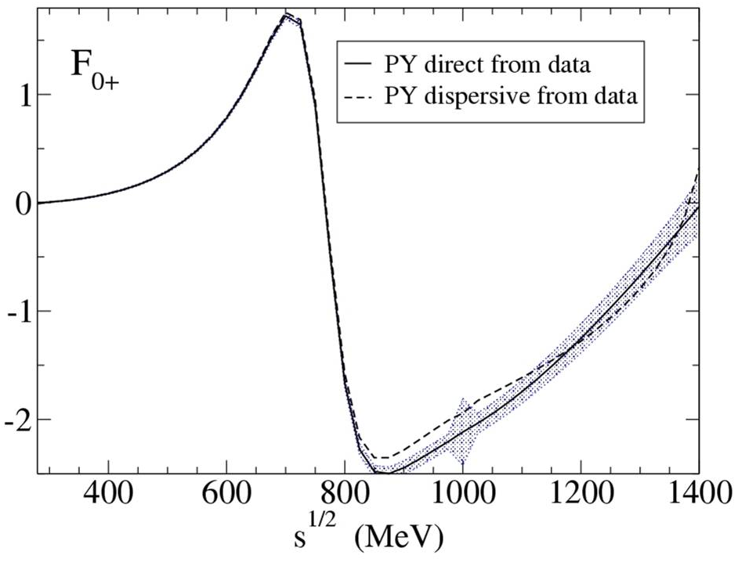
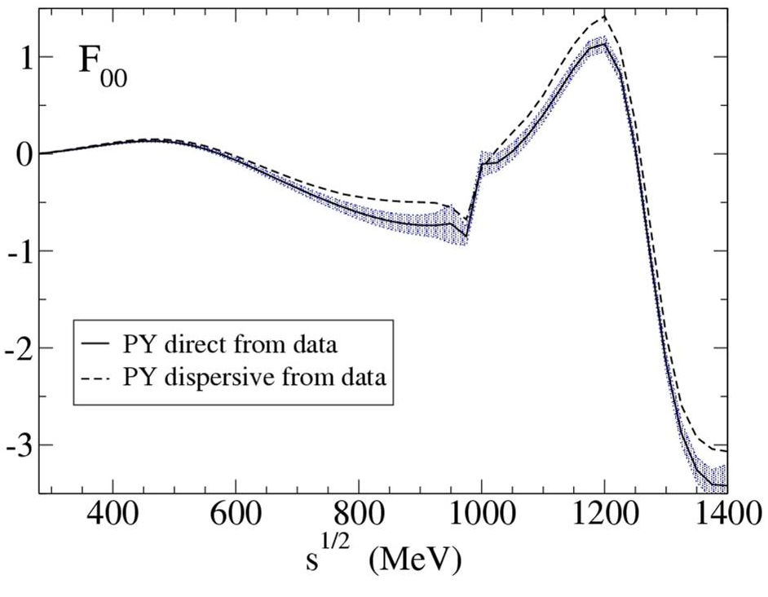
Example: Global fit
Good agreement up to
950 MeV
Fairly reasonable above
Room for improvement !!

Slide 30
Our series of works: 2005-2011
R. Kaminski, JRP, F.J. Ynduráin Eur.Phys.J.A31:479-484,2007. PRD74:014001,2006
JRP ,F.J. Ynduráin. PRD71, 074016 (2005) , PRD69,114001 (2004),
R. García Martín, R. Kaminski, JRP, J. Ruiz de Elvira, F.J. Ynduráin, Phys.Rev. D83 (2011) 074004,
R. García Martín, R. Kaminski, JRP, J. Ruiz de Elvira ,Phys.Rev.Lett. 107 (2011) 072001
Independent and simple fits
to data in different channels.
“Unconstrained Data Fits=UDF”
Check Dispersion Relations
Some sets discarded
Others, room for improvement
Impose FDRs, Roy & GKPY Eqs
on data fits
“Constrained Data Fits CDF”
Describe data and are consistent with Dispersion relations

Slide 31


Imposing FDR’s, Roy Eqs., GKPY Eqs. and crossing sum rules
To improve our fits, we can IMPOSE FDR’s, Roy Eqs. GKPY Eqs. and some SRs
We obtain CONSTRAINED FITS TO DATA (CFD) by minimizing:
$χ^{2}$=$W\left\{{\overline{d_{00}}}^{2}+{\overline{d_{0+}}}^{2}+{\overline{d_{It=1}}}^{2}\right\}$
3 FDR’s
$$+ {\overline{d_{{SR}_{J}}}}^{2}+{\overline{d_{{SR}_{K}}}}^{2}+\sum_{k}{\frac{{(p_{k}−p_{k}^{exp})}^{2}}{{δp}_{k}^{2}}}$$
Sum Rules for
crossing
Parameters of the unconstrained data fits
W roughly counts the number of effective degrees of freedom
(sometimes we add weight on certain energy regions)

Slide 32
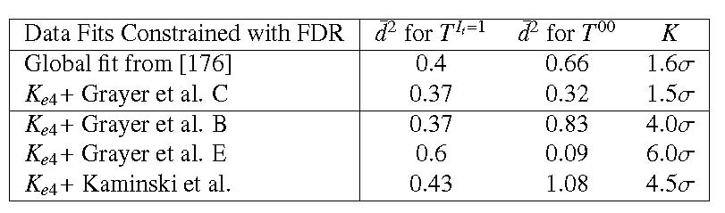
Imposing FDRs and Sum rules
After imposing FDRs and SRs
The resulting fits differ by less than ~1σ -1.5 σ from original unconstrained fits
But some sets cannot be made to satisfy SR:
DISCARDED
Remarkable improvement
in 00 FDR
Fit C included within uncertainties of “Global Fit”.
So we keep the “Global Fit”

Slide 33
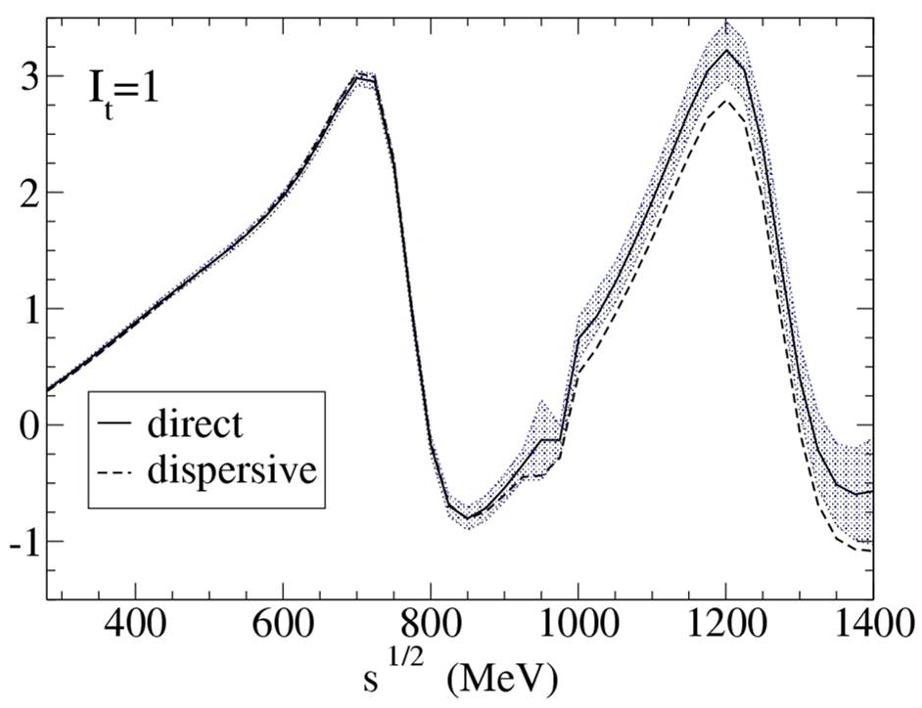
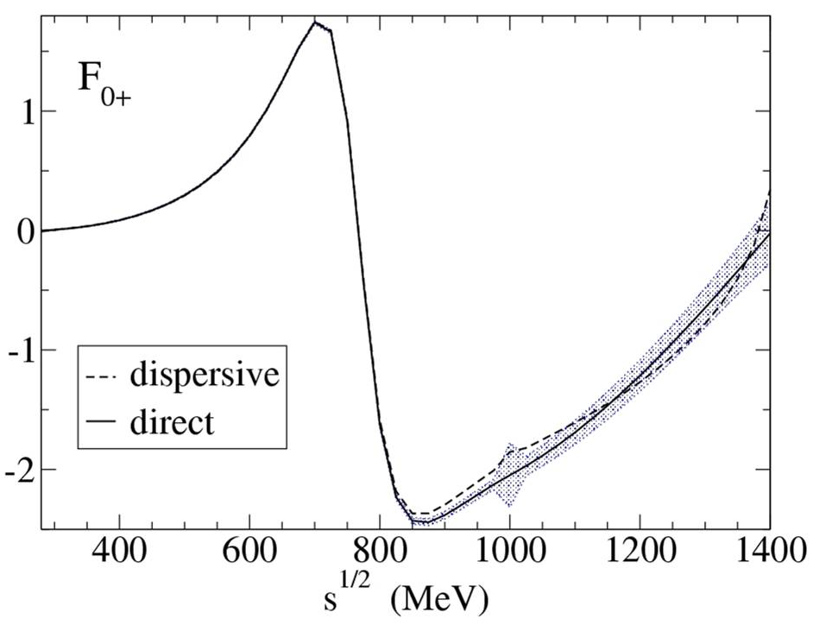
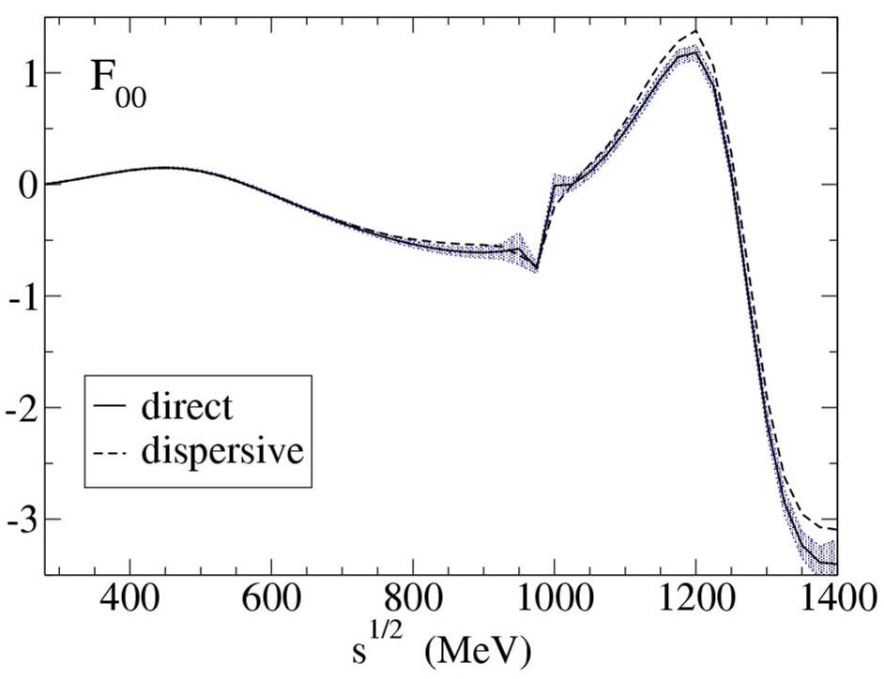
Improving the fits with Forward dispersion relations
Example: Improved Global fit.
Similar for Solution C
This fixes the FDRs and SRs without spoiling the data description.
But what about the partial-wave Dispersion Relations?

Slide 34

Imposing FDR’s, Roy Eqs., GKPY Eqs. and crossing sum rules
To improve our fits, we can IMPOSE FDR’s, Roy Eqs. GKPY Eqs. and some SRs
We obtain CONSTRAINED FITS TO DATA (CFD) by minimizing:
$χ^{2}$=$W\left\{{\overline{d_{00}}}^{2}+{\overline{d_{0+}}}^{2}+{\overline{d_{It=1}}}^{2}\right\}$
3 FDR’s
$$+ {\overline{d_{{SR}_{J}}}}^{2}+{\overline{d_{{SR}_{K}}}}^{2}+\sum_{k}{\frac{{(p_{k}−p_{k}^{exp})}^{2}}{{δp}_{k}^{2}}}$$
Sum Rules for
crossing
Parameters of the unconstrained data fits
W roughly counts the number of effective degrees of freedom
(sometimes we add weight on certain energy regions)

Slide 35
Imposing FDR’s, Roy Eqs., GKPY Eqs. and crossing sum rules
To improve our fits, we can IMPOSE FDR’s, Roy Eqs. GKPY Eqs. and some SRs
We obtain CONSTRAINED FITS TO DATA (CFD) by minimizing:
$χ^{2}$=$W\left\{{\overline{d_{00}}}^{2}+{\overline{d_{0+}}}^{2}+{\overline{d_{It=1}}}^{2}+{\overline{d_{{S0}_{Roy}}}}^{2}+{\overline{d_{{S2}_{Roy}}}}^{2}+{\overline{d_{P_{Roy}}}}^{2}+{\overline{d_{{S0}_{GKPY}}}}^{2}+{\overline{d_{{S2}_{GKPY}}}}^{2}+{\overline{d_{P_{GKPY}}}}^{2}\right\}$
3 FDR’s
3 Roy Eqs.
3 GKPY Eqs.
$$+ {\overline{d_{{SR}_{J}}}}^{2}+{\overline{d_{{SR}_{K}}}}^{2}+\sum_{k}{\frac{{(p_{k}−p_{k}^{exp})}^{2}}{{δp}_{k}^{2}}}$$
Sum Rules for
crossing
Parameters of the unconstrained data fits
W roughly counts the number of effective degrees of freedom
(sometimes we add weight on certain energy regions)

Slide 36
Forward Dispersion Relations for UNCONSTRAINED fits
FDRs averaged d²
<932MeV <1400MeV
π⁰π⁰ 0.31 2.13
π⁰π⁺ 1.03 1.11
I_{t}=1 1.62 2.69
NOT GOOD! In the intermediate
region. Need improvement

Slide 37
Roy Eqs. for UNCONSTRAINED fits
Roy Eqs. averaged d²
<932MeV <1100MeV
S0wave 0.64 0.56
P wave 0.79 0.69
S2 wave 1.35 1.37
GOOD! But room for improvement

Slide 38
GKPY Eqs. for UNCONSTRAINED fits
Roy Eqs. averaged d²
<932MeV <1100MeV
S0wave 1.78 2.42
P wave 2.44 2.13
S2 wave 1.19 1.14
Pretty bad. GKPY Eqs are much stricter
Lots of room for improvement

Slide 39
Checks of Dispersion Relations
We already saw that the data did not satisfy well FDRs up to 930 MeV
Now we have seen it also happens from 930 to 1400 MeV
And that this is also the case for other DR like Roy and GKPY Eqs.
Once again we find the same lesson:
Despite nice-looking fits, analytic properties may be WRONG, or at least not accurate
Let us now improve the fits by constraining them to satisfy all dispersion relations

Slide 40
Forward Dispersion Relations for CONSTRAINED fits
FDRs averaged d²
<932MeV <1400MeV
π⁰π⁰ 0.32 0.51
π⁰π⁺ 0.33 0.43
I_{t}=1 0.06 0.25
VERY GOOD!!!

Slide 41
Roy Eqs. for CONSTRAINED fits
Roy Eqs. averaged d²
<932MeV <1100MeV
S0wave 0.02 0.04
P wave 0.04 0.12
S2 wave 0.21 0.26
VERY GOOD!!!

Slide 42
GKPY Eqs. for CONSTRAINED fits
Roy Eqs. averaged d²
<932MeV <1100MeV
S0wave 0.23 0.24
P wave 0.68 0.60
S2 wave 0.12 0.11
VERY GOOD!!!

Slide 43
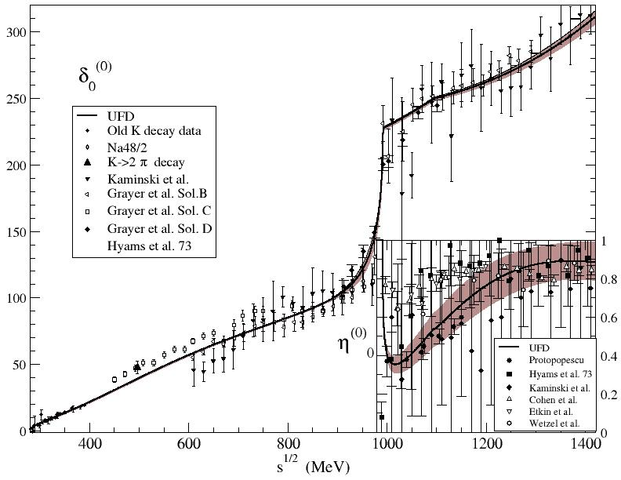
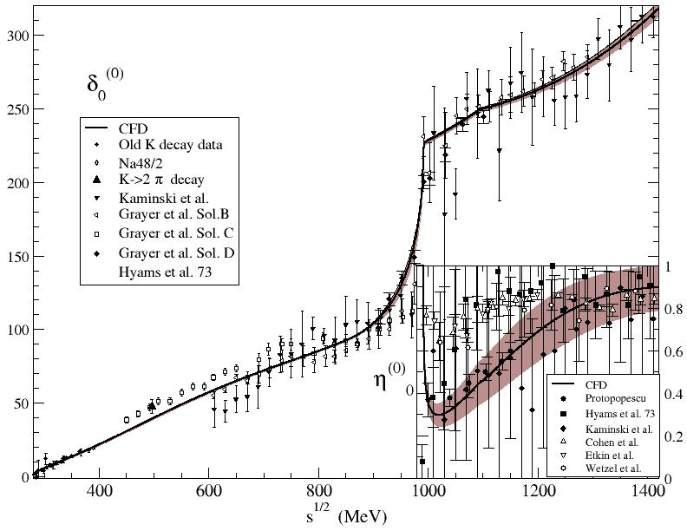
S0 wave: from UFD to CFD
Only sizable change in f0(980) region

Slide 44
DIP vs NO DIP inelasticity scenarios
Now we find large differences in
GKPY S0 wave d²
UFD
CFD
992MeV< e <1100MeV
850MeV< e <1050MeV
Dip 1.02
No dip 3.49
Dip 6.15
No dip 23.68
Other waves
worse
and data
on phase
NOT described
Improvement possible?
No dip (enlarged errors) 1.66
But becomes
the “Dip” solution
No dip (forced) 2.06

Slide 45
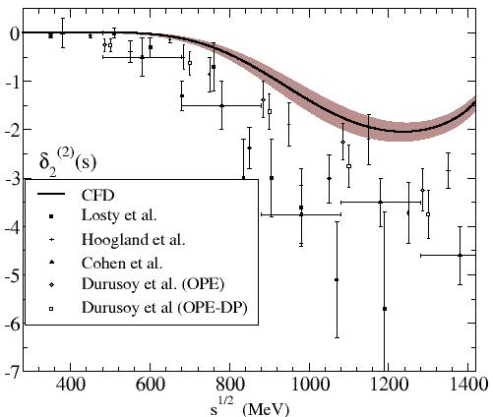
From UFD to CFD
As expected, the wave suffering the largest change is the D2
Apart from S0 and D2, changes in other waves from UFD to CFD is
imperceptible

Slide 46
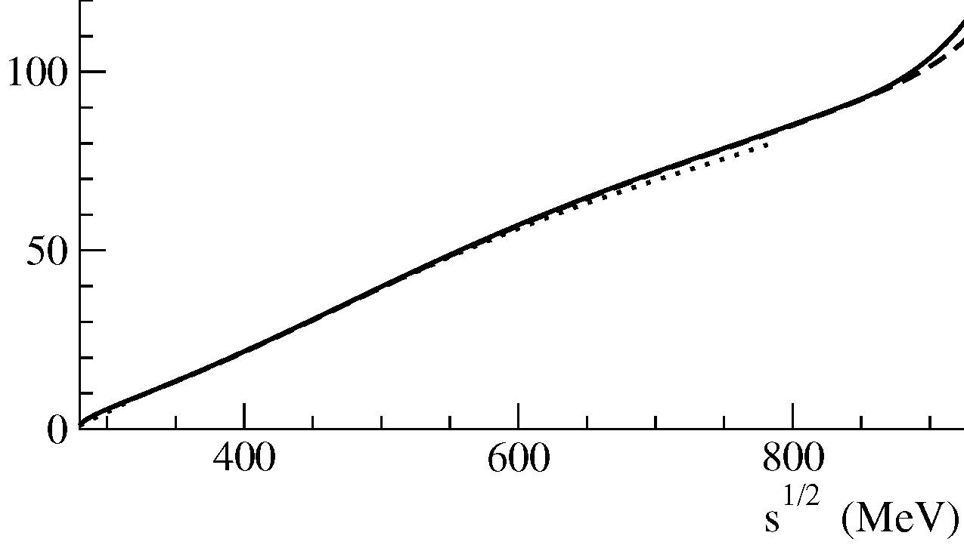
Other approaches
Other groups (Ananthanarayan, Gasser, Laetwyler, Caprini, Colangelo, Maussallam)
have used Roy Eqs. alone to obtain
SOLUTIONS for the S and P waves below 800 or 1000 MeV,
using the rest as input.
For their most precise results, they use Chiral Perturbation Theory as INPUT
(or universal band)
The results shown so far are quite consistent with theirs

Slide 47
Summary of this part
So far, for ππ→ππ, we have :
Discarded inconsistent data sets
ended up with a relatively simple set of partial waves (S0,S2,P,D0,D2,F) up to 1420 MeV. which
  Describe the data reasonably well
  Are consistent with 9 Dispersion Relations and crossing sum rules
Similar results for S, P waves obtained by solving Roy Eqs., instead of imposing them as constraints

Slide 48
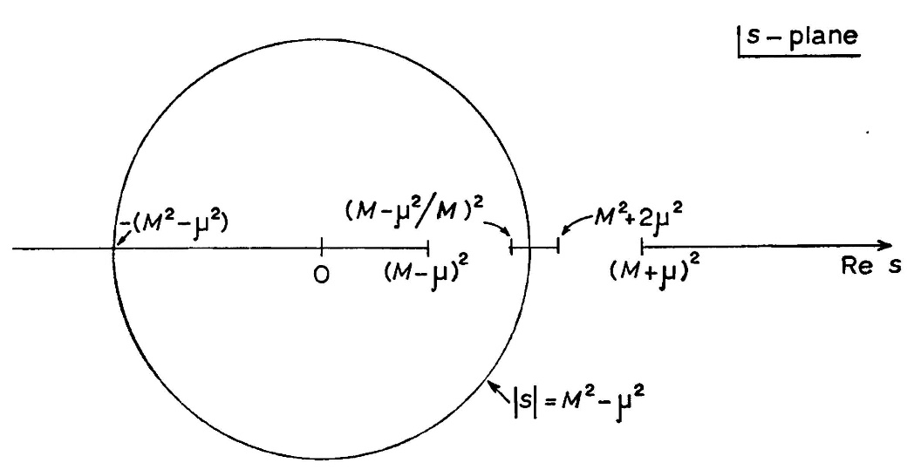
πK Scattering
A similar approach can be followed for πK.
The scalar I=1/2 wave is again a mess
There is also a SOLUTION of
Roy-Steiner equations
in the elastic region. Uses ChPT as input
(Descotes-Genon, Moussallam)
Roy-Steiner equations are more complicated because using crossing
to rewrite the left cut one also needs ππ→KK.
In addition, the different masses give rise to new analytic structures
(Circular cut)
But FDRs are equally simple…

Slide 49
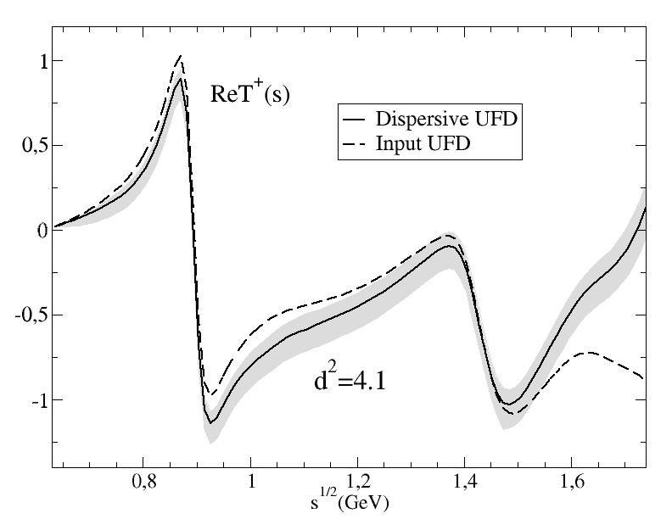
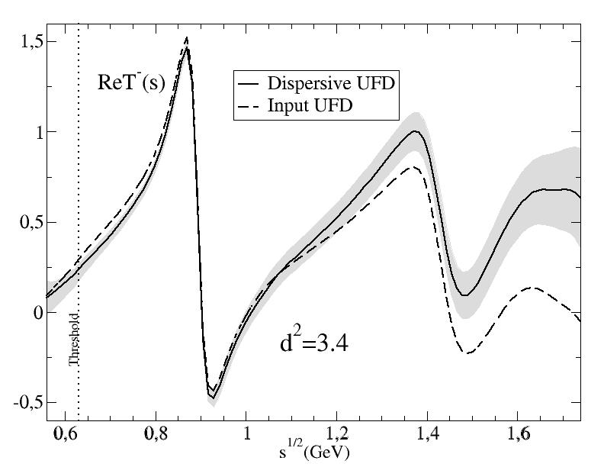
(not a solution of dispersión relations,
but a constrained fit) (A.Rodas & JRP)
Dispersive analysis of
πK scattering DATA
First observation:
Forward Dispersion relations
Not well satisfied by data
Particularly at high energies
So we use
Forward Dispersion Relations as CONSTRAINTS on fits

Slide 50
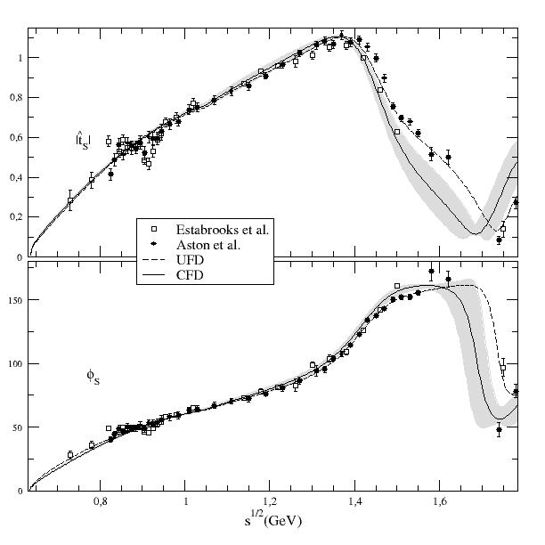
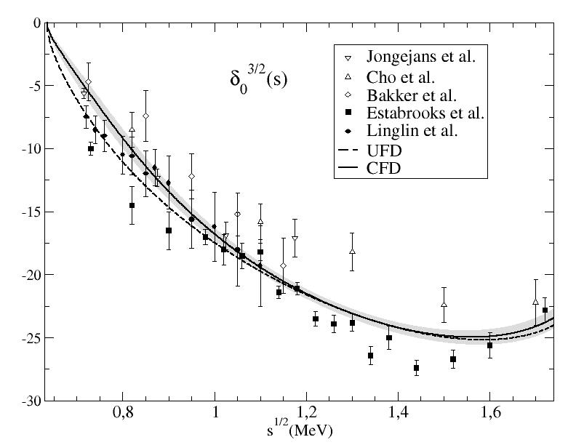
From Unconstrained (UFD) to Constrained Fits to data (CFD)
S-waves. The most interesting for the K₀* resonances
Largest changes from UFD to CFD
at higher energies

Slide 51
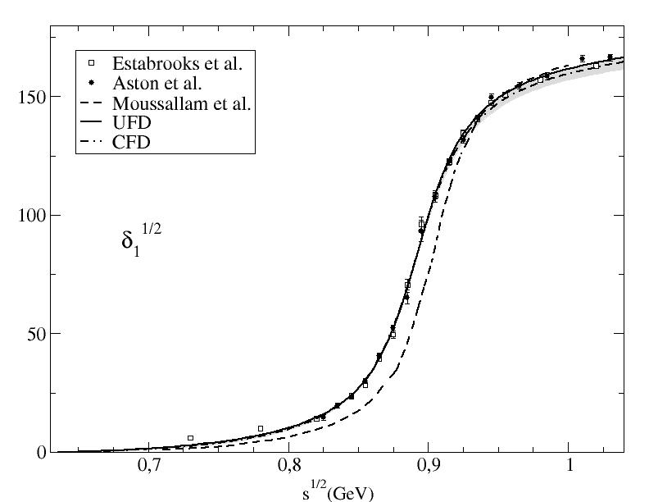
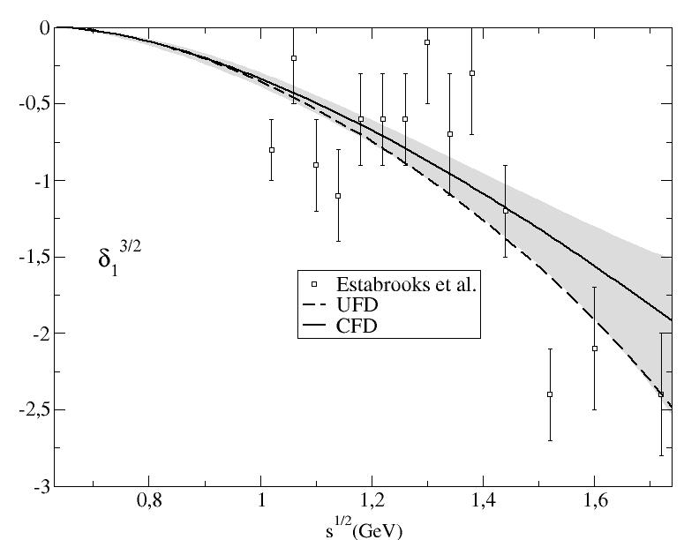
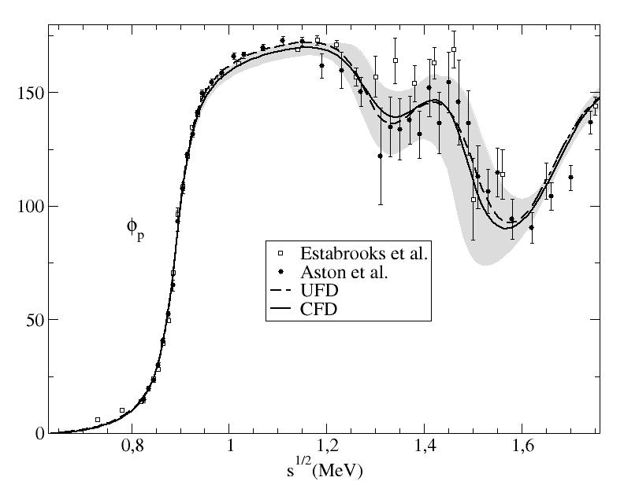
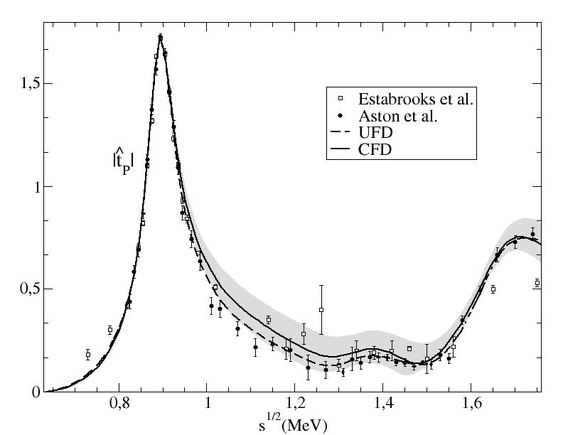
From Unconstrained (UFD) to Constrained Fits to data (CFD)
P-waves: Small changes
Our fits describe data well
SOLUTION from previous Roy-Steiner approach

Slide 52
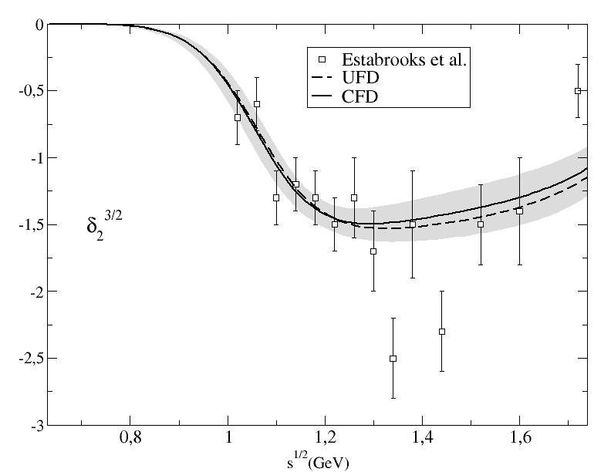
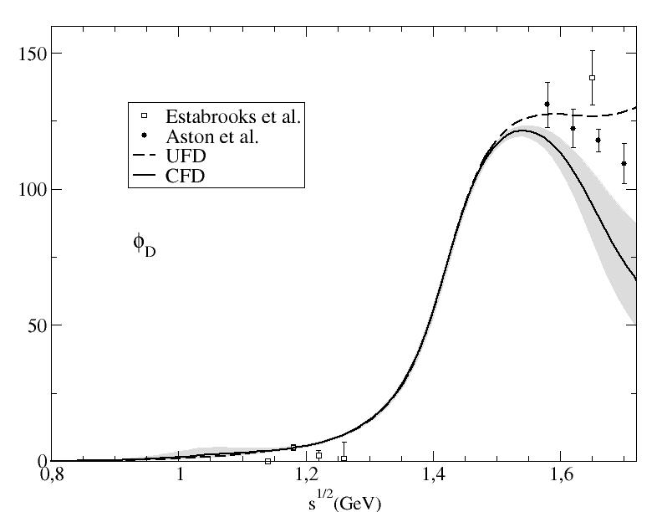



From Unconstrained (UFD) to Constrained Fits to data (CFD)
D-waves: Largest changes of all, but at very high energies
F-waves:
Imperceptible changes
Regge parameterizations allowed to vary: Only πK-ρ residue changes by 1.4 deviations

Slide 53


Consistency up to 1.6 GeV!!
Consistency up to 1.74 GeV!!

Slide 54
Summary of this part
So far, for πK→πK, we have :
We also discarded some inconsistent data sets
A relatively simple set of partial waves up to F and 1600 MeV, which
  Describe the data
  Are consistent with 2FDRs
Similar results for S, P waves
obtained by solving Roy Eqs.
Although with small differences
Our fits describe data well
SOLUTION from previous Roy-Steiner approach

Slide 55
Resonances in meson-meson scattering from partial-wave dispersion relations

Slide 56

Resonances
Usually resonances are associated to “bumps” in cross sections

Slide 57


Resonances:simplest case
Usually, they are described by Breit-Wigner shapes
Which in the elastic case produce a typical phase shift rapid increase
from 0 to 180 degrees that we have already found several times
ρ(770)
f₂(1275)
K*(892)
These are easily identified…

Slide 58

Resonances:simplest case
Breit-Wigner shapes are easily recognizable…
But do you see resonances there?
Nevertheless there is a resonance (a pole) on each graph: the σ/f₀(500) and the κ/K₀*(800) light scalars

Slide 59


Motivation: The f₀(500) or σ, half a century around
I=0, J=0 ππ exchange very important for nucleon-nucleon attraction!!
Crude Sketch of NN potential:
From C.N. Booth
Scalar-isoscalar field already proposed by Johnson & Teller in 1955
Name given by Schwinger in 1957. Multiplet of isospin.
Soon interpreted within “Linear sigma model” (Gell-Mann) or Nambu Jona Lasinio - like models, in the 60’s.

Slide 60
Motivation: Light scalars
The f₀’s have the vacuum quantum numbers.
Relevant for spontaneous chiral symmetry breaking.
Glueballs: Feature of non-abelian QCD nature
The lightest one expected with these quantum numbers
If κ exists σ almost discarded as glueball (also by lattice)
Why lesser role in the saturation of ChPT parameters?
SU(3) classification. How many multiplets? Inverted hierarchy?
If too many states one might be glueball
Non ordinary mesons? Tetraquarks, molecules, mixing…
First of all it is relevant to settle their existence, mass and width
Since the 60’s-70’s many MODELS in conflict

Slide 61

Resonances as poles
But you have already been taught that bumps or dips can be distorted by other
nearby resonances or analytic structures
The Breit-Wigner shape is just an approximation for narrow and isolated resonances
The universal features of resonances are their
pole positions and residues *
*in the Riemann sheet obtained from an analytic continuation through the physical cut

Slide 62


Resonances as poles
ρ(770)
It is a paradigmatic example of a relatively narrow and isolated resonance in an elastic channel
Example:
the ρ(770)
But things are not always that simple…

Slide 63


σ PDG uncertainties ca. 2010
Example: Poles from
same experiment!!

Slide 64
Two problems with existence and parameters of light scalars: Experiment and theory
We have already seen how bad the data was
In addition, Many old an new studies based on crude/simple models,
Strong model dependences
Suspicion: What you put in is what you get out??
Even experimental analysis using
MODEL DEPENDENT theoretical tools may contribute to confusion WHEN EXTRAPOLATING FAR INTO THECOMPLEX S-PLANE
or INTERPRETING MEANING of pole parameters
(Breit-Wigners, isobars, K-matrix, ….)
Fortunately, dispersive formalisms provide the correct analytic structure, precise
AND MODEL INDEPENDENT analyses

Slide 65
What is a dispersion relation.? Very Briefly and for π π
CAUSALITY:
Partial waves t(s) are ANALYTIC in complex s plane
with cuts due to thresholds (also in crossed channels)
Cauchy Theorem determines t(s) at ANY s,
from an INTEGRAL on the contour
If t->0 fast enough at high s, curved part vanishes
Otherwise, determined up to polynomial
(subtractions)
Left cut usually a problem
We simply calculate t(s)
anywhere we want using
the same integral expression
Good for:
1) Calculating t(s) where there is not data
2) Constraining data analysis
3) ONLY MODEL INDEPENDENT extrapolation to complex s-plane

Slide 66



The second Riemann sheet in the elastic case
For elastic partial waves the second Riemann sheet is easy to obtain.
Due to elastic unitarity:
$$S^{II}(s)=\frac{1}{S^{I}(s)}$$
Recalling
S$\left(s\right)=1+2iσ t(s)$
$$t^{II}(s)=\frac{t^{I}(s)}{1+2iσ t^{I}(s)}$$
The second sheet is then:
Looking for resonance poles
Is nothing but looking for a zero in that denominator

Slide 67
The real improvement: Analyticity (and Effective Lagrangians)
Unitarized ChPT 90’s Truong, Dobado, Herrero, JRP, Oset, Oller, Ruiz Arriola, Nieves, Meissner,…
Uses Chiral Perturbation Theory amplitudes inside dispersion relation.
Relatively simple, although different levels of rigour. Generates all scalars
Crossing (left cut) approximated… , not so good for precision
Roy-like equations. 70’s Roy, Basdevant, Pennington, Petersen…
00’s Ananthanarayan, Caprini, Colangelo, Gasser, Leutwyler, Moussallam, Decotes Genon, Lesniak, Kaminski, JRP…
Left cut implemented with precision . Use data on all waves + high energy .
Optional: ChPT predictions for subtraction constants
The most precise and model independent pole determinations
f₀(500) and K₀*(800) existence, mass and width
firmly established with precision
By 2006 very precise Roy Eq.+ChPT pole from SOLUTION of Roy Eqs. Caprini,Gaser, Leutwyler

Slide 68


Why so much worries about low energy and CORRECT ANALYTIC STRUCTURE?
It is somewhat misleading to think of analyticity in terms of $\sqrt{s}$
Left cut due to
Crossed channels
in scattering, not in
production
500
σ
ρ
Since the partial wave is analytic in s ….
Threshold very close
left cut and subthreshold region very close
500²
ρ
Very deep
Re s ~ Im s
σ
For the σ and κ a good control of the left cut and threshold region is relevant

Slide 69

Some relevant Roy-like POLE Determinations
which the PDG took into account in their 2012 σ revision
Roy Eqs. I. Caprini, G. Colangelo, H. Leutwyler PRL97 011601 (2006)
An S0 Wave solution up to 800 MeV, uses ChPT input
${(441}_{−8}^{+16}$)-i(${272}_{−12.5}^{+9}$) MeV
GKPY equations = Roy like with one subtraction
R. Garcia-Martin , R. Kaminski, JRP, J. Ruiz de Elvira, PRL107, 072001(2011).
Includes latest NA48/2 constrained data fit .One subtraction allows use of data only
NO ChPT input but good agreement with previous Roy Eqs.+ChPT results.
Roy equations B. Moussallam, Eur. Phys. J. C71, 1814 (2011).
An S0 Wave solution up to KK threshold with input from previous Roy Eq. works

Slide 70
The consistency of dispersive approaches, and also with
previous results implementing UNITARITY, ANALTICITY and
chiral symmetry constraints by many other people …
(Ananthanarayan, Caprini, Bugg, Anisovich, Zhou, Ishida Surotsev, Hannah, JRP, Kaminski, Loiseau, Lesniak,Oller, Oset, Dobado,
Tornqvist, Schechter, Fariborz, Saninno, Van Beveren, Rupp, Zou, Zheng, etc….)
… led the PDG to neglect those works not fullfilling these constraints
also restricting the sample to those consistent with NA48/2,
together with results from heavy meson decays
Finally quoting in the 2012 PDG edition…
M=400-550 MeV
Γ=400-700 MeV
Accordingly THE NAME of the resonance was changed to…
f₀(500)

Slide 71
DRAMMATIC AND LONG AWAITED CHANGE
ON “sigma” RESONANCE @ PDG!!
The f0(600) or “sigma”
in PDG 1996-2010
M=400-1200 MeV
Γ=500-1000 MeV
Becomes
f0(500) or “sigma”
in PDG 2012
M=400-550 MeV
Γ=400-700 MeV
To my view…
still too
conservative,
but quite a good improvement

Slide 72



Actually, in
PDG 2012:
“Note on
scalars”
At the risk of being annoying….
Now I find somewhat bold to average those results, particularly the uncertainties since they are mostly systematic
Still conservatively, I suggest:
${(449}_{−16}^{+22}$)-i(275±12) MeV
8. G. Colangelo, J. Gasser, and H. Leutwyler, NPB603, 125 (2001).
9. I. Caprini, G. Colangelo, and H. Leutwyler, PRL 96, 132001 (2006).
10. R. Garcia-Martin , R. Kaminski, JRP, J. Ruiz de Elvira, PRL107, 072001(2011).
11. B. Moussallam, Eur. Phys. J. C71, 1814 (2011).
JRP, Physics Reports 658-2016-1

Slide 73
This was a long awaited improvement !!!!
Unfortunately, to keep the confusion
the PDG still quotes a “Breit-Wigner mass” and width…
I have no words…

Slide 74
Some relevant recent Roy-like POLE Determinations of the f₀(980)
(also appearing in the PDG 2012 revision)
GKPY equations = Roy like with one subtraction
Garcia-Martin , Kaminski, JRP, Ruiz de Elvira, PRL107, 072001(2011)
Roy equations
B. Moussallam, Eur. Phys. J. C71, 1814 (2011).

Slide 75
Based on this, PDG12 made a small correction for the f0(980) mass
& more conservative uncertainties

Slide 76
Comments on the minor additions to the K₀*(800) @PDG12
Still “omittted from the summary table” since, “needs confirmation”
But, all sensible implementations of unitarity, chiral symmetry, describing the data
find a pole between 650 and 770 MeV with a 550 MeV width or larger.
Since 2009 two EXPERiMENTAL results are quoted from D decays @ BES2
Surprisingly BES2 gives a pole position of
Fortunately, the most sounded determination comes from a Roy-Steiner dispersive formalism, consistent with UChPT Decotes Genon et al 2006
But AGAIN!!
PDG goes on giving Breit-Wigner parameters!! More confusion!!
Recently found as virtual state on the lattice (J.Dudek et al., 2014) consistently with UChPT

Slide 77
Kappa pole from CFD
We have amplitudes that describe data and satisfy dispersion relations up to 1.6 GeV
THERE IS ALSO A KAPPA POLE
Extracted from conformal parameterization
Preliminary and STILL MODEL DEPENDENT
M-i Γ/2=(680±15)-i(334±i15) MeV
Compare to PDG:
M-i Γ/2=(682±29)-i(273±i12) MeV
Still in progress:
A second dispersive determinationwith Roy-Steiner and FDRs will finally settle the κ/K₀*(800) issue at the PDG. Our group has been asked to do it.

Slide 78
Summary of this part
Dispersion relations have been useful for establishing the existence of resonances and for rigorous determinations of their parameters
For light scalars, they have settled the longstanding σ-meson controversy and are on the way to settle that of the κ-meson

Slide 79
Regge Theory and High Energy meson-meson scattering

Slide 80
For Forward Dispersion Relations we only need TOTAL CROSS SECTIONS
This is due to the Optical Theorem: Im T(s, t=0) ~ σ_{tot}

Slide 81


Our Regge fit
Factorization to relate the same Reggeon in different channels
(in the ν=s-u variable)
Regge Pole
Five trajectories: R=Pomeron, f,a,ρ,ω
10 processes:
NN, KN, πN
Data Compilation
from COMPAS Collaboration
For our meson-meson calculations
Data on 3 π π total cross sections
Only P,f, ρ needed. Good to fix the ρ
$$F\left(s,t,u\right)=4π^{2} Im T(s,t,u)$$

Slide 82





Factorization, example for $ππ$.
For each reggeon:
$$σ_{NN}\sim f_{N}^{R}f_{N}^{R}$$
$$\frac{σ_{πN}}{σ_{NN}}=\frac{f_{π}^{R}}{f_{N}^{R}}$$
$$σ_{ππ}\sim \frac{{σ_{πN}}^{2}}{σ_{NN}}$$
$$σ_{πN}\sim f_{π}^{R}f_{N}^{R}$$
The Pomeron is actually a cut, but since we only need description up to 10-20 GeV apole approximation is OK (but we also did it with the cut)

Slide 83

Data on ππ total cross sections at high energy
4 EXPERIMENTS, ‘67, ’73, ’76,’80: NOT phase shift analysis
Large systematics mostly below 2 GeV, and the Δ⁻⁻ in π⁻ π⁻
All consistent above
2 GeV. Not used below
σπ⁻π⁻ (mb)
Pomeranchuk theorem OK
In conflict with
CERN-Munich in
1.4<√s<2 GeV
σπ⁺π⁻ (mb)

Slide 84

UNconstrained Fits for High energies
JRP, F.J.Ynduráin. PRD69,114001 (2004)
Fitting N-N, meson–N and π-π cross section data, assuming factorization
(in the ν=s-u variable)
$F_{π^{±}π}=(P_{ππ}+f_{ππ})$/3$∓$ $ρ_{ππ}$/2
$F_{π^{0}π}=(P_{ππ}+f_{ππ})$/3
Similar treatment for πK,
but no data available

Slide 85


High Energy ππ Regge description
Other groups have made other fits later.
General agreement, although more conservative.
Nevertheless recall that for our purposes here,
we only need an averaged description, to be used inside integrals.
In this sense OK to use Regge in ππ down to 1400 MeV in our integrals

Slide 86


High Energy ππ Regge description
Also fair agreement with “rediscovered” data not included in the fits
(7-10% Syst. uncertainty in data not shown)
NOTE THESE CURVES
ARE A PREDICTION
(7-10% Syst. uncertainty in data not shown)
More confidence on Regge description
Nevertheless recall that for our purposes here,
we only need an averaged description, to be used inside integrals.
In this sense OK to use Regge in ππ down to 1400 MeV in our integrals

Slide 87
For partial-wave Dispersion Relations we also need t-dependence
Fortunately just for relatively small |t|

Slide 88


Small t-dependence on ππ Regge description
No data.
But constraints from Sum Rules
Models differ in details, but typically a strong forward peak: exp(-b t)
Reduced residues
$$\overline{β}\left(t\right)=β(t)/β(0)$$
relatively similar in
different models
Differences partly
responsible for slighly
different results
(not too severe since they are
fairly compatible)
Similar treatment for πK

Slide 89
Summary
JRP, Physics Reports 658-2016-1
Dispersion Relations for meson-meson scattring are very useful to
Discard inconsistent data sets
Obtain a constrained data description consistent with fundamental requirements
Provide a rigorous analytic continuation to the complex plane to establish the existence of certain resonances like light scalars
Provide a reliable determination of resonance parameters, particularly light scalars.
I have also shown a fairly good Regge description of π π scattering, needed for the high-energy part of the DR

Slide 90
Spare Slides

Slide 91
The light scalar controversy. The theory side... classification
Scalar SU(3) multiplets identification controversial
Too many resonances for many years….
But there is an emerging picture
σ
a₀
A Light scalar nonet:
κ(800)
f₀
Non-strange heavier!!
Inverted hierarchy problem
For quark-antiquark
f₀(600) and f₀(980) are
really octet/singlet mixtures
Singlet
f₀(980)
a₀(980)
+ Another
heavier scalar nonet:
K(1430)
+ glueball
f₀ singlet
f₀
f₀
a₀(1450)
Enough f₀ states have been observed: f₀(1370), f₀(1500), f₀(1700).
The whole picture is complicated by mixture between them (lots of works here)

Slide 92
Motivation
In recent years great effort to extend a precise Regge description of
forward hadron scattering down in energies:
Very Systematic analysis of COMPAS, COMPETE Collaborations, etc...:
PDG 2000
PDG 2002-2004
COMPETE 2002
“Former” ideas in Regge Theory were “rescued” to extend Regge to lower energies.
Logarithmic growths, lifting of degeneracy...
Regge over a wide energy range helps determining:
-The logarithmic growth law
- Subleading trajectories
- Degeneracy issues
-Saturation of unitarity bounds?
...

Slide 93
We propose (“rescue”) further simple refinements that allow the
application of Regge theory down to ~1 GeV in Kinetic Energy
for forward hadronic scattering
1) Use of ν=(s-u)/2 powers instead of s powers. This is the natural Regge variable needed to express symmetric amplitudes.
2) Use of a logarithmic law from an improved unitarity bound
(Yndurain, 1972). Faster than s log s, slower than s log² s.
3) Phase space corrections in total cross sections
4) Inclusion of ππ data
Data fits show a sizable χ²/d.o.f. improvement of with each suggestion

Slide 94
First suggestion: ν=s-u powers
Regge behavior can be deduced from the Froissart-Gribov representation.
Dispersion relation for s↔u even (similar for odd) amplitudes
Partial wave projection in t-channel using P_{l}(cosθ_{t}) with
Continued to L complex plane
Asimptotically
Natural Regge variable ν
If a complex Regge pole accurs at l=α(t)
Forward scattering t=0
customarily ν~s

Slide 95
Implication of First suggestion: ν=s-u powers
Factorization occurs at ν, not at s
The same ν, corresponds to different s for each process
ν^{1/2} | ππ s^{1/2} | πN s^{1/2} | NN s^{1/2}
1 GeV | 1.0 GeV | 1.4 GeV | 1.7 GeV
1.5 GeV | 1.5 GeV | 1.8 GeV | 2.0 GeV
2 GeV | 2.0 GeV | 2.2 GeV | 2.4 GeV
3 GeV | 3.0 GeV | 3.2 GeV | 3.3 GeV
I will show results down to a given KINETIC energy.
Roughly that is energy above threshold

Slide 96
Third suggestion: Independent factorization of different singularities
One-pole factorization (constant term) made by Gell-Mann, Gribov, Pomeranchuk
Recently generalized for other kind of singularities by COMPETE (Cudell et al.)
Each singularity should factorize separately
In practice, only relevant for the Pomeron:
the constant and logarithmic terms factorize separately in each process

Slide 97
Our fit: INPUT
Fit to data of COMPASS group compilation + ππ scattering data
Excellent compilation of total cross sections and ReT/ImT ratios.
But, original sources not always give systematic errors.
Some sets incompatible.
If compilation used “as such”, data without systematic errors (usually older)
has more weight than data with careful study of systematics (usually newer)
1) Use compilation “as such”. Good for comparison.
Two
approaches:
2) Add typical systematic error to points without it
0.5% systematic error added to NN data
1% systematic error added to πN data
1.5% systematic error added to KN data
3) Neglect conflicting points. “Sieve” algorithms. (Halzen et al.)

Slide 98
Our fit
We use some usual features
- Factorization
- Degeneracy: f/ρ, a/ω as in PDG
Together with our three improvements
1) ν instead of s powers
2) Improved logarithmic law for Pomeron: (Yndurain 72)
3) Phase space
β_{P} | 1.87± 0.02 | f_{N}^{P} | 1.285 ±0.002 | f_{K}^{P} | 0.738±0.004
A | 0.046±0.001 | ν² | 1.14±0.02
β_{f} | 0.90±0.02 | f_{N}^{f} | 2.29±0.03 | f_{K}^{f} | 0.l1±0.02
α_{f} | 0.68±0.01 | f_{N}ª | 0.20±0.05 | f_{K}ª | 0.59±0.16
β_{ρ} | 1.27±0.10 | f_{N} ^{ρ} | 0.52±0.04 | f_{K} ^{ρ} | 0.48±0.04
α_{ρ} | 0.447±0.006 | f_{N} ^{ω} | 2.06±0.02 | f_{K} ^{ω} | 0.65±0.01

Slide 99
Our fit
Global fit to total cross sections ~ Im T, and ReT/ImT
E_{kin}min | 1-1.3 GeV | 1.5 GeV | 2 GeV | 3 GeV
# data points | 1186 | 1002 | 895 | 768
 | χ²/d.o.f. with syst.error/ “as such”
Our parametrization | 0.85/1.56 | 0.63/1.14 | 0.58/1.05 | 0.52/0.95
Better than the absolute values of χ²/d.o.f., the relevant
observation will be the trend of the different suggestions.
σ _{LHC} | 115/110 mb | 115/110 mb | 115/110 mb | 114/110 mb
Compatible with COMPETE group σ _{LHC}=111.5±1.2+4.1-2.1 mb ,
but allowing for somewhat larger central values. Errors will be similar: ±4 mb.

Slide 100

-
Our fit: Total pp and pp cross sections
The fit extends from Kinetic energies ~1 GeV to 30 TeV !!

Slide 101




Our fit : Total cross sections

Slide 102




Our fit
We have also included ReT/ImT

Slide 103
χ² /d.o.f. improvement: first suggestion: ν=s-u powers
Only affects the intermediate/low energy.
The fits are similar to existing ones at high energies
Larger χ² /d.o.f. if using s, but fits are good if E_{kin}> 3 GeV,
as it is already known (COMPAS, COMPETE, PDG...)
E_{kin}min | 1-1.3 GeV | 1.5 GeV | 2 GeV | 3 GeV
# data points | 1186 | 1002 | 895 | 768
 | χ²/d.o.f.
Our parametrization | 0.99 | 0.71 | 0.68 | 0.63
s instead of ν powers | 1.73 | 1.24 | 1.09 | 0.87

Slide 104
Sub-subleading trajectories
Reaching so low in energies...
What about other sub-subleading trajectories?
Since the χ²/dof was already pretty good, thr\ey are not needed
from the statistics point of view
Still, we are studying the effect of another two f’ and ϕ trajectories...
The price to pay are 5-6 more parameters
We have checked they could help restoring degeneracy.
Imposing exact degeneracy (extreme case) for the 4 subleading trajectories
χ²/dof =1.02 down to E_{kin}>1 GeV
The sub-subleading trajectories come with a natural intercept ~0.25.
Still, 4 more parameters...

Slide 105
On the use of Breit-Wigner forms
for the f0(500)
…or how I make friends with experimentalists…

Slide 106





The PDG still quotes “Breit-Wigner parameters”, which are used often
There are problems
with isobar models
and the BW formula
WHEN GOING TO COMPLEX s
or interpreting
the Mass and Width

Slide 107
Problems with isobar models and Breit-Wigners
1) Isobar models violate subenergy unitarity and/or 3-body unitarity and analyticity
In usual cases of narrow well separated resonances this might not be a big problem, but…
2) The BW form is a NARROW WIDTH approximation. Only keeps LO in Γ/M.
3) The BW form violates chiral symmetry (Even in the rho channel)
The low energy region is ESSENTIAL for the sigma pole determination

Slide 108
Problems with isobar models and Breit-Wigners
1) Isobar models violate subenergy unitarity and/or 3-body unitarity and analyticity
In usual cases of narrow well separated resonances this might not be a big problem, but…
2) The BW form is a NARROW WIDTH approximation. Only keeps LO in Γ/M.
3) The BW form violates chiral symmetry (Even in the rho channel)
The low energy region is ESSENTIAL for the sigma pole determination
4) Changing Γ to Γ(s) with Blatt-Weiskopf barrier factors is just the NLO of square well
In addition it has SPURIOUS SINGULARITIES at threshold. (As the K-matrix does)

Slide 109
Problems with isobar models and Breit-Wigners
1) Isobar models violate subenergy unitarity and/or 3-body unitarity and analyticity
In usual cases of narrow well separated resonances this might not be a big problem, but…
2) The BW form is a NARROW WIDTH approximation. Only keeps LO in Γ/M.
3) The BW form violates chiral symmetry (Even in the rho channel)
The low energy region is ESSENTIAL for the sigma pole determination
4) Changing Γ to Γ(s) with Blatt-Weiskopf barrier factors is just the NLO of square well
In addition it has SPURIOUS SINGULARITIES at threshold. (As the K-matrix does)
5) In elastic region, the strong phase in production should be the same as in scattering

Slide 110
Problems with isobar models and Breit-Wigners
1) On the real axis it might be OK…The problem is the search for poles in the COMPLEX s-plane and the INTERPRETATION of the pole as a mass and width
2) As a result, BW “determinations” produce poles above 500 MeV and at least 100 MeV narrower “widths” than rigorous dispersive calculations.
Thus the APPARENT DISCREPANCY between production and scattering and
misleading conclusions when using those BW values for mass and width
The BW parameters CANNOT be interpreted the sigma MASS and WIDTH
3) Other experiments, like BES, have tried BW, with M=
better analytic propoerties (The Chiral Unitary approach, ask Oset) and found a good description of data with more reasonable poles. Thre are also phase parameterizations in the literature that satisfy dispersion relations
IT IS FEASIBLE and NOT TOO COMPLICATED

Slide 111
Problems with isobar models and Breit-Wigners
NOT COMPLAINING
About BW or ANY OTHER PARAMETERIZATION to fit or describe an amplitude at PHYSICAL values of s
COMPLAINING ABOUT
Extending BW or other parameterrizations to complex s-plane
Believing that the pole in your parameterization is a good approximation to the actual pole of the analytic amplitude.
That paramaterization and pole CANNOT be used to describe some other processes. Like scattering. This is one of the main interests of poles.
Believing that your definition of M and Γ are the actual mass or widths of a resonance and deriving theoretical consequences from it. Example…

Slide 112
NEW ROY-LIKE EQS. WITH ONE SUBTRACTION, (GKPY EQS)
When S.M.Roy derived his equations he used. TWO SUBTRACTIONS.
Very good for low energy region:
But no need for it!
In fixed-t dispersion relations at high energies :
if symmetric the u and s cut (Pomeron) growth cancels.
if antisymmetric dominated by rho exchange (softer).
ONE SUBTRACTION also allowed
GKPY Eqs.
Already introduced in Montpellier in QCD 08
R. Garcia Martin, R. Kaminski, J.R.Pelaez, F.J. Yndurain
Int.J.Mod.Phys.A24, AIP Conf.Proc.1030, Int.J.Mod.Phys.A24, Nucl.Phys.Proc.Suppl.186

Slide 113
Analytic continuation to the complex plane
In previous works dispersion relations well satisfied below 932 MeV
Now, good description up to 1100 MeV.
We can calculate in the f0(980) region.
Effect of the f0(980) on the f0(600) under control.
We do NOT obtain the poles directly from the constrained parametrizations, which are used only as an input for the dispersive relations.
The σ and f0(980) poles and residues are obtained from the
DISPERSION RELATIONS extended to the complex plane.
Residues from: or residue theorem
This is parametrization and model independent.
Remember this is an isospin symmetric formalism. We have added a systematic uncertainty as the difference of using M_{K+} or M_{K-.} It is only relevant for th f0(980) with yielding an additional ±4 MeV uncertainty

Slide 114
Final Result: Analytic continuation to the complex plane
f0(600)
f0(980)
Roy Eqs. Pole:
Residue:
GKPY Eqs. pole:
Residue:
We also obtain the ρ pole:

Slide 115
We can now use sum rules to obtain threshold parameters:
We use the Froissart Gribov representantion, Olsson sum rule, and a couple of other sum rules we have derived
Threshold parameters

