Slide 1
CINet: A CyberInfrastructure for Network Science
NSF Software Development for CyberInfrastructure Grant OCI-1032677
Additional support by grants from DTRA V&V, DTRA CNIMS, NSF NetSE, NSF DIBBS
  Team
  Virginia Tech, Indiana Uni., SUNY Albany, Jackson State, Argonne National Lab, U. Chicago, NCAT, U. Houston Downtown

Slide 2
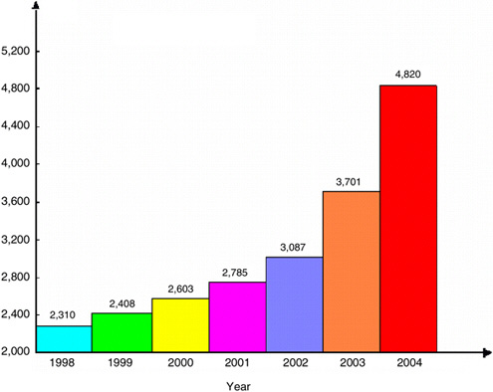
Network Science
“Network science is the study of network representations of physical, biological, and social phenomena”
Research in network science has been increasing very rapidly in the last decade, in many different scientific fields.
Networks can be very large: ~10⁸ nodes, ~10¹⁰ edges, requiring HPC for analysis
There is a need for middleware, i.e., an interface layer
  Domain experts don’t need to become experts in graph theory, data mining, and high-performance computing
Number of papers with “Complex Networks” in the title
“Network Science”, National Academies Press, 2005
Notes:
Epidemiology – National daily contact network
300 million nodes, 1.5 billion edges (p-l), 150 billion edges (p-p)

Slide 3
Challenges
Challenge 1: How can we make an analytic engine that
  Reduces programming overhead,
  Reuse s existing resources,
  Enhances Portability
Challenge 2: Can we make a simple computational interface so that domain experts can use the available resources interactively and with little or no training

Slide 4
What is CINet
A broadly accessible cyberinfrastructure
  A web portal that hides the details of computation and data management, thereby minimizing the learning effort required
A flexible framework
  Allows easy extension by integrating off-the-shelf network analysis suites for analysis and visualization; this means new algorithms can be added easily over time
A common repository
  Managing data, models, and results through a digital library that maintains metadata
Fostering research, teaching and collaboration
  Building a broad user base, from multiple disciplines, including incorporation into courses on network science at many different universities
Notes:
Extend network science for large networks and computationally expensive measures to social sciences

Slide 5
CINet Vision
CINet should be self-sustainable. User can contribute
  new networks (graphs)
  new network algorithms
  hardware (compute resources)
  research results
CINet should be self-manageable. End users insulated from
  complexities of resource allocation
  scheduling, cross-platform interactions
  other low-level concerns

Slide 6
CINet Concept and Overview

Slide 7
CINet Concept: Enabling Crowd-sourced Self-sustainability
Network Science Courses (Albany, NCAT,JSU)
Case Studies
Granite: Tool for Structural Analysis
GDS-Cal: Tool for Phase Space Analysis of Graph dynamics
VizApp: App for Network Visualization
Add Structural method
Add Network or course material
Store meta-data and results
Add Data and Statistical analysis method
Middleware: Simfrastructure
Computing resources and data storage

Slide 8
CINet Overview
Structural Analysis Tool (Granite)
  110+ networks (graphs)
  18+ network generators
  70+ network algorithms (measures)
    Adapted from 3 different graph libraries: GaLib, SNAP, NetworkX
  Visualization of networks (uses Gephi toolkit)
  Service for adding new networks (graphs)
  Service for adding new structural analysis tools (graph algorithms)
  Python-based domain specific language, NetScript, supporting complex workflows
Graph Dynamical System Calculator (GDS Calc)
  Analyzing the phasic structure of a graph dynamical system (smaller networks but complete phase structure)
Resource Manager
  Allows multiple computational resources to be used and selected
  uses FutureGrid (more than 5000 processing cores)
Website
  Additional resources (course notes, videos, tutorials, research papers etc).
Middleware and Digital Library

Slide 9
Granite:
A Tool for Structural Analysis of Complex Networks

Slide 10
Granite: A Tool for Structural Analysis
Granite allows users to run various network algorithms (measures) on a variety of networks
  Measures can compute structural properties (e.g., degree distribution, clustering coefficient) of networks
  Network size can range from tiny (10s of nodes) to very large (100s of millions of nodes)
  Provides both exact and (provably) approximate algorithms
Granite automatically picks best implementation of specified measure
Granite automatically picks most appropriate compute resource
http://cinetdev.vbi.vt.edu/granite/granite.html

Slide 11
Graph Libraries
Granite includes network algorithmic modules from three graph algorithm libraries:
  GaLib (A New Graph Algorithm Library)
    Developed at NDSSL, Virginia Tech
    Carefully designed simple memory-efficient data structure
    Streaming algorithms
      Make one or more passes through the data file
    Sampling-based approximation algorithms
    External memory algorithms
      Only a part of the data are stored in memory at a time
    Parallel algorithms
  NetworkX
    Developed at Los Alamos National Lab by Aric Hagberg et al.
    Open source Python graph library
  SNAP
    Developed at Stanford University by Jure Leskovec et al.
    Stanford Network Analysis Platform

Slide 12
Network Algorithms (Measures) in CINet
Currently CINet has about 80+ implementations of network algorithms (measures) available
They cover different areas of algorithms such as
  Graph Centrality related (15+ such algorithms)
    PageRank, Betweenness centrality, Clustering coefficient, k-Core, etc.
  Shortest Path and Connectivity related (25+ such algorithms)
    BFS, DFS, MST, Dijkstra’s SSSP, Center, Diameter, Articulation point, Bridge edges, Strongly and Weakly connected component, Component size distribution, etc.
  Subgraph and Motif Counting related (6+ such algorithms)
    Count triangles, Clique counts, Find maximal clique, etc.
  Flow related (2+ such algorithms)
    Maximum flow, minimum cut, etc.
  Others (10+ such algorithms)
    Biparite graph, Maximal independent set, Common neighbors, Chordal graph, etc.
  Approximation Algorithms (10+)
    All pair shortest path related (Diameter, Shortest path distribution), Vertex cover, Dominating set, etc.
More to come …

Slide 13
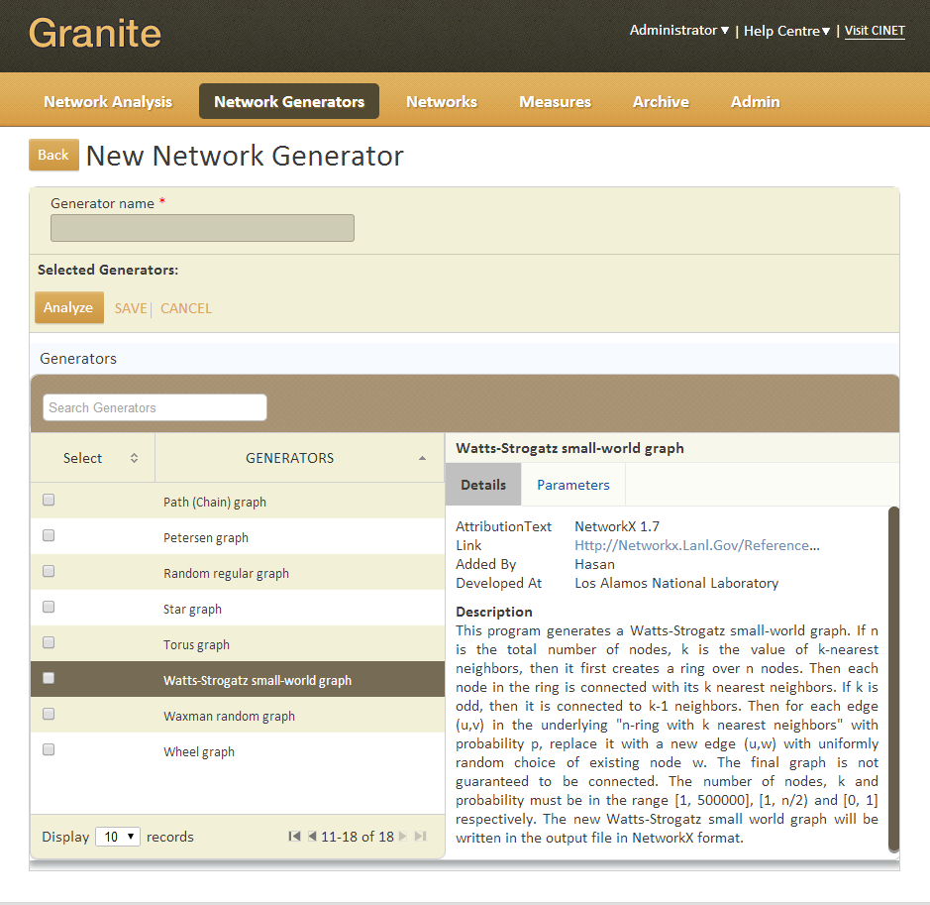
Network Generators in CINet
18+ network generators available
  Random network generators (8+ such generators)
    Erdos-Renyi, Watts-Strogatz small-world, Barabasi-Albert, Waxman random graph, etc.
  Deterministic network generators (8+ such generators)
    Binary, Star, Wheel, Grid, Torus, Hypercube, etc.
  Many of them can generate networks with millions of nodes and edges
  User can add networks after generating them in CINet
Screenshot

Slide 14
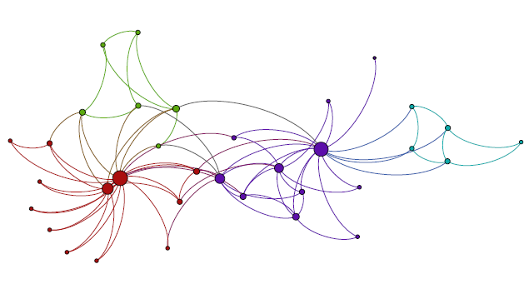
Networks (Graphs)
130+ small and large networks
  Larger network contains ~10M nodes and ~400M edges
  Social contact networks
    Miami, Chicago, Washington DC, Detroit, New York, Seattle
  Multi-modal urban transportation networks (e.g., subway, cars, buses).
    Portland, Oregon
  Adolescent friendship networks
    High school in New River Valley
  Blog and other online networks
    Twitter, Slashdot, Epinions
  Infrastructure networks
    Ad hoc and mesh, phone call, electrical power
  Biological networks
Networks can be weighted, and labeled.
Karate Club Network [Zachery 1977]

Slide 15
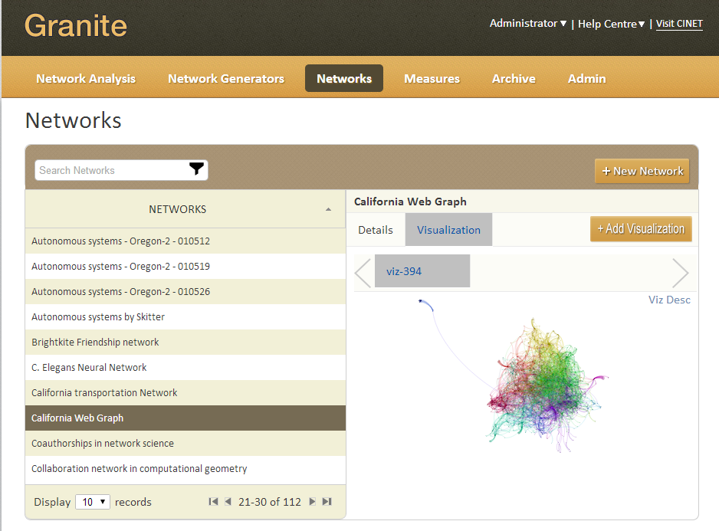
Network Visualization
User can submit visualization job for a network.
User can view & download generated visualization.
Visualization has 2 user interfaces in Granite
  Quick static view while
  selecting network for
  analysis
  Detailed interactive
  view
Uses Gephi toolkit

Slide 16
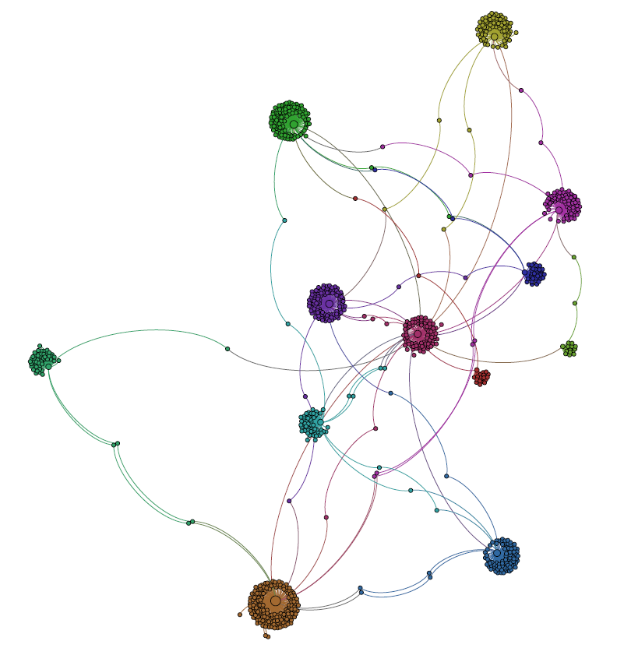
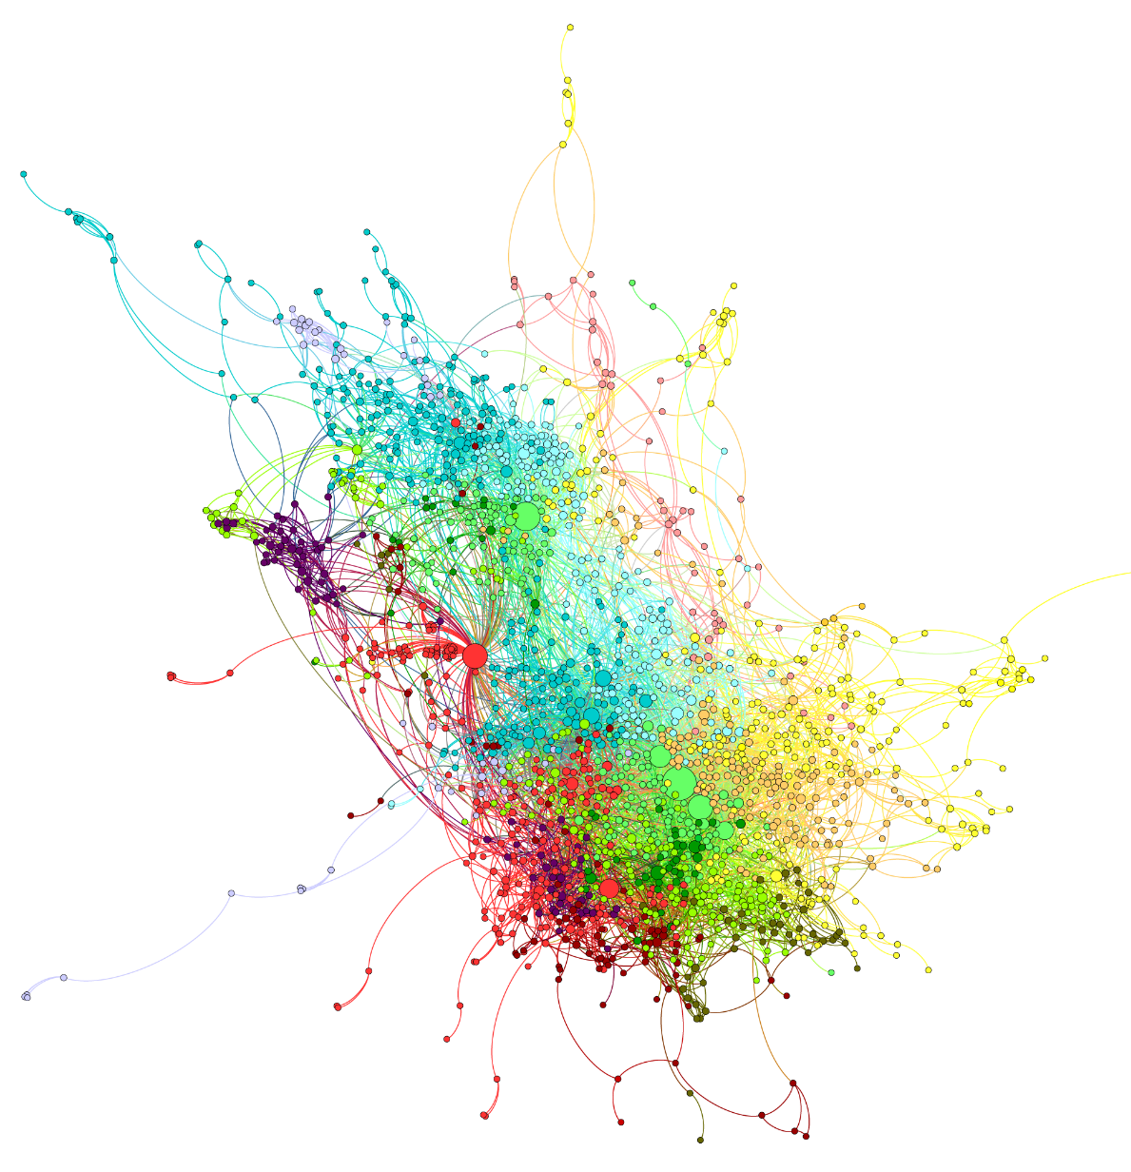
Network Visualization (Features)
User chooses parameters for visualization
  Layout algorithms such as Force atlas, Random, Yifan Hu, and Fruchterman Reingold
  Feature based organization such as determining node size and color using degree, pagerank, betweenness centrality values
  Applying community detection algorithm to visualize different communities in different colors
For a very large network, a subgraph can be visualized
User can import links to embed visualizations in other webpages
Store rendered networks into organized structure (pdf, png, gefx,etc.)
Community detection in Miami subgraph with 1000 nodes
Amazon co-purchase network

Slide 17
NetScript:
A Domain Specific Language for Network Analytics

Slide 18
NetScript: A Domain Specific Language
NetScript: A Domain Specific Language that will allow domain experts to analyze graph across libraries without learning to code in them separately
Challenges:
  Incompatible graph representation formats.
  Libraries developed in many languages (e.g., C/C++, Java, Python).
  Multiple programming paradigms (sequential programming, parallel programming : MPI, OpenMP, multithreading).
  Large data communication between the libraries.
  Error handling across the systems
  Ability to configure the systems dynamically

Slide 19
An Example
Usecase: Generate a set of random graphs with a specific property (e.g., diameter>=6) and compute the average degree distribution.
Significance: NetworkX and GaLib have random graph generators but they do not support graph generation with user defined properties.
DSL Code Snippet:
1 G = generateGraphNP(1000,0.7)
2 #No of nodes=1000,
3 #Prob. of choosing an edge between
4 #any two node = 0.7,
5 #mapped to NetworkX API
6 while diameter(G)<6:
7 #NetworkX measure
8 G=shuffle(G, 0.5)
9 #shuffle or edge swap
10 #ratio=0.5,
11 #mapped to GaLib API
NetworkX
(Python lib)
1
1
2
NetworkX
(Python lib)
2
Graph conversion &
data passing through extended interpreter
3
u
v
u
v
x
y
x
y
Galib
(C++ lib)
3

Slide 20
Features of NetScript
Python data structures for graphs, node, edge.
Node and edge can be of any type and can be labeled.
16 Generators for classic, random and synthetic graphs.
Standard 50+ graph algorithms (graph traversal, shortest path calculation, associatively computation, centrality detection etc.)
Network visualization through Matplotlib
Graph converters to and form LEDA., GEXF, GML, Pickle, YAML, Graph6
Automatic graph conversion and data passing between libraries.
Extended Python interpreter for data passing between C++ compiler and Python interpreter
Minimal internal graph conversion.

Slide 21
Making Granite Self-Sustainable: Concept of Services and Apps

Slide 22
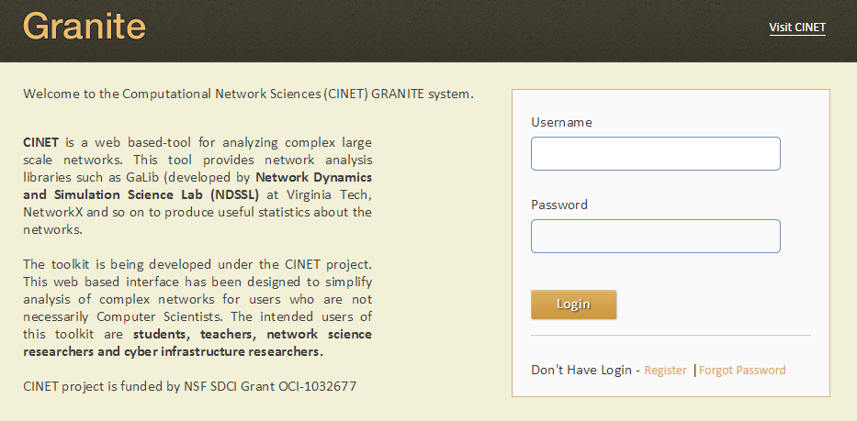
Service 1 – User Management
User can request account
  Its FREE to use
To open an account, go to:
http://cinet.vbi.vt.edu
Go to: Tools -> Granite
Click Register
All the entities – Networks, Measures, Generators, Analyses have owners. Due to this, access privileges can be inherited.

Slide 23
Service 2 – Add Networks
User can add network by uploading a file
A network can be in any one of two formats
  Adjacency list
  Edge list
For each uploaded network,
  syntactic and semantic checks are done to validate the network
  meta-data (no. of edges & nodes) are automatically calculated
  network is automatically converted from one format to another
User can specify
  metadata for the uploaded network
  visibility of the uploaded network as
    Public : available to all users for analysis
    Private: available only to the owner for analysis

Slide 24
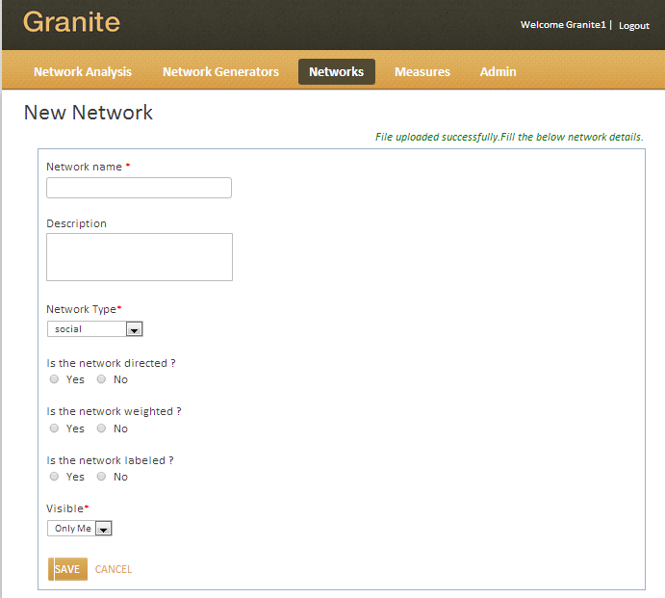
Service 2 – Add Networks (Screenshot)

Slide 25
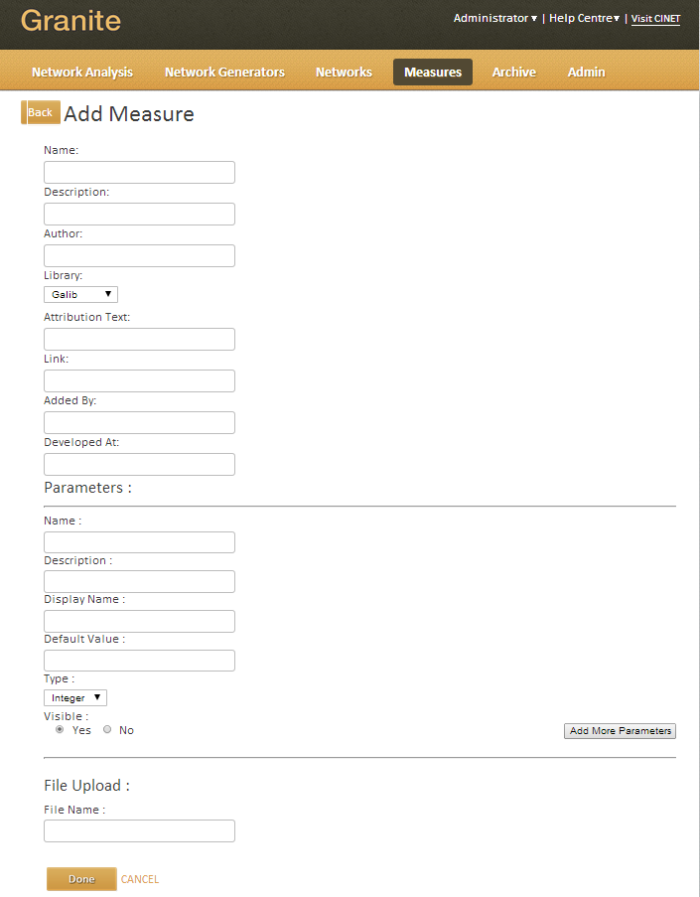
Service 3 – Add Network Algorithms (Measures)
User can add network algorithms with the help of CINET team
Resource manager ensures security by sandbox
  Run the new executable in Virtual Machine
Similar service for adding network generators

Slide 26
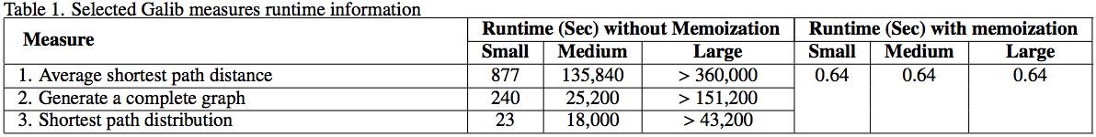
Service 4 – Memoization
Provides a platform enabling repeatable science
A digital library service
  Stores the result of deterministic network algorithms, e.g., minimum spanning tree
  All input parameters are captured and archived
  Retrieve the results from previous runs when the same algorithm is run with same parameters without recomputing
  Keeps the system manageable by saving compute resources, time, storage space, etc.
Performance:

Slide 27
GDSCalc:
Graph Dynamical System Calculator

Slide 28
GDSCalc: Graph Dynamical System Calculator
Abstracts many different application domains.
f₁
f₂
Elements of a GDS (graph dynamical system).
  (Dependency) graph, nodes (vertices) have state.
  Vertex functions, f.
    Quantifies when a node changes state, and to what state, based on its neighborhood.
  Update Scheme: the execution order of the vertex functions.
    Sequential: Nodes update one-at-a-time in a prescribed order.
    Synchronous: Nodes update simultaneously.
A primary use: compute phase space.
  Set of all state transitions for all possible system states.
Graph X:
v₁
v₅
v₂
f₅
v₄
v₃
f₄
f₃
Example sequential update scheme
Node update sequence:
Permutation π = (3,5,2,4,1)
Example system state transition for ratcheted threshold-1 node function and Boolean {0,1} state space.
Same input; different output: update scheme matters.
sequential update:
(0,0,1,0,0)
(1,1,1,1,0)
synchronous update:
(0,0,1,0,0)
(0,1,1,1,0)

Slide 29
Resource Manager

Slide 30
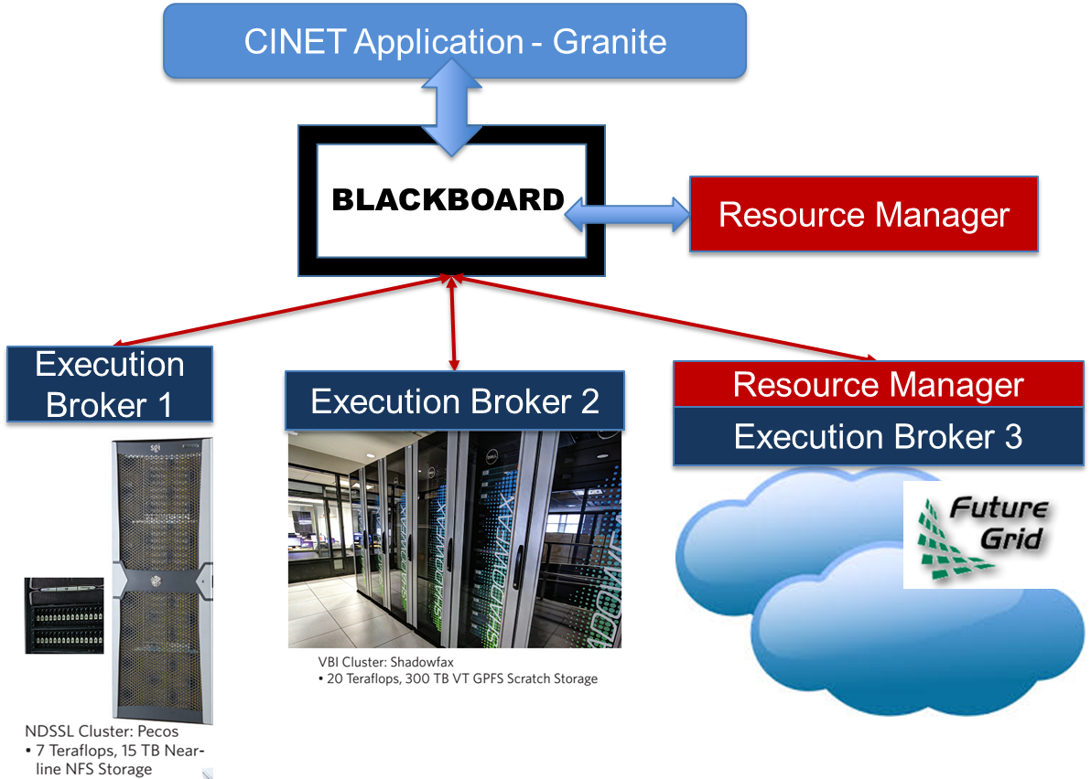
Resource Manager
Vision of Resource Manger:
Find best fit available resource to allocate job
Achieves load balancing and fault-tolerance
  by health monitoring
Resources made readily pluggable.

Slide 31
Resource Manager
Integrated Resources:
  HPC Clusters
    Shadowfax (hosted by Virginia Tech)
      Contains more than 1100 processing cores
    Pecos (hosted by Virginia Tech)
      Contains more than 900 processing cores
  Cloud Infrastructures
    Openstack and Eucalyptus hosted in FutureGrid
      Contains more than 5000 processing cores
Integrated resources have large processing ability
  Around 7000 processing cores in total
  Shared with other users

Slide 32
Fostering Research, Teaching, Collaboration
CINet is being used for teaching purpose in Network Science related courses in different universities
  SUNY Albany, NCAT, Virginia Tech, Univ. of Maryland
CINet provides a platform for collaborations
  Virginia Tech, Indiana Uni., SUNY Albany, Jackson State, Argonne National Lab, U. Chicago, NCAT
Evaluators from different universities
  SUNY Albany, Maryland, NCAT, Virginia Tech

Slide 33
Where is CINet heading
The base funding is over; we plan to host 4 workshops to get user feedback. Hope to improve CINet using other ongoing programs
New version of CINet will be deployed in a month: a new website is being created as well
Each of the modules is being enhanced to some extent; additionally new modules are being added (E.g. general simulation of contagions on networks). Will add Giraph based implementations and algorithms we develop under DIBBs here.
Main goal is to try and increase the user base -- CINet is ready to be used by the academic community.

Slide 34
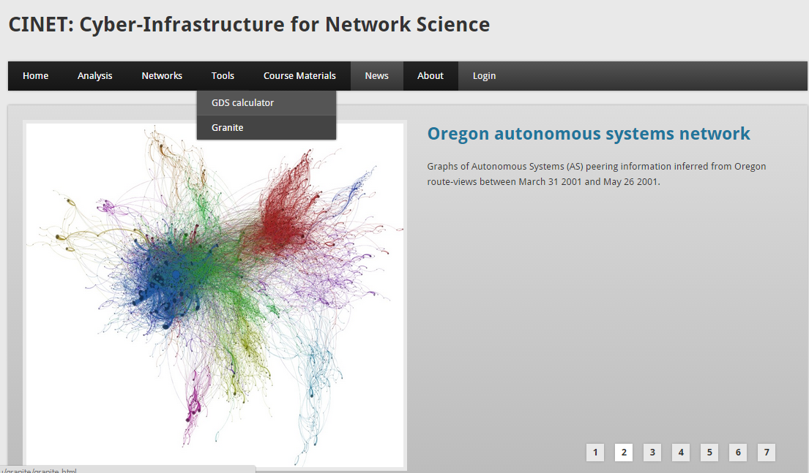
Demonstration of Granite
Go to: cinet.vbi.vt.edu
Go to: Tools -> Granite
Username:
demo
Password:
demo1234

Slide 35
Conclusion
A CyberInfrastructure that
  provides both static and dynamical network analysis tool
  contains a bunch of network algorithms, network generators, real-world and artificial networks
  is Self-sustainable and self-manageable
  has lots of apps and services, e.g., visualization, memoization, add measures, networks, etc.
  HPC Resources and resource manager
CINet makes life easy for network scientists.

Slide 36
Thank You!
http://cinet.vbi.vt.edu

