Slide 1
High-Performance Federated and Service-Oriented
Geographic Information Systems
Ahmet Sayar
Advisor: Prof. Geoffrey C. Fox

Slide 2
Outline
Geographic Information Systems and Open Geographic Standards
Motivations and Motivating Use Cases
Challenges
Research Issues
Federated Service-Oriented Geographic Information System
Abstraction of the system
Performance-oriented designs and evaluations
Contribution
Future Work

Slide 3
Geographic Information Systems
A Geographic Information System is a system for creating, storing, sharing, analyzing, manipulating and displaying spatial data and associated attributes.
GIS history saw the evolution from mainframe GIS to Desktop GIS to Distributed GIS.
Modern GIS require:
  Distributed data access for spatial databases
  Utilizing remote analysis, simulation or visualization tools.
Problems with traditional distributed GIS approaches:
  Distributed nature of the geo-data; various client-server models, databases, HTTP, FTP, XML DBs etc.
  Data format problems, conversion overheads
  Data processing issues, hardware and software requirements

Slide 4
Geographic Information Systems -cont
Distributed nature
Heterogeneous data and computation sources
Needs to be federated/ integrated and interpreted to develop knowledge
Large size data conversion and transfers
Needs interoperability to extend with new data and computation sources

Slide 5
Open Geographic Standards
Open GIS Standards bodies aim to make geographic information and services neutral and available across any network, application, or platform.
Two major well-known standard bodies: Open Geospatial Standards (OGC) and ISO/TC211
OGC Specifications defines online services and data models:
  Data Format Specs: Geographic Markup Language (GML), SensorML, Observation and Measurements (O&M)
  Service Specs: Web Feature Service (WFS), Web Map Service (WMS), Web Coverage Service (WCS)
OGC Services are HTTP GET/POST based; limited data transport capabilities.
Request-response type services; centralized, synchronous applications.

Slide 6
Motivations
Interoperable Service-oriented Geographic Information Systems (Merging Web Services with Open Geographic Standards (OGC))
Sharing and integration of distributed geographic data and computation resources
Uniform service interfaces enabling unified data display and attribute querying from a single access point (federation)
Responsive and interactive early visual-warning GIS systems (design issues from the performance’s point of view)

Slide 7
Motivating Use Cases
Very successful and highly acclaimed earthquake science applications
  Pattern Informatics (PI) - UC Davis and NASA JPL
    Earthquake forecasting code developed by Prof. John Rundle (UC Davis) and collaborators, uses seismic archives.
  Virtual California –UC Davis and NASA JPL
    Time series analysis code, can be applied to GPS and seismic archives. It can be applied to real-time and archival data.
Interdependent Energy Infrastructure Simulation System (IEISS) – Los Alamos National Laboratory (LANL)
  Models infrastructure networks (e.g. electric power systems and natural gas pipelines) and simulates their physical behavior, interdependencies between systems.

Slide 8
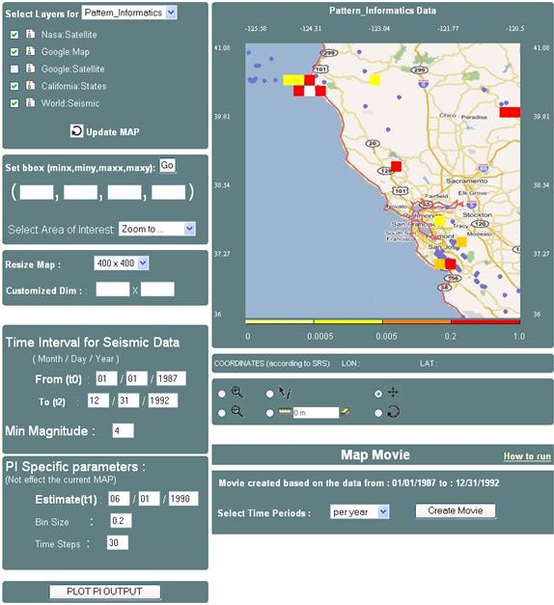
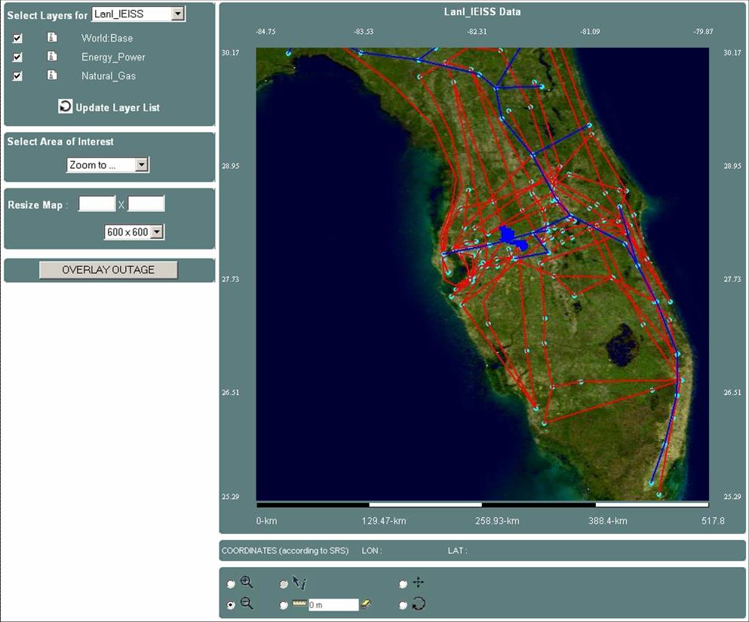

Slide 9
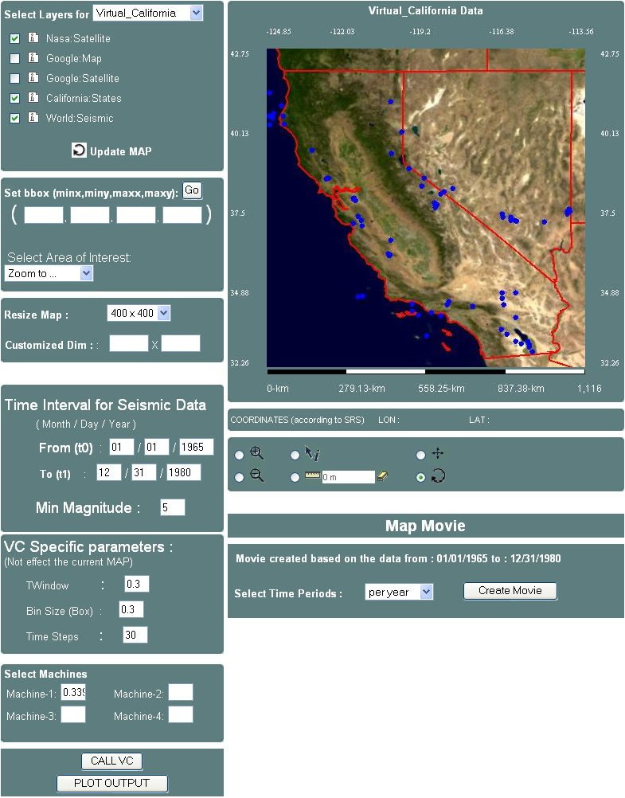
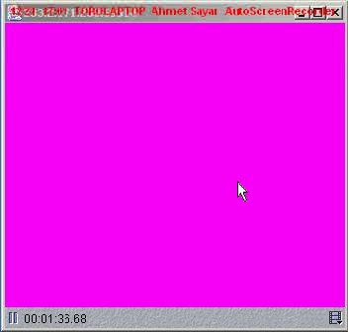

Slide 10
Challenges
Interoperability
  Is needed for heterogeneity of distributed nature of data and resources
  Solved by Web Services, Open Standards and structured data
  BUT costs performance
Responsiveness
  GIS applications require quick response
    Emergency early warning systems
    Home-land security and natural disasters.
  Resource consuming processes on large volume of data sets
    Map rendering, XML structured data transfers and parsing etc.
  Limited network bandwidth

Slide 11
Research Issues
Interoperable Service-Oriented GIS
  Adoption of Open Geographic Standards (OGC)
  Integrating Web Services with Open Geographic Standards
Capability file-based federated GIS system
  Through common data-model and service interfaces.
Principles for generalizing the proposed federated GIS system
  Conditions and requirements
Addressing the requirements for the performance and responsiveness of the interoperable GIS systems
  Data-oriented.
    Exploring performance efficient XML structured geo-data handling (data transfer and rendering)
  Proposed Federator oriented designs
    Pre-fetching, Caching and Attribute-based query decomposition and parallel processing
Notes:
In order to create federated Service-Oriented GIS and optimize its performance and responsiveness, we will investigate the following research issues
Federation is built on top of the proposed interoperable Service-Oriented GIS

Slide 12
Federated Service-Oriented GIS

Slide 13

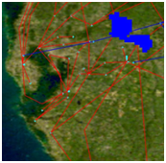
Architectural Framework
Federation is based on common data model and service capability files
  Common data model –data description language (GML)
Interoperable service-oriented GIS (triangle)
  Services types and interfaces : WMS and WFS
  Capabilities definitions
Aggregator WMS (AWMS) as federator
  Over Interoperable service-oriented GIS
  Capabilities aggregator
  Unified data display/query
WFS
User Portal
Interactive Map-Tools
Aggregator
WMS
1
WMS
WMS
GIS
2
WFS
2
2
3
1
WFS
1
Capability Aggregator
Map Rendering
Request Handler
-Query partitioning
-and assembly
Browser
WMS
GetCapability
GetMap
GetFeatureInfo
1
2
3
OGCand-ISO/TC-211standards
Notes:
There are many WMS and WFS around
These are all compatible to Open Geographic Standards
We first implement them in common standards and then converted to them web services.

Slide 14
  Interoperable service-oriented GIS (triangle)
Composed of two types of online services, WMS and WFS,
And two types of data:
  Binary data –map images and,
  Structured-data –GML : content (core data) and presentation (attribute and geometry elements)
WFS are data services providing data in common data model
  Providing local-data with common service API
WMS are data rendering services (like filters) providing human comprehensible data (map images).
  Information content offered by WMS is organized into “layers”.
  Some layers are map-images from other WMSs.
  Some layers are renderings of GML data from other WFSs.
Merging these standards with Web Services
  Developing Web Service counterparts of WMS and WFS
  Enable publishing, locating, invoking, and moreover, linking these services together to create more complex and explanatory information
Notes:
THESE ARE ALL OGC STANDARDS HERE I WILL TELL WHAT WE CONTRIBUTE:
INTERATE THE STANDARDS WITH WEB SERVICES
FEDERATING CAPABILITIES AT THE AGGREGATRO WMS TO ENABLE UNIFIED DATA DISPLAY AND INTERACTIVE QUERY
There are two types of data flying around in the below GIS. One is for vector data encoded in GML common data model and provided to the system through WFS. Another is binary data encoded in map images.

Slide 15
Capability files for standard services
WMS
WFS
<Capabilities>
<Service>
<Name>
<OnlineResource>
<ContactInfo>
</Service>
<Capability>
<Request>
<GetCapability>
<GetMap>
<GetFeatureInfo>
</Request>
<LayerList>
<Layer-1>
<Layer-2>
</LayerList>
</Capability>
</Capabilities>
<Capabilities>
<Service>
<Name>
<OnlineResource>
<ContactInfo>
</Service>
<Capability>
<Request>
<GetCapability>
<GetFeature>
<DescribeFeatureType>
</Request>
<DataList>
<Data-1>
<Data-2>
</ DataList >
</Capability>
</Capabilities>
General Service Metadata
Operations -
Web Service Interfaces
Metadata about provided data/information
Notes:
Federating capability-files from WMS and WFS
Capability files schema are defined by OGC
<service> tags are common for WMS and WFS but <Capability> tags have different tag names and attributes not shown here.
<LayerList> and <DataList> tags have attribute based descriptions such as available bbox, spatial reference systems (SRS), output formats etc.
<service>:
General service metadata as a whole.
General services’ invocation point.
Contact information such as names addresses etc.
<capability>:
<Request> names the actual operations that are supported. It also has some sub-tags about offered output formats and URL prefixes for each operations
<layerList>:
The geographic information content offered for a portroyal by a WMS server is orgnized into “layers”
Moreover, each available map is advertised by a <layer> element.
As a means of classifying and organizing layers, a single parent layer may enclose any number of additional layers, which may be hierarchically nested as desired. Some properties defined in parent layer are inherited by the children it encloses.
WFS indicate which feature type they can serve and what operations are supported on each feature type.

Slide 16
Capabilities federation
Project -> map -> layer -> data {GML}
Pre-defined tree-like static paths starting from federator (AWMS)
  Application-based hierarchical data
  Root is map-image at the AWMS
  Composing the layers (WMS) and GML (WFS)
Services exchange their capability files through common service interface - getCapability.
  Successive communications are done based on the definitions and constraints described in capability files
[Project]-PI
  [Layer]-1
    [Data]-1
      state boundaries (WFS-1)
    [Data]-2
      Rivers (WFS-2)
  [Layer-2]
    [sub-layer]-1
      Google map (WMS-1)
  [Layer-3]
    [Data]-1
      Earthquake-seismic(WFS-3)
Notes:
getCapabilities operations are to obtain service metadata which is a machine and human readable description of the server’s information content and acceptable request parameter values.

Slide 17
Federator (AWMS)
AWMS aggregates, composes and orchestrates WMS and WFS services and, express the layer level compositions in its capabilities file by federating other services’ capabilities metadata.
Federation is done over the pre-defined path built by the chained capabilities files.
Unified data access/query/display.
Enhanced capabilities and functionalities to enhance the system’s responsiveness.
Provides application (or project)-based hierarchical data/ information composition through its capability metadata
  project-> map -> layer -> {vector, raster and binary data}.
Information layering and layer-composition through capability federation
Notes:
request and response handlers covering query partitioning and assembling of the results returned to the partitioned sub-queries according to the request done to the hierarchical data defined in capability file

Slide 18
How to integrate any-data to the proposed system
WFS-based mediation
API in Open Geographic Standards
Adapters
  Any-data to GML
Query conversion
  “GetFeature” to local query (SQL for database)
  “GetFeature” to Xpath Queries (XML files)
Result set conversion
  Local query result to GML
(1) WFS front end
(2) local data-specific adapter
(3) local data source
Query
Response
WFS Service Layer
getCapability,getFeature,describeFeatureTyp
WSDL
(1)
Request Handler
Composition
(2)
Mapping: query re-creation
Source Connection/Execution
Local
Data/ information Sources
Databases, file systems SRB etc.
(3)

Slide 19
Abstraction of the system

Slide 20
Abstracting the architecture – I from GIS to ASIS
From Geographic Information Systems (GIS) to Application Specific Information Systems (ASIS).
We will need the domain-specific equivalent of the Web Feature Service for metadata and data. We call this generalization the Application Specific Feature Service (ASFS)
We also need to define the generalization of the Geography Markup Language, which is a language expressing the domain specific features. We call this Application Specific Language (ASL).
We finally introduce Application Specific Visualization Services (ASVS) generalizing the Web Map Service to both visualize information and provide a way of navigating ASFS compatible databases (cf. GetFeatureInfo for GIS)
Notes:
One will need a set of basic tools, Application Specific Tools and Transformations (ASTT), to manipulate information expressed in language and key data of application which correspond to coordinate transformations for GIS –ADAPtors
The ASVS can itself be federated and presents an ASFS output interface. All user and system services will input and output data in ASL using filters to process raw data into ASL. The high performance Web Service techniques described earlier allow one to combine high performance with the expressivity of ASL

Slide 21
Abstracting the architecture – II from GIS to ASIS
The approach we have adopted can be extended to other domains besides Geographic Information Systems.
One can define a GIS-style information model in many application areas such Biology, Chemistry and Astronomy.
Web Services provide key low level capability but do not define an information or data architecture but rather leave this to domain specific specification activities which is represented in capabilities metadata and domain specific common data model ASL.
AS Tools have data specific adaptors and provide common API as in GIS’s WFS and WMS.
Such as filter, transformation, reasoning, data-mining, analysis
AS
Repository
ASVS Display Federator
AS Tool
(ASVS mediation)
AS Services
(user defined)
AS Tool
(ASFS mediation)
4
3
2
1
AS
Sensor
AS
Sensor
Messages using ASL

Slide 22
Abstracting the architecture – III from GIS to ASIS
ASFS Mediation
1: Set of adaptors converting any data to ASL
2: Service interfaces serving its capability file and data in ASL
  GetCapabilities
  GetASL
  DescribeASLType
ASVS Mediation
3: Set of adaptors converting any data to binary images
  This is optional if there is no need for “user-defined services”.
4: Service interfaces serving its capability file and data in ASL
  GetCapabilities (capability description in XML)
  GetDisplay (displaying in images)
  GetASLInfo (querying the data attributes)

Slide 23
Performance-oriented designs, measurements and evaluations
Performance enhancements in Interoperable GIS systems
Notes:
Responsiveness and performance issues are mostly related to using structured common data model to solve the interoperability issues and limited bandwidth of the current internet

Slide 24
Introduction
Interoperability requirements bring up some costs: Compliance costs
  Common data model (GML)
  Web Services (SOAP protocol for communication)
Large scale science applications using large scale data, and resource consuming processes
Turning compliance requirements into competitiveness

Slide 25
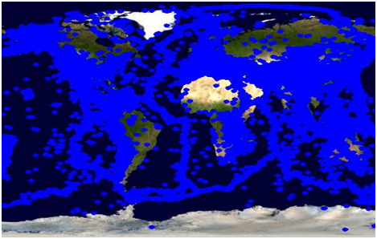
Limits of Conventional OGC-GIS systems
Conventional:
  On-demand data access, single-threaded and no-caching
Related projects: Deegree and UMN-Minnesota Map Servers
Small data sets (less than 500KB) response times are ok
For larger data sizes the performance is not enough.

Slide 26
Enhancements Approaches
Performance issues in interoperable service-oriented GIS
  (1) Using structured data model (GML)
  (2) Domain specific data characteristics:
    Large-scale, variable sized and un-evenly distributed
(1) Data-Oriented
  Large sized structured data transfers
  Data parsing and rendering
(2) Federator(AWMS)-Oriented
  (1) Pre-fetching
  (2) Locality-based query decomposition and parallel processing
  Approaches change depending on the data characteristics
    Update frequency of the archived data
  If update intervals > time to transfer whole data
  then (1) else (2)

Slide 27
(1) Data-Oriented Approaches

Slide 28
  Data-Oriented - I
  Large sized structured data transfer
Structured data enables interoperability and inter-service communication
BUT, XML representation of data tend to be significantly larger than binary representations
The larger data size means the greater bandwidth is required to transfer the data
Initial proposed SOA based GIS used GIS Web Services and SOAP over HTTP as transfer protocol.
BUT, this had some limitations over the performance.
We investigated topic-based publish-subscribe messaging systems for exchanging SOAP messages and data payloads between proposed GIS Web Services

Slide 29
Streaming Data Transfer
registry
UDDI
w s d l
2
3
(A)WMS
w
s
d
l
WFS
getFeature
1
Subscriber
(topic, IP, port)
Publisher
client
GML
GML
server
Topic-wfs
Narada Brokering Server
SOAP is used for negotiation (line-1) – standard getFeature request
  Publisher information in (topic, IP, port) triple is returned.
For retrieving the results NB subscriber is used. Data streamed by publisher
Lines 1, 2 and 3 show classic publish-find-bind triangle of Web Services
Test results are obtained by using real Pattern Informatics geo-science application and archived earthquake seismic GML data records.
Performance gain is average 40%

Slide 30
Data-Oriented - II
Data Parsing and Rendering
  Processing XML data: Separating (extracting) core-data (such as geometry elements) from the attributes and other tags.
Two well-known widely-used approaches are document models (DOM) and push models (SAX).
BUT, these don’t provide good enough performance results.
We use pull approach for XML processing.
  Xpp from Extreme labs
  Parses only what is asked for
  No support for document validation (major gains of performance)
  Doesn’t build complete object model in memory (DOM)
  Very small footprints –no document state footprints (DOM)
  Tags and contents are returned directly to appl from calls to parser (indirectly in the form of callbacks -SAX)
  Fast processing (fewer unnecessary event callbacks –SAX)

Slide 31
 |  | DOM (dom4j) |  |  |  |  | Pull Parsing
Data Size (MB) |  | Average Parsing Time(msec) | StdDev | Average Rendering Time(msec) | Average Total Time Pars+Rend | StdDev | Average Total Time | StdDev
0.001 |  | 394.29 | 18.68 | 75 | 469 | 21.32 | 15.59 | 0.87
0.01 |  | 429.32 | 36.46 | 65 | 494 | 20.87 | 72.81 | 7.41
0.1 |  | 484.41 | 18.18 | 141 | 625 | 23.04 | 183.06 | 23.25
1 |  | 663.94 | 18.09 | 96 | 760 | 31.58 | 270.47 | 40.09
5 |  | 1,247.00 | 36.74 | 175 | 1,422 | 47.66 | 671.74 | 76.05
10 |  | 2,126.63 | 20.73 | 1,430 | 3,557 | 61.51 | 1,025.67 | 51.49
100 |  | 1,159,613.67 | 13,122.61 | ---- | ---- | ---- | 7,059.72 | 93.16
150 |  | ---- | ---- | ---- | ---- | ---- | 11,047.89 | 107.80
200 |  | ---- | ---- | ---- | ---- | ---- | 14,949.12 | 253.15
The tests are done with 1GB allocated virtual memory
Dashed lines in the table represent memory exceptions
For the DOM we have used dom4j and for pull parsing we have used Xpp from Extreme Labs.
For the XML data, we have used earthquake seismic data records encoded in GML

Slide 32
Federator (AWMS)-Oriented Approaches
Two techniques are proposed
1. Pre-fetching
2. Attribute-based query partitioning for parallel processing and caching

Slide 33
Data Characteristic
(c,d)
(c,d)
Data is described with location attribute formulated in coordinates.
Based on the location values, the data is described as un-evenly distributed and variable sized.
It is not easy to implement well-known performance enhancing techniques.
Cannot share workload justly
R3
R2
(c, (b+d)/2)
(c, (b+d)/2)
R1
R4
(a,b)
((a+c)/2, b)
(a,b)
((a+c)/2, b)
(a)
(b)
Proposed approaches
  1. Pre-fetching
  2. Parallel processing with caching through attribute-based query decomposition

Slide 34
1. Pre-fetching
Getting the GML data before it is needed
For overcoming the natural bandwidth problem.
Not-frequently changing archived data
Red curve – response by using pr-fetched data
Black curve – response by on-demand fetching
PM (defined with task and timer) runs independent of real application
WMS Aggregator
WFS
User Portal
Interactive Tools
Processor
WMS
WMS
2
WFS
2
1
PM
1
WFS
GML
Temp Storage
NB
Local File System
PF: Pre-fetching module NB: NaradaBrokering WMS: Web Map Service WFS: Web Feature Service
Synch move

Slide 35
Pre-fetching performance test in Response times
Data Size | Average Response |  | Average Response
KB | Pre-fetching | StdDev | On-demand | StdDev
1 | 1,006.47 | 176.84 | 2,375.24 | 152.40
10 | 1,040.33 | 233.24 | 2,578.69 | 252.49
100 | 1,148.44 | 233.11 | 7,973.16 | 374.12
1000 | 1,687.44 | 421.92 | 59,335.69 | 343.76
10,000 | 2,785.37 | 282.39 | 573,324.66 | 836.46
Tests are done with the real geo-science application.
PI earthquake forecasting application using earthquake seismic records.
For data size 10MB, pre-fetching is about 200 times faster
The larger the data size the higher the performance gains.

Slide 36
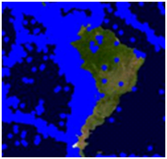
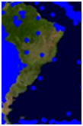
2. Parallel processing with caching
Attribute-based query decomposition and parallel process with caching
Main query partitioning based on bbox attribute value
Each partition is assigned to a separate thread
The number of partition are defined by locality information from one-time caching for successive requests belong to same session.
Parallel processing with caching
  Cached data extraction (a)
  Rectangulation (b)
  Partitioning with locality information for Parallel processing (c)
R1.1’
Cached Data
Successive main query
R1.2’
R1.3’
R1
R1.4’
R2
R2.1’
R2.2’
(a)
(b)
(c)

Slide 37
Caching: Mapping browser based sessions across to Web Services
One-time caching of critical data (GML) for the successive main queries
  Cached data is kept till the next query is served
Updating header of SOAP message
Ex: Mapping browser’s session info to AWMS
  AWMSServicesSoapBindingStub binding;
  binding = (AWMSServicesSoapBindingStub) new
  AWMServiceLocator().getAWMSServices(new URL( service_address));
String sessionID = session.getid(); //unique session id assigned by JSP
String channel_name = “AWMS_getMap_Request”;
binding.setHeader(service_address, channel_name, sessionID);

Slide 38
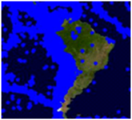
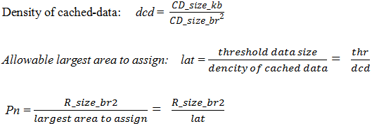
Parallel processing with caching through attribute-based query decomposition - I
Attribute is bounding box (bbox) defined as
  (minx, miny, maxx, maxy)
CD_size_br² = (maxx^{c} - minx^{c})*(maxy^{c} - miny^{c})
R_size_br² = (maxx - minx)*(maxy - miny)
And pre-defined thr (threshold) value to determine if partitioning is required for a rectangle (bbox)
P_{n} : The number of partitions calculated for a rectangle
(maxx^{c}, maxy^{c})
(minx, miny)
(minx^{c}, miny^{c})
(minx, miny)
1. Determining the number of partitions (P_{n})

Slide 39

Parallel processing with caching through attribute-based query decomposition - II
2. How to partition a rectangle in bbox
  We know the rectangle’s bbox and Pn.
  Since we still don’t know the workload falls in that bbox earlier, we partition that rectangle into equal sizes
  There are two options here, vertical partitioning anf horizontal partitioning. Let’s pick vertical and explain the algorithm:
maxx, maxy
1
S_{y}
2
Pn
Calculating the bboxes of the partitioned regions:
for (i=0; i<Pn*s_{y}; i=i+s_{y};)
print ( minx, miny – i, maxx, maxy-(i+s_{y}) ) ;
minx,miny
Partitioning the rectangle along the coordinate y

Slide 40
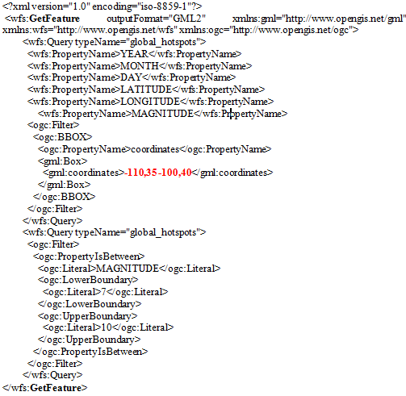

Parallel processing with caching through attribute-based query decomposition - III
3. How to created sub-queries
  After having partitioned regions’ bbox values printed in previous step, corresponding sub-queries are created.
  Each partition is differentiated by their bbox values calculated above. Other attributes are inherited from the main query.
  Ex: main query bbox is ““-110, 35, -100, 40” and let’s assume we found out that Pn=5
Decomposing the rectangle according to
P_{n} and s_{y}
Creating queries for these bbox values
A rectangle from the rectangulation process
-110, 35, -100, 36
GetFeature-1
-110, 36, -100, 37
GetFeature-2
-110, 35, -100, 40
-110, 37, -100, 38
GetFeature-3
-110, 38, -100, 39
GetFeature-4
-110, 39, -100, 40
GetFeature-5

Slide 41


Performance tests – based on case scenarios
(1) No usage of cached-data
(2)-(3) Complete usage of cached-data
(4) Partial usage of cached-data
R1
1
WFS
Critical data provider in GML
R3
GetFeature requests
R1
R2
r₁
r₂
r₃
r_{Pn}
R4
2
. . .
Critical data falling into partitioned regions
GML
Cached
GML₁
GML₂
GML_{Pn}
. . . .
3
Main query: cached data extraction and rectangulation
Critical data layer
R₂
R₁
Cached Data
Successive request
Layers from Other
WFS and WMS
R1
R2
Main query >---rectangulation---> Rectangles[R_{s}] >---partition---> sub-queries [r_{s}]
4

Slide 42
(Case-1) No usage of cached data –pure pp
T_{table} = Time for federator (AWMS) to access the GML data. From database to federator (AWMS)
T_{table} = T_{GML conversion}
  + Tstreming the data WFS to federator
  + T_{building GML at federator}
No overlapping and no-benefit from cached data
The main query is partitioned and assigned to threads. No-rectangulation and cached-data extraction
The proposed parallel processing cause some overheads in query partitioning, corresponding query creation and assembling the responses to create the averall reponse to the main query.
  As sample case we use 10-threaded case (next slide).
Notes:
We also need to compare the response timings and compare them with ordinary approaches

Slide 43
(Case-1) Overhead and Response timings for 10-thread pp
The performance does not increase in the same ratio at which the thread number increases. That is because of the overhead times.
T_{Response for 10-thread} = Tdata transfer (green line in previous figure)
+ Tsum of overhead timings in the left table
Amongst the overhead timings, only the map rendering depends on the data size, others depends on the number of partitions.
The larger the data thehigher the performance gain.
There is no performance gain for less then a threshold data size handled. For example for earthquake seismic GML data it is around 20KB.

Slide 44
Complete (case-3) and partial (case-4) usage of cached-data
Case-3: happens when the successive query falls in the boundaries of the cached data.
Cached-data is enough to respond to the main query. The only task is the cached-data extraction and overlaying the other layers.
Performance results are same as in case of pre-fetching is applied.
Case-4: happens when the user moves the map to another region. If only the one point of main query falls in cached-data boundaries.
This is the case where pp is applied with caching. Case scenario:
  ½ of the requested data is already cached. Cached data is processesd as in case-3.
  Other half is going to be requested by 10-threaded parallel processing
  Number of partitions and their sizes are determined by using overlapped cached data density (we call it locality information)

Slide 45
(Case-4) partial (1/2 cached) usage of cached data
 | Comparison of the response times
GML Data | Hybrid (half cached half pp) |  | Orinary systems
Size - MB | time | StdDev | time | StdDev
0.01 | 7,063.38 | 357.46 | 2,578.69 | 252.49
0.1 | 9,702.49 | 322.20 | 7,973.16 | 374.12
0.5 | 12,892.12 | 361.53 | 30,868.52 | 482.83
1 | 14,692.18 | 414.89 | 59,635.69 | 343.76
5 | 45,401.40 | 590.89 | 288,594.12 | 772.41
10 | 70,494.98 | 475.19 | 574,825.16 | 836.46
There is no gain of using pp with caching technique for the small sizes of data due to the overheads.
We propose a threshold value to define if the partitioning is needed as explained before.
For this scenario the proposed system is almost 8 times faster than the ordinary on-demand one-threaded systems.
As the data size increases, that ratio increases.

Slide 46
Summary of Contributions
A framework for capability file-based federated Service-Oriented GIS
Integrated Web Services with Open Geographic Standards for supporting interoperability at both data and application levels
Abstraction of federated Service-Oriented GIS for general domains
  Generalizing the proposed GIS framework
  Defining the requirements in terms of components
Investigating performance efficient designs
  Streaming GIS Web Services
  Capability file-based Pre-fetching
  Attribute-based query partitioning and caching techniques for parallel processing
Comprehensive benchmarks to evaluate the performance and responsiveness of the systems
Contribution as system software
  Web Map Server (WMS)
  Federator (AWMS)
  Interactive map tools for data display, query and analysis

Slide 47
Future Research Directions
Developing more general framework for application specific information systems –ASIS
  Considering semantics of data and services
  Distributed capability federation
  Capability files and application specific languages
  Inter-service communications through capability exchange
Integrating ASIS with science applications at the view-level
  Science plotting services
  Processed data overlay and association with input data

