Slide 1
High-Performance Federated and
Service-Oriented
Geographic Information Systems
Ahmet Sayar
(asayar@cs.indiana.edu)
Advisor: Prof. Geoffrey C. Fox
Notes:
Today's presentation is on my research topic – High …….systems. ( Slow)

Slide 2
Outline
Motivations
Research Issues
Architecture: Federated Service-Oriented Geographic Information System
Performance enhancing designs - measurements and analysis
Conclusions
Notes:
I will be addressing these factors in today's presentation ( wait sometime so they can read).

Slide 3
Geographic Information Systems (GIS)
GIS is a system for creating, storing, sharing, analyzing, manipulating and displaying geo-data and associated attributes.
Inherently requires federation (see the figure)
  Autonomy for scalability, flexibility and extensibility
Distributed data access for geo-data resources (databases, digital libraries etc.)
Utilizing remote analysis, simulation or visualization tools.
Open Standards
  OGC and ISO/TC-211
Notes:
Decision making in Geographic Information Systems (GIS) increasingly relies on analyses of spatial data in map-based formats.
Maps are complex structures composed of layers created from distributed heterogeneous data sources.
Don keep repeating Geographic Information System
Just say GIS System or these,,, etc.
JUST GO SLOW
Tell something about the figure – explain it
FROM DIFFERENT DISCIPLINES AND SKILL/EXPERT LEVELS.
Problems with traditional distributed GIS approaches:
Distributed nature of the geo-data; various client-server models, databases, HTTP, FTP
Open geographic standards:
Aim is to make geographic information and services neutral and available across any network, application, or platform.
Two major well-known standard bodies: Open Geospatial Standards (OGC) and ISO/TC211.
OGC Specifications defines online services and data models:
Data Format Specs: Geographic Markup Language (GML)
Service Specs: Web Feature Service (WFS), Web Map Service (WMS)
OGC Services are HTTP-based which has limited data transport capabilities.
HTTP-based services are request-response type services; centralized and synchronous applications.
Open Geographic Standards:

Slide 4
Motivations
Requirements for
Interoperable Service-oriented Geographic Information Systems
  Necessity for sharing and integrating heterogeneous data and computation resources to produce knowledge.
Uniform data access/query, display and analysis from a single access point
Responsive and interactive information systems
  GIS applications require quick response
    Emergency early warning systems
    Home-land security and natural disasters.
Notes:
The first motivation behind my research is the need for interoperable ….
There is also a need to provide uniform data access/query, …
And finally GIS applications need immediate data as they are used in emergency or homeland… so it requires us to investigate high performance information systems
2.bullet: application-based hierarchy of the distributed data resources
BUT meeting interoperability compliance costs performance
3.bullet: Resource consuming processes on large volume of data sets
Map rendering, XML structured data transfers and parsing etc.
Limited network bandwidth.
RIGHT DATA IN TIME

Slide 5
Research Issues
Interoperability
  Defining component based Service-oriented GIS data Grid framework
  Adoption of Open Geographic Standards -data model and services
  Applying Web Service principles to GIS data services
  Integrating Web Service and Open Geographic Standards
Federation
  Capability-based federation of GIS Web Service components
  Unified data access/query, display from a single access point through integrated data-views
Addressing high-performance support for responsiveness
  Streaming GIS Web Services
  Pre-fetching: Central approach over distributed autonomous data resources
  Dynamic load balancing through attribute based query decomposition
Notes:
Here are the issues I attempt to address in my current research-
1.bullet:
Web Service and XML-based query language extensions.
4.bullet:
Streaming extensions – Streaming GIS web Services using pub/sub based messaging middleware
Studying and investigating best rendering techniques from XML based common data.
Federator oriented approaches:
Pre-fetching
Client-based caching
Workload forecasting and parallel procesing
Streaming extensions
Web Service extensions at the data and service levels

Slide 6

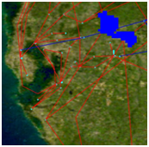
  Web Service components and data-flow
  Service-oriented GIS
Built over:
  Web Services standards (WS-I) and
  Open Geographic Standards (OGC and ISO/TC-211)
Consists of two types of online services
  Web Map Services (WMS) and Web Feature Services (WFS)
And two types of data:
  Binary data –map images (provided by WMS),
  Structured-data –GML : content (core data) and presentation (attribute and geometry elements) (provided by WFS)
WMS are rendering services -human comprehensible data (binary map images)
WFS are data services -common model Geographic Markup Language (GML)
  behaving as mediator and annotation services.
WMS and WFS have their own type of capability metadata (data+service information) defined by Open Geographic specs.
Inter-service communication is done through “getCapability” service interface.
Components are Web Services and all control goes through SOAP messages
XML-based query languages (standard schema)
GIS
WMS GML rendering
WFS (mediator)
wsdl
wsdl
Binary data
GML
getCapability
getMap
getFeatureInfo
getCapability
getFeature
DescribeFeatureType
Notes:
I will here talk about the interoperable……..
General Features:
OGC data formats and application interfaces to achieve interoperability at both data and service levels
Web Services to realize Service-oriented architecture
Integrating the standards with web service standards
XML-based query language
We develop a GIS providing standard control and access interfaces for archival data types.
Supports alternate transport and representation schemes, uses topic based messaging infrastructure for data and message exchange.

Slide 7
Federation Framework
Step-2: (Run time – green lines) Users access/query and display data sources from a single access point (federator) over integrated data-views (multi-layered map images).
  Some layers are in binary map images (layers from WMS), and some are rendered from GML which is provided by WFS.
  Enables users to query the map images based on their attributes and features
  On Demand Data Access: There is no copying of the data at any intermediary places. Data are kept at their originating sources. Consistency and autonomy.
Step-1: (Setup– blue lines in the figure)Federator search for standard components providing required data layers and organize them in one aggregated capability file.
  Federator is an extended WMS
  Aggregated capability is actually a WMS capability representing application-based hierarchical layer composition.
  Capabilities are collected via getCapability standard service interface
  Federator provides single view of federated sources
Integrated data-view: b over a
3
1
Aggregated Capability
WMS
a. NASA satellite layer
a
JPL at California
a
b
4
Event-based
Interactive Map-Tools
1
Federator
WFS
b
Browser
Browser
2
Browser
2
b
b
b. Earthquake-seismic data
Events:
- Move,
- Zooming in/out
- Panning (drag-drop)
- Rectangular region
- Distance calc.
- Attribute querying
a
3
a
WFS
CGL at Indiana
1. GetCapability (metadata data+service)
2. GetMap (get map data in set of layer(s))
3. GetFeatureInfo (query the attributes of data)

Slide 8
Why Capability metadata
Web Services provide key low level capability but do not define an information or data architecture
These are left to domain specific capabilities metadata and associated data description language (GML).
Machine and human readable information
  Enables easy integration and federation
Enables developing application based standard interactive re-usable tools
  for data query display and analysis
  Seamless data/access/query
Notes:
4.bullet: Dynamic upgrading user interfaces
Ex. interactive map tools

Slide 9
Architecture Summary
Fine-grained dynamic information presentation
  Heterogeneous data sources queried as a single resource
  Integrated data-view in multi-layered map images
  No burden of accessing data source with ad-hoc queries.
  interactive feature based querying besides displaying the data
Just-in-time or late-binding federation
  Data always is kept at its originating resource
  Autonomous local resources -Easy data-maintenance
Interoperable and extendable
  Open Geo-Standards are integrated with Web Service principles.
  Converting HTTP/GET-POST queries into XML-based queries.
Notes:
Fine-grained dynamic information presentation through a federation framework enabled us heterogeneous data sources to be queried as a single resource over integrated data-view in multi-layered map images
Autonomous local resources -controlling definition of data
Removing the burden of individually accessing each data source with ad-hoc query languages.
Enables interactive feature based querying besides displaying the data
Extending the standard service definitions with streaming data transfer capabilities by using publish-subscribe based messaging middleware.
We do fine-grained dynamic information presentation enabling attribute-based querying and interaction over integrated data-views in multi-layered map images.
Integrated data views are multi-layered map images composed of distributed standard GIS Web Service components.
These quality of services and framework enables
Extensibility, interoperability
Autonomy and easy data maintenance.

Slide 10
Federator-oriented data access/query optimization for distributed map rendering
Notes:
Lets discuss the performance…………..designs in such federated service oriented framework
Federated spatial database display
We propose federator-oriented data …optimization techniques for distributed map rendering

Slide 11
Background: Geo-data Characteristics
Geo-data
  un-evenly distributed
  variable sized
according to their locations attributes.
  Ex. Human population and earthquake-seismicity data
Queried/displayed/analyzed based on location attribute
  Location is a point described with (x, y) coordinates.
  2-dim range query
    Rectangle defined in bounding box
Unexpected workload distribution:
(c,d)
(c, (b+d)/2)
(a,b)
((a+c)/2, b)
Geo-data is mostly represented as large sets of points, chains of line-segments, and polygons.
Notes:
Geo-data characteristics illustrate efficient load balancing and un-expected workload sharing problems in distributed computing

Slide 12
Performance Investigation
Interoperability requirements’ compliance costs
  XML-encoded common data model (GML)
  Standard Web Service interfaces accepting XML-based queries
  Costly query/response conversions
    XML-queries to SQL
    Relational objects to GML
  Query processing does not scale with data size
Tough data characteristics: Variable sized and unevenly distributed nature of geo-data
    Unexpected workload to apply natural load-balancing and parallel processing
Aim: Turning compliance requirements into competitiveness by optimizing federated query responses.
Notes:
GIS is mostly used in early warning systems, and therefore require quick response times.
In such a distributed federated system, data is autonomous and thus heterogeneous
>Query and response conversions
The geo-data sets in geographic applications are usually very large.
Interactive and real-time applications require quick response times.

Slide 13
Enhancement Approaches
Federator-oriented data access/query optimization for distributed map rendering:
Extension to Open Standards: Streaming data transfer
Pre-fetching (centralized)
  GML-tiling
Dynamic load balancing and parallel processing (decentralized)
  Range query partitioning through Workload-table (WT)
Notes:
We address these performance issues from the federator’s point of view (which is upper level approach)
We have introduced/developed federator-oriented data access/query optimization techniques (over the OGC standard data services)
3. Seems like a natural solution, but geo-data is variable sized and unevenly distributed.

Slide 14
1. Extension to Open Standards:
Streaming data transfer
Motivations:
  HTTP based query/response does not allow large scale data move
  Memory exceptions in creating GML representation of large query results
  Removing SOAP message creation overhead
Strategies: Streaming data flow extensions to GIS Web Services
  Mapping OGC’s definitions of data service to Web Service Standards
  HTTP-GET/POST to XML-queries
  Service descriptions are in WSDL
  Web Service - as a hand-shake protocol.
  Data transfer is over publish-subscribe messaging systems (Naradabrokering).
  Enables client to render map images with partially returned data
Extension
client
Federator (WMS) GML rendering
Subscriber
GML
(topic, IP, port)
Narada Brokering Server
GetFeature
Topic,IP,port
1
2
W S D L
WFS
Publisher
GML
server
DB
Notes:
Initial problems regarding data transfer and rendering in GIS developed in accordance with Open Standards
HTTP based query/response does not allow large scale data move
Rendering large scale XML data with common xml processors had some problems such as mem exception

Slide 15
2. GML-tiling
On-demand access/rendering
over TT
Motivations:
  Time and resource consuming query/ response conversions in autonomous data sources
  Poor performance in data access/query
Strategies:
  Pre-fetching the data
  Database is mapped to a data structure (Tile-table) in federator
  Successive on-demand queries are served from federator’s local disk
On-demand access/rendering
Interactive
Client Tools
Federator
(WMS)
Federator
(WMS)
Tile-table
Pre-fetching (batch job) running routinely
GML
GetFeature
GML
GetFeature
WFS
WFS
SQL
Relational objects
SQL
DB
DB
On-demand queries are served from TT
TT is synchronized with database routinely.
Straight-forward
Notes:
Motivation: Performance bottleneck
On-demand access to originating databases through WFS,
Transmitting XML-encoded GML representation of data
Strategies:
Periodically fetching the whole data before it is needed (so called pre-fetching).
Databases are mapped to GML files and stored locally in the federator
Successive on-demand queries are served by using pre-fetched data
Pros/Cons:
Removes the repeated resource consuming query/data conversions at WFS and associated Databases.
Gives the best performance outcomes for the archived data,
But, might cause inconsistency
In the following chapters we present enhancement techniques to reduce the negative effects of time consuming query/data conversions and data transfer latencies. We focus on the issues at the upper level of data handling. We are not proposing enhancement over query and/or response conversions at the autonomous resources integrated through mediators (WFS). Our enhancement approaches are at the federator and view-level.

Slide 16
Tile-table (TT)
Created and updated by a module independent of run-time
  Synchronized with the database routinely
TT is consisted of <key, value> : <bbox, GML> pairs.
  Each partitioned rectangle below is represented by <bbox, GML>
Recursive binary cut (half/half)
  Until each box has less than threshold GML size
Lets illustrate the table with sample scenario
  each point data corresponds to 1MB and
  threshold value of each partition is 5MB
(1,1)
(1,1)
3
1
4
2
5
(1, 3/4)
1
3
4
4
3
(1, 1/2)
5
4
(0,0)
(0,0)
(1/2, 0)
Notes:
If in first fetch, data size exceeds the allowed size, then cut into 2
Figures represent whole ranges in database for the selected data layer.
(0,0,1,1)
(0,0,1/2,1) (1/2,0,1,1)

Slide 17
How It is Created
Recursive binary cut 2 dimensional ranges:
  R: Full range for the data in bounding-box
  t: Threshold data size
  PT(R, t) = PT(R_{half}, t)+PT(R_{half}, t)
    Gml = getFeature (R_{half}, t)
    If (Gml_size<= t)
      Put it into memory and/or disk space as pair <R_{half}, Gml>
      And return;
    Else
      Call PT(R_{half},t)
Threshold data size changes depending on the data and network.

Slide 18
How It is Used (Run-time)
On-demand data access and rendering responded over TT
Lets say federator gets a queries positioned to TT as below
p₂
r₁
p₁
p₄
p₁₂
r₂
p₃
(r_{i}): On-demand query in bbox
(p_{i}): WT entries in GML
r₁: p₁₂
r₂: p₁, p₅, p₁₂
r₃: p₁₁,p₁₀
r₄: p₁, p₉, p₃, p₆
r₄
p₆
p₅
p₈
p₉
p₇
r₃
p₁₁
p₁₀
Find all partitions that overlap with the query r_{i} ( i.e. p_{i} values )
Obtain GML values from TT using corresponding Pi values.
  GML = TT.get(p_{i})
Extract the geometry elements in GML, and render the layer.

Slide 19
Summary (GML-tiling)
Similar to that used by Google Maps
  Map image tiles, replacing computation with storage
GML-tiling enables
  Feature-rich maps
  Attribute based querying of map data
  Dynamic styling
  But spends time on rendering of GML (cost prices)
Each layer has its own GML-tile table
It is good as long as the local storage is large enough.
Entries are stored through Apache-Ehcache
  and served in hierarchy as outlined
  Federator’s cache (memory)
  Federator’s local disk
  If memory overflows, entries are dumped into disk
Entries move between memory and disk space
  Policy is defined in Ehcache configuration (LFU, LIFO etc.).
Notes:
Google Map is faster because
Replace computation with image tiles
Cut and merge based on query ranges
Static
central
Two cases at setup stage
Local disk store is capable of storing whole data-layer
- Entries are <bbox, GML>
Or Not
- Entries are <bbox, size>
Google-like map servers are fast because
They replace computation with storage.
Pre-making all images and cut up into tiles
Responses are in terms of the tile compositions.
Google’s approach is good for the client-server based applications
Static and central.
In large scale applications it is impossible to cache whole data
There is always a limit on storage and computation capabilities
Not distributed and not extensible.
Client-based caching enables
Autonomy of data sources and easy data maintenance.
Scalability over distributed data and computation sources
Fine-grained dynamic information presentation
Attribute-based query from a single access point over integrated data-views.

Slide 20
3. Dynamic Load balancing / Parallel processing
(x’,y’)
Main query range: Range
Range = R1+R2+R3+R4
R1
R2
Interactive
Client Tools
(1/2)
R3
R4
Federator
(WMS)
Federator
(WMS)
(x,y)
[Range]
1/2
[Range]
Motivation:
  Single process flow for on-demand queries are not responsive for large datasets
  Interoperability costs
  Moving large data
Strategies:
  Parallel on-demand query optimization
  Dynamic load balancing through range query partitioning
1. Partitioning into 4
(R1), (R2), (R3), (R4)
3. Merging
2. Query Creations
Q1, Q2, Q3, Q4
Single Query Range:[Range]
Q
WFS
Queries
WFS
WFS
WFS
Responses
DB
DB
Straight-forward
Parallel fetching
Notes:
Motivation: Single process flow is not adequate for responsiveness
Heterogeneity and autonomous resources
Query/data conversions (relational-tables to object)
Strategy: Load-balancing and parallel processing
Partition the range query into equal sized (in bbox) regions.
The attributes of the main query are inherited by corresponding partitioned sub-regions
It does not guarantee even-workload sharing.
Un-evenly distribution of data based on location attribute
Data-dense/sparse regions

Slide 21
Workload Table (WT)
Dynamic load-balancing
Helps with fair workload sharing to worker WFS nodes.
Keeps up-to-date ranges in bounding boxes
  In which data sizes are less than or equal to pre-defined threshold size.
  Routinely synchronized with database
Similar to Tile Table in creation:
  But, entries show expected workload not GML
  <key, size>:<bbox, size>
Each layer data has its own WT
All possible ranges of data in database are represented as bounding box partitions in WT

Slide 22
How It is Used
Lets say federator gets a query whose range is R
R overlaps with: p₁₂, p₁ and p₅
Overlapped regions in bbox are: r₁, r₂ and r₃
Instead of making one query to database through WFS with range R;
  Make 3 parallel queries whose all attributes are same except for range attributes.
    r₁, r₂ and r₃
(1,1)
p₂
R
p₁
p₄
p₁₂
r₂
p₃
r₁
r₃
p₆
(1, 3/4)
p₅
p₈
p₉
p₇
p₁₁
p₁₀
(0,0)
(1/2, 0)
(1, 1/2)
WT

Slide 23
GML-tiling vs. Workload Table (WT)
GML-tiling is central approach over distributed data resources. - Federator pre-fetches the data layer as GML-tile table and keeps it in its local storage - Remote database is mapped to the set of GML tiles identified by their bbox ranges On-demanded queries are served using GML-tiles in federator Intermediary storage of data in federator | WT is decentralized approach and no-intermediary storage of data -Enables equal workload sharing to worker nodes -Enables autonomy, scalability and easy data maintenance On-demanded queries are served from remote database through WFS No intermediary storage of data
GML-tiling is faster than parallel access through WT
Notes:
Faces time consuming request/response conversion
(Request): GetFeature request to SQL,
(Response): Relational tables to GML
This is used in the cases where GML-tiling can not be used
If data is too large – does not fit in federator’s local disk storage
If data at its local storage changes often -not possible to synchronize with database by using GML-tiling
WT is created based on one attribute defined as bbox
Further queries are done with X-path queries locally
WT approach can be applied to any data in any domain
Accessed with attribute based range queries, such as rectangular region, date, weight, length etc.

Slide 24
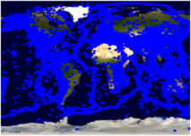
Test Setup
Test Data
  NASA Satellite maps -binary image from NASA WMS OnEarth project
  Earthquake Seismic data as GML from WFSs
Setup is in LAN
  gf15,..19.ucs.indiana.edu.
  2 Quad-core processors running at 2.33 GHz with 8 GB of RAM.
Evaluations of :
  Pre-fetching (central) model [GML-tiling]
  Dynamic load-balancing and parallel-processing through query partitioning [workload-table]
GetMap
WMS
NASA Satellite Map Images
JPL California
Binary map image
GetMap
1
Event-based dynamic map tools
Federator
Binary map image
GML
WFS-1
DB1
Replicated WFS and DBs
Browser
2
2
1
GetFeature
..
Earthquake Seismic records
1: NASA satellite
map images
2: Earthquake-
seismic records
CGL
Indiana
WFS-5
DB6
2
Notes:
Measurement of success are evaluated relatively. They are compared with base-line performance results given earlier.
Throughout the performance slides, we will be working on two-layers for simplicity.
One is NASA satellite map images provided by OnEarth project’s WMS
Another is earthquake seismic data provided by WFS in GML.
two layered map images whose layers are NASA Satellite map image layer (bottom) and earthquake seismic data layer.
Performance enhancing design techniques are mostly focusing on XML-encoded common data model (GML) handling
(transfer/rendering/display)
In this sense, GML data is fetched, rendered and overlaid on NASA satellite map images which is shown as layer 2 in the figure.
Binary map images are fast enough to access and display. Because there is no need burdening query and data conversion as it is done for GML.
Map images are stored in WMS and served on request.
It is like Google map approach. They replace computation with storage. Their approach is central and static.
We also have integrated and used Google Map as base map layer to overlay GML data. But not shown here.
2 Quad-core Intel Xeon processors running at 2.33 GHz with 8 GB of memory and operating Red Hat Enterprise Linux ES release
WFS servers, federator server and event-based interactive map tools are in Indiana University Community Grids Labs.
Performance enhancing designs are grouped into three based on data/information flow phases. Each group has different concern and has different effects on overall end-to-end response time. We will be analyzing them separately.
Overall response times = A + B + Image transfer from federator to client
The BOTTLENECK is data fetching.
A and B will be analyzed in details with their processing steps and at the end, we give overall response time based on query types depending on their positioning to cached data.

Slide 25
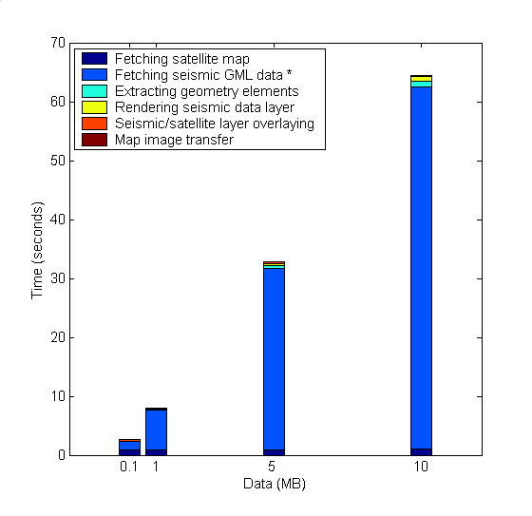
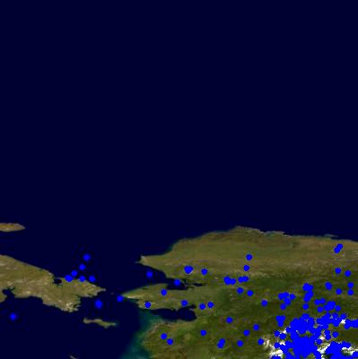
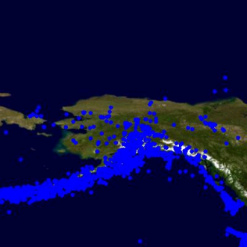
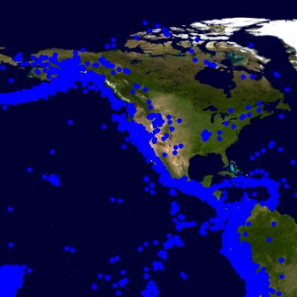
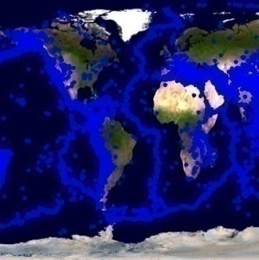
Base-line System Tests
Binary map image
WMS
1.NASA Satellite Map Images
1
Event-based dynamic map tools
Federator
Browser
Binary map image
GML
WFS
DB
2.Earthquake seismic data
2
2
1
(d). Average response time
(b). Map rendering time
(a). Query/response conversions & data transfer
(c). Map images transfer time
Selected query ranges:
b
0.1
1
d
(a)
5
10
Response times = a + b + c
a is dominating factor
Notes:
WHY DID YOU CHOSE THESE BOXES AND DATA SIZES:
Mention about your experiences with real science applications
-Virtual California etc.
-attributes etc

Slide 26
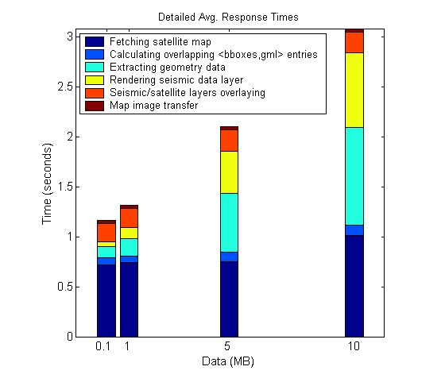
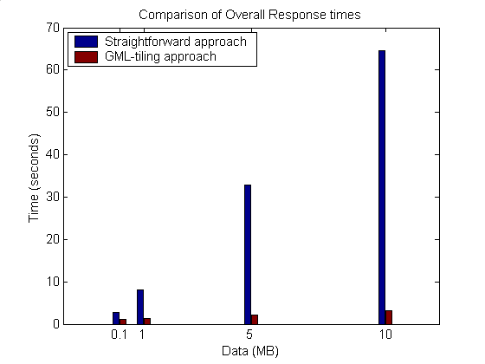
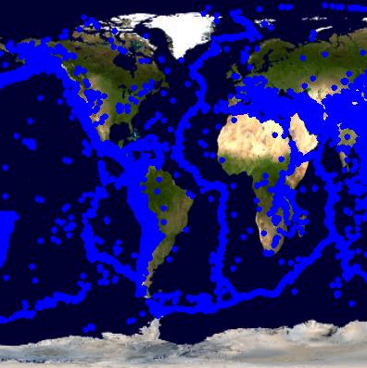
1. Using GML-tiling
The system bottleneck -(a)- is removed.
On-demand client requests/queries are served from GML tiles.
Setup: Predefined threshold tile size for seismic data is 2MB
Tiles: <bbox, gml> – locally stored in memory/disk
0.1
1
5
10
Notes:
Why did you choose these data?
Show the results for high sizes
Put a stress test
Log scale--

Slide 27
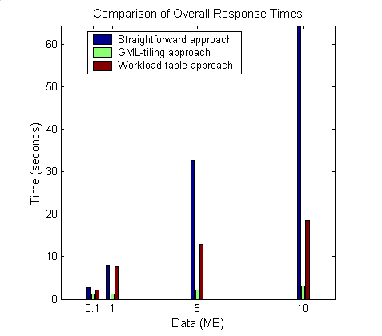
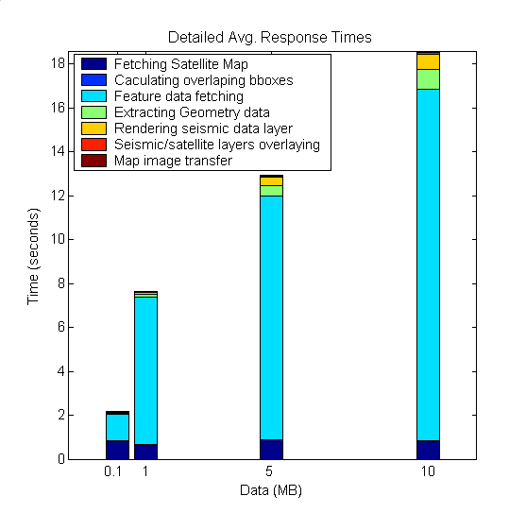
2. Load-balancing and parallel processing through WT
Optimized parallel data/access/query through Workload-table.
Each tile assigned to a worker node corresponds to GML data whose sizes are limited with 2MB
Entries in Workload table (partitions) for selected main query ranges
0.1
1
5
10
Notes:
Compared to GML-tiling:
->finding out overlapped bboxes not need to get GML from cache/disk
Additional feature-data fetching (GMLs will be caught from remote database)
Same size different WFS #
Same WFS# different sizes
Same WFS# and sizes different thr

Slide 28
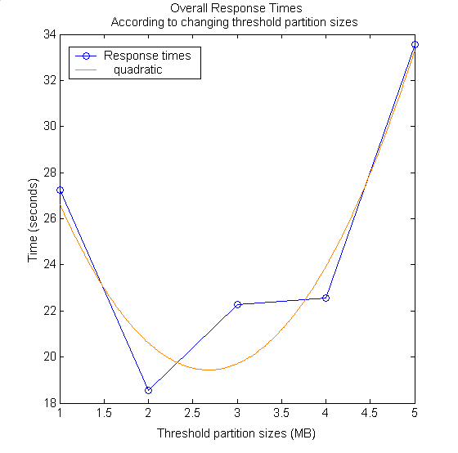
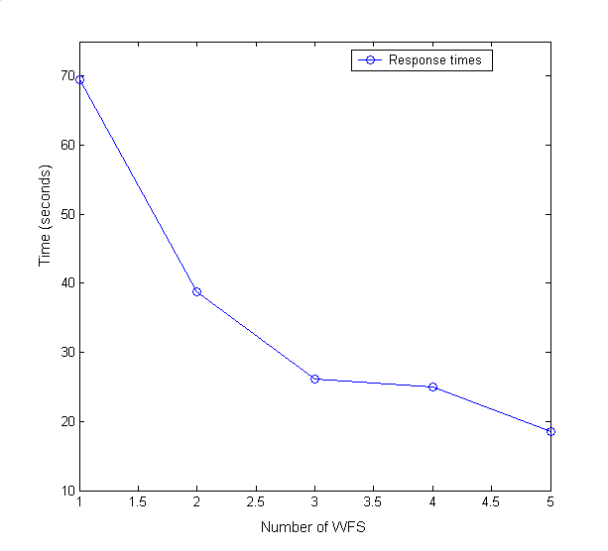
Parallel processing through WT (Cont’d)
Performance effecting factors
#of WFS worker nodes
  As the number increases, the performance increases
Speedup: 1.9
Keep everything same only change WFS number:
-> queries are for 10MB of data,
-> threshold size is defined as 2MB
Keep everything same only change threshold partition sizes:
-> queries are for 10MB of data,
-> the number of WFS is 5
Threshold partition size
  Pre-defined according to the network and data characteristics
    Make test queries
  Max value is the size of whole data in database –’max’
  If it is set too big (ex. ‘max’)
    No parallel query, no gain
  If it is set relatively too small,
    Excessive number of threads degrade the performance
Speedup: 2.4
Speedup: 1.7
Speedup: 1.9
Speedup: 2.9
Speedup: 2.9
Speedup: 2.5
Speedup: 2.6
Speedup: 2.4
Speedup: 3.5
Speedup: 3.5
Notes:
Possible solution to define threshold data size is making test runs before setting it up
Start with minimum and increase ‘thr’ until the un-tolerable response times.

Slide 29
Summary & Conclusions
-Federator-oriented data access/query optimizations-
Modular: Extensible with any third-party OGC compliant data services (WMS and WFS).
Data layers can be handled with different techniques
  GML-tiling or Workload Table.
Best performance outcomes are achieved through central GML-tiling
  Synchronization periodicity for Tile-table must be defined carefully.
Success of parallel access/query is based on how well we share the workload with worker nodes.
  Dynamic load balancing with Workload-table.
Streaming data transfer technique allows data rendering even on partially returned data.
Federator’s natural characteristic allows us to develop advanced caching and parallel processing designs.
  Inherently layers from separate data sources
  Individual layer decomposition and parallel processing
Notes:
Queries are consisted of the limited number of ranges
Bounding boxes defining locations of data
Other ranges are handled with application specific X-Path queries.
Lets look at the outcomes of the proposed performance enhancing techniques.
1. Streaming data transfer techniques built over web service communication protocol allow data rendering even on partially returned data besides giving better performance results
5. You can store huge data as long as your local disc capacity allows
By using conventional communication networks, storage and computation resources, we obtained high degree of responsiveness.
Streaming data transfer technique enables data rendering on partially returned data
When the data validation is not needed as in the proposed federated GIS system, Pull parsing gives the best performance results in XML encoded GML data rendering .
Pre-fetching and parallel-processing techniques are applied mutually exclusive.
Pre-fetching gives the best performance results but might cause data inconsistency due to storing data at federator. Prefetc runner’s triggering periodicity must be defined carefully.
Parallel-processing techniques success is based on how well we share the workload to worker nodes.
This is the challenge because of the un-evenly distributed and variable sized geo-data characteristics based on its location attribute.
We saw that
Working-window and locality principles into the map rendering through client-based caching
Parallel processing through attribute-based query decomposition with the help of client-based caching
Helped us increase the system responsiveness a lot.

Slide 30
Contributions
Federated Service-oriented Geographic Information System framework
  Integrating Web Services with Open Geographic Standards to support interoperability at both data and service levels
  Production of knowledge from distributed data sources in multi-layered map images.
    Hierarchical data definitions through capability metadata federations
    Fine-grained dynamic information presentation
    Unified interactive data access/query and display from a single point.
Federator-oriented data access/query optimization and applications to distributed map rendering
  Extensions to Open Standards: Streaming GIS Web Services
  Central GML-tiling approach
  Dynamic load balancing through workload-table
  Parallel optimized range queries through partitioning
Notes:
Stateless GIS components are interacted in a statefull way through federators
Investigated performance efficient designs and did detailed benchmarking

Slide 31
Contributions (Systems Software)
Developing Web Map Server (WMS) in Open Geographic Standards
  Extended with Web Service Standards and
  Streaming map creation capabilities
Developing GIS Federator
  Extended from WMS
  Provides application-specific and layer-structured hierarchical data as a composition of distributed standard GIS Web Service components
  Enables uniform data access and query from a single access point.
Interactive map tools for data display, query and analysis.
  Browser and event-based.
  Extended with AJAX (Asynchronous Java and XML)
Notes:
Ex. Pattern Informatics: plotting earthquake forecasting values over the map
The topic is "Applying Web Service Architecture Principles to Web-based
Mapping Tools" or something similar. The subtopics make this concrete.
Subtopics
* Re-architecting WMS to use Web Service Architectures. You have
already done this. WSDL, SOAP messages, etc.
* Client-server patterns: stateless request response+thin client; thick
client/AJAX approach; hybrid approach with caching and sessions. What
are the advantages and disadvantages of each?
* Collaborative WMS: streaming servers and session-based participation
* Distributed WMS for load balancing and performance: discuss models,
such as passive master/fixed worker (ie the OnEarth model model we
currently use) and the active master, dynamically configurable worker
(as we discussed today). Discuss scenerios: distribution of task by
grid and by layer. The first is similar to the Google map approach, the
latter is by overlay object (each worker WMS node renders a separate layer).
* WMS libraries for overlay objects: developing a plugin API to simplify
the creation of specialized WMS constructs such as contour plots and
vector plots. These are built out of atomic parts (such as poly-lines
and points). You need to think about how to make it simple for other
people to a) write clients that make maps using overlays, and b) develop
their own overlay plugins.

Slide 32
Acknowledgement
The work described in this presentation is part of the QuakeSim project which is supported by the Advanced Information Systems Technology Program of NASA's Earth-Sun System Technology Office.
Galip Aydin: Web Feature Server (WFS)

Slide 33
Thanks!....

Slide 34
BACK-UP SLIDES

Slide 35
Possible Future Research Directions
Applying distributed hard-disk approach (ex. Hadoop) to handle large scale of GML-tiling and/or Workload tables
Finding out the best threshold partition size on the fly.
  Currently pre-defined by test runs
Extending the system with Web2.0 standards
Handling/optimizing multiple range-queries
  Currently we handle only bbox ranges

Slide 36
Why OpenGIS
Published OGC specifications.
Vendor compliance.
Vendor independence.
Open source options.
Interoperability, collaboration.
Public data availability.
Custodian managed data sources.
OGC compliant GIS works
  Cubewerx
  ArcIMS WMS connector
  Intergraph GeoMedia
  UMN MapServer
  MapInfo MapXtreme
  PennState GeoVista
  Wisconsin VisAD, and many more…

Slide 37
Integrated data-view
Multi-layered Map images
Query heterogeneous data sources as a single resource
  Heterogeneous: local resource controls definition of the data
  Single resource: remove the burden of individually accessing each data source
Easy extension with new data and service resources
No real integration of data
  Data always at local source
  Easy maintenance of data
Seamless interaction with the system
  Collaborative decision makings
Client/User-Query
Integrated View
Display &
Federation
services
GML
GML
WMS
WFS
WFS
Mediator
Mediator
Mediator
DB
Files
WWW
Data in files, HTML, XML/Relational Databases, Spatial Sources/sensors
Notes:
And Quality of services

Slide 38
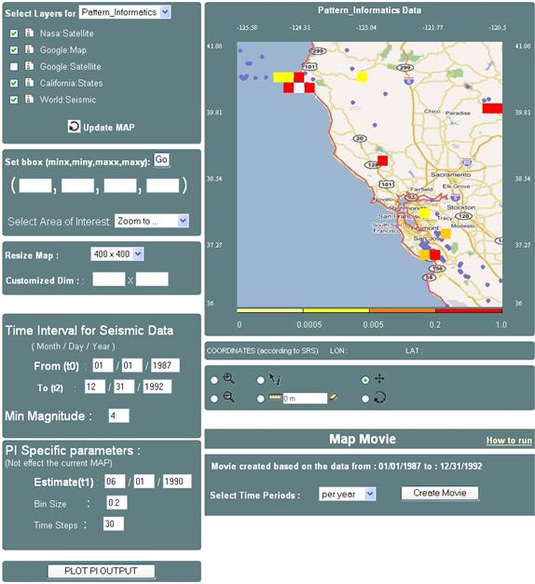
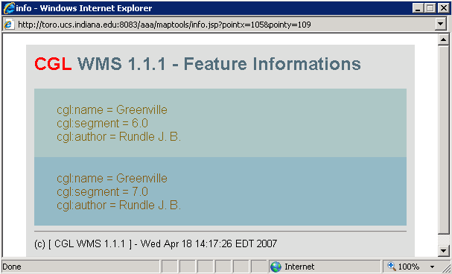
Hierarchical data
Integrated data-view
1
2
3
1: Google map layer
2: States boundary lines layer
3: seismic data layer
Event-based Interactive Tools :
Query and data analysis over integrated data views
Notes:
Since common data model based on content and presentation
We can also further query the data layers based on their attributes
Presentation tags are used for displaying.
Interactive Information Visualization tools provide researcher with remarkable capabilities to support discovery. By combining powerful data mining methods with user-controlled interfaces, users are able to benefit distributed heterogeneous data sources (access/attribute-based-query/display) from a single access point.
Users can begin with an overview, zoom-in on areas of interests, filter-out un-wanted items/layers, and click for details-on-demand.
With careful design and efficient algorithms, OGC provided data-layers can be enriched with some other data and/or processing resources.

Slide 39
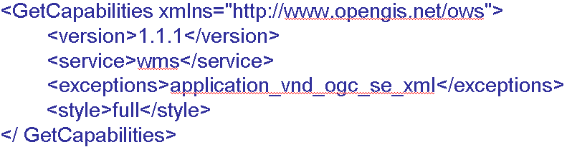
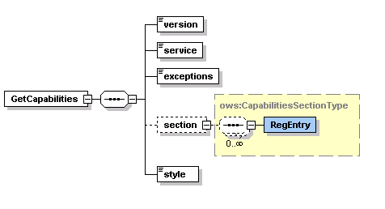
GetCapabilities Schema and Sample Request Instance

Slide 40
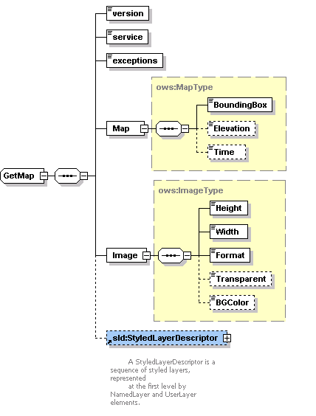
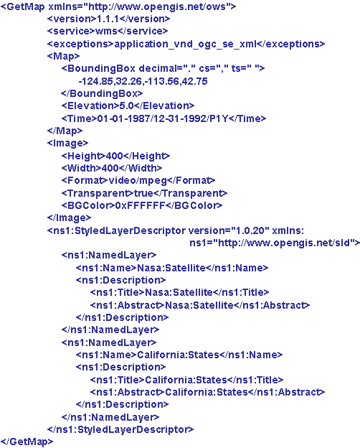
GetMap Schema and Sample Request Instance

Slide 41
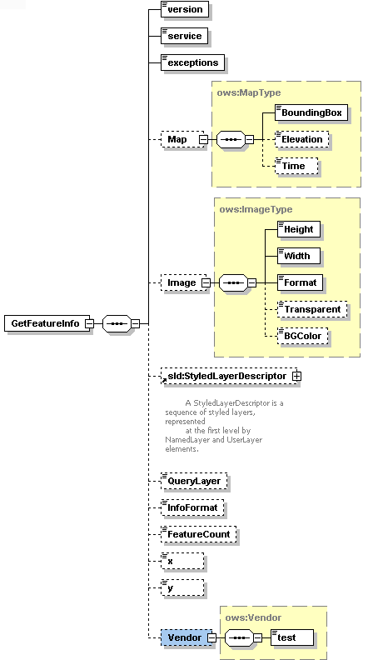
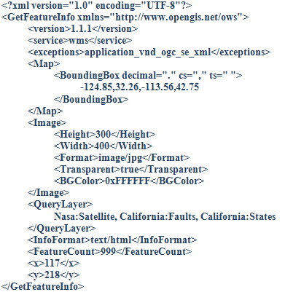

Slide 42
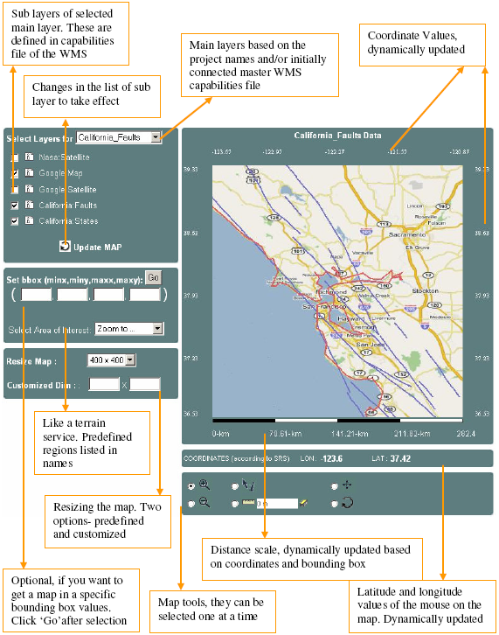
Event-based Interactive Map Tools
<event_controller>
  <event name="init" class="Path.InitListener" next="map.jsp"/>
  <event name="REFRESH" class=" Path.InitListener " next="map.jsp"/>
  <event name="ZOOMIN" class=" Path.InitListener " next="map.jsp"/>
  <event name="ZOOMOUT" class="Path.InitListener" next="map.jsp"/>
  <event name="RECENTER" class="Path.InitListener“next="map.jsp"/>
  <event name="RESET" class=" Path.InitListener " next="map.jsp"/>
  <event name="PAN" class=" Path.InitListener " next="map.jsp"/>
  <event name="INFO" class=" Path.InitListener " next="map.jsp"/>
</event_controller>

Slide 43
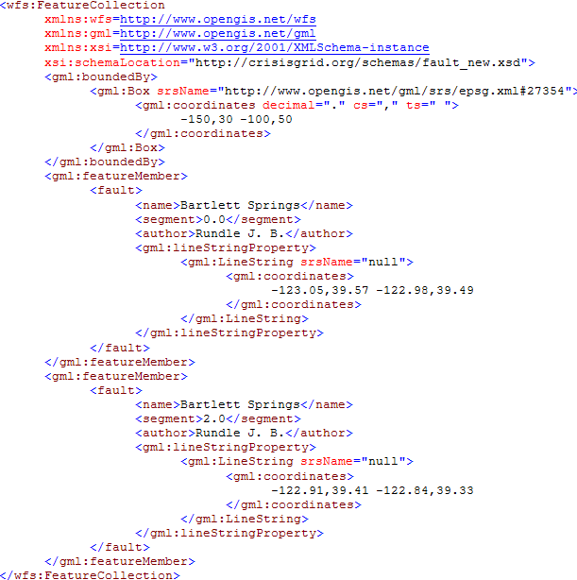
Sample GML document

Slide 44
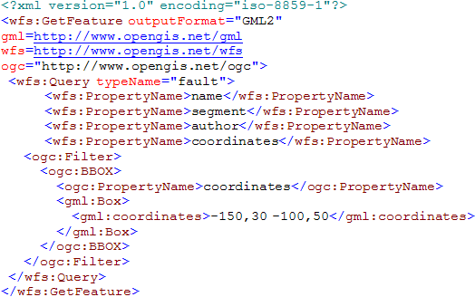
Sample GetFeature Request Instance

Slide 45
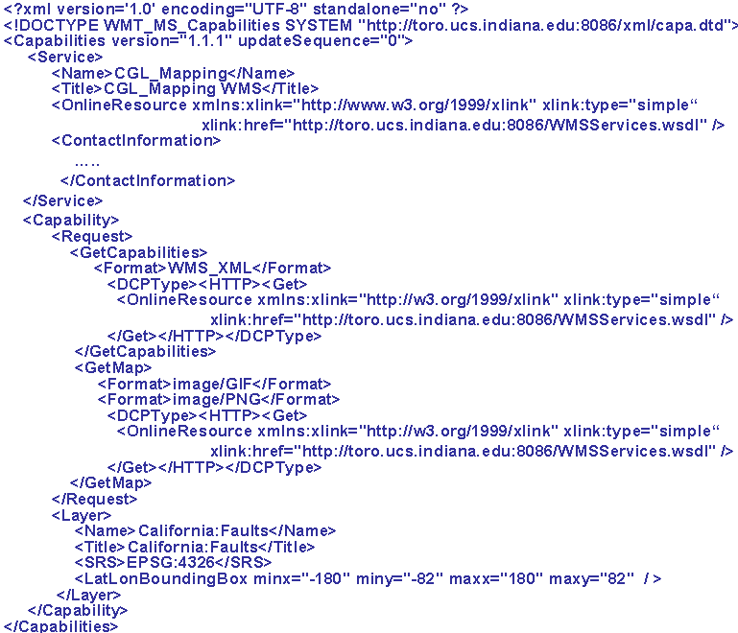
A Template simple capabilities file for a WMS

Slide 46
Generalization of the Proposed Architecture
GIS-style information model can be redefined in any application areas such as Chemistry and Astronomy
  Application Specific Information Systems (ASIS).
We need to define Application Specific
  Language (ASL) -> GML :expressing domain specific features, semantic of data
  Feature Service (ASFS) -> WFS :Serving data in common language (ASL)
  Visualization Services (ASVS) -> WMS : Visualizes information and provide a way of navigating ASFS compatible/mediated data resources
  Capabilities metadata for ASVS and ASFS.
We need to define Application Specific:
  Federator federating the capabilities of distributed ASVS and ASFS to create application-based hierarchy of distributed data and service resources.
Mediators: Query and data format conversions
  Data sources maintain their internal structure
  Large degree of autonomy
  No actual physical data integration
Unified data query/access/display
Such as filter, transformation, reasoning, data-mining, analysis
AS
Repository
1
Federator
ASVS
AS Tool
(ASVS)
AS Services
(user defined)
AS Tool
(ASFS)
4
3
2
1
2
Mediator
Mediator
3
Standard service API
Standard service API
AS
Sensor
AS
Sensor
Capability Federation
ASL-Rendering
Standard service API
Messages using ASL
Notes:
We will need the domain-specific equivalent of the Web Feature Service.
Federator
It is actually an ASVS but with an extended capabilities for capability federation and interacting and integrating multiple servers providing data in hierarchical/integrated data views defined in capabilities metadata.

Slide 47
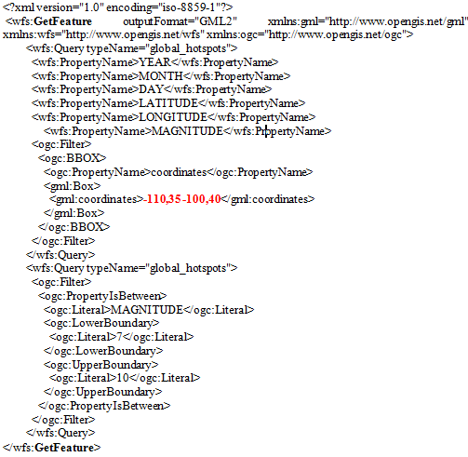
Sample GetFeature request to get feature data (GML) from WFS.
-110,35,-100,36
GFeature-1
-110,36,-100,37
GFeature-2
-110,37,-100,38
GFeature-3
-110,38,-100,39
GFeature-4
-110,39,-100,40
GFeature-5
Partition list as bbox values for sample case :
- Pn=5
- Main query getMap bbox 110,35 -100,40

Slide 48
Map rendering from GML
B
WMS
Converting objects into image
Plotting geometry
elements over the layer
Parsing and extracting geometry elements
Binary map image
GML
Notes:
Image conversion time in Figure is for resolution 400x400 in pixel.
Sample image conversion values are for JPEG creation
Average conversion time:25.43msec
Image conversion time changes based on
map images’ user-defined resolution values
Requested image format such as JPEG.

Slide 49
Interoperability Requirements on Geo-data
Geo-data is stored in various formats by heterogeneous autonomous resources.
Encoded as GML: Enables data to be carried with their attributes – content and presentation
Integrated to the system through WFS-based mediation
  Standard service interfaces accepting standard queries.
  GetFeature: Querying the data
Queried using its location attribute (bounding box) and other data-specific attributes
  Ex. earthquake data: magnitude of seismic activity and date event occurred.
Notes:
The range queries are intersections of ranges defined on attributes.

Slide 50
Standard Query (GetFeature)
<?xml version="1.0" encoding="iso-8859-1"?>
<wfs:GetFeature outputFormat="GML2" xmlns:gml="http://www.opengis.net/gml" >
<wfs:Query typeName="global_hotspots">
<wfs:PropertyName>LATITUDE</wfs:PropertyName>
<wfs:PropertyName>LONGITUDE</wfs:PropertyName>
<wfs:PropertyName>MAGNITUDE</wfs:PropertyName>
<ogc:Filter>
<ogc:BBOX>
<ogc:PropertyName>coordinates</ogc:PropertyName>
<gml:Box>
<gml:coordinates>-124.85,32.26 -113.36,42.75</gml:coordinates>
</gml:Box>
</ogc:BBOX>
</ogc:Filter>
</wfs:Query>
<wfs:Query typeName="global_hotspots">
<ogc:Filter>
<ogc:PropertyIsBetween>
<ogc:Literal>MAGNITUDE</ogc:Literal>
<ogc:LowerBoundary>
<ogc:Literal>7</ogc:Literal>
</ogc:LowerBoundary>
<ogc:UpperBoundary>
<ogc:Literal>10</ogc:Literal>
</ogc:UpperBoundary>
</ogc:PropertyIsBetween>
</ogc:Filter>
</wfs:Query>
</wfs:GetFeature>
Corresponding SQL query:
Select LATITUDE, LONGITUDE, MAGNITUDE from Earthquake-Seismic where
-124.85 < X < -113.36 & 32.26 < Y < 42.75
& 7 < MAGNITUDE < 10
Notes:
SQL queries are created from these attributes and their constraint range values

