Slide 1
High-Performance Federated and
Service-Oriented
Geographic Information Systems
Ahmet Sayar
(asayar@cs.indiana.edu)
Advisor: Prof. Geoffrey C. Fox
Notes:
Today's presentation is on my research topic – High …….systems. ( Slow)

Slide 2
Outline
Motivations
Research Issues
Architecture: Federated Service-Oriented Geographic Information System
Performance enhancing designs - measurements and analysis
Conclusions
Notes:
I will be addressing these factors in today's presentation ( wait sometime so they can read).

Slide 3
Introduction
Distributed service arch for managing the production of knowledge from distributed collections of observations and simulation data through integrated data-views (maps).
Integrated data-views are defined by a “federator” located on top of the standard data service components
  Components
    Web Services
    Translate information into a common data model
  Federator
    Combine information from several resources (components)
    Allows browsing of information
    Manage constraints across heterogeneous sites
Federator-oriented distributed data access/query optimization for responsive Information Systems
Notes:
1 and 2 bullets are regarding first part: service oriented federation arch
3. Bullet is regarding high-performance issues in data transfer (collecting) and rendering (map creation)
Our motivating domain will be GIS

Slide 4
Motivations
Integration of data from distributed heterogeneous sources
  Burden of accessing data sources with ad-hoc queries
  Hard to extract comprehensible knowledge.
    Interactive queries over integrated data-view
Unable to get and render the required information in a timely fashion due to
  Accessing the heterogeneous/autonomous systems
    Query/response conversions
  Data access/query does not scale with size
Notes:
The World Wide Web and its associated web programming models have revolutionized accessibility to data/information sources.
BUT numerous incompatible formats, data/storage heterogeneity, and machine un-readability make this task even impossible.
In order to be able to integrate and share the data/information, data sources need to be interoperable and provide standard service interfaces interacting with standard messaged and transport protocols.
Need for multiple data access/query/display simultaneously to make more complex info/knowledge
Application-based hierarchy of distributed data sources.

Slide 5
Research Issues
Interoperability
  Adoption of Open Geographic Standards -data model and services
  Integrating Web Service and Open Geographic Standards
  Defining component based Service-oriented GIS data Grid
Federation
  Capability-based federation of GIS Web Service components
  Unified data access/query and display from a single access point through integrated data-views
Addressing high-performance support for responsiveness
  Streaming GIS Web Services
  Pre-fetching: Central approach over distributed data resources
  Dynamic load balancing via attribute based query decomposition
Notes:
Under those motivations we will address these research issues throughout the presentation
1. The interoperability issues have been studied by many public/private organizations last two decades at data and service levels. Among these are Web Service standards (WS-I) for cross-language, platform and operating systems, and OGC for defining domain specific data model and online service definitions in GIS.
2. There are three general issues here. The first is the data modeling (how to integrate different source schemas); the second is their querying (how to answer to the queries posed on the global schema); and the third is the common presentation model of data sources, i.e. mapping of common data model to a display model enabling integration/overlaying with other data sets (integrated data-view).
We will be researching how to handle query/response over federated dispersed autonomous OGC data services.
3. federator-oriented data access/query optimization for distributed map rendering
SUMMARY:
Adopting domain-specific standards for online services and data models
Extending as Web Services to create SOA arch for GIS data grid and enable it to be integrated to Geo-Science grids
Federated Information system over standard web service components
Investigating performance efficient designs : federator-oriented optimized data access/query for distributed map rendering
Applicable to general science domains requiring range queries.

Slide 6
Background:
Geographic Information Systems (GIS)
GIS is a system for creating, storing, sharing, analyzing, manipulating and displaying geo-data and associated attributes.
From traditional centralized mainframe and desktop systems to collaborative distributed systems
  Distributed nature of the geo-data; various client-server models, databases, HTTP, FTP
Relies on analyses of spatial data in map-based formats
  Layers from autonomous/ heterogeneous data sources
Open Standards
  OGC and ISO/TC-211
Notes:
2. Over the past two decades, GIS has evolved from traditional centralized mainframe and desktop systems to collaborative distributed systems.
3.The nature of the geographical applications requires seamless integration and sharing of spatial data from a variety of providers.
4. Decision making in Geographic Information Systems (GIS) increasingly…
Maps are complex structures composed of layers created from distributed heterogeneous data sources.
FROM DIFFERENT DISCIPLINES AND SKILL/EXPERT Areas.
GIS requires data and computation resources from distributed virtual organizations to be composed based on application requirements, and accessed and queried from a single uniform access point over the refined data with interactive display tools. This requires seamless integration and interaction of data and computation resources. The resources span organizational disciplinary and technical boundaries and use different client-server models, data archiving systems and heterogeneous message transfer protocols.

Slide 7

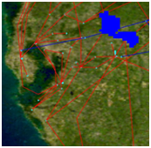
Background (Cont’d)
OGC’s GIS data services
Web Map Services (WMS) and Web Feature Services (WFS)
WMS are rendering services -human comprehensible data (map images)
WFS are data services serving any data in common model
  Mediation and annotation services.
  Geographic Markup Language (GML) : Content and presentation
WMS and WFS have capability metadata (data+service) defined by OGC.
Inter-service communication through “getCapability” service interface.
HTTP-Get/Post queries consist of parameter-value pairs
WMS GML rendering
WFS (mediator)
Binary data
GML
getCapability
getMap
getFeatureInfo
getCapability
getFeature
DescribeFeatureType
Notes:
In order to provide interoperable and extensible GIS framework, we adopted domain-specific standard specifications for data model and online-services from OGC.
Open geographic standards:
Aim is to make geographic information and services neutral and available across any network, application, or platform.
Two major well-known standard bodies: Open Geospatial Standards (OGC) and ISO/TC211.
OGC Specifications defines online services and data models:
Data Format Specs: Geographic Markup Language (GML)
Service Specs: Web Feature Service (WFS), Web Map Service (WMS)
WMS and WFS are two major services defined by OGC for creating a basic GIS framework enabling information rendering of heterogeneous data sources as map images.

Slide 8
Service oriented GIS
-Built over Geographic Standards-
Built over:
  Web Services standards (WS-I) and
  Open Geographic Standards (OGC and ISO/TC-211)
OGC’s HTTP-based services
  Request-response type services; centralized and synchronous applications.
  Limited data transport capabilities
Extensions to Standards: Integrating OGC standards with Web Services principles
  Makes applications span cross-language, platform and operating systems
  Enables integration of Geo-science Grid applications with data services
  HTTP-GET/POST to XML-based queries as SOAP messages
  Service descriptions in WSDL
  Streaming data transfer capabilities
    Publish/subscribe based messaging middleware
Notes:
In this slide I explain what we did:
Given:
Online-service descriptions (WMS and WFS), corresponding capability metadata for each and
domain specific data model description/schema –GML
By web services, we mean the self-contained, web-enabled applications capable not only of performing business activities on their own but also processing the ability to engage other web services in order to complete higher-order business transactions.
Web services can be invoked through XML-based RPC mechanisms across firewalls.
Web services provide a cross-platform, cross-language solution based on XML messaging.
Web services facilitate ease of application integration using a lightweight infrastructure without affecting scalability.
Web services enable interoperability among heterogeneous applications.

Slide 9
Federation Framework
Step-1: (Setup– blue dashed lines)Federator search for standard components providing required data layers and organize them in one aggregated capability file.
  Federator is an extended WMS
  Aggregated capability is actually a WMS capability representing application-based hierarchical layer composition.
  Capabilities are collected via getCapability standard service interface
  Federator provides single view of federated sources
Step-2: (Run time – green lines) Users access/query and display data sources from a single access point (federator) over integrated data-views (multi-layered map images).
  Some layers are in map images (layers from WMS), and some are rendered from GML which is provided by WFS.
  Enables users to query the map images based on their attributes and features
  On Demand Data Access: There is no copying of the data at any intermediary places. Data are kept at their originating sources. Consistency and autonomy.
Integrated data-view: b over a
3
1
Aggregated Capability
WMS
a. NASA satellite layer
a
JPL at California
a
b
4
Event-based
Interactive Map-Tools
1
Federator
WFS
b
Browser
Browser
2
Browser
2
b
b
b. Earthquake-seismic data
Events:
- Move,
- Zooming in/out
- Panning (drag-drop)
- Rectangular region
- Distance calc.
- Attribute querying
a
3
a
WFS
CGL at Indiana
1. GetCapability (metadata data+service)
2. GetMap (get map data in set of layer(s))
3. GetFeatureInfo (query the attributes of data)
Notes:
Over the GIS Web Service components we propose SOA based federated information system architecture for understanding and managing the production of knowledge from distributed observation, simulation and analysis through integrated data-views in the form of multi-layered map images.
Infrastructure is based on common data model, OGC compatible standard GIS Web-Service components and a federator.
Federator is actually an extended WMS provides one global view over several data sources that are processed as one source.
aggregating capability metadata from distributed standard GIS services and orchestrating/synchronizing requests and responses over the composition of data services referenced
There are three general issues here. The first is the data modeling (how to integrate different source schemas); the second is their querying (how to answer to the queries posed on the global schema); and the third is the common presentation model of data sources, i.e. mapping of common data model to a display model enabling integration/overlaying with other data sets (integrated data-view). The first two groups of research issues are related to lower level (database and files) data format/query/access heterogeneities summarized as semantic heterogeneity. In the proposed framework we take them as granted by applying Open Geographic Standards specifications for data models (GML) and online services (WMS and WFS).
Since they have standard service API and capability metadata about their services and data, they can be composed, or chained, by capability exchange and aggregation through their common service method called “getCapability”.
Local administrators maintain control over their systems and yet provide access to their data by the global users at the federation level.

Slide 10
Federation Through Capability Aggregation
Quality of service
  More complex information/knowledge creation by leveraging multiple sources data provided
  No need for ad-hoc client tools and burden of multiple connections
  Mediates interface level heterogeneity (Web service, HTTP)
Performance
  State-full access/query over stateless data services
  Enables load-balancing and parallel processing
    Each layer comes from different server
    Individual layers can also be created in parallel
Notes:
Federator (investigated):
Inspired from OGC: Cascading WMS
Federator: Extended WMS
Map -> Layer -> Data {GML / binary images} ->Raw data (any type).
A map is application-based, human-recognizable, integrated data display and is composed of layers. A layer is a data rendering of a single homogeneous data source. Layers are created from the structured XML-encoded common data model (GML) or binary map images (raster data). Heterogeneous data sources (raw data) are integrated to the system as GML or binary map images through the resource specific mediators. The mediators have resource specific adaptors for request and response conversions and appropriate capability metadata describing the data and resources.
The federator enables state-full service access over the stateless GIS Web Service components, and results in better performance for responsive GIS systems.

Slide 11
Why Capability Metadata
Web Services provide key low level capability but do not define an information or data architecture
These are left to domain specific capabilities metadata and associated data description language (GML).
Machine and human readable information
  Enables easy integration and federation
Enables developing application based standard interactive re-usable tools
  for data query display and analysis
  Seamless data/access/query
Notes:
4.bullet: Dynamic upgrading user interfaces
Ex. interactive map tools

Slide 12
Architecture Summary
Fine-grained dynamic information presentation
  Heterogeneous data sources are queried as a single resource
  Integrated data-view in multi-layered map images
  No burden of accessing data source with ad-hoc queries.
  Interactive feature based querying besides displaying the data
Just-in-time or late-binding federation
  Data always is kept at its originating resource
  Autonomous local resources -Easy data-maintenance
Interoperable and extendable
  Open Geo-Standards are integrated with Web Service principles.
Notes:
Fine-grained dynamic information presentation through a federation framework enabled us heterogeneous data sources to be queried as a single resource over integrated data-view in multi-layered map images
Autonomous local resources -controlling definition of data
Attribute-based querying and interaction over integrated data-views in multi-layered map images.
Integrated data views are multi-layered map images composed of distributed standard GIS Web Service components.

Slide 13
Federator-oriented data access/query optimization for distributed map rendering
Notes:
Lets discuss the performance…………..designs in such federated service oriented framework
Federated spatial database display
We propose federator-oriented data …optimization techniques for distributed map rendering

Slide 14
Performance Investigation
Interoperability requirements’ compliance costs
  XML-encoded common data model (GML)
  Standard Web Service interfaces accepting XML-based queries
  Costly query/response conversions
    XML-queries to SQL
    Relational objects to GML
  Query processing does not scale with data size
Tough data characteristics: Variable sized and unevenly distributed nature of geo-data
    Unexpected workload to apply natural load-balancing and parallel processing
Aim: Turning compliance requirements into competitiveness by optimizing federated query responses.
Notes:
GIS is mostly used in early warning systems, interactive real-time applications , It requires quick response times.
0- distributed nature of data:
Data and the computational resources are naturally distributed
Large data volumes make it impossible to put all geospatial data into one big data center.
Decision making requires these distributed heterogeneous data sources to be shared, and represented/rendered to extract useful knowledge
1-using semi-structured data model:
OGC recommends using GML data. GML carries content and the presentation tags together with the core data.
That enables the data sources to be queried and displayed together
Those resulting XML representations of data tend to be significantly larger than binary representations of the same data.
The larger document size means that the greater bandwidth is required to transfer of data, as compared to the equivalent binary representations.
2- There are some characteristics of geo-data that make it difficult to design distributed GIS with satisfactory performance.
Services provided by a GIS requires heavy CPU usage due to the complex computation involved in the underlying computational geometry.
GIS services often transmit large resulting data sets such as images

Slide 15
Geo-data Characteristics
Unexpected workload distribution: The work is decomposed into independent work pieces, and the work pieces are of highly variable sized
Geo-data
  un-evenly distributed
  variable sized
according to their locations attributes.
  Ex. Human population and earthquake-seismicity data
Queried/displayed/analyzed based on range queries built on location attribute
  Location is a point described with (x, y) coordinates.
  2-dim range query: Rectangle defined in bounding box
(c,d)
(c, (b+d)/2)
(a,b)
((a+c)/2, b)
Geo-data is mostly represented as large sets of points, chains of line-segments, and polygons.
Notes:
Geo-data characteristics illustrate efficient load balancing and un-expected workload sharing problems in distributed computing

Slide 16
Enhancement Approaches
Federator-oriented data access/query optimization for distributed map rendering:
Extension to Open Standards: Streaming data transfer
Pre-fetching (centralized)
  GML-tiling
Dynamic load balancing and parallel processing (decentralized)
  Range query partitioning through Workload-table (WT)
Notes:
The standards themselves do not deliver working systems. Constructing successful working systems requires smart design.
We address these performance issues from the federator’s point of view (which is upper level approach)
We have introduced/developed federator-oriented data access/query optimization techniques (over the OGC standard data services)
Our aim is optimizing the response times for interactive GIS systems using standard GIS components.

Slide 17
1. Extension to Open Standards:
Streaming data transfer
Motivations:
  HTTP based query/response does not allow large scale data transfer
  Memory exceptions in creating GML representation of large query results
  Removing SOAP message creation overhead
Strategies: Streaming data flow extensions to GIS Web Services
  Mapping OGC’s definitions of data service to Web Service Standards
  HTTP-GET/POST to XML-queries
  Web Service - as a hand-shake protocol.
  Data is transferred over publish-subscribe messaging systems (Naradabrokering).
  Enables client to render map images with partially returned data
Extension
client
Federator (WMS) GML rendering
Subscriber
GML
(topic, IP, port)
Narada Brokering Server
GetFeature
Topic,IP,port
1
2
W S D L
WFS
Publisher
GML
server
DB
Notes:
Initial problems regarding data transfer and rendering in GIS developed in accordance with Open Standards
HTTP based query/response does not allow large scale data move
Rendering large scale XML data with common xml processors had some problems such as mem exception
The streaming technique is commonly used in transmitting multimedia contents. For web browsing images, streaming is not very crucial; the required number of pixels will be limited by the web browser’s screen size.

Slide 18
2. GML-tiling
On-demand access/rendering
over TT
Motivations:
  Time and resource consuming query/ response conversions in autonomous data sources
  Poor performance in data access/query
Strategies:
  Pre-fetching the data
  Database is mapped to a data structure (Tile-table) in federator
  Successive on-demand queries are served from federator’s local disk
On-demand access/rendering
Interactive
Client Tools
Federator
(WMS)
Federator
(WMS)
Tile-table
Pre-fetching (batch job) running routinely
GML
GetFeature
GML
GetFeature
WFS
WFS
SQL
Relational objects
SQL
DB
DB
On-demand queries are served from TT
TT is synchronized with database routinely.
Straight-forward
Notes:
Strategies:
Periodically fetching the whole data before it is needed (so called pre-fetching).
Databases are mapped to chunks of GML files in a structure and stored locally in the federator
Successive on-demand queries are served by using pre-fetched data
Pros/Cons:
Removes the repeated resource consuming query/data conversions at WFS and associated Databases.
Gives the best performance outcomes for the archived data,
But, might cause inconsistency
Faces time consuming request/response conversion
(Request): GetFeature request to SQL,
(Response): Relational tables to GML
We focus on the issues at the upper level of data handling. We are not proposing enhancement over query and/or response conversions at the autonomous resources integrated through mediators (WFS). Our enhancement approaches are at the federator and view-level.

Slide 19
Tile-table (TT)
Created and updated by a module independent of run-time
  Synchronized with the database routinely
TT is consisted of <key, value> : <bbox, GML> pairs.
  Each partitioned rectangle below is represented by <bbox, GML>
Recursive binary cut (half/half)
  Until each box has less than threshold GML size
Lets illustrate the table with sample scenario
  Whole data range in database (0,0,1,1) -> (minx,miny,maxx,maxy)
  Each point data corresponds to 1MB and
  Threshold data size falling in a partition is 5MB
(1,1)
(1,1)
3
1
4
2
5
(1, 3/4)
1
3
4
4
3
(1, 1/2)
5
4
(0,0)
(0,0)
(1/2, 0)
Notes:
If in first fetch, data size exceeds the allowed size, then cut into 2
Figures represent whole ranges in database for the selected data layer.
(0,0,1,1)
(0,0,1/2,1) (1/2,0,1,1)

Slide 20
How It is Created
Recursive binary cut 2 dimensional ranges:
  R: Full range for the data in bounding-box
  t: Threshold data size
  PT(R, t) = PT(R_{half}, t)+PT(R_{half}, t)
    Gml = getFeature (R_{half})
    If (size(Gml)<= t)
      Put it into memory and/or disk space as pair <R_{half}, Gml>
      And return;
    Else
      Call PT(R_{half},t)
Threshold data size changes depending on the data and network-bandwidth.

Slide 21
Storing Entries: Pairs of <bbox, GML>
Storage hierarchy:
  Federator’s Memory Store
  Federator’s Disk Store
  Allowable memory and disk capacity
  If memory overflows, entries are dumped into disk
  If disk overflows, evicted according to the policy (LRU or LFU)
Entries move between memory and disk space
  Policy is defined in configuration (LFU, LIFO etc.)
Locality of reference: Data that is near other data or has just been used is more likely to be used again
Notes:
Entries are stored through Apache-Ehcache

Slide 22
How It is Used (Run-time)
On-demand data access and rendering responded over TT
Lets say federator gets a queries positioned to TT as below
p₂
r₁
p₁
p₄
p₁₂
r₂
p₃
(r_{i}): On-demand query in bbox
(p_{i}): WT entries in GML
r₁: p₁₂
r₂: p₁, p₅, p₁₂
r₃: p₁₁,p₁₀
r₄: p₁, p₉, p₃, p₆
r₄
p₆
p₅
p₈
p₉
p₇
r₃
p₁₁
p₁₀
Find all partitions that overlap with the query r_{i} ( i.e. p_{i} values )
Obtain GML values from TT using corresponding p_{i} values.
  GML = TT.get(p_{i})
Extract the geometry elements in GML, and render the layer.

Slide 23
Summary and Related Work
Google Maps tiling:
  Map image tiles, replacing computation with storage
  No rendering – image tiles.
  Central, clustered
  But static, not extendable
GML-tiling enables creation of distributed “responsive” map rendering architecture
  Each layer has its own GML-tile table
  Rendering of structured common data model
  Extensibility – reusable components
  Autonomy – local management of resource
  Attribute based querying of map data besides displaying
  Price: But spends time on rendering of GML
Notes:
Google-like map servers are fast because
They replace computation with storage.
Pre-making all images and cut up into tiles
Responses are in terms of the tile compositions.
Client-server application
Static
Central

Slide 24
3. Dynamic Load-balancing & Parallel Processing
(x’,y’)
Main query range: Range
Range = R1+R2+R3+R4
R1
R2
Interactive
Client Tools
(1/2)
R3
R4
Federator
(WMS)
Federator
(WMS)
(x,y)
[Range]
1/2
[Range]
Motivation:
  Single process flow for on-demand queries are not responsive for large datasets
  Interoperability costs
  Moving large data
Strategies:
  Parallel on-demand query optimization
  Dynamic load balancing through range query partitioning
1. Partitioning into 4
(R1), (R2), (R3), (R4)
3. Merging
2. Query Creations
Q1, Q2, Q3, Q4
Single Query Range:[Range]
Q
WFS
Queries
WFS
WFS
WFS
Responses
DB
DB
Straight-forward
Parallel fetching
Notes:
Strategy: Load-balancing and parallel processing
Partition the range query into equal sized regions (in bbox).
The attributes of the main query are inherited by corresponding partitioned sub-regions
Seems like a natural solution, but geo-data is variable sized and unevenly distributed.
It does not guarantee even-workload sharing.
Un-evenly distribution of data based on location attribute
Data-dense/sparse regions

Slide 25
Workload Table (WT)
Periodically updated workload estimation table
  Considerations of data dense/sparse regions
  Each layer-data has its own WT
Enables dynamic load-balancing and adaptable parallel processing
Helps with fair workload sharing to worker nodes.
Keeps up-to-date ranges in bounding boxes
  In which data sizes are “<=“ pre-defined threshold size.
  Routinely synchronized with the databases
Similar to Tile Table in creation:
  But, entries show expected workload in size not actual data
  <key, size>:<bbox, size>
Notes:
Efficient workload sharing to workers
Dynamic load-balancing and query approximation
Adapted workload sharing to increase the efficiency of parallelization.
Motivating domain: Geo-data, GIS
Applications: Range queries

Slide 26
How It is Used
Lets say federator gets a query whose range is R
R overlaps with: p₁₂, p₁ and p₅
Overlapped regions in bbox are: r₁, r₂ and r₃
Instead of making one query to database through WFS with range R;
  Make 3 parallel queries whose all attributes are same except for range attributes.
    r₁, r₂ and r₃
(1,1)
p₂
R
p₁
p₄
p₁₂
r₂
p₃
r₁
r₃
p₆
(1, 3/4)
p₅
p₈
p₉
p₇
p₁₁
p₁₀
(0,0)
(1/2, 0)
(1, 1/2)
WT

Slide 27
GML-tiling vs. Workload Table (WT)
GML-tiling is central approach over distributed data resources. - Pre-fetching data layers as GML-tile tables in its local storage. - Remote database is mapped to the set of GML tiles identified by their bounding-box ranges On-demanded queries are served using GML-tiles in federator Intermediary storage of data in federator - Risk of inconsistency | WT is decentralized approach -Enables equal workload sharing to worker nodes -Estimating un-predictable workload falling in range query On-demanded queries are served from remote database through WFS No intermediary storage of data -Enables autonomy, scalability and easy data maintenance
GML-tiling is faster than parallel access through WT
Notes:
This is used in the cases where GML-tiling can not be used
If data is too large – does not fit in federator’s local disk storage
If data at its local storage changes often -not possible to synchronize with database by using GML-tiling
WT is created based on one attribute defined as bbox
Further queries are done with X-path queries locally
WT approach can be applied to any data in any domain
Accessed with attribute based range queries, such as rectangular region, date, weight, length etc.

Slide 28
Related Work
-Parallel data access/query optimization-
Map Reduce (application of cluster computing):
  Motivation: Large scale data processing, Job parallelization
  Based on two main functions:
    Map: Like partitioning the workload
    Reduce: Like combining the responses to partitions.
  Motivating domain: Web pages (in billions)
  Implementation: Hadoop:
    Putting the files in distributed nodes and making search of words in parallel
WT not only partition the work to workers but also take the un-evenly shared workloads into considerations.
WT enables adapted computing
Notes:
Borrows the terms “map and reduce” from functional programming
map (in_key, in_value) -> (out_key, intermediate_value) list
reduce (out_key, intermediate_value list) -> out_value list
If the application is doing a word count, the map function would break the line into words and output the word as the key and 1 as the value
Map:
Records from the data source (lines out of files, rows of a database, etc) are fed into the map function as key*value pairs: e.g., (filename, line)
map() produces one or more intermediate values along with an output key from the input
Reduce:
After the map phase is over, all the intermediate values for a given output key are combined together into a list
reduce() combines those intermediate values into one or more final values for that same output key
(in practice, usually only one final value per key)

Slide 29
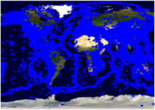
Test Setup
Test Data
  NASA Satellite maps image from WMS (at California NASA JPL)
  Earthquake Seismic data as GML from WFSs (at Indiana Univ. CGL Labs)
Setup is in LAN
  gf15,..19.ucs.indiana.edu.
  2 Quad-core processors running at 2.33 GHz with 8 GB of RAM.
Evaluations of :
  Pre-fetching (central) model [GML-tiling]
  Dynamic load-balancing and parallel-processing through query partitioning [Workload-table]
GetMap
WMS
NASA Satellite Map Images
JPL California
Binary map image
GetMap
1
Event-based dynamic map tools
Federator
Binary map image
GML
WFS-1
DB1
Replicated WFS and DBs
Browser
2
2
1
GetFeature
..
Earthquake Seismic records
1: NASA satellite
map images
2: Earthquake-
seismic records
CGL
Indiana
WFS-5
DB6
2
Notes:
Throughout the performance slides, we will be working on two-layers for simplicity.
These are the layers actually used in real geo-science applications Pattern Informatics and Virtual California
Performance enhancing design techniques are mostly focusing on XML-encoded common data model (GML) handling (transfer/rendering/display)
In this sense, GML data is fetched, rendered and overlaid on NASA satellite map images which is shown as layer 2 in the figure.
Binary map images are fast enough to access and display. Because there is no need burdening query and data conversion as it is done for GML.
We also have integrated and used Google Map as base map layer to overlay GML data. But not shown here.
2 Quad-core Intel Xeon processors running at 2.33 GHz with 8 GB of memory and operating Red Hat Enterprise Linux ES release

Slide 30
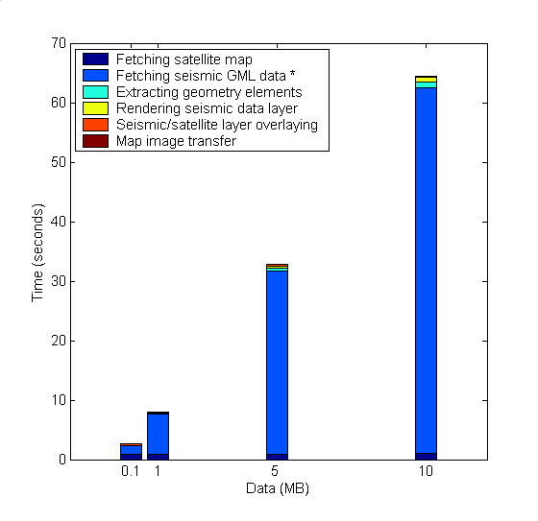
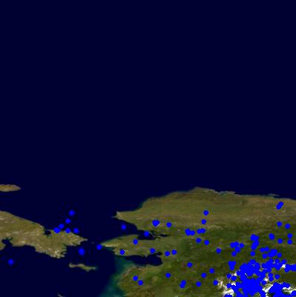
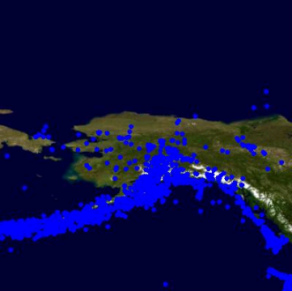
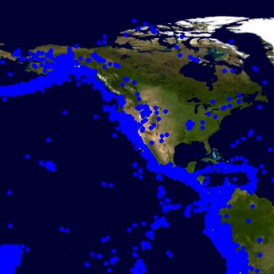
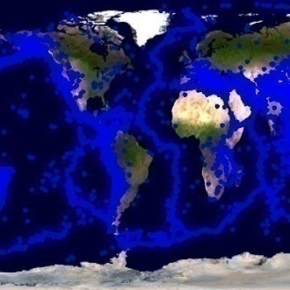
Base-line System Tests
Binary map image
WMS
1.NASA Satellite Map Images
1
Event-based dynamic map tools
Federator
Browser
Binary map image
GML
WFS
DB
2.Earthquake seismic data
2
2
1
(d). Average response time
(b). Map rendering time
(a). Query/response conversions & data transfer
(c). Map images transfer time
Selected query ranges:
b
0.1
1
d
(a)
5
10
Response times = a + b + c
a is dominating factor
Notes:
Measurement of success and speedups are evaluated relatively.
WHY DID YOU CHOSE THESE BOXES AND DATA SIZES:
Mention about your experiences with real science applications -Virtual California etc., attributes etc
*X-Coordinates and selected ranges:*
-We assume that the requested queries are for 0.1 1 5 and 10 MB and above bboxes represents these data size and geo-data characteristics
-To show the system’s behavior against the dramatically changing data size we picked these data sizes and corresponding possible ranges.
We could pick any other ranges corresponding those data sizes and result would not change.
*Analysis:*
The system does not scale with data sizes because of ‘(a)’.
Response time is the linear function of data sizes.

Slide 31
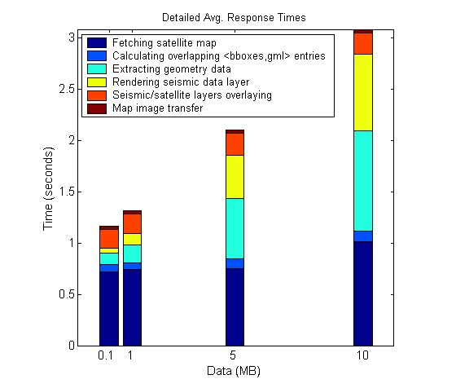
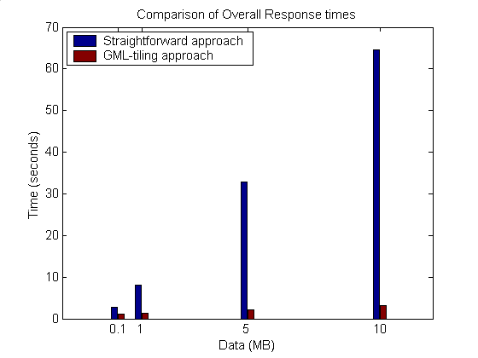
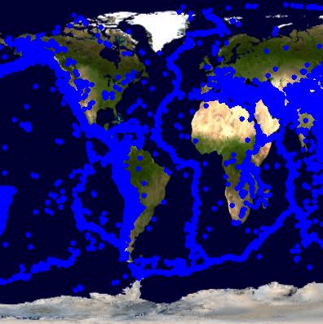
1. Using GML-tiling
The system bottleneck -(a)- is removed with the cost of
  Calculating overlapped entries and accessing tile table to get corresponding GML sets
On-demand client requests/queries are served from GML tiles.
Setup: Predefined threshold tile size for seismic data is 2MB
Tiles: <bbox, gml> – locally stored in memory/disk
Speedup:20.95
0.1
1
15.61
5
10
6.16
2.29
Notes:
It seems all components of overall response time is scalable.
For 10MB data
GNL-tiling is almost 30 times faster than the straightforward approach.
As the data size increases the performance gain ratio increases.
Show the results for high sizes
Put a stress test

Slide 32
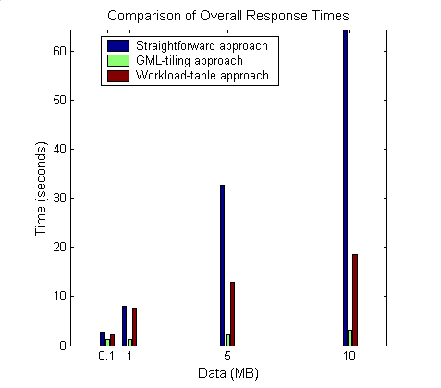
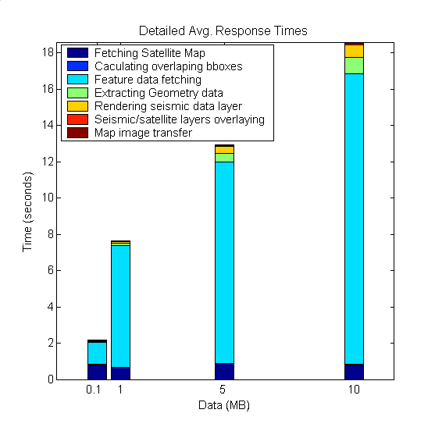
2. Parallel Processing Through WT
-(a)- still exists
  But reduced by doing parallel data access through Workload-table.
Setup: Predefined threshold tile size for seismic data is 2MB
Entries in Workload table (partitions) for selected main query ranges
0.1
1
5
10
Notes:
Map is rendered from originating data source- database.
Compared to GML-tiling:
->finding out overlapped bboxes not need to get GML from cache/disk
Additional feature-data fetching (GMLs will be caught from remote database)

Slide 33
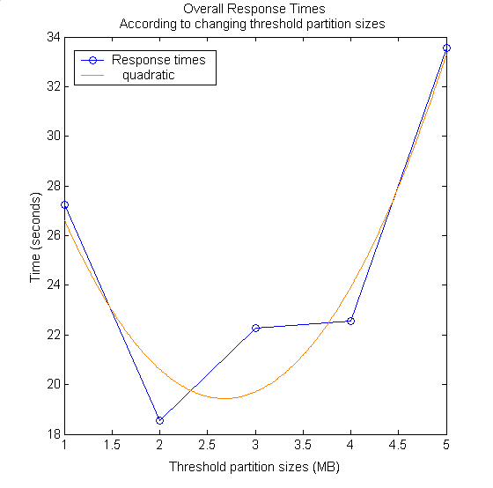
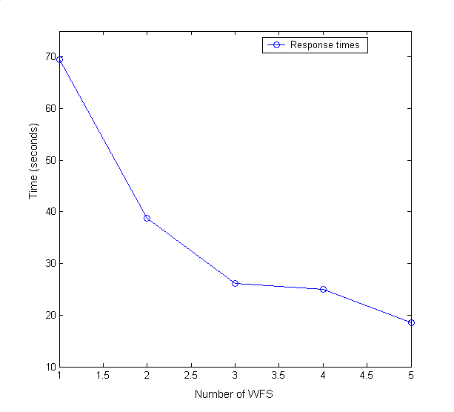
Parallel Processing Through WT (Cont’d)
Performance effecting factors
Speedup: 1.9
#of WFS worker nodes
  As the number increases, the performance increases
Keep everything same only change threshold partition sizes:
-> queries are for 10MB of data,
-> the number of WFS is 5
Keep everything same only change WFS number:
-> queries are for 10MB of data,
-> threshold size is defined as 2MB
Speedup: 2.4
Threshold partition size
  Pre-defined according to the network and data characteristics
    Make test queries
  Max value is the size of whole data in database –’max’
  If it is set too big (ex. ‘max’)
    No parallel query, no gain
  If it is set relatively too small,
    Excessive number of threads degrade the performance
Speedup: 1.9
Speedup: 2.9
Speedup: 2.9
Speedup: 1.7
Speedup: 3.5
Speedup: 2.5
Speedup: 2.6
Speedup: 2.4
Speedup: 3.5
If queried_data_size ≤ threshold_prt_size there is no parallelization and performance gain
- That means query is small enough
Else if queried_data_size > threshold_prt_size there will be gain
- At least two parallel queries
Notes:
Possible solution to define threshold data size is making test runs before setting it up
Start with minimum and increase ‘thr’ until the un-tolerable response times.
Data is still un-evenly distributed in each partition, that explains why the figure does have elbows

Slide 34
Summary & Conclusions
-Federator-oriented data access/query optimizations-
Modular: Extensible with any third-party OGC compliant data services (WMS and WFS).
Data layers can be handled with different techniques
  GML-tiling or Workload Table.
Best performance outcomes are achieved through central GML-tiling
  Synchronization periodicity for Tile-table must be defined carefully.
Success of parallel access/query is based on how well we share the workload with worker nodes.
  Periodically updated workload estimation table: Workload-table.
Streaming data transfer technique allows data rendering even on partially returned data.
Federator’s natural characteristic allows us to develop advanced caching and parallel processing designs.
  Inherently layers from separate data sources
  Individual layer decomposition and parallel processing
Notes:
Queries are consisted of the limited number of ranges
Bounding boxes defining locations of data
Other ranges are handled with application specific X-Path queries.
Lets look at the outcomes of the proposed performance enhancing techniques.
By using conventional communication networks, storage and computation resources, we obtained high degree of responsiveness.
Pre-fetching gives the best performance results but might cause data inconsistency due to storing data at federator. Prefetc runner’s triggering periodicity must be defined carefully..

Slide 35
Contributions
Federated Service-oriented Geographic Information System framework
  Integrating Web Services with Open Geographic Standards to support interoperability at both data and service levels
  Distributed service arch to manage production of knowledge as integrated data-views in the form of multi-layer map images
    Hierarchical data definitions through capability metadata federations
    Fine-grained dynamic information presentation
    Unified interactive data access/query and display from a single point.
Federator-oriented data access/query optimization and applications to distributed map rendering
  Extensions to Open Standards: Streaming GIS Web Services
  GML-tiling approach
  Dynamic load balancing for un-predictable workload sharing
  Parallel optimized range queries through partitioning
Notes:
Stateless GIS components are interacted in a statefull way through federators
Investigated performance efficient designs and did detailed benchmarking

Slide 36
Contributions (Systems Software)
Web Map Server (WMS) in Open Geographic Standards
  Extended with Web Service Standards and
  Streaming map creation capabilities
GIS Federator
  Extended from WMS
  Provides application-specific and layer-structured hierarchical data as a composition of distributed standard GIS Web Service components
  Enables uniform data access and query from a single access point.
Interactive map tools for data display, query and analysis.
  Browser and event-based.
  Extended with AJAX (Asynchronous Java and XML)

Slide 37
Acknowledgement
The work described in this presentation is part of the QuakeSim project which is supported by the Advanced Information Systems Technology Program of NASA's Earth-Sun System Technology Office.
Galip Aydin: Web Feature Server (WFS)

Slide 38
Thanks!....

Slide 39
BACK-UP SLIDES

Slide 40
Related Work
-Federation Framework-
UCSD-SDSC (University of California at San Diego - San Diego Super Computing Center)
  MIX (Mediation in XML)
  Metadata (who created it, what is the data about, …)
  No standards. They define their own data model and corresponding metadata
  getFeature like XML-based query - XMAS
  Spatial queries over databases to display integrated view
    Can utilize our proposed tiling and workload table arch.
Domain: Neuroscience data federation

Slide 41
Related Work
-Federation Framework-
TSIMMIS (The Stanford-IBM Manager of Multiple Information Sources)
  Distributed data federation
  Not related to spatial queries and data display
  Not integrated view issues
  Only concern is semantic heterogeneity of data to be integrated
  OEM objects and OEM-Query labguage – like getFeature and GML
Domain: Scientific documents, articles, cite-index

Slide 42
Possible Future Research Directions
Applying distributed hard-disk approach (ex. Hadoop) to handle large scale of GML-tiling and/or Workload tables
Finding out the best threshold partition size on the fly.
  Currently pre-defined by test runs
Extending the system with Web2.0 standards
Handling/optimizing multiple range-queries
  Currently we handle only bbox ranges

Slide 43
Why OpenGIS
Published OGC specifications.
Vendor compliance.
Vendor independence.
Open source options.
Interoperability, collaboration.
Public data availability.
Custodian managed data sources.
OGC compliant GIS works
  Cubewerx
  ArcIMS WMS connector
  Intergraph GeoMedia
  UMN MapServer
  MapInfo MapXtreme
  PennState GeoVista
  Wisconsin VisAD, and many more…

Slide 44
Integrated data-view
Multi-layered Map images
Query heterogeneous data sources as a single resource
  Heterogeneous: local resource controls definition of the data
  Single resource: remove the burden of individually accessing each data source
Easy extension with new data and service resources
No real integration of data
  Data always at local source
  Easy maintenance of data
Seamless interaction with the system
  Collaborative decision makings
Client/User-Query
Integrated View
Display &
Federation
services
GML
GML
WMS
WFS
WFS
Mediator
Mediator
Mediator
DB
Files
WWW
Data in files, HTML, XML/Relational Databases, Spatial Sources/sensors
Notes:
And Quality of services

Slide 45
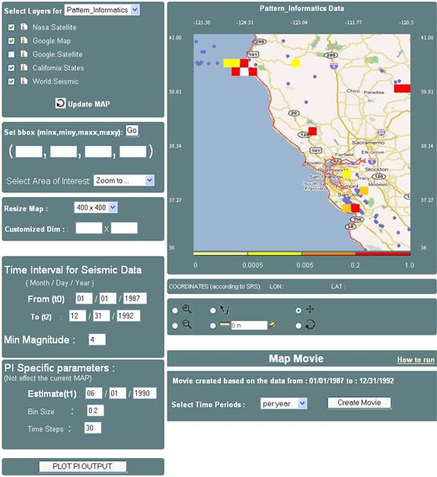
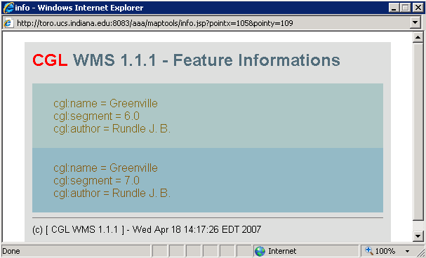
Hierarchical data
Integrated data-view
1
2
3
1: Google map layer
2: States boundary lines layer
3: seismic data layer
Event-based Interactive Tools :
Query and data analysis over integrated data views
Notes:
Since common data model based on content and presentation
We can also further query the data layers based on their attributes
Presentation tags are used for displaying.
Interactive Information Visualization tools provide researcher with remarkable capabilities to support discovery. By combining powerful data mining methods with user-controlled interfaces, users are able to benefit distributed heterogeneous data sources (access/attribute-based-query/display) from a single access point.
Users can begin with an overview, zoom-in on areas of interests, filter-out un-wanted items/layers, and click for details-on-demand.
With careful design and efficient algorithms, OGC provided data-layers can be enriched with some other data and/or processing resources.

Slide 46
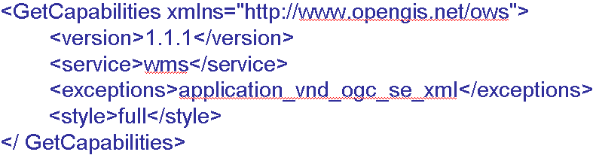
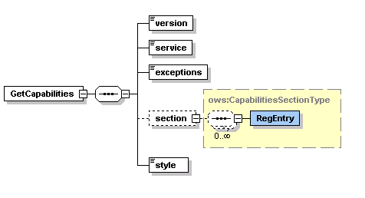
GetCapabilities Schema and Sample Request Instance

Slide 47
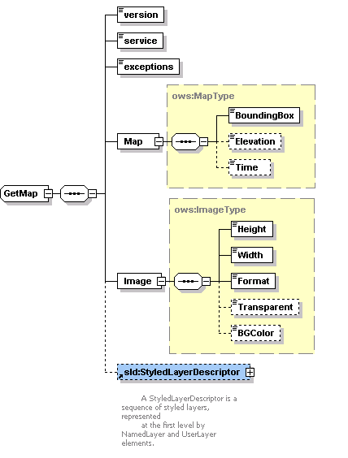
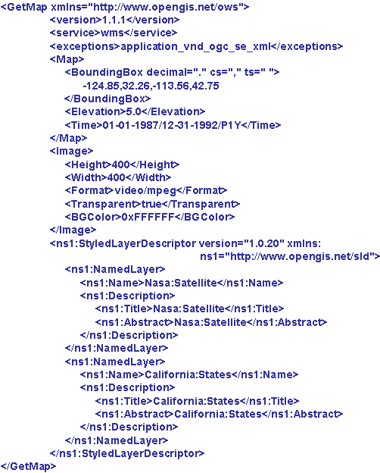
GetMap Schema and Sample Request Instance

Slide 48
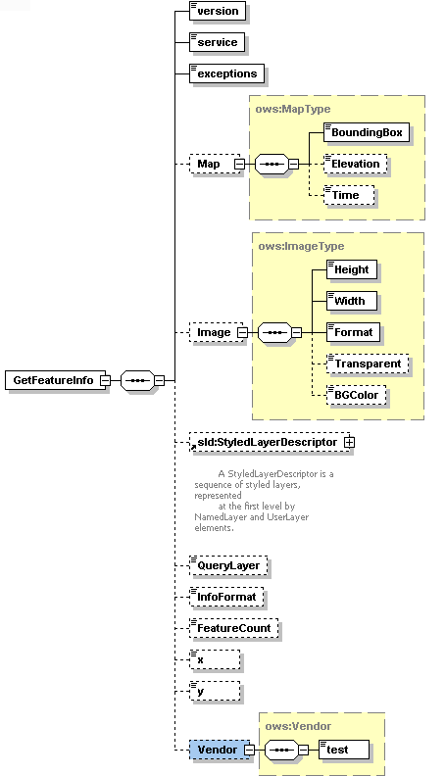
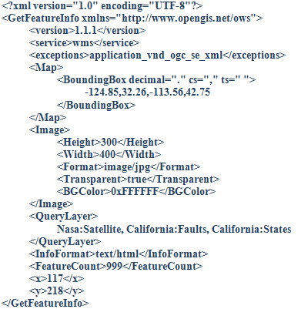

Slide 49
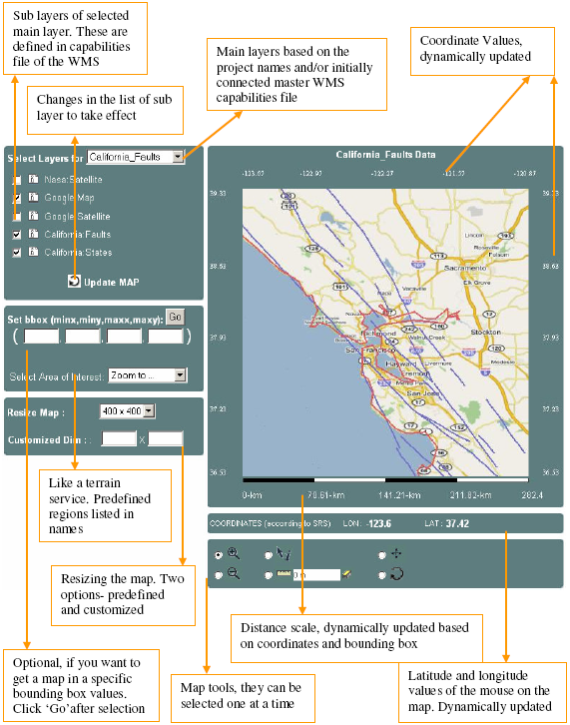
Event-based Interactive Map Tools
<event_controller>
  <event name="init" class="Path.InitListener" next="map.jsp"/>
  <event name="REFRESH" class=" Path.InitListener " next="map.jsp"/>
  <event name="ZOOMIN" class=" Path.InitListener " next="map.jsp"/>
  <event name="ZOOMOUT" class="Path.InitListener" next="map.jsp"/>
  <event name="RECENTER" class="Path.InitListener“next="map.jsp"/>
  <event name="RESET" class=" Path.InitListener " next="map.jsp"/>
  <event name="PAN" class=" Path.InitListener " next="map.jsp"/>
  <event name="INFO" class=" Path.InitListener " next="map.jsp"/>
</event_controller>

Slide 50
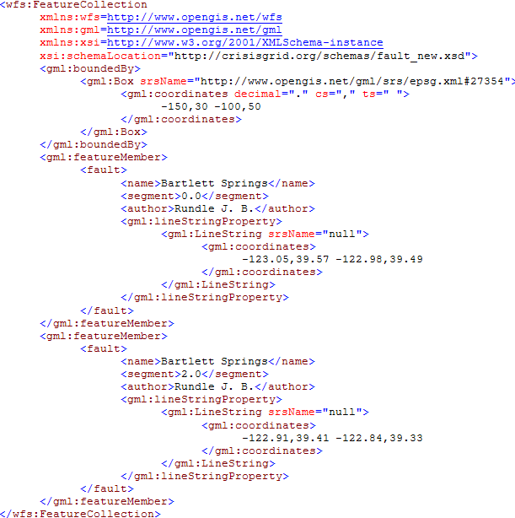
Sample GML document

Slide 51
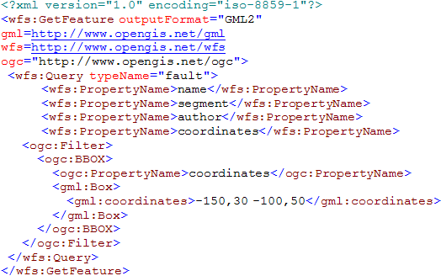
Sample GetFeature Request Instance

Slide 52
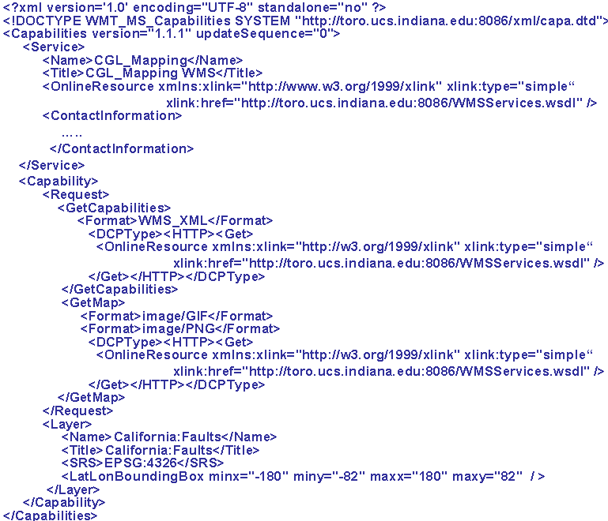
A Template simple capabilities file for a WMS

Slide 53
Generalization of the Proposed Architecture
GIS-style information model can be redefined in any application areas such as Chemistry and Astronomy
  Application Specific Information Systems (ASIS).
We need to define Application Specific
  Language (ASL) -> GML :expressing domain specific features, semantic of data
  Feature Service (ASFS) -> WFS :Serving data in common language (ASL)
  Visualization Services (ASVS) -> WMS : Visualizes information and provide a way of navigating ASFS compatible/mediated data resources
  Capabilities metadata for ASVS and ASFS.
We need to define Application Specific:
  Federator federating the capabilities of distributed ASVS and ASFS to create application-based hierarchy of distributed data and service resources.
Mediators: Query and data format conversions
  Data sources maintain their internal structure
  Large degree of autonomy
  No actual physical data integration
Unified data query/access/display
Such as filter, transformation, reasoning, data-mining, analysis
AS
Repository
1
Federator
ASVS
AS Tool
(ASVS)
AS Services
(user defined)
AS Tool
(ASFS)
4
3
2
1
2
Mediator
Mediator
3
Standard service API
Standard service API
AS
Sensor
AS
Sensor
Capability Federation
ASL-Rendering
Standard service API
Messages using ASL
Notes:
We will need the domain-specific equivalent of the Web Feature Service.
Federator
It is actually an ASVS but with an extended capabilities for capability federation and interacting and integrating multiple servers providing data in hierarchical/integrated data views defined in capabilities metadata.

Slide 54
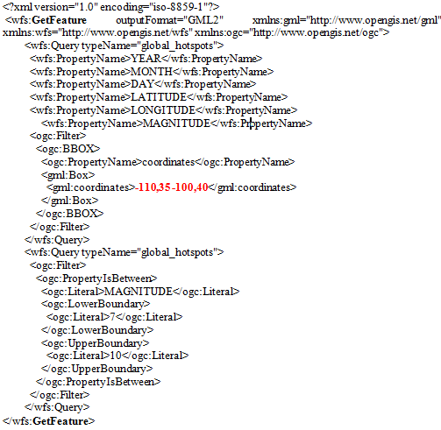
Sample GetFeature request to get feature data (GML) from WFS.
-110,35,-100,36
GFeature-1
-110,36,-100,37
GFeature-2
-110,37,-100,38
GFeature-3
-110,38,-100,39
GFeature-4
-110,39,-100,40
GFeature-5
Partition list as bbox values for sample case :
- Pn=5
- Main query getMap bbox 110,35 -100,40

Slide 55
Map rendering from GML
B
WMS
Converting objects into image
Plotting geometry
elements over the layer
Parsing and extracting geometry elements
Binary map image
GML
Notes:
Image conversion time in Figure is for resolution 400x400 in pixel.
Sample image conversion values are for JPEG creation
Average conversion time:25.43msec
Image conversion time changes based on
map images’ user-defined resolution values
Requested image format such as JPEG.

Slide 56
Interoperability Requirements on Geo-data
Geo-data is stored in various formats by heterogeneous autonomous resources.
Encoded as GML: Enables data to be carried with their attributes – content and presentation
Integrated to the system through WFS-based mediation
  Standard service interfaces accepting standard queries.
  GetFeature: Querying the data
Queried using its location attribute (bounding box) and other data-specific attributes
  Ex. earthquake data: magnitude of seismic activity and date event occurred.
Notes:
The range queries are intersections of ranges defined on attributes.

Slide 57
Standard Query (GetFeature)
<?xml version="1.0" encoding="iso-8859-1"?>
<wfs:GetFeature outputFormat="GML2" xmlns:gml="http://www.opengis.net/gml" >
<wfs:Query typeName="global_hotspots">
<wfs:PropertyName>LATITUDE</wfs:PropertyName>
<wfs:PropertyName>LONGITUDE</wfs:PropertyName>
<wfs:PropertyName>MAGNITUDE</wfs:PropertyName>
<ogc:Filter>
<ogc:BBOX>
<ogc:PropertyName>coordinates</ogc:PropertyName>
<gml:Box>
<gml:coordinates>-124.85,32.26 -113.36,42.75</gml:coordinates>
</gml:Box>
</ogc:BBOX>
</ogc:Filter>
</wfs:Query>
<wfs:Query typeName="global_hotspots">
<ogc:Filter>
<ogc:PropertyIsBetween>
<ogc:Literal>MAGNITUDE</ogc:Literal>
<ogc:LowerBoundary>
<ogc:Literal>7</ogc:Literal>
</ogc:LowerBoundary>
<ogc:UpperBoundary>
<ogc:Literal>10</ogc:Literal>
</ogc:UpperBoundary>
</ogc:PropertyIsBetween>
</ogc:Filter>
</wfs:Query>
</wfs:GetFeature>
Corresponding SQL query:
Select LATITUDE, LONGITUDE, MAGNITUDE from Earthquake-Seismic where
-124.85 < X < -113.36 & 32.26 < Y < 42.75
& 7 < MAGNITUDE < 10
Notes:
SQL queries are created from these attributes and their constraint range values

Slide 58
Motivations
Interoperable Service-oriented Geographic Information Systems
  Necessity for sharing and integrating heterogeneous data and computation resources to produce knowledge.
Uniform data access/query, display and analysis from a single access point
Responsive and interactive information systems
  GIS applications require quick response
    Emergency early warning systems
    Home-land security and natural disasters.
Notes:
The decision makers often need information from multiple sources, but are unable to get and fuse the required information in a timely fashion due to the difficulties of accessing the different systems, and due to the fact that the information obtained can be inconsistent and contradictory.
1.
The World Wide Web and its associated web programming models have revolutionized accessibility to data/information sources. At the same time, numerous incompatible formats, data heterogeneity (both the data types and storage formats), and machine un-readability of this data have limited data integration and federation. The seamless integration and federation of data from distributed heterogeneous data sources have been the major challenges of information system communities and decision support systems. In order to be able to integrate and share the data/information, data sources need to be in interoperable formats and provide standard service interfaces that interact with standard message formats and transport protocols.
2. Why federation? Highlight it:
The proposed federated service-oriented information system framework supports collaborative decision making over integrated data views, described in layer-structured hierarchical data. The users access the system as though all the data and functions come from one site. User doenot need to create ad-hoc queries to heterogeneous resources. The data distribution and connection paths stay hidden and formulated as hierarchical data defined in federator’s capability metadata.
Data anlamli olmasi icin bazen baska datalarla karsilastirilmasi overlay edilmesi gerekir. Bu yuzden bu data lara bir noktadan eszamanli ulasip analiz edilmesi icin bir federated system gerekli.
Application-based hierarchy of distributed data sources.
3.Right data in time: Resource consuming processes on large volume of data sets, Map rendering, XML structured data transfers and parsing etc.
Limited network bandwidth.

