Slide 1
High-Performance Federated and
Service-Oriented
Geographic Information Systems
Ahmet Sayar
(asayar@cs.indiana.edu)
Advisor: Prof. Geoffrey C. Fox
Notes:
Today's presentation is on my research topic – High …….systems.

Slide 2
Outline
Motivations
Research Issues
Architecture: Federated Service-Oriented Geographic Information System
Performance enhancing designs - measurements and analysis
Conclusions
Notes:
I will be addressing these factors in today's presentation ( wait sometime so they can read).

Slide 3
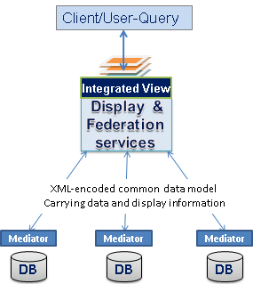
Introduction
Distributed service arch for managing the production of knowledge from distributed collections of data via integrated data-views.
Integrated data-views are defined by a “federator” located on top of the standard data components
  Components
    Web Services
    Translate information into a common data model
  Federator
    Combine information from several resources (components)
    Allows browsing of information
    Manage constraints across heterogeneous sites
Federator-oriented distributed data access/query optimization for responsive Information Systems

Slide 4
Motivations
Necessity for sharing and integrating heterogeneous data resources to produce knowledge
  Data, storage, platform and protocols heterogeneities
  Burden of individually accessing each data source
Unable to access/query and render the information in a timely fashion
  Interactive queries require large data movement, transformation and rendering
  Data access/query does not scale with size
  Accessing the heterogeneous/autonomous databases
    Query/response conversions
Notes:
1.
The World Wide Web and its associated web programming models have revolutionized accessibility to data/information sources.
In order to be able to integrate and share the data/information, data sources need to be interoperable and provide standard service interfaces interacting with standard message and transport protocols.
BUT data is kept in different formats and stored in numerous incompatible storages and provided by heterogeneous systems and internet protocols.
Integration of data from distributed heterogeneous sources
Comprehensible knowledge – Integrated data-views
Needs uniform access and query from single access point
2.
GIS applications require quick response
Emergency early warning systems
Home-land security and natural disasters.

Slide 5
Research Issues
Interoperability
  Adoption of domain-specific Open Standards -data model and services
  Integrating Web Service and Open Standards
    SOA arch for data grid and enable it to be integrated to Science Grids
Federation
  Query heterogeneous data sources as a single resource
  Capability-based federation of standard Web Service components
  Unified data access/query and display from a single access point through integrated data-views
Performance
Federator-oriented data access/query optimizations
  Pre-fetching technique
  Dynamic load balancing and unpredictable workload estimation over range queries
  Parallel data access/query via attribute based query decomposition
Notes:
Under those motivations we will address these research issues throughout the presentation
1. The interoperability issues have been studied by many public/private organizations last two decades at data and service levels. Among these are Web Service standards (WS-I) for cross-language, platform and operating systems, and OGC for defining domain specific data model and online service definitions in GIS.
There are three general issues here.
Capability metadata for each different group of components are defined by Standards
We define aggregated capability enabling hierarchical data definition in multi-layer format.
how to integrate different source schemas
how to answer to the queries posed on the global schema
mapping of common data model to a display model enabling integration/overlaying with other data sets (integrated data-view)
Investigate how to handle query/response over federated dispersed autonomous OGC data services referenced in aggregated capability metadata in metadata
3. federator-oriented data access/query optimization for distributed map rendering
Dynamic load balancing via attribute based query decomposition
Unpredictable workload estimation over range queries

Slide 6
Motivating domain
Geographic Information Systems (GIS)
GIS is a system for creating, storing, sharing, analyzing, manipulating and displaying geo-data and associated attributes.
  Distributed nature of the geo-data; various client-server models, databases, HTTP, FTP
Modern GIS requires
  Distributed data access for spatial databases
  Utilizing remote analysis, simulation or visualization tools
  Analyses of spatial data in map-based formats
Notes:
2. Over the past two decades, GIS has evolved from traditional centralized mainframe and desktop systems to collaborative distributed systems.
2.The nature of the geographical applications requires seamless integration and sharing of spatial data from a variety of providers.
3. Decision making in Geographic Information Systems (GIS) increasingly…
Maps are complex structures composed of layers created from distributed heterogeneous data sources.
FROM DIFFERENT DISCIPLINES AND SKILL/EXPERT Areas.
GIS requires data and computation resources from distributed virtual organizations to be composed based on application requirements, and accessed and queried from a single uniform access point over the refined data with interactive display tools. This requires seamless integration and interaction of data and computation resources. The resources span organizational disciplinary and technical boundaries and use different client-server models, data archiving systems and heterogeneous message transfer protocols.

Slide 7




Background (Cont’d)
OGC’s Interoperability Standards
Open Geospatial Consortium (OGC) solves the semantic heterogeneity by defining standards for services and data model
  Web Map Services (WMS) - rendering map images
  Web Feature Services (WFS) – serving data in common data model
  Geographic Markup Language (GML) : Content and presentation
Domain specific capability-metadata defining data+service
Database
Adaptor/wrapper
Rendering Engine
Display Tools
Street Data
Street Layer
WFS (mediator)
GML
WMS GML rendering
Binary data
Each layer is rendered from heterogeneous resources
Notes:
In order to provide interoperable and extensible GIS framework, we adopted domain-specific standard specifications for data model and online-services from OGC.
Open geographic standards:
Aim is to make geographic information and services neutral and available across any network, application, or platform.
Two major well-known standard bodies: Open Geospatial Standards (OGC) and ISO/TC211.
OGC Specifications defines online services and data models:
Data Format Specs: Geographic Markup Language (GML)
Service Specs: Web Feature Service (WFS), Web Map Service (WMS)
WMS and WFS are two major services defined by OGC for creating a basic GIS framework enabling information rendering of heterogeneous data sources as map images.

Slide 8
Open Geographic Standards
Open GIS Standards bodies aim to make geographic information and services neutral and available across any network, application, or platform
Two major standard bodies: OGC and ISO/TC211
Obstacles in adopting OGC standards to large scale Geo-science applications
  OGC Services are HTTP GET/POST based; limited data transport capabilities.
  Request-response type services; centralized, synchronous applications
Notes:
HTTP is a request/response standard between a client and a server. A client is the end-user, the server is the web site
Typically, an HTTP client initiates a request. It establishes a Transmission Control Protocol (TCP) connection to a particular port on a host (port 80 by default. An HTTP server listening on that port waits for the client to send a request message. Upon receiving the request, the server sends back a status line, such as "HTTP/1.1 200 OK", and a message of its own
The reason that HTTP uses TCP and not UDP is because much data must be sent for a webpage, and TCP provides transmission control, presents the data in order, and provides error correction
How to
Integrate geo-data with Geo-science Grid applications
link /cascade services to create more complex info/knowledge
Make them scalable with large scale applications

Slide 9
Service oriented GIS
To create a GIS Data Grid Architecture we utilize
  Web Services to realize Service Oriented Architecture
  OGC data formats and application interfaces to achieve interoperability at both data and service levels
Extensions to Standards:
Integrating OGC standards with Web Services principles
  Makes applications span cross-language, platform and operating systems
  Enables integration of Geo-science Grid applications with data services
  Orchestration of services, workflow.
Streaming data transfer capabilities:
  SOAP message creation overhead
  XML-encoded GML creation and transfer times
  Publish/subscribe based messaging middleware
  Enables client to render map images with partially returned data
Notes:
In this slide I explain what we did:
Web Service: "a software system designed to support interoperable machine to machine interaction over a network.
By web services, we mean the self-contained, web-enabled applications capable not only of performing business activities on their own but also processing the ability to engage other web services in order to complete higher-order transactions.
2.XML Encoding: Size of the geospatial data increases with GML encoding which increases transfer times, or may cause exceptions
SOAP message creation overhead
Strategies: Streaming data flow extensions to GIS Web Services
Web Service -as a handshake protocol.
Data is transferred over publish-subscribe messaging systems.
Enables client to render map images with partially returned data
A key difference between CORBA and the Web service technologies (UDDI/WSDL/SOAP) is that CORBA provides a true object-oriented component architecture unlike the Web services, which are primarily message based (SOAP, despite its name, does not really deal with objects). Moreover, CORBA also comes with a standard set of services (Events, Naming, Trading) that allow application writers to focus on the business logic rather than on the details of the communication infrastructure. Comparing this with the ongoing work on Web service technologies, we are forced to ask the question: are we reinventing the wheel?
For Web services, the preferred transport protocol is SOAP over HTTP. Because HTTP is the ubiquitous Web protocol with a well-defined port, firewalls are usually configured to allow inbound and outbound HTTP traffic, thus enabling SOAP messages to cross firewall boundaries easily. The presence of Web service does not require any change in the firewall configuration. SOAP over secure HTTP (using SSL) is handled in the same way

Slide 10
Capability aggregation/chaining for Service/data federation
Capability = metadata (OGC defined)
Since the standard GIS Web Service have standard service API and capability metadata, they can be composed, or chained, by capability exchange and aggregation through their common service method called “getCapability”.
Metadata is pulled from many places into a single location
Ex: Dublin Core and OAI-PMH (Open Archives Initiative Protocol for Metadata Harvesting) in digital libraries domain
  (Dublin Core - RDF) - (Capability - GML) [relation mappings]
Federator collects/harvest domain specific standard capabilities
  Provides global view over distributed data resources
  Inspired from “cascading WMS”
  Data provided are in layer tags: defining data-service mappings
  Behaves as a client to federated services
  Handling queries/responses for federated services
Notes:
Dublin core: An attempt to improve resource discovery on the Web - now adopted more broadly
15 elements for descriptive metadata: Title, creator, subject, description, publisher, date, type, source, format etc. - looks like end node.
Dublin Core vs RDF (defined by W3C) - Capability vs GML
RDF and GML Imposes structural constraints on the expression of application data models for consistent encoding, exchange and processing of metadata
Usage is different: dc elements for resource description is embedded in rdf documents. In GML-capability case: capability utilizes the semantics of GML elements.
Dublin core is an application of RDF data model
Dc:date -> rdf:value

Slide 11
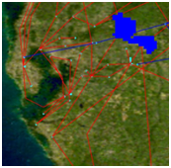
Federation Framework
Step-1: (Setup) Federator search for the components providing required data layers and organize them in one aggregated capability.
  Aggregated capability is actually a WMS capability representing application-based hierarchical layer composition.
  Capabilities are collected via standard service interface
  Federator provides single view of federated sources
Step-2: (Run time) Users access/query and display data sources through federator over integrated data-views.
  Some layers are in map images (layers from WMS), and some are rendered from GML which is provided by WFS.
  Enables users to query the map images based on their attributes and features
  On Demand Data Access: There is no intermediary storage of data.
Integrated data-view: b over a
Aggregated Capability
a. NASA satellite layer
a
WMS
JPL at California
a
b
Event-based
Interactive Map-Tools
1
Federator
WFS
b
Browser
Browser
2
Browser
b
b
b. Earthquake-seismic data
Events:
- Move,
- Zooming in/out
- Panning (drag-drop)
- Rectangular region
- Distance calc.
- Attribute querying
a
3
a
WFS
CGL at Indiana
1. GetCapability (metadata data+service)
2. GetMap (get map data in set of layer(s))
3. GetFeatureInfo (query the attributes of data)
Notes:
Over the GIS Web Service components we propose SOA based federated information system architecture for understanding and managing the production of knowledge from distributed observation, simulation and analysis through integrated data-views in the form of multi-layered map images.
Infrastructure is based on common data model, OGC compatible standard GIS Web-Service components and a federator.
Federator is actually an extended WMS provides one global view over several data sources that are processed as one source.
aggregating capability metadata from distributed standard GIS services and orchestrating/synchronizing requests and responses over the composition of data services referenced
There are three general issues here. The first is the data modeling (how to integrate different source schemas); the second is their querying (how to answer to the queries posed on the global schema); and the third is the common presentation model of data sources, i.e. mapping of common data model to a display model enabling integration/overlaying with other data sets (integrated data-view). The first two groups of research issues are related to lower level (database and files) data format/query/access heterogeneities summarized as semantic heterogeneity.
Local administrators maintain control over their systems and yet provide access to their data by the global users at the federation level.

Slide 12
Federation Through Capability Aggregation
Capability: Machine and human readable information: easy integration
Web Services provide key low level capability, Information/data architecture are defined in domain specific capabilities metadata and associated data description language (GML).
Quality of services
  More complex information/knowledge creation by leveraging multiple data sources
  No need for ad-hoc client tools and burden of multiple connections
  Mediates communication heterogeneity (Web service, HTTP)
  Stateful access/query over stateless data services
  Fine-grained dynamic information presentation
Just-in-time or late-binding federation
Interoperable and extendable
Notes:
Fine-grained dynamic information presentation
Heterogeneous data sources are queried as a single resource
Integrated data-view in multi-layered map images
No burden of accessing data source with ad-hoc queries.
Interactive feature based querying besides displaying the data
Just-in-time or late-binding federation
Data always is kept at its originating resource
Autonomous local resources -Easy data-maintenance
Interoperable and extendable
Open Geo-Standards are integrated with Web Service principles.
Federator (investigated):
Inspired from OGC: Cascading WMS
Federator: Extended WMS
Map -> Layer -> Data {GML / binary images} ->Raw data (any type).
A map is application-based, human-recognizable, integrated data display and is composed of layers. A layer is a data rendering of a single homogeneous data source. Layers are created from the structured XML-encoded common data model (GML) or binary map images (raster data). Heterogeneous data sources (raw data) are integrated to the system as GML or binary map images through the resource specific mediators. The mediators have resource specific adaptors for request and response conversions and appropriate capability metadata describing the data and resources.
The federator enables state-full service access over the stateless GIS Web Service components, and results in better performance for responsive GIS systems.

Slide 13
Federator-oriented data access/query optimization for distributed map rendering
Notes:
Lets discuss the performance…………..designs in such federated service oriented framework
Federated spatial database display
We propose federator-oriented data …optimization techniques for distributed map rendering
Federator enables Performance enhancements through:
State-full access/query over stateless data services
Enables load-balancing and parallel processing
Each layer comes from different server
Individual layers can also be created in parallel

Slide 14
Performance Investigation
Interoperability requirements’ compliance costs
  XML-encoded common data model (GML)
  Standard Web Service interfaces accepting XML-based queries
  Costly query/response conversions at WFS
    XML-queries to SQL
    Relational objects to GML
  Query processing does not scale with data size
Variable sized and unevenly distributed nature of geo-data
    Example: Human population and earthquake-seismicity data
    NOT easy to apply load-balancing and parallel processing
(c,d)
Unexpected workload distribution: The work is decomposed into independent work pieces, and the work pieces are of highly variable sized
(c, (b+d)/2)
(a,b)
((a+c)/2, b)
Notes:
GIS is mostly used in early warning systems, interactive real-time applications , It requires quick response times.
0- distributed nature of data:
Data and the computational resources are naturally distributed
Large data volumes make it impossible to put all geospatial data into one big data center.
Decision making requires these distributed heterogeneous data sources to be shared, and represented/rendered to extract useful knowledge
1-using semi-structured data model:
OGC recommends using GML data. GML carries content and the presentation tags together with the core data.
That enables the data sources to be queried and displayed together
Those resulting XML representations of data tend to be significantly larger than binary representations of the same data.
The larger document size means that the greater bandwidth is required to transfer of data, as compared to the equivalent binary representations.
2- There are some characteristics of geo-data that make it difficult to design distributed GIS with satisfactory performance.
Services provided by a GIS requires heavy CPU usage due to the complex computation involved in the underlying computational geometry.
GIS services often transmit large resulting data sets such as images

Slide 15
Enhancement Approaches
Aim: Turning compliance requirements into competitiveness by optimizing federated query responses
Pre-fetching (centralized)
  GML-tiling
Dynamic load balancing and parallel query (decentralized)
  Range query partitioning through workload estimation table (WT)
Notes:
Change the name to estimation …
The standards themselves do not deliver working systems. Constructing successful working systems requires smart design.
We address these performance issues from the federator’s point of view (which is upper level approach)
We have introduced/developed federator-oriented data access/query optimization techniques (over the OGC standard data services)
Our aim is optimizing the response times for interactive GIS systems using standard GIS components.

Slide 16
1. GML-tiling
On-demand access/rendering
over TT
Pre-fetching the data before it is actually needed
Database is mapped to a data structure (Tile-table) in federator
  And periodically synchronized
Successive on-demand queries are served from federator’s local disk
On-demand access/rendering
Interactive
Client Tools
Federator
(WMS)
Federator
(WMS)
Tile-table
Pre-fetching (batch job) running routinely
GML
GetFeature
GML
GetFeature
WFS
WFS
SQL
Relational objects
SQL
DB
DB
On-demand queries are served from TT
TT is synchronized with database routinely.
Straight-forward
Notes:
Don’t spend time
Strategies:
Periodically fetching the whole data before it is needed (so called pre-fetching).
Databases are mapped to chunks of GML files in a structure and stored locally in the federator
Successive on-demand queries are served by using pre-fetched data
Pros/Cons:
Removes the repeated resource consuming query/data conversions at WFS and associated Databases.
Gives the best performance outcomes for the archived data,
But, might cause inconsistency
Faces time consuming request/response conversion
(Request): GetFeature request to SQL,
(Response): Relational tables to GML
We focus on the issues at the upper level of data handling. We are not proposing enhancement over query and/or response conversions at the autonomous resources integrated through mediators (WFS). Our enhancement approaches are at the federator and view-level.

Slide 17
Tile-table (TT)
Created and updated by a module independent of run-time
  Synchronized with the database routinely
TT is consisted of <key, value> : <bbox, GML> pairs.
  Each partitioned rectangle below is represented by <bbox, GML>
Recursive binary cut (half/half)
  Until each box has less than threshold GML size
Lets illustrate the table with sample scenario
  Whole data range in database (0,0,1,1) -> (minx,miny,maxx,maxy)
  Each ‘ ’ corresponds to 1MB and
  Threshold data size falling in a partition is 5MB
    Means each box covers 5 ‘ ‘ at most
(1,1)
1
(1,1)
3
5
4
2
3
(1, 3/4)
1
4
4
3
(1, 1/2)
5
4
(0,0)
(0,0)
(1/2, 0)
Notes:
If in first fetch, data size exceeds the allowed size, then cut into 2
Figures represent whole ranges in database for the selected data layer.
(0,0,1,1)
(0,0,1/2,1) (1/2,0,1,1)

Slide 18
Utilizing Locality of Reference
Data that is near other data or has just been used is more likely to be used again
Storage hierarchy (Ehcache libraries):
  Federator’s Memory Store
  Federator’s Disk Store
  Allowable memory and disk capacity
  If memory overflows, entries are dumped into disk
  If disk overflows, evicted according to the policy (LRU or LFU)
Entries move between memory and disk space
  Policy is defined in configuration (LFU, LIFO etc.)
Notes:
Entries are stored through Apache-Ehcache

Slide 19
How It is Used (Run-time)
On-demand data access and rendering responded over TT
Lets say federator gets a queries positioned to TT as below
p₂
r₁
p₁
p₄
p₁₂
r₂
p₃
(r_{i}): On-demand query in bbox
(p_{i}): WT entries in GML
r₁: p₁₂
r₂: p₁, p₅, p₁₂
r₃: p₁₁,p₁₀
r₄: p₁, p₉, p₃, p₆
r₄
p₆
p₅
p₈
p₉
p₇
r₃
p₁₁
p₁₀
Find all partitions that overlap with the query r_{i} ( i.e. p_{i} values )
Obtain GML values from TT using corresponding p_{i} values.
  GML = TT.get(p_{i})
Extract the geometry elements in GML, and render the layer.

Slide 20
Summary and Related Work
Google Maps tiling:
  Map image tiles, replacing computation with storage
  No rendering – uses premade image tiles.
  Static, not extendable
GML-tiling enables creation of distributed map rendering
  Tiles are consisted of structured data model –GML
    Enables attribute based querying of map data besides displaying
  Rendering of GML
  Standards – easy to extend with new data sources
Notes:
Google map like arch is not applicable to use with conventional computation resources – because of the size requirements

Slide 21
2. Dynamic Load-balancing & Parallel Query
Interactive
Client Tools
(x’,y’)
R1
R2
Federator
(WMS)
Federator
(WMS)
(1/2)
[Range]
R3
R4
[Range]
(x,y)
1. Partitioning into 4
(R1), (R2), (R3), (R4)
1/2
3. Merging
Main query range: Range
Range = R1+R2+R3+R4
Single Query Range:[Range]
2. Query Creations
Q1, Q2, Q3, Q4
Q
WFS
Queries
WFS
WFS
WFS
Responses
DB
DB
Straight-forward
Parallel fetching
Notes:
Seems like a natural solution, but geo-data is variable sized and unevenly distributed.
It does not guarantee even-workload sharing.
Un-evenly distribution of data based on location attribute
Data-dense/sparse regions

Slide 22
Adaptive Range Query Optimization
Dynamic nature of data
Query approximation problem
Optimal partitioning of data is difficult to achieve because polygons are neither distributed uniformly nor of similar size.
  The load they impose varies, depending on query range attributes (location of the query).
  It is difficult to develop a fair partitioning strategy that is optimal for all range queries

Slide 23
Load balancing via Range Query Partitioning
Estimating the workload of 2-dimensional range queries when the data sets have numerical attributes with real values.
The range queries are intersections of ranges, each range being defined on a single attribute.
  Lets say A is the set of attributes A={A₁, A₂, … A_{n}}
  Attribute gets values between some intervals: α_{i} < A_{i} < β_{i}
  Range queries are of the form
    (α₁ < A₁ < β₁) & (α₂ < A₂ < β₂) & .. (α_{n} < A_{n} < β_{n})
Ex data attributes and their ranges: Earthquake seismic data
  A1: Date seismic event happened : 01/01/1900<A1<12/31/2006
  A2: Magnitude of the seismicity : 0<A2<10
  A3: Location it happened (2-dim coordinate) : (-180,-90)<A3<(180,90)
Aim: Cutting the ranges into smaller pieces in queries corresponding to the approximately equal loads.
Notes:
Finding approximate answers to multi-dimensional range queries over real valued attributes has significant applications in data exploration and database query optimization
Partitioning the data involved in range query into approximately equal loads

Slide 24
Workload Estimation Table (WT)
Similar to Tile Table in creation:
  But, entries show expected workload in size not actual data
  <key, size>:<bbox, size>
Periodically updated
  Considerations of data dense/sparse regions
  Each layer-data has its own WT
Helps with fair workload sharing to worker nodes.
Keeps up-to-date ranges in bounding boxes
  In which data sizes ≤ pre-defined threshold size.
  Routinely synchronized with the databases
Notes:
Efficient workload sharing to workers
Dynamic load-balancing and query approximation
Adapted workload sharing to increase the efficiency of parallelization.
Motivating domain: Geo-data, GIS
Applications: Range queries
FOR 2-dim range queries

Slide 25
WT Creation/Refinement
Recursive binary cut 2 dimensional ranges:
  R: Full range for the data in bounding-box
  t: Threshold data size
  PT(R, t) = PT(R_{half}, t)+PT(R_{half}, t)
    Gml = getFeature (R_{half})
    If (size(Gml)<= t)
      Put it into memory/disk as pair <R_{half}, size(Gml)>
      And return;
    Else
      Call PT(R_{half},t)
Threshold data size changes depending on the data and network-bandwidth.

Slide 26
WT Utilization
Lets say federator gets a query whose range is R
R overlaps with: p₁₂, p₁ and p₅
Overlapped regions in bbox are: r₁, r₂ and r₃
Instead of making one query to database through WFS with range R;
  Make 3 parallel queries whose all attributes are same except for range attributes.
    r₁, r₂ and r₃
(1,1)
p₂
R
p₁
p₄
p₁₂
r₂
p₃
r₁
r₃
p₆
(1, 3/4)
p₅
p₈
p₉
p₇
p₁₁
p₁₀
(0,0)
(1/2, 0)
(1, 1/2)
WT

Slide 27
Performance effecting factors
#of parallel queries to a single worker node
  Changes according to threshold partition size and number of worker nodes
  As the number increase, performance increase
    but after some number increase rate decreases
#of WFS worker nodes
  As the number increases, the performance increases
Partitioning and merging overheads at federator
  As the partition number increases, the overhead increases
Main query at federator
WFS
DB
Performance evaluations will be performed on earthquake seismic data kept in MySQL database
Notes:
Possible solution to define threshold data size is making test runs before setting it up
Start with minimum and increase ‘thr’ until the un-tolerable response times.
Data is still un-evenly distributed in each partition, that explains why the figure does have elbows
Data fetching is already fast but large overhead because of
XML-based query decomposition [internal -bottleneck-]
*Connection overhead and multiple queries to same server –thread switching overheads etc. are not displayed at 3.
These are tried to be shown at items 1 and 2 by showing that performance does not increase at the same ratio in which thread number increases.
*even if we partition all equal, the actual query will have partially overlapping regions and this causes uneven sharing again.
*Performance tests give different results for different systems. That is why we make speed-up tests to evaluate the enhancement approaches. T(multi-threaded/partitions)/T(singleprocessflow)
*Because of the base overhead times and good enough performance for small data sets, approach is applied to relatively large data sets.
*In addition in order to avoid large overhead times we propose multi-WT based on zoom-levels (Future work)

Slide 28
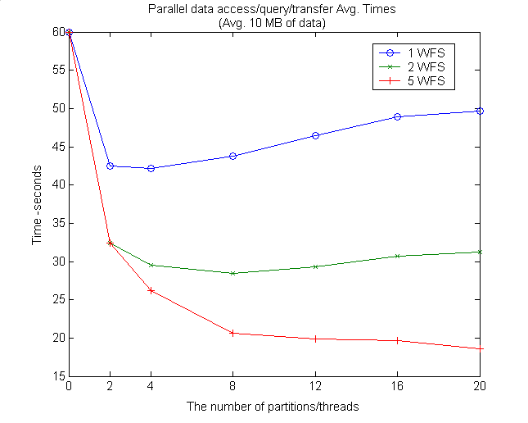
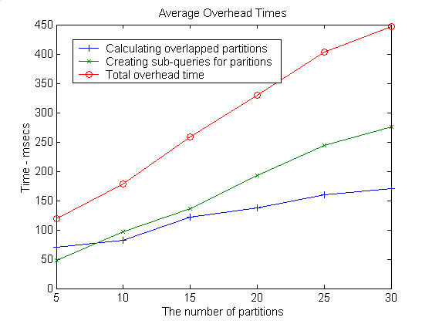
8-core WFS worker nodes
Each partition is assigned to separate threads
Notes:
Sub-query creation: 11.89 msec/query
Kirmizi’yi bul. Bence biraz daha yuksek cikmali?
Remove merging!
It is done in parallel and that does not effect performance – asynchronous run
I/O and cpu jobs run together.
Getting overlapping partition bboxes from WT
Creating sub-queries partitions returned from WT

Slide 29
Summary
We parallelized range query using data partitioning (to reduce synchronization) and dynamic load balancing (to improve speedup)
  Overlapping I/O and CPU bound processes
    While fetching the data for a partition, rendering the GML response to another partition
Speed up increases as the partition number increases and then increase rate decreases.
  The initial increase is due to improved load balance by reducing the effect of fluctuation in partitions’ loads,
  and the decrease is due to the non-parallelizable overheads and limited number of clusters.
Success of parallel access/query is based on how well we share the workload with worker nodes.
Notes:
Fluctuation in data uniformity in queried region is decreased as the paralllel processing increase
But

Slide 30
Related Work
Science.gov (government science portal)
  Federated search technology—simultaneously executing a query against an array of databases, then aggregating the results
  Gives users a single entry point for searching science portals in parallel with only one query
Hadoop :
  Putting the files in distributed nodes and making search of words in parallel
WT not only partitions the work to workers but also takes the un-evenly shared workloads into consideration.
WT enables adapted computing
Notes:
Science.gov provide an information infrastructure that would span and transcend institutional boundaries
Hadoop: By distributing the data, Hadoop can process it in parallel on the nodes where the data is located
Hadoop implements MapReduce, using the Hadoop Distributed File System (HDFS) (see figure below.) MapReduce divides applications into many small blocks of work. HDFS creates multiple replicas of data blocks for reliability, placing them on compute nodes around the cluster. MapReduce can then process the data where it is located

Slide 31
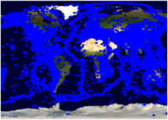
Test Setup: Overall performance evaluation
Test Data
  NASA Satellite maps image from WMS (at California NASA JPL)
  Earthquake Seismic data from WFSs (at Indiana Univ. CGL Labs)
Setup is in LAN
  gf12,15,17,18,19.ucs.indiana.edu.
  2 Quad-core processors running at 2.33 GHz with 8 GB of RAM.
Evaluations of :
  Pre-fetching (central) model [GML-tiling]
  Dynamic load-balancing and parallel-processing through query partitioning [Workload estimation table]
GetMap
WMS
NASA Satellite Map Images
JPL California
Binary map image
GetMap
1
Event-based dynamic map tools
Federator
Binary map image
GML
WFS-1
DB1
Replicated WFS and DBs
Browser
2
2
1
GetFeature
..
Earthquake Seismic records
1: NASA satellite
map images
2: Earthquake-
seismic records
CGL
Indiana
WFS-5
DB5
2
Notes:
Throughout the performance slides, we will be working on two-layers for simplicity.
These are the layers actually used in real geo-science applications Pattern Informatics and Virtual California
Performance enhancing design techniques are mostly focusing on XML-encoded common data model (GML) handling (transfer/rendering/display)
In this sense, GML data is fetched, rendered and overlaid on NASA satellite map images which is shown as layer 2 in the figure.
Binary map images are fast enough to access and display. Because there is no need burdening query and data conversion as it is done for GML.
We also have integrated and used Google Map as base map layer to overlay GML data. But not shown here.
Intel Xeon processors running at 2.33 GHz with 8 GB of memory and operating Red Hat Enterprise Linux ES release

Slide 32
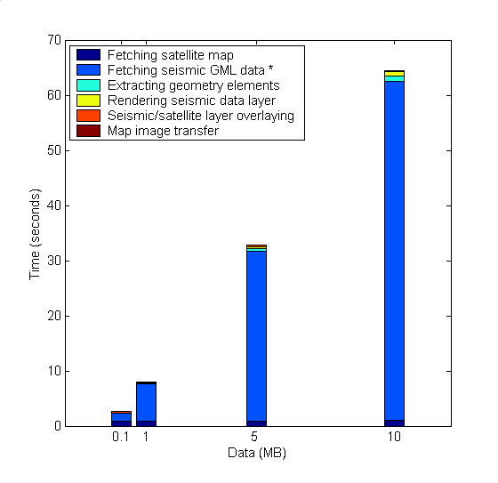
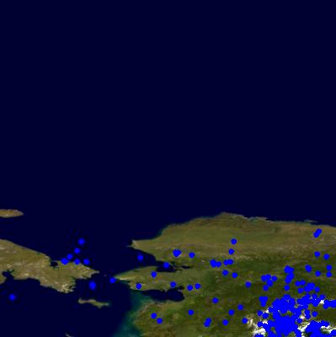
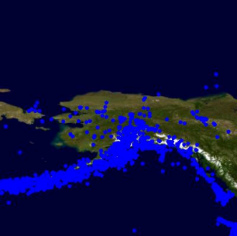
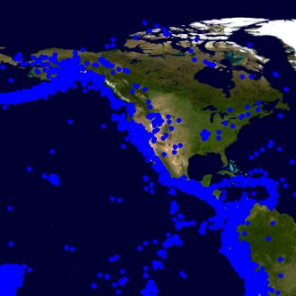
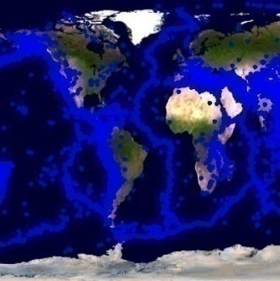
Baseline System Tests
Binary map image
WMS
1.NASA Satellite Map Images
1
Event-based dynamic map tools
Federator
Browser
Binary map image
GML
WFS
DB
2.Earthquake seismic data
2
2
1
(d). Average response time
(b). Map rendering time
(a). Query/response conversions & data transfer
(c). Map images transfer time
Selected query ranges:
b
0.1
1
d
(a)
5
10
Response times = a + b + c
a is dominating factor
Notes:
Measurement of success and speedups are evaluated relatively.
WHY DID YOU CHOSE THESE BOXES AND DATA SIZES:
Mention about your experiences with real science applications -Virtual California etc., attributes etc
Pattern Informatics – plotting geodata
*X-Coordinates and selected ranges:*
-We assume that the requested queries are for 0.1 1 5 and 10 MB and above bboxes represents these data size and geo-data characteristics
-To show the system’s behavior against the dramatically changing data size we picked these data sizes and corresponding possible ranges.
We could pick any other ranges corresponding those data sizes and result would not change.
*Analysis:*
The system does not scale with data sizes because of ‘(a)’.
Response time is the linear function of data sizes.

Slide 33
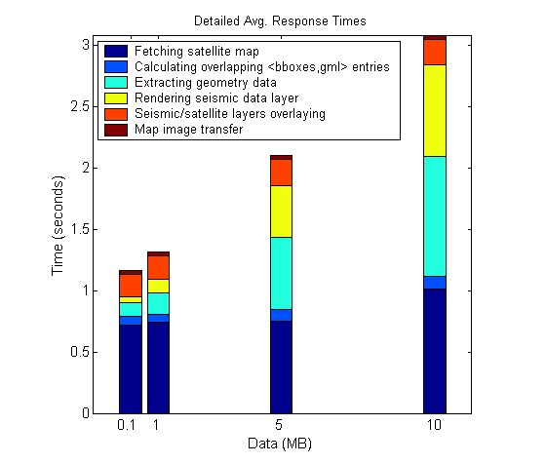
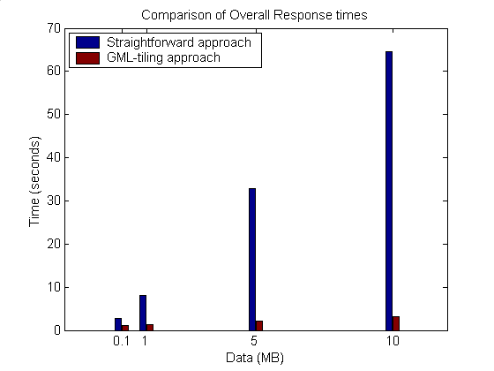
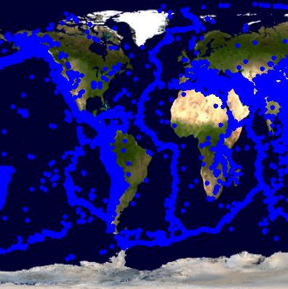
1. Using GML-tiling
The system bottleneck -(a)- is removed with the cost of
  Calculating overlapped entries and accessing tile table to get corresponding GML sets
Client’s requests/queries are served from GML tiles at federator.
Setup: Predefined threshold tile size for seismic data is 2MB
Tiles: <bbox, gml> – locally stored in memory/disk
Speedup:20.95
0.1
1
15.61
5
10
6.16
2.29
Notes:
It seems all components of overall response time is scalable.
As the data size increases the performance gain ratio increases.
Show the results for high sizes
Put a stress test

Slide 34
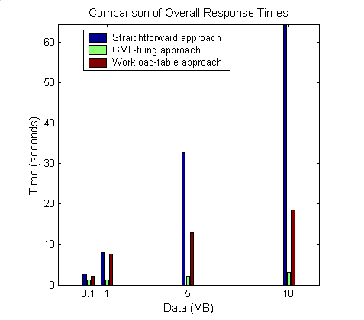
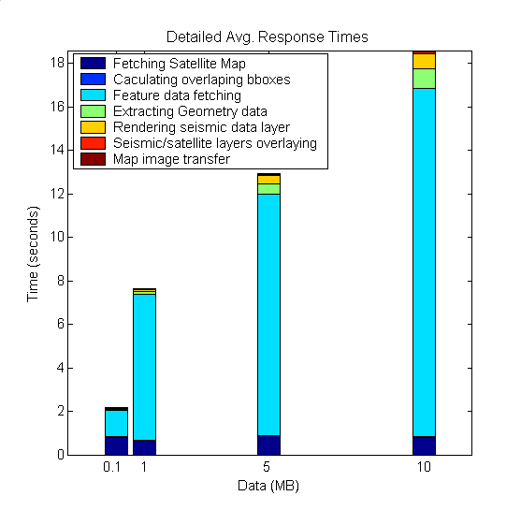
2. Parallel Processing Through WT
-(a)- still exists but
  reduced by parallel data access through Workload estimation table.
Setup: Predefined threshold tile size for seismic data is 2MB
Entries in Workload table (partitions) for selected main query ranges
0.1
1
5
10
Notes:
Map is rendered from originating data source- database.
Compared to GML-tiling:
->finding out overlapped bboxes not need to get GML from cache/disk
Additional feature-data fetching (GMLs will be caught from remote database)

Slide 35
Summary & Conclusions
Modular: Extensible with any third-party OGC compliant data services.
Enables use of large data in Geo-science Grid applications in responsive manner.
Data layers can be handled with different techniques
  Tiling or parallel queries via workload estimation table.
Streaming data transfer technique allows data rendering even on partially returned data.
Federator’s natural characteristic allows advanced caching and parallel processing designs.
  Inherently layers from separate data sources
  Individual layer decomposition and parallel processing
Notes:
Queries are consisted of the limited number of ranges
Bounding boxes defining locations of data
Other ranges are handled with application specific X-Path queries.
By using conventional communication networks, storage and computation resources, we obtained high degree of responsiveness.

Slide 36
Contributions
Proposed and implemented a SOA architecture to provide a common platform to integrate Geo-data sources to Geo-science Grids applications seamlessly.
  Integrating Web Services with Open Geographic Standards to support interoperability at both data and service levels
Federated Service-oriented GIS framework
  Distributed service arch to manage production of knowledge as integrated data-views in the form of multi-layer map images
    Hierarchical data definitions through capability metadata federations
    Unified interactive data access/query and display from a single access point.
Federator-oriented data access/query optimization and applications to distributed map rendering
  XML-encoded data tiling to optimize the range queries
  Dynamic load balancing for un-predictable workload sharing
  Parallel optimized range queries through partitioning
  Utilized publish/subscribe messaging system for high performance data transfer
Notes:
Stateless GIS components are interacted in a stateful way through federators
Investigated performance efficient designs and did detailed benchmarking

Slide 37
Contributions (Systems Software)
Web Map Server (WMS) in Open Geographic Standards
  Extended with Web Service Standards and
  Streaming map creation capabilities
GIS Federator
  Extended from WMS
  Provides application-specific and layer-structured hierarchical data as a composition of distributed standard GIS Web Service components
  Enables uniform data access and query from a single access point.
Interactive map tools for data display, query and analysis.
  Browser and event-based.
  Extended with AJAX (Asynchronous Java and XML)

Slide 38
Acknowledgement
The work described in this presentation is part of the QuakeSim project which is supported by the Advanced Information Systems Technology Program of NASA's Earth-Sun System Technology Office.
Galip Aydin: Web Feature Server (WFS)

Slide 39
Thanks!....

Slide 40
BACK-UP SLIDES

Slide 41
Possible Future Research Directions
Integrating dynamic/adaptable resources discovery and capability aggregation service to federator.
Applying distributed hard-disk approach (ex. Hadoop) to handle large scale of GML-tiling and/or Workload tables
Finding out the best threshold partition size on the fly.
  Currently pre-defined by test runs
Extending the system with Web2.0 standards
Handling/optimizing multiple range-queries
  Currently we handle only bbox ranges

Slide 42
Why OpenGIS
Published OGC specifications.
Vendor compliance.
Vendor independence.
Open source options.
Interoperability, collaboration.
Public data availability.
Custodian managed data sources.
OGC compliant GIS works
  Cubewerx
  ArcIMS WMS connector
  Intergraph GeoMedia
  UMN MapServer
  MapInfo MapXtreme
  PennState GeoVista
  Wisconsin VisAD, and many more…

Slide 43
Integrated data-view
Multi-layered Map images
Query heterogeneous data sources as a single resource
  Heterogeneous: local resource controls definition of the data
  Single resource: remove the burden of individually accessing each data source
Easy extension with new data and service resources
No real integration of data
  Data always at local source
  Easy maintenance of data
Seamless interaction with the system
  Collaborative decision makings
Client/User-Query
Integrated View
Display &
Federation
services
GML
GML
WMS
WFS
WFS
Mediator
Mediator
Mediator
DB
Files
WWW
Data in files, HTML, XML/Relational Databases, Spatial Sources/sensors
Notes:
And Quality of services

Slide 44
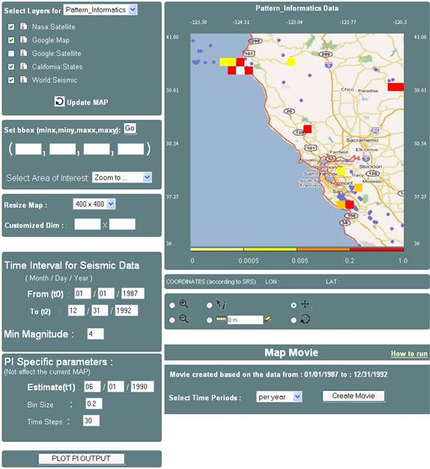
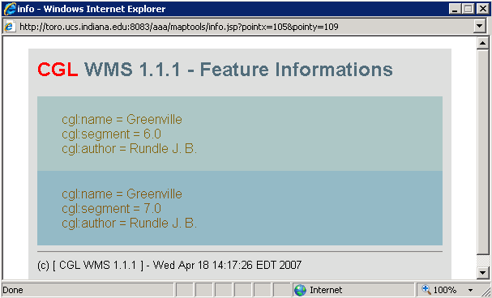
Hierarchical data
Integrated data-view
1
2
3
1: Google map layer
2: States boundary lines layer
3: seismic data layer
Event-based Interactive Tools :
Query and data analysis over integrated data views
Notes:
Since common data model based on content and presentation
We can also further query the data layers based on their attributes
Presentation tags are used for displaying.
Interactive Information Visualization tools provide researcher with remarkable capabilities to support discovery. By combining powerful data mining methods with user-controlled interfaces, users are able to benefit distributed heterogeneous data sources (access/attribute-based-query/display) from a single access point.
Users can begin with an overview, zoom-in on areas of interests, filter-out un-wanted items/layers, and click for details-on-demand.
With careful design and efficient algorithms, OGC provided data-layers can be enriched with some other data and/or processing resources.

Slide 45
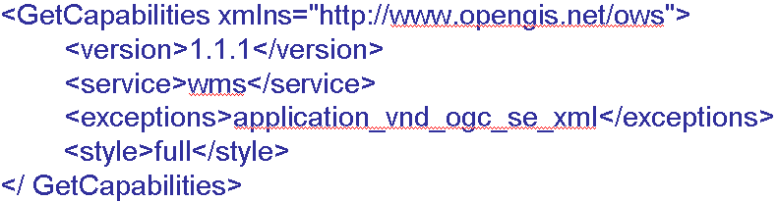
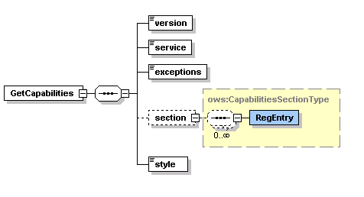
GetCapabilities Schema and Sample Request Instance

Slide 46
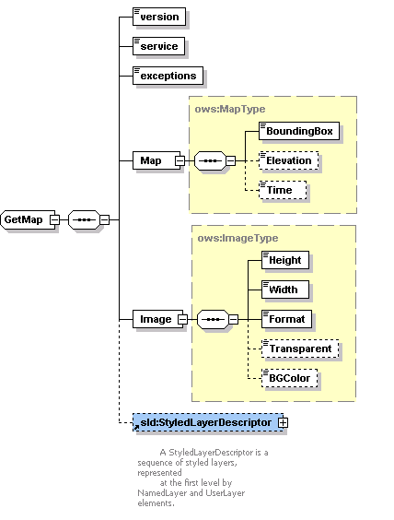
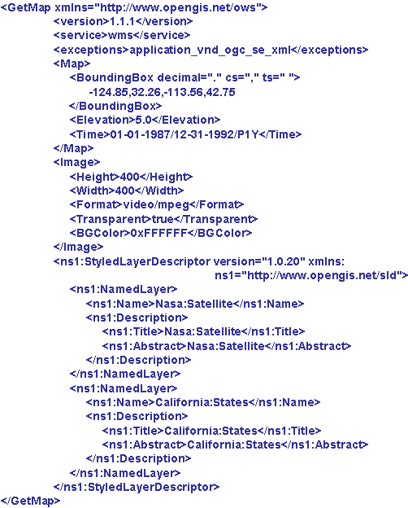
GetMap Schema and Sample Request Instance

Slide 47
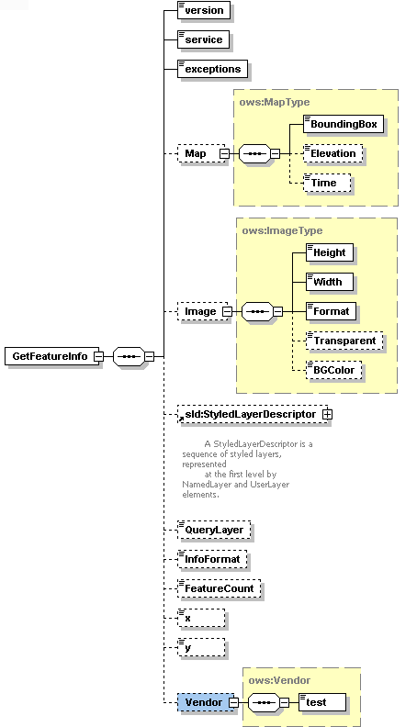
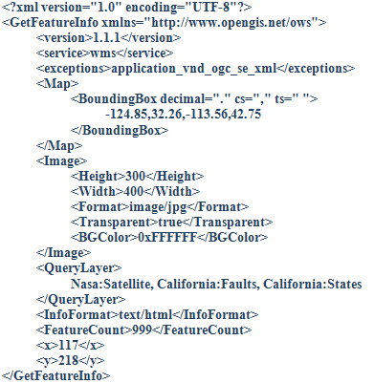

Slide 48
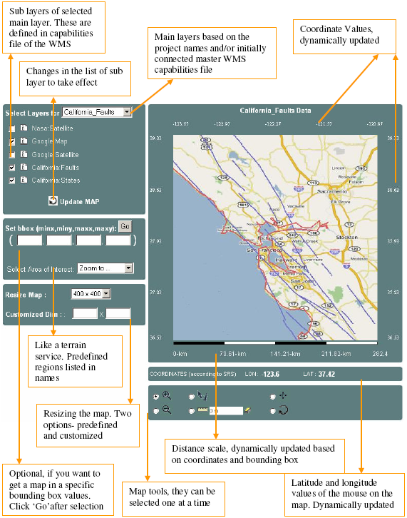
Event-based Interactive Map Tools
<event_controller>
  <event name="init" class="Path.InitListener" next="map.jsp"/>
  <event name="REFRESH" class=" Path.InitListener " next="map.jsp"/>
  <event name="ZOOMIN" class=" Path.InitListener " next="map.jsp"/>
  <event name="ZOOMOUT" class="Path.InitListener" next="map.jsp"/>
  <event name="RECENTER" class="Path.InitListener“next="map.jsp"/>
  <event name="RESET" class=" Path.InitListener " next="map.jsp"/>
  <event name="PAN" class=" Path.InitListener " next="map.jsp"/>
  <event name="INFO" class=" Path.InitListener " next="map.jsp"/>
</event_controller>

Slide 49
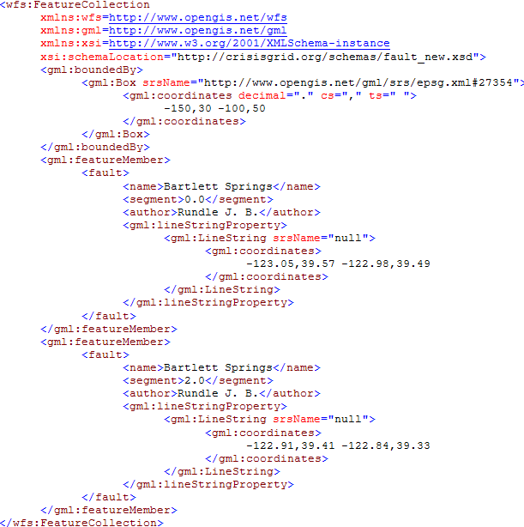
Sample GML document

Slide 50
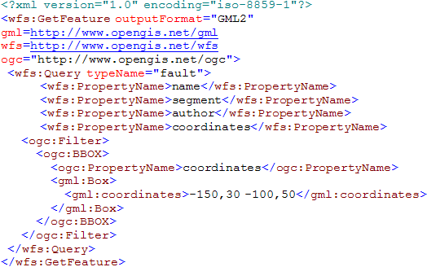
Sample GetFeature Request Instance

Slide 51
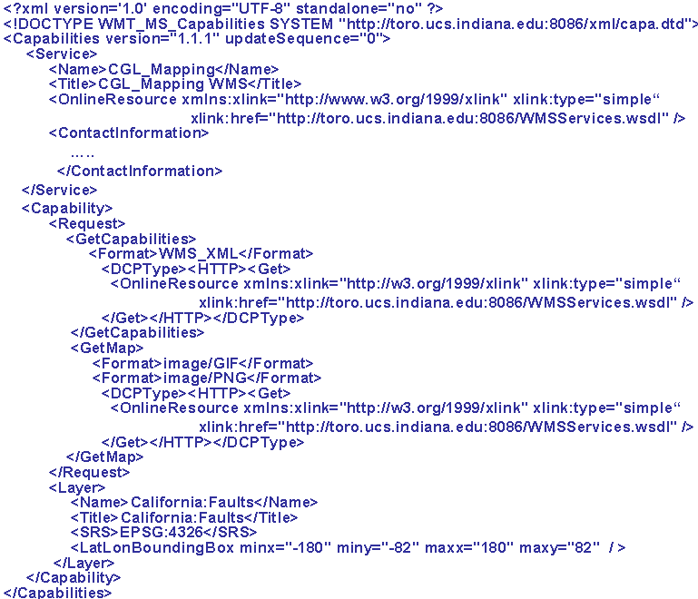
A Template simple capabilities file for a WMS

Slide 52
Generalization of the Proposed Architecture
GIS-style information model can be redefined in any application areas such as Chemistry and Astronomy
  Application Specific Information Systems (ASIS).
We need to define Application Specific
  Language (ASL) -> GML :expressing domain specific features, semantic of data
  Feature Service (ASFS) -> WFS :Serving data in common language (ASL)
  Visualization Services (ASVS) -> WMS : Visualizes information and provide a way of navigating ASFS compatible/mediated data resources
  Capabilities metadata for ASVS and ASFS.
We need to define Application Specific:
  Federator federating the capabilities of distributed ASVS and ASFS to create application-based hierarchy of distributed data and service resources.
Mediators: Query and data format conversions
  Data sources maintain their internal structure
  Large degree of autonomy
  No actual physical data integration
Unified data query/access/display
Such as filter, transformation, reasoning, data-mining, analysis
AS
Repository
1
Federator
ASVS
AS Tool
(ASVS)
AS Services
(user defined)
AS Tool
(ASFS)
4
3
2
1
2
Mediator
Mediator
3
Standard service API
Standard service API
AS
Sensor
AS
Sensor
Capability Federation
ASL-Rendering
Standard service API
Messages using ASL
Notes:
We will need the domain-specific equivalent of the Web Feature Service.
Federator
It is actually an ASVS but with an extended capabilities for capability federation and interacting and integrating multiple servers providing data in hierarchical/integrated data views defined in capabilities metadata.

Slide 53
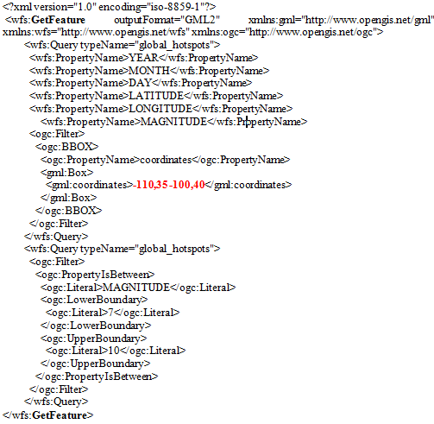
Sample GetFeature request to get feature data (GML) from WFS.
-110,35,-100,36
GFeature-1
-110,36,-100,37
GFeature-2
-110,37,-100,38
GFeature-3
-110,38,-100,39
GFeature-4
-110,39,-100,40
GFeature-5
Partition list as bbox values for sample case :
- Pn=5
- Main query getMap bbox 110,35 -100,40

Slide 54
Map rendering from GML
B
WMS
Converting objects into image
Plotting geometry
elements over the layer
Parsing and extracting geometry elements
Binary map image
GML
Notes:
Image conversion time in Figure is for resolution 400x400 in pixel.
Sample image conversion values are for JPEG creation
Average conversion time:25.43msec
Image conversion time changes based on
map images’ user-defined resolution values
Requested image format such as JPEG.

Slide 55
Interoperability Requirements on Geo-data
Geo-data is stored in various formats by heterogeneous autonomous resources.
Encoded as GML: Enables data to be carried with their attributes – content and presentation
Integrated to the system through WFS-based mediation
  Standard service interfaces accepting standard queries.
  GetFeature: Querying the data
Queried using its location attribute (bounding box) and other data-specific attributes
  Ex. earthquake data: magnitude of seismic activity and date event occurred.
Notes:
The range queries are intersections of ranges defined on attributes.

Slide 56
Standard Query (GetFeature)
<?xml version="1.0" encoding="iso-8859-1"?>
<wfs:GetFeature outputFormat="GML2" xmlns:gml="http://www.opengis.net/gml" >
<wfs:Query typeName="global_hotspots">
<wfs:PropertyName>LATITUDE</wfs:PropertyName>
<wfs:PropertyName>LONGITUDE</wfs:PropertyName>
<wfs:PropertyName>MAGNITUDE</wfs:PropertyName>
<ogc:Filter>
<ogc:BBOX>
<ogc:PropertyName>coordinates</ogc:PropertyName>
<gml:Box>
<gml:coordinates>-124.85,32.26 -113.36,42.75</gml:coordinates>
</gml:Box>
</ogc:BBOX>
</ogc:Filter>
</wfs:Query>
<wfs:Query typeName="global_hotspots">
<ogc:Filter>
<ogc:PropertyIsBetween>
<ogc:Literal>MAGNITUDE</ogc:Literal>
<ogc:LowerBoundary>
<ogc:Literal>7</ogc:Literal>
</ogc:LowerBoundary>
<ogc:UpperBoundary>
<ogc:Literal>10</ogc:Literal>
</ogc:UpperBoundary>
</ogc:PropertyIsBetween>
</ogc:Filter>
</wfs:Query>
</wfs:GetFeature>
Corresponding SQL query:
Select LATITUDE, LONGITUDE, MAGNITUDE from Earthquake-Seismic where
-124.85 < X < -113.36 & 32.26 < Y < 42.75
& 7 < MAGNITUDE < 10
Notes:
SQL queries are created from these attributes and their constraint range values

Slide 57
Geo-data Characteristics
Unexpected workload distribution: The work is decomposed into independent work pieces, and the work pieces are of highly variable sized
Geo-data
  un-evenly distributed
  variable sized
according to their locations attributes.
  Ex. Human population and earthquake-seismicity data
Queried/displayed/analyzed based on range queries built on location attribute
  Location is a point described with (x, y) coordinates.
  2-dim range query: Rectangle defined in bounding box
(c,d)
(c, (b+d)/2)
(a,b)
((a+c)/2, b)
Geo-data is mostly represented as large sets of points, chains of line-segments, and polygons.
Notes:
Geo-data characteristics illustrate efficient load balancing and un-expected workload sharing problems in distributed computing

Slide 58
Why Capability Metadata
Web Services provide key low level capability but do not define an information or data architecture
These are left to domain specific capabilities metadata and associated data description language (GML).
Machine and human readable information
  Enables easy integration and federation
Enables developing application based standard interactive re-usable tools
  for data query display and analysis
  Seamless data/access/query
Notes:
4.bullet: Dynamic upgrading user interfaces
Ex. interactive map tools

Slide 59
Architecture Summary
Fine-grained dynamic information presentation
  Heterogeneous data sources are queried as a single resource
  Integrated data-view in multi-layered map images
  No burden of accessing data source with ad-hoc queries.
  Interactive feature based querying besides displaying the data
Just-in-time or late-binding federation
  Data always is kept at its originating resource
  Autonomous local resources -Easy data-maintenance
Interoperable and extendable
  Open Geo-Standards are integrated with Web Service principles.
Notes:
Remove
Fine-grained dynamic information presentation through a federation framework enabled us heterogeneous data sources to be queried as a single resource over integrated data-view in multi-layered map images
Autonomous local resources -controlling definition of data
Attribute-based querying and interaction over integrated data-views in multi-layered map images.
Integrated data views are multi-layered map images composed of distributed standard GIS Web Service components.

Slide 60
Streaming data transfer
XML Encoding: Size of the geospatial data increases with GML encoding which increases transfer times, or may cause exceptions
SOAP message creation overhead
Strategies: Streaming data flow extensions to GIS Web Services
  Web Service -as a handshake protocol.
  Data is transferred over publish-subscribe messaging systems.
  Enables client to render map images with partially returned data
Extension
client
WMS GML rendering
Subscriber
GML
(topic, IP, port)
Narada Brokering Server
GetFeature
Topic,IP,port
1
2
W S D L
WFS
Publisher
GML
server
DB
Notes:
1.2. stateless: needs to complete whole response to transfer transaction. But it might causes memory exception to create whole GML response.
Initial problems regarding data transfer and rendering in GIS developed in accordance with Open Standards
HTTP based query/response does not allow large scale data move
Rendering large scale XML data with common xml processors had some problems such as mem exception
The streaming technique is commonly used in transmitting multimedia contents. For web browsing images, streaming is not very crucial; the required number of pixels will be limited by the web browser’s screen size.

Slide 61
Related Work
-Parallel data access/query optimization-
Map Reduce (application of cluster computing):
  Motivation: Large scale data processing, Job parallelization
  Based on two main functions:
    Map: Like partitioning the workload
    Reduce: Like combining the responses to partitions.
  Motivating domain: Web pages (in billions)
  Implementation: Hadoop:
    Putting the files in distributed nodes and making search of words in parallel
WT not only partitions the work to workers but also takes the un-evenly shared workloads into consideration.
WT enables adapted computing
Notes:
Borrows the terms “map and reduce” from functional programming
map (in_key, in_value) -> (out_key, intermediate_value) list
reduce (out_key, intermediate_value list) -> out_value list
If the application is doing a word count, the map function would break the line into words and output the word as the key and 1 as the value
Map:
Records from the data source (lines out of files, rows of a database, etc) are fed into the map function as key*value pairs: e.g., (filename, line)
map() produces one or more intermediate values along with an output key from the input
Reduce:
After the map phase is over, all the intermediate values for a given output key are combined together into a list
reduce() combines those intermediate values into one or more final values for that same output key
(in practice, usually only one final value per key)
Hadoop: By distributing the data, Hadoop can process it in parallel on the nodes where the data is located
Hadoop implements MapReduce, using the Hadoop Distributed File System (HDFS) (see figure below.) MapReduce divides applications into many small blocks of work. HDFS creates multiple replicas of data blocks for reliability, placing them on compute nodes around the cluster. MapReduce can then process the data where it is located

Slide 62
Integrated data-view
Query heterogeneous data sources as a single resource
  Heterogeneous: local resource controls definition of the data
  Single resource: remove the burden of individually accessing each data source
  Seamless interaction with the system
No real integration of data
  Data always at local source
  Easy maintenance of data
Client/User-Query
Integrated View
Display &
Federation
services
Federator
XML-encoded common data model
Carrying data and display information
Standard data components
Mediator
Mediator
Mediator
DB
DB
DB
Data in files, HTML, XML/Relational Databases, Spatial Sources/sensors
Notes:
And Quality of services

