Slide 1
High-Performance Federated and
Service-Oriented
Geographic Information Systems
Ahmet Sayar
(asayar@cs.indiana.edu)
Advisor: Prof. Geoffrey C. Fox
Notes:
Today's presentation is on my research topic – High …….systems.

Slide 2
Outline
Motivations
Research Issues
Architecture: Federated Service-Oriented Geographic Information System
Performance enhancing designs - measurements and analysis
Conclusions
Notes:
I will be addressing these factors in today's presentation ( wait sometime so they can read).

Slide 3
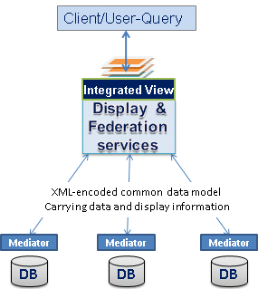
Introduction
Distributed service arch for managing the production of knowledge from distributed collection of data via integrated data-views.
Integrated data-views are defined by a “federator” located on top of the standard data components
  Components
    Web Services
    Translate information into a common data model
  Federator
    Combines information from several resources (components)
    Allows browsing of information
    Manages constraints across heterogeneous sites
Federator-oriented distributed data access/query optimization.
Mediators: Standard Web Service components with standard service interfaces
Notes:
After defining such a framework we investigate ….

Slide 4
Motivations
Necessity for sharing and integrating heterogeneous data resources to produce knowledge
  Problems in data and storage heterogeneities
  Burden of individually accessing each data source
Data access/query do not scale with data size
  Distributed nature of data and ownership
  Interoperability/compliance costs: Accessing heterogeneous and autonomous data sources
  Information systems require interactive queries involving large data movement, processing and rendering in a responsive manner
Notes:
1.
The internet and its associated web programming models have revolutionized accessibility to data/information sources.
To be able to produce knowledge from these data resources, they need to be shared, integrated and federated.
In order to be able to integrate the data/information, they need to be interoperable and provided with standard service interfaces.
However, in the real world, data is kept in different formats and stored in numerous incompatible storages and provided by heterogeneous systems and internet protocols.
These heterogeneity issues have been studied by open standards bodies. They propose online services and common data model mostly XML-structured.
Because of the interoperability and compliance costs and common problems with distributed nature of data and ownership issues, accessing/querying the data does not scale with data size.
2.
GIS applications require quick response
Emergency early warning systems
Home-land security and natural disasters.

Slide 5
Research Issues
Interoperability
  Adoption of domain specific Open Standards -data model and services
  Integrating Web Service and Open Standards
    Creating a Service Oriented Architecture (SOA) for data Grid and enabling it to be integrated to Science Grids
Federation
  Querying heterogeneous data sources as a single resource
  Unified data access/query and display from a single access point through integrated data-views
  Capability metadata federation of standard Web Service components
Performance: Data access/query optimizations
  Adaptive load balancing and unpredictable workload estimation for range queries
  Parallel data access/query via attribute-based query decomposition
Notes:
Under those motivations we will address these research issues throughout the presentation
We also investigate a federation framework over the standard web servi
Use the words “investigate”, research, etc.
There are three general issues here.
Capability metadata for each different group of components are defined by Standards
We define aggregated capability enabling hierarchical data definition in multi-layer format.
how to integrate different source schemas
how to answer to the queries posed on the global schema
mapping of common data model to a display model enabling integration/overlaying with other data sets (integrated data-view)
Investigate how to handle query/response over federated dispersed autonomous OGC data services referenced in aggregated capability metadata in metadata
3. federator-oriented data access/query optimization for distributed map rendering

Slide 6
Geographic Information Systems (GIS)
GIS is a system for creating, storing, sharing, analyzing, manipulating and displaying geo-data and associated attributes.
  Distributed nature of geo-data; various client-server models, databases, HTTP, FTP
Modern GIS requires
  Distributed data access for spatial databases
  Utilizing remote analysis, simulation or visualization tools
  Analyses of spatial data in map-based formats
Feature enriched multi-layer maps. Each feature data is collected from distributed resources and rendered an overlaid
Notes:
2. Over the past two decades, GIS has evolved from traditional centralized mainframe and desktop systems to collaborative distributed systems.
2.The nature of the geographical applications requires seamless integration and sharing of spatial data from a variety of providers.
3. Decision making in Geographic Information Systems (GIS) increasingly…
Maps are complex structures composed of layers created from distributed heterogeneous data sources.
FROM DIFFERENT DISCIPLINES AND SKILL/EXPERT Areas.
GIS requires data and computation resources from distributed virtual organizations to be composed based on application requirements, and accessed and queried from a single uniform access point over the refined data with interactive display tools. This requires seamless integration and interaction of data and computation resources. The resources span organizational disciplinary and technical boundaries and use different client-server models, data archiving systems and heterogeneous message transfer protocols.

Slide 7




OGC’s Interoperability Standards
Open Geospatial Consortium (OGC) solves the semantic heterogeneity by defining standards for services and the data model
  Web Map Services (WMS) - rendering map images
  Web Feature Services (WFS) – serving data in common data model
  Geographic Markup Language (GML) : Content and presentation
Domain specific capability-metadata defining data/service
Database
Adaptor/wrapper
Rendering Engine
Display Tools
Street Data
Street Layer
WFS (mediator)
GML
WMS GML rendering
Binary data
Notes:
In order to provide interoperable and extensible GIS framework, we adopted domain-specific standard specifications for data model and online-services from OGC.
WMS and WFS are two major services defined by OGC for creating a basic GIS framework enabling information rendering of heterogeneous data sources as map images.

Slide 8
Open Geographic Standards
Open GIS Standards bodies aim to make geographic information and services neutral and available across any network, application, or platform
Two major standards bodies: OGC and ISO/TC211
Obstacles in adopting OGC standards to large scale Geo-science applications
  OGC Services are HTTP GET/POST based; limited data transport capabilities.
  Request-response type services; centralized, synchronous applications
Notes:
HTTP is a request/response standard between a client and a server. A client is the end-user, the server is the web site
Typically, an HTTP client initiates a request. It establishes a Transmission Control Protocol (TCP) connection to a particular port on a host (port 80 by default. An HTTP server listening on that port waits for the client to send a request message. Upon receiving the request, the server sends back a status line, such as "HTTP/1.1 200 OK", and a message of its own
The reason that HTTP uses TCP and not UDP is because much data must be sent for a webpage, and TCP provides transmission control, presents the data in order, and provides error correction

Slide 9
Service oriented GIS
To create a GIS Data Grid Architecture we utilize
  Web Services to realize Service Oriented Architecture
  OGC data formats and application interfaces to achieve interoperability at both data and service levels
  Extensions to Open GIS Standards (to integrate with Web Services principles)
From HTTP GET/POST to SOAP based message descriptions and Service descriptions in WSDL
  Makes applications span cross-language, platform and operating systems
  Enables integration of Geo-science Grid applications with data services
  Allows orchestration of services and workflow.
2. Streaming data transfer capabilities: Utilization of publish/subscribe based messaging middleware
  Removes the burden of SOAP message creation overhead
  Overlaps the data conversion and transfer times
  Enables map-image rendering with partially returned data
Notes:
1.We have built a Service-oriented GIS data grid by utilizing…
2. Because of the obstacles in adopting OGC standards to large scale geo-science grid applications, we extended …
Web Service: "a software system designed to support interoperable machine to machine interaction over a network.
By web services, we mean the self-contained, web-enabled applications capable not only of performing business activities on their own but also processing the ability to engage other web services in order to complete higher-order transactions.
2.XML Encoding: Size of the geospatial data increases with GML encoding which increases transfer times, or may cause exceptions
SOAP message creation overhead
Strategies: Streaming data flow extensions to GIS Web Services
Web Service -as a handshake protocol.
Data is transferred over publish-subscribe messaging systems.
Enables client to render map images with partially returned data
A key difference between CORBA and the Web service technologies (UDDI/WSDL/SOAP) is that CORBA provides a true object-oriented component architecture unlike the Web services, which are primarily message based (SOAP, despite its name, does not really deal with objects). Moreover, CORBA also comes with a standard set of services (Events, Naming, Trading) that allow application writers to focus on the business logic rather than on the details of the communication infrastructure. Comparing this with the ongoing work on Web service technologies, we are forced to ask the question: are we reinventing the wheel?
For Web services, the preferred transport protocol is SOAP over HTTP. Because HTTP is the ubiquitous Web protocol with a well-defined port, firewalls are usually configured to allow inbound and outbound HTTP traffic, thus enabling SOAP messages to cross firewall boundaries easily. The presence of Web service does not require any change in the firewall configuration. SOAP over secure HTTP (using SSL) is handled in the same way

Slide 10
Federating Standard GIS Web Services
For managing the production of knowledge from distributed data sources via integrated data-views in the form of multi-layered map images
Based on common data model, OGC compatible standard GIS Web Service components and a federator.
Since the standard GIS Web Services have standard service API and capability metadata, they can be composed by aggregating their capabilities.
Capability is a type of metadata (OGC defined)
Service/data federation through a Federator :
  Collects/harvest domain specific standard capabilities
  Provides global view over distributed data sources
  Enables heterogeneous data sources to be integrated to Geo-science Grid applications -single point of access through the standard Web Service interfaces
Notes:
Old title: Capability Aggregation for Service/data federation (think about this)
After defining service oriented GIS over the Open GIS standards:
We proposed a federation framework for ...
Ex: Dublin Core and OAI-PMH (Open Archives Initiative Protocol for Metadata Harvesting) in digital libraries domain
(Dublin Core - RDF) - (Capability - GML) [relation mappings]
Dublin core: An attempt to improve resource discovery on the Web - now adopted more broadly
15 elements for descriptive metadata: Title, creator, subject, description, publisher, date, type, source, format etc. - looks like end node.
Dublin Core vs RDF (defined by W3C) - Capability vs GML
RDF and GML Imposes structural constraints on the expression of application data models for consistent encoding, exchange and processing of metadata
Usage is different: dc elements for resource description is embedded in rdf documents. In GML-capability case: capability utilizes the semantics of GML elements.
Dublin core is an application of RDF data model
Dc:date -> rdf:value

Slide 11
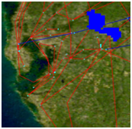
Federation Framework
Phase-1: (Setup) Creation of aggregated capability:
  Represents application-based hierarchical data-layer composition.
  Capabilities are collected via standard service interface
  Provides single view of federated sources
Phase-2: (Run time) Unified data query over integrated data-views.
  Layers from WMS (as map images) and WFS (as GML)
  On Demand Data Access: There is no intermediary storage of data.
Federator:
  Provides one global view over several data sources that are processed as one source
  Orchestrating/synchronizing requests and responses
Aggregated Capability
a. NASA satellite layer
Integrated data-view: b over a
a
WMS
JPL at California
a
b
Federator
Event-based
Interactive Map-Tools
b
wsdl
WFS
Browser
Browser
Browser
b
b
b. Earthquake-seismic data
a
a
WFS
Events:
- Move,
- Zooming in/out
- Panning (drag-drop)
- Rectangular region
- Attribute querying
Display/federation services
CGL at Indiana
Notes:
Federator is actually an extended WMS provides one global view over several data sources that are processed as one source.
aggregating capability metadata from distributed standard GIS services and orchestrating/synchronizing requests and responses over the composition of data services referenced
There are three general issues here. The first is the data modeling (how to integrate different source schemas); the second is their querying (how to answer to the queries posed on the global schema); and the third is the common presentation model of data sources, i.e. mapping of common data model to a display model enabling integration/overlaying with other data sets (integrated data-view).
Enables users to query the map images based on their attributes and features

Slide 12
Federation Through Capability Aggregation
Capability: Machine and human readable information, enables easy data/service integration
Web Services provide standard key low level capability, but don’t define domain specific data/service descriptions.
Information/data architecture are defined in domain specific capability metadata (and associated data description language (GML)).
Quality of services
  Single point of access: No burden of accessing data source with ad-hoc queries
  Fine-grained dynamic information presentation
  Enables more complex information creation by leveraging multiple data sources
  Provides stateful access/query over stateless data services
  Interoperable and extendable
Just-in-time or late-binding federation
Notes:
Fine-grained dynamic information presentation
Heterogeneous data sources are queried as a single resource
Integrated data-view in multi-layered map images
No burden of accessing data source with ad-hoc queries.
Interactive feature based querying besides displaying the data
5. Data always is kept at its originating resource
Autonomous local resources -Easy data-maintenance
A map is application-based, human-recognizable, integrated data display and is composed of layers. A layer is a data rendering of a single homogeneous data source. Layers are created from the structured XML-encoded common data model (GML) or binary map images (raster data). Heterogeneous data sources (raw data) are integrated to the system as GML or binary map images through the resource specific mediators. The mediators have resource specific adaptors for request and response conversions and appropriate capability metadata describing the data and resources.
The federator enables state-full service access over the stateless GIS Web Service components, and results in better performance for responsive GIS systems.

Slide 13
Federator-oriented data access/query optimization for distributed map rendering
Notes:
.. for high-performance support in distributed map rendering.
Federated spatial database display
We propose federator-oriented data …optimization techniques for distributed map rendering

Slide 14
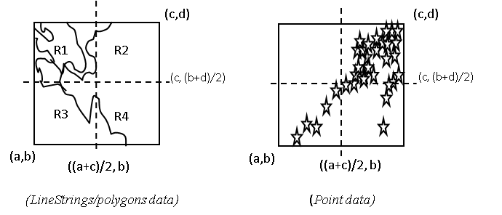
Performance Investigation
Interoperability requirements’ compliance costs
  Using XML-encoded common data model (GML)
  Using Web Services’ XML-based standard SOAP protocol
  Costly query/response conversions at data resource (ex. WFS)
    XML-queries to SQL
    Relational objects to GML
Variable-sized and unevenly-distributed nature of geo-data
    Example: Human population and earthquake-seismicity data
    NOT easy to perform load-balancing and parallel processing
>> Unexpected workload distribution: The work is decomposed into independent work pieces, and the work pieces are of highly variable sized
Notes:
In addition to distributed nature of the data and common problems with large data movement,…
GIS is mostly used in early warning systems, interactive real-time applications , It requires quick response times. But because of the distributed nature of data and interoperability requirements’ cost, it is not easy to develop a responsive interactive information systems.
0- distributed nature of data:
Data and the computational resources are naturally distributed
Large data volumes make it impossible to put all geospatial data into one big data center.
Decision making requires these distributed heterogeneous data sources to be shared, and represented/rendered to extract useful knowledge
1-using semi-structured data model:
OGC recommends using GML data. GML carries content and the presentation tags together with the core data.
That enables the data sources to be queried and displayed together
Those resulting XML representations of data tend to be significantly larger than binary representations of the same data.
The larger document size means that the greater bandwidth is required to transfer of data, as compared to the equivalent binary representations.
2- There are also some characteristics of geo-data that make it difficult to design a distributed GIS with satisfactory performance.
Services provided by a GIS requires heavy CPU usage due to the complex computation involved in the underlying computational geometry.
GIS services often transmit large resulting data sets such as images

Slide 15
Adaptive Range Query Optimization
Data is defined and queried in ranges (location)
Dynamic nature of data
Query approximation problem
Optimal partitioning of data is difficult to achieve because polygons-points-linestrings are neither distributed uniformly nor of similar size
  The load they impose varies, depending on query range
  It is difficult to develop a fair partitioning strategy that is optimal for all range queries
Notes:
We address those issues by focusing on adaptive range query optimization …

Slide 16
Parallel Range Queries
Interactive
Client Tools
(x’,y’)
R1
R2
Federator
(WMS)
Federator
(WMS)
(x’, (y+y’)/2)
[Range]
R3
R4
[Range]
(x,y)
1. Partitioning into 4
(R1), (R2), (R3), (R4)
((x+x’)/2, y)
3. Merging
Main query range:
[Range] = (R1)+(R2)+(R3)+(R4)
Single Query Range:[Range]
2. Query Creations
Q1, Q2, Q3, Q4
Q
WFS
Queries
WFS
WFS
WFS
Responses
DB
DB
Straight-forward
Parallel fetching
Notes:
In order to optimize a range query the commonly known way is the decomposing the range and making parallel queries instead of sending one large range.
Seems like a natural solution, but geo-data is variable sized and unevenly distributed.
It does not guarantee even-workload sharing.

Slide 17
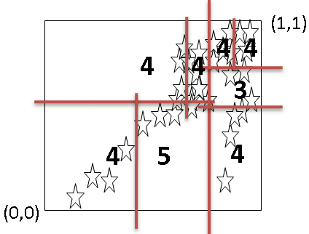
Workload Estimation Table (WT)
Aim: Cutting the 2-dimensional query ranges into smaller pieces with approximately equal query sizes.
Created once and synchronized/refined routinely with DB
Consideration of data dense/sparse regions
Each layer-data has its own distribution characteristics and WT
WT is consisted of <key, value> : <bbox, size> pairs.
  size ≤ pre-defined threshold query size
Lets illustrate this with a sample scenario
  Whole data range in database is (0,0,1,1) and 32MB of data size
  Each ‘ ’ corresponds to 1MB and
  Max query size for each partition is 5MB (max 5 ‘ ’ in each partition)
Whole data in Database
(1,1)
(1,1)
4
8
WT consists of <key, value>
key: rectangle
value: query-size
4
8
4
4
3
32
15
17
7
4
5
4
9
(0,0)
(0,0)

Slide 18
WT Creation/refinement
- Two-level recursive binary cuts -
(maxx,maxy)
  PT(R, t, er) = PT(R₁, t, er) + PT(R₂, t, er)
    t: The max value of acceptable query size for a partition
    er (error rate) : The max acceptable degree of fluctuations in partitions query sizes
    er = [size(R1)-size(R2)] / size(R₂)
  PT(R, t, er) {
    [(R₁,size₁):(R₂,size₂)] = PTInBalance(R, er)
    If ((size₁ or size₂)≤ t) /*(sizes are almost the same)*/
      Put the partitions into memory/disk as pairs
        <R₁, size₁>
        <R₂, size₂>
      And return;
    else
      PT(R₁,t,er); PT(R₂,t,er)
    }
PTInBalance(R, er){
  current_er = 1;
  l = minx
  r = maxx
  While(current_er > er){
    mp = (l+r)/2
    R₁ = minx, miny, mp, maxy /*R=R₁+R₂*/
    R₂ = mp, miny, maxx, maxy
    gml₁ = getData(R₁)
    gml₂ = getData(R₂)
    If(gml₁>gml₂); {r = mp}
    else {l = mp}
    current_er = (size(gml₁)-size(gml₂)) / max[size(gml₁), size(gml₂)]
    }
    return [(R₁,size(gml₁)):(R₂,size(gml₂))]
    }
/*Like finding out center of gravity*/
R₁
R₂
(minx,miny)
mp = (minx+maxx)/2
Remote data access to find out the data size for the corresponding range/partition
(maxx,maxy)
R₁
R₂
(minx,miny)
mp = (minx+maxx)/2
Notes:
PSUODOCODE OLARAK YAZ……

Slide 19
WT Utilization in Parallel Queries
Lets say federator gets a query whose range is R
R is positioned in the WT to see the most efficient partitions for parallel queries
(1,1)
R overlaps with: p₅, p₆, p_{7,} p₈, p_{9,} and p₁₀
Instead of making one query in range R;
  Make 6 parallel queries:
    p₅, p₆, p_{7,} p₈, r₁ and r₂
    R = p₅+p₆+p₇+p₈+r₁+r₂
There are still minor fluctuations
  Inevitable partial overlapping (r₁ and r₂)
p₂
p₁
p₄
p₁₂
p₃
p₆
R
p₅
p₈
p₉
p₇
r₂
r₁
p₁₁
p₁₀
(0,0)
WT (reflects the distribution characteristics of data in DB)

Slide 20
Performance Evaluation over the Streaming GIS Web Services
How do the #of WFS and #of partitions together affect the performance?
When the WFS number is kept same, how does the partition-threshold size in WT affect the #of parallel queries and the performance?
Performance is evaluated with earthquake seismic data kept in relational tables in MySQL database
Servers/nodes are deployed on 2 (Quad-core) processors running at 2.33 GHz with 8 GB of RAM.
NB
Federator/WMS
NB
Earthquake seismic data (130MB in GML)
WFS
WFS
DB
S
P
DB
Partitioned main query
P
S: Subscriber
P: Publisher
NB: NaradaBroker (publish/subscribe-based data streaming over a topic)
Notes:
It is not like plain http connection
Single subscriber multiple NB for each WFS

Slide 21
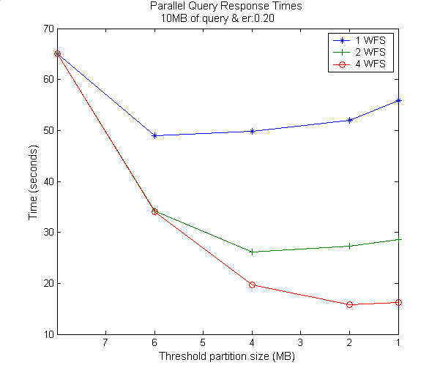
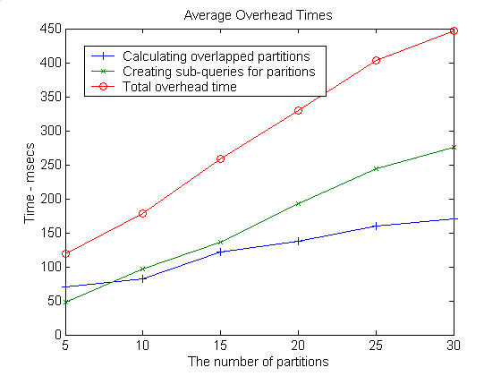
i
Avg. #of partitions
2.2
4.6
8.5
16.9
No prt
Figure shows how #of parallel queries affects the response times together with #of WFS
For the same query size (10MB) using different WT created with different “threshold partition size”
– The average values of 10 different query regions/ranges and each query is 10MB in size
- Without partitioning (single query); it takes average 64.51 seconds
- As the threshold partition size decreases, the number of partitions/parallel-queries increases (X-axis)
Notes:
WT built with different thr sizes give different #of partitions for the same query ranges
Speed up increases as the partition number increases and then increase rate decreases.
The initial increase is due to improved load balance by reducing the effect of fluctuation in partitions’ loads,
and the decrease is due to the non-parallelizable overheads and limited number of clusters.
1 2 4
6mb 49.0 34.2 34.1 avg:2prts
4mb 49.82 26.2 19.7 avg:4prts
2mb 52 27.3 15.8 avg:8pts
1mb 56.9 29.6 14.6 avg:16prts
2-cpu var 1WFS icin mesela 2 kat artmasi lazim ama degil ???
Cunku prt size 6 iki prt bile olsa prt size lari esit degil – partial overlapping.
Thr prt size kuculdukce surrenden prt artar ve esit yuk dagilimi artar.
Overhead times:
Avg. sub-query creation time for a particular partition: 10.89 msec
Merging the results: It is done in parallel and that does not effect performance – asynchronous run
I/O and cpu jobs run together.

Slide 22
Summary & Related Work
We parallelized the range queries by using data partitioning (to reduce synchronization) and dynamic load balancing (to improve speedup)
Success of the parallel access/query is based on how well we share the workload with worker nodes.
WT not only decomposes the work to workers, but also takes the un-evenly shared workloads into consideration.
WT enables adapted computing
Science.gov (government science portal)
  Federated search technology—simultaneously executing a query against an array of databases, then aggregating the results
  Gives users a single entry point for searching science portals in parallel with only one query
Hadoop :
  Puts the files in distributed nodes and makes the search in parallel
  Searching a sentence by partitioning into words
Notes:
Science.gov provide an information infrastructure that would span and transcend institutional boundaries
Hadoop: By distributing the data, Hadoop can process it in parallel on the nodes where the data is located
Hadoop implements MapReduce, using the Hadoop Distributed File System (HDFS) (see figure below.) MapReduce divides applications into many small blocks of work. HDFS creates multiple replicas of data blocks for reliability, placing them on compute nodes around the cluster. MapReduce can then process the data where it is located

Slide 23
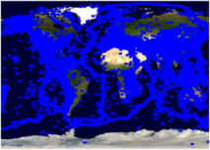
Test Setup: Overall performance evaluation
Test Data
  NASA Satellite maps image from WMS (at California NASA JPL)
  Earthquake Seismic data from WFSs (at Indiana Univ. CGL Labs)
Setup is in LAN
  gf12,17,18,19.ucs.indiana.edu.
  2 (Quad-core) processors running at 2.33 GHz with 8 GB of RAM.
WMS
NASA Satellite Map Images
JPL California
Binary map image
GetMap
1
Event-based dynamic map tools
Federator
Binary map image
GML
WFS-1
DB1
Replicated WFS and DBs
Browser
2
2
1
..
Earthquake Seismic records
1: NASA satellite
map images
2: Earthquake-
seismic records
CGL
Indiana
WFS-4
DB5
2
Notes:
Throughout the performance slides, we will be working on two-layers for simplicity.
These are the layers actually used in real geo-science applications Pattern Informatics and Virtual California
Performance enhancing design techniques are mostly focusing on XML-encoded common data model (GML) handling (transfer/rendering/display)
In this sense, GML data is fetched, rendered and overlaid on NASA satellite map images which is shown as layer 2 in the figure.
Binary map images are fast enough to access and display. Because there is no need burdening query and data conversion as it is done for GML.
We also have integrated and used Google Map as base map layer to overlay GML data. But not shown here.
Intel Xeon processors running at 2.33 GHz with 8 GB of memory and operating Red Hat Enterprise Linux ES release

Slide 24
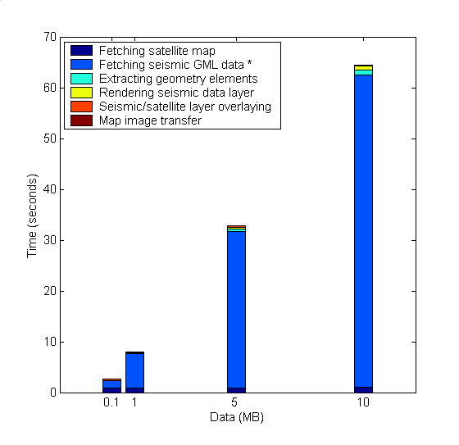
Baseline System Tests
Binary map image
WMS
1.NASA Satellite Map Images
1
Event-based dynamic map tools
Federator
Browser
Binary map image
GML
WFS
DB
2.Earthquake seismic data
2
2
1
(d). Average response time
(b). Map rendering time
(a). Query/response conversions & data transfer
(c). Map image transfer time
b
d
(a)
Notes:
Measurement of success and speedups are evaluated relatively.
We see the data providers as black boxes.
*X-Coordinates and selected ranges:*
-We assume that the requested queries are for 0.1 1 5 and 10 MB
-Data sizes are selected to show the system’s behavior against the dramatically changing values..
*Analysis:*
The system does not scale with data sizes because of ‘(a)’.
Response time is the linear function of data sizes.

Slide 25
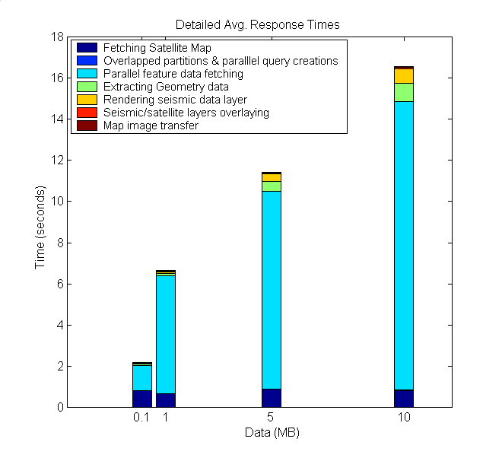
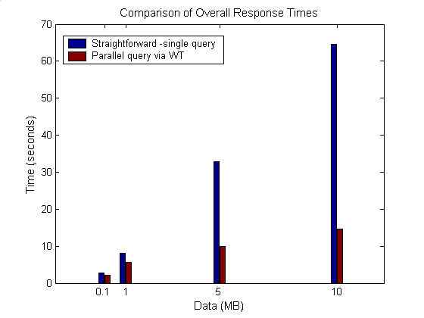
Parallel Processing Through WT
WT is created with 1MB of threshold partition query size and .20 error rate
Average of 10 different query ranges
Notes:
We enhanced system performance bottleneck by adopting optimized parallel query approach given earlier whose WT is created with …

Slide 26
Summary & Conclusions
Modular: Extensible with any third-party OGC compliant data service.
Enables the use of large data in Geo-science Grid applications in a responsive manner.
Streaming data transfer technique allows data rendering even on partially returned data.
Federator’s natural characteristic allows advanced caching and parallel processing designs.
  Inherently layers from separate data sources
  Individual layer decomposition and parallel processing
Notes:
Queries are consisted of the limited number of ranges
Bounding boxes defining locations of data
Other ranges are handled with application specific X-Path queries.
By using conventional communication networks, storage and computation resources, we obtained high degree of responsiveness.

Slide 27
Contributions
Proposed and implemented a SOA architecture to provide a common platform to integrate Geo-data sources into Geo-science Grid applications seamlessly.
  Integrating Web Services with Open Geographic Standards to support interoperability at both data and service levels
Federated Service-oriented GIS framework
  Distributed service arch to manage production of knowledge as integrated data-views in the form of multi-layer map images
    Hierarchical data definitions through capability metadata federations
    Unified interactive data access/query and display from a single access point.
Federator-oriented data access/query optimization and applications to distributed map rendering
  Dynamic load balancing for sharing unpredictable workload
  Parallel optimized range queries through partitioning
  Utilization of a publish/subscribe messaging system for high performance data transfer
Notes:
Stateless GIS components are interacted in a stateful way through federators
Investigated performance efficient designs and did detailed benchmarking

Slide 28
Contributions (Systems Software)
Web Map Server (WMS) in Open Geographic Standards
  Extended with Web Service Standards, and
  Streaming map creation capabilities
GIS Federator
  Extended from WMS
  Provides application-specific and layer-structured hierarchical data as a composition of distributed GIS Web Service components
  Enables uniform data access and query from a single access point.
Interactive map tools for data display, query and analysis.
  Browser and event-based
  Extended with AJAX (Asynchronous Java and XML)

Slide 29
Acknowledgement
The work described in this presentation is part of the QuakeSim project which is supported by the Advanced Information Systems Technology Program of NASA's Earth-Sun System Technology Office.
Galip Aydin: Web Feature Server (WFS)

Slide 30
Thanks!....

Slide 31
BACK-UP SLIDES

Slide 32
Possible Future Research Directions
Integrating dynamic/adaptable resources discovery and capability aggregation service to federator.
Applying distributed hard-disk approach (ex. Hadoop) to handle large scale of workload estimation tables
Layered WT for different zoom levels
  Avoiding from unnecessary number of parallel queries
Extending the system with Web2.0 standards
Handling/optimizing multiple range-queries
  Currently we handle only bbox ranges

Slide 33
Integrated data-view
Multi-layered Map images
Query heterogeneous data sources as a single resource
  Heterogeneous: local resource controls definition of the data
  Single resource: remove the burden of individually accessing each data source
Easy extension with new data and service resources
No real integration of data
  Data always at local source
  Easy maintenance of data
Seamless interaction with the system
  Collaborative decision makings
Client/User-Query
Integrated View
Display &
Federation
services
GML
GML
WMS
WFS
WFS
Mediator
Mediator
Mediator
DB
Files
WWW
Data in files, HTML, XML/Relational Databases, Spatial Sources/sensors
Notes:
And Quality of services

Slide 34
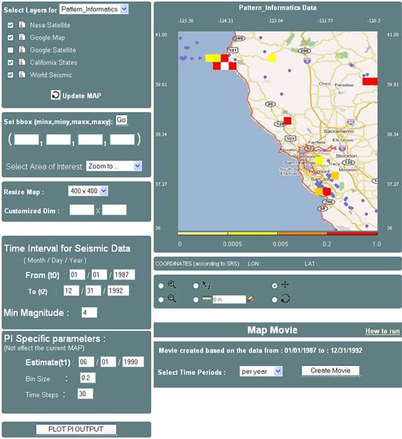
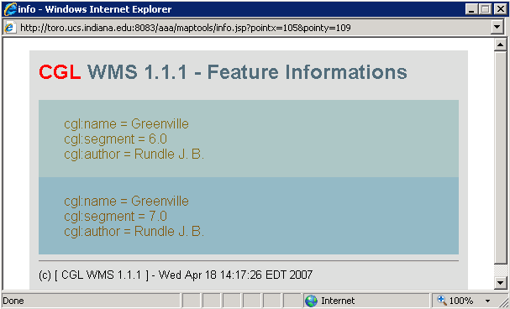
Hierarchical data
Integrated data-view
1
2
3
1: Google map layer
2: States boundary lines layer
3: seismic data layer
Event-based Interactive Tools :
Query and data analysis over integrated data views
Notes:
Since common data model based on content and presentation
We can also further query the data layers based on their attributes
Presentation tags are used for displaying.
Interactive Information Visualization tools provide researcher with remarkable capabilities to support discovery. By combining powerful data mining methods with user-controlled interfaces, users are able to benefit distributed heterogeneous data sources (access/attribute-based-query/display) from a single access point.
Users can begin with an overview, zoom-in on areas of interests, filter-out un-wanted items/layers, and click for details-on-demand.
With careful design and efficient algorithms, OGC provided data-layers can be enriched with some other data and/or processing resources.

Slide 35
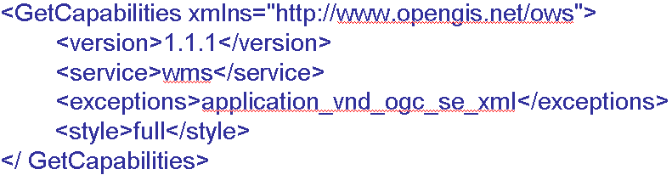
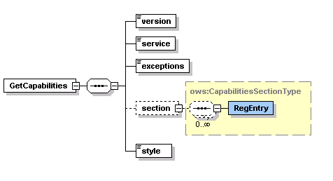
GetCapabilities Schema and Sample Request Instance

Slide 36
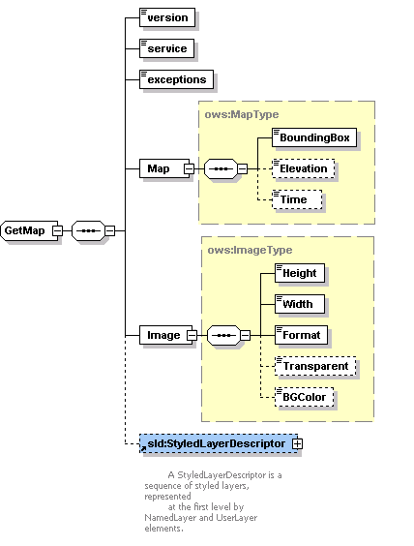
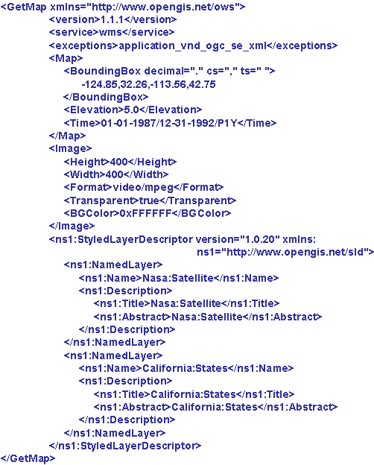
GetMap Schema and Sample Request Instance

Slide 37
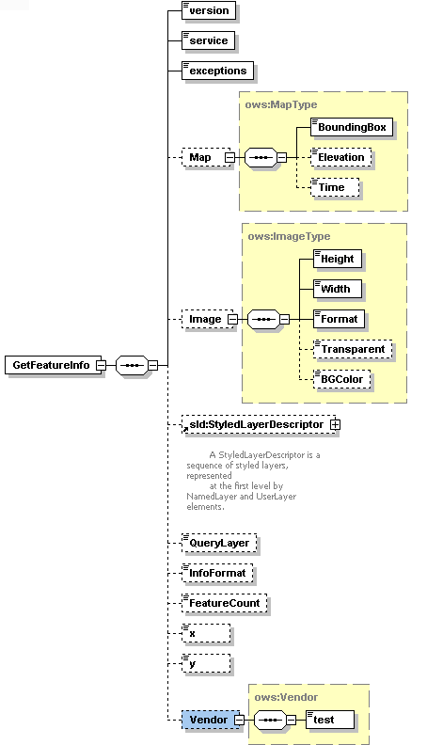
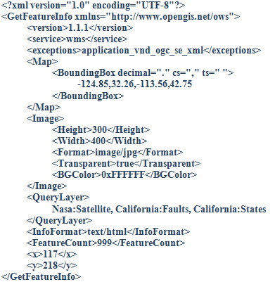

Slide 38
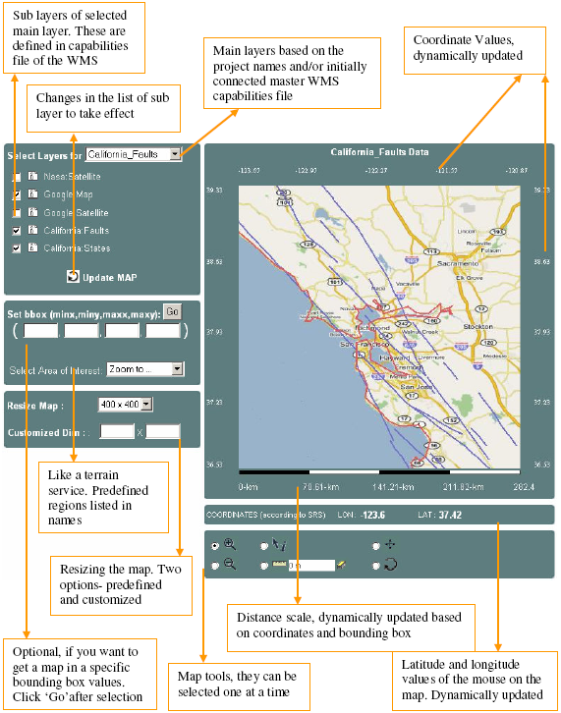
Event-based Interactive Map Tools
<event_controller>
  <event name="init" class="Path.InitListener" next="map.jsp"/>
  <event name="REFRESH" class=" Path.InitListener " next="map.jsp"/>
  <event name="ZOOMIN" class=" Path.InitListener " next="map.jsp"/>
  <event name="ZOOMOUT" class="Path.InitListener" next="map.jsp"/>
  <event name="RECENTER" class="Path.InitListener“next="map.jsp"/>
  <event name="RESET" class=" Path.InitListener " next="map.jsp"/>
  <event name="PAN" class=" Path.InitListener " next="map.jsp"/>
  <event name="INFO" class=" Path.InitListener " next="map.jsp"/>
</event_controller>

Slide 39
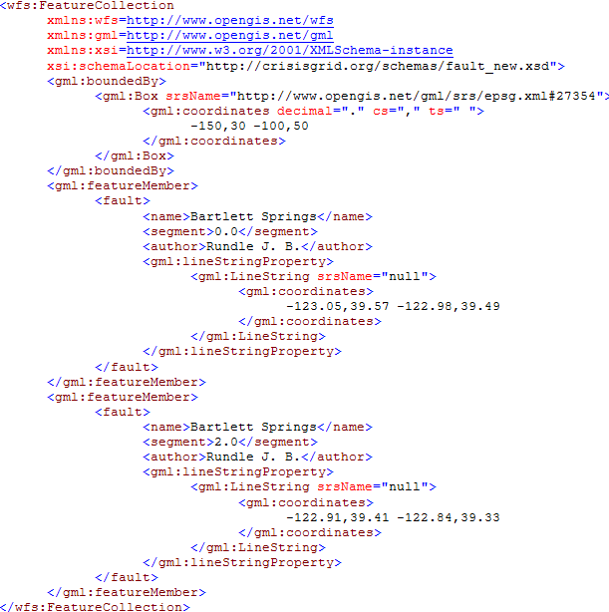
Sample GML document

Slide 40
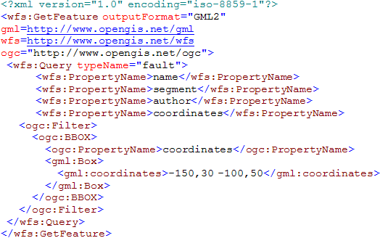
Sample GetFeature Request Instance

Slide 41
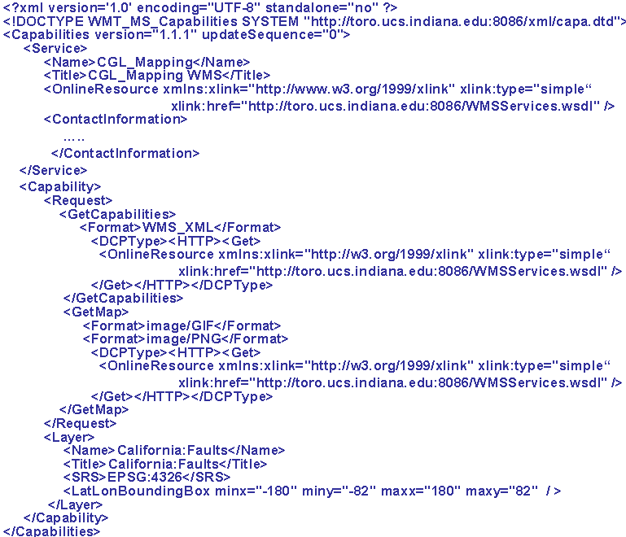
A Template simple capabilities file for a WMS

Slide 42
Generalization of the Proposed Architecture
GIS-style information model can be redefined in any application areas such as Chemistry and Astronomy
  Application Specific Information Systems (ASIS).
We need to define Application Specific
  Language (ASL) -> GML :expressing domain specific features, semantic of data
  Feature Service (ASFS) -> WFS :Serving data in common language (ASL)
  Visualization Services (ASVS) -> WMS : Visualizes information and provide a way of navigating ASFS compatible/mediated data resources
  Capabilities metadata for ASVS and ASFS.
We need to define Application Specific:
  Federator federating the capabilities of distributed ASVS and ASFS to create application-based hierarchy of distributed data and service resources.
Mediators: Query and data format conversions
  Data sources maintain their internal structure
  Large degree of autonomy
  No actual physical data integration
Unified data query/access/display
Such as filter, transformation, reasoning, data-mining, analysis
AS
Repository
1
Federator
ASVS
AS Tool
(ASVS)
AS Services
(user defined)
AS Tool
(ASFS)
4
3
2
1
2
Mediator
Mediator
3
Standard service API
Standard service API
AS
Sensor
AS
Sensor
Capability Federation
ASL-Rendering
Standard service API
Messages using ASL
Notes:
We will need the domain-specific equivalent of the Web Feature Service.
Federator
It is actually an ASVS but with an extended capabilities for capability federation and interacting and integrating multiple servers providing data in hierarchical/integrated data views defined in capabilities metadata.

Slide 43
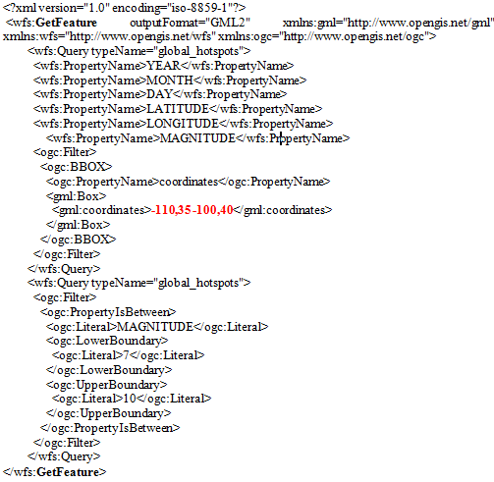
Sample GetFeature request to get feature data (GML) from WFS.
-110,35,-100,36
GFeature-1
-110,36,-100,37
GFeature-2
-110,37,-100,38
GFeature-3
-110,38,-100,39
GFeature-4
-110,39,-100,40
GFeature-5
Partition list as bbox values for sample case :
- Pn=5
- Main query getMap bbox 110,35 -100,40

Slide 44
Map rendering from GML
B
WMS
Converting objects into image
Plotting geometry
elements over the layer
Parsing and extracting geometry elements
Binary map image
GML
Notes:
Image conversion time in Figure is for resolution 400x400 in pixel.
Sample image conversion values are for JPEG creation
Average conversion time:25.43msec
Image conversion time changes based on
map images’ user-defined resolution values
Requested image format such as JPEG.

Slide 45
Interoperability Requirements on Geo-data
Geo-data is stored in various formats by heterogeneous autonomous resources.
Encoded as GML: Enables data to be carried with their attributes – content and presentation
Integrated to the system through WFS-based mediation
  Standard service interfaces accepting standard queries.
  GetFeature: Querying the data
Queried using its location attribute (bounding box) and other data-specific attributes
  Ex. earthquake data: magnitude of seismic activity and date event occurred.
Notes:
The range queries are intersections of ranges defined on attributes.

Slide 46
Standard Query (GetFeature)
<?xml version="1.0" encoding="iso-8859-1"?>
<wfs:GetFeature outputFormat="GML2" xmlns:gml="http://www.opengis.net/gml" >
<wfs:Query typeName="global_hotspots">
<wfs:PropertyName>LATITUDE</wfs:PropertyName>
<wfs:PropertyName>LONGITUDE</wfs:PropertyName>
<wfs:PropertyName>MAGNITUDE</wfs:PropertyName>
<ogc:Filter>
<ogc:BBOX>
<ogc:PropertyName>coordinates</ogc:PropertyName>
<gml:Box>
<gml:coordinates>-124.85,32.26 -113.36,42.75</gml:coordinates>
</gml:Box>
</ogc:BBOX>
</ogc:Filter>
</wfs:Query>
<wfs:Query typeName="global_hotspots">
<ogc:Filter>
<ogc:PropertyIsBetween>
<ogc:Literal>MAGNITUDE</ogc:Literal>
<ogc:LowerBoundary>
<ogc:Literal>7</ogc:Literal>
</ogc:LowerBoundary>
<ogc:UpperBoundary>
<ogc:Literal>10</ogc:Literal>
</ogc:UpperBoundary>
</ogc:PropertyIsBetween>
</ogc:Filter>
</wfs:Query>
</wfs:GetFeature>
Corresponding SQL query:
Select LATITUDE, LONGITUDE, MAGNITUDE from Earthquake-Seismic where
-124.85 < X < -113.36 & 32.26 < Y < 42.75
& 7 < MAGNITUDE < 10
Notes:
SQL queries are created from these attributes and their constraint range values

Slide 47
Geo-data Characteristics
Unexpected workload distribution: The work is decomposed into independent work pieces, and the work pieces are of highly variable sized
Geo-data
  un-evenly distributed
  variable sized
according to their locations attributes.
  Ex. Human population and earthquake-seismicity data
Queried/displayed/analyzed based on range queries built on location attribute
  Location is a point described with (x, y) coordinates.
  2-dim range query: Rectangle defined in bounding box
(c,d)
(c, (b+d)/2)
(a,b)
((a+c)/2, b)
Geo-data is mostly represented as large sets of points, chains of line-segments, and polygons.
Notes:
Geo-data characteristics illustrate efficient load balancing and un-expected workload sharing problems in distributed computing

Slide 48
Why Capability Metadata
Web Services provide key low level capability but do not define an information or data architecture
These are left to domain specific capabilities metadata and associated data description language (GML).
Machine and human readable information
  Enables easy integration and federation
Enables developing application based standard interactive re-usable tools
  for data query display and analysis
  Seamless data/access/query
Notes:
4.bullet: Dynamic upgrading user interfaces
Ex. interactive map tools

Slide 49
Architecture Summary
Fine-grained dynamic information presentation
  Heterogeneous data sources are queried as a single resource
  Integrated data-view in multi-layered map images
  No burden of accessing data source with ad-hoc queries.
  Interactive feature based querying besides displaying the data
Just-in-time or late-binding federation
  Data always is kept at its originating resource
  Autonomous local resources -Easy data-maintenance
Interoperable and extendable
  Open Geo-Standards are integrated with Web Service principles.
Notes:
Remove
Fine-grained dynamic information presentation through a federation framework enabled us heterogeneous data sources to be queried as a single resource over integrated data-view in multi-layered map images
Autonomous local resources -controlling definition of data
Attribute-based querying and interaction over integrated data-views in multi-layered map images.
Integrated data views are multi-layered map images composed of distributed standard GIS Web Service components.

Slide 50
Streaming data transfer
XML Encoding: Size of the geospatial data increases with GML encoding which increases transfer times, or may cause exceptions
SOAP message creation overhead
Strategies: Streaming data flow extensions to GIS Web Services
  Web Service -as a handshake protocol.
  Data is transferred over publish-subscribe messaging systems.
  Enables client to render map images with partially returned data
Extension
client
WMS GML rendering
Subscriber
GML
(topic, IP, port)
Narada Brokering Server
GetFeature
Topic,IP,port
1
2
W S D L
WFS
Publisher
GML
server
DB
Notes:
1.2. stateless: needs to complete whole response to transfer transaction. But it might causes memory exception to create whole GML response.
Initial problems regarding data transfer and rendering in GIS developed in accordance with Open Standards
HTTP based query/response does not allow large scale data move
Rendering large scale XML data with common xml processors had some problems such as mem exception
The streaming technique is commonly used in transmitting multimedia contents. For web browsing images, streaming is not very crucial; the required number of pixels will be limited by the web browser’s screen size.

Slide 51
Related Work
-Parallel data access/query optimization-
Map Reduce (application of cluster computing):
  Motivation: Large scale data processing, Job parallelization
  Based on two main functions:
    Map: Like partitioning the workload
    Reduce: Like combining the responses to partitions.
  Motivating domain: Web pages (in billions)
  Implementation: Hadoop:
    Putting the files in distributed nodes and making search of words in parallel
WT not only partitions the work to workers but also takes the un-evenly shared workloads into consideration.
WT enables adapted computing
Notes:
Borrows the terms “map and reduce” from functional programming
map (in_key, in_value) -> (out_key, intermediate_value) list
reduce (out_key, intermediate_value list) -> out_value list
If the application is doing a word count, the map function would break the line into words and output the word as the key and 1 as the value
Map:
Records from the data source (lines out of files, rows of a database, etc) are fed into the map function as key*value pairs: e.g., (filename, line)
map() produces one or more intermediate values along with an output key from the input
Reduce:
After the map phase is over, all the intermediate values for a given output key are combined together into a list
reduce() combines those intermediate values into one or more final values for that same output key
(in practice, usually only one final value per key)
Hadoop: By distributing the data, Hadoop can process it in parallel on the nodes where the data is located
Hadoop implements MapReduce, using the Hadoop Distributed File System (HDFS) (see figure below.) MapReduce divides applications into many small blocks of work. HDFS creates multiple replicas of data blocks for reliability, placing them on compute nodes around the cluster. MapReduce can then process the data where it is located

Slide 52
Integrated data-view
Query heterogeneous data sources as a single resource
  Heterogeneous: local resource controls definition of the data
  Single resource: remove the burden of individually accessing each data source
  Seamless interaction with the system
No real integration of data
  Data always at local source
  Easy maintenance of data
Client/User-Query
Integrated View
Display &
Federation
services
Federator
XML-encoded common data model
Carrying data and display information
Standard data components
Mediator
Mediator
Mediator
DB
DB
DB
Data in files, HTML, XML/Relational Databases, Spatial Sources/sensors
Notes:
And Quality of services

Slide 53
Compare with Space-filling
User queries are unexpected
Query corners might fill in any partitioned box in space-filling table
Queries are always in bbox – rectangle
  You cant send one-dim array
  Ranges are unexpected
Space-filling curve algorithm assume you have a work in your hand needs to be partitioned
5
Lets say overall db (whole range): 30MB
There are 6 workers
Each assigned equal work: 5MB
0
5
5
5
5
0
1
5
Problems:
Non-rectangular shape
Overlapped partitions have un-balanced workload
5
Partitions defined by space-filling
query

Slide 54
Enhancement Approaches
Aim: Turning compliance requirements into competitiveness by optimizing federated query responses
Pre-fetching (centralized)
  GML-tiling
Dynamic load balancing and parallel query (decentralized)
  Range query partitioning through workload estimation table (WT)
Notes:
The standards themselves do not deliver working systems. Constructing successful working systems requires smart design.
We address these performance issues from the federator’s point of view (which is upper level approach)
We have introduced/developed federator-oriented data access/query optimization techniques (over the OGC standard data services)
Our aim is optimizing the response times for interactive GIS systems using standard GIS components.

Slide 55
1. GML-tiling
On-demand access/rendering
over TT
Pre-fetching the data before it is actually needed
Database is mapped to a data structure (Tile-table) in federator
  And periodically synchronized
Successive on-demand queries are served from federator’s local disk
On-demand access/rendering
Interactive
Client Tools
Federator
(WMS)
Federator
(WMS)
Tile-table
Pre-fetching (batch job) running routinely
GML
GetFeature
GML
GetFeature
WFS
WFS
SQL
Relational objects
SQL
DB
DB
On-demand queries are served from TT
TT is synchronized with database routinely.
Straight-forward
Notes:
Strategies:
Periodically fetching the whole data before it is needed (so called pre-fetching).
Databases are mapped to chunks of GML files in a structure and stored locally in the federator
Successive on-demand queries are served by using pre-fetched data
Pros/Cons:
Removes the repeated resource consuming query/data conversions at WFS and associated Databases.
Gives the best performance outcomes for the archived data,
But, might cause inconsistency
Faces time consuming request/response conversion
(Request): GetFeature request to SQL,
(Response): Relational tables to GML
We focus on the issues at the upper level of data handling. We are not proposing enhancement over query and/or response conversions at the autonomous resources integrated through mediators (WFS). Our enhancement approaches are at the federator and view-level.

Slide 56
Tile-table (TT)
Created and updated by a module independent of run-time
  Synchronized with the database routinely
TT is consisted of <key, value> : <bbox, GML> pairs.
  Each partitioned rectangle below is represented by <bbox, GML>
Recursive binary cut (half/half)
  Until each box has less than threshold GML size
Lets illustrate the table with sample scenario
  Whole data range in database (0,0,1,1) -> (minx,miny,maxx,maxy)
  Each ‘ ’ corresponds to 1MB and
  Threshold data size falling in a partition is 5MB
    Means each box covers 5 ‘ ‘ at most
(1,1)
0
(1,1)
3
5
3
1
1
(1, 3/4)
1
4
3
2
(1, 1/2)
5
4
(0,0)
(0,0)
(1/2, 0)
Notes:
If in first fetch, data size exceeds the allowed size, then cut into 2
Figures represent whole ranges in database for the selected data layer.
(0,0,1,1)
(0,0,1/2,1) (1/2,0,1,1)

Slide 57
Utilizing Locality of Reference
Data that is near other data or has just been used is more likely to be used again
Storage hierarchy (Ehcache libraries):
  Federator’s Memory Store
  Federator’s Disk Store
  Allowable memory and disk capacity
  If memory overflows, entries are dumped into disk
  If disk overflows, evicted according to the policy (LRU or LFU)
Entries move between memory and disk space
  Policy is defined in configuration (LFU, LIFO etc.)
Notes:
Entries are stored through Apache-Ehcache

Slide 58
How It is Used (Run-time)
On-demand data access and rendering responded over TT
Lets say federator gets a queries positioned to TT as below
p₂
r₁
p₁
p₄
p₁₂
r₂
p₃
(r_{i}): On-demand query in bbox
(p_{i}): WT entries in GML
r₁: p₁₂
r₂: p₁, p₅, p₁₂
r₃: p₁₁,p₁₀
r₄: p₁, p₉, p₃, p₆
r₄
p₆
p₅
p₈
p₉
p₇
r₃
p₁₁
p₁₀
Find all partitions that overlap with the query r_{i} ( i.e. p_{i} values )
Obtain GML values from TT using corresponding p_{i} values.
  GML = TT.get(p_{i})
Extract the geometry elements in GML, and render the layer.

Slide 59
Summary and Related Work
Google Maps tiling:
  Map image tiles, replacing computation with storage
  No rendering – uses premade image tiles.
  Static, not extendable
GML-tiling enables creation of distributed map rendering
  Tiles are consisted of structured data model –GML
    Enables attribute based querying of map data besides displaying
  Rendering of GML
  Standards – easy to extend with new data sources
Notes:
Google map like arch is not applicable to use with conventional computation resources – because of the size requirements

Slide 60
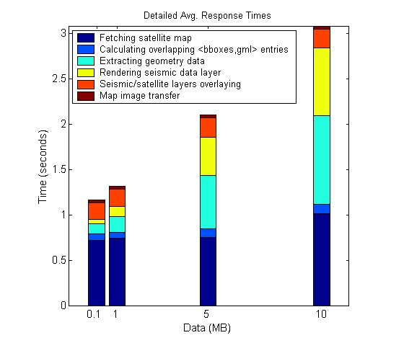
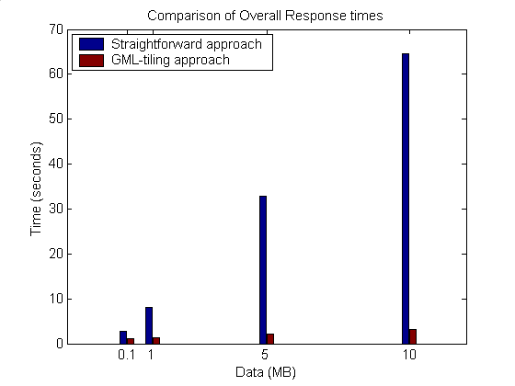
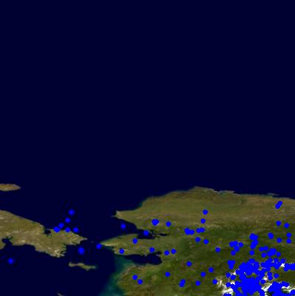
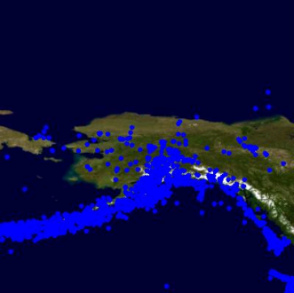
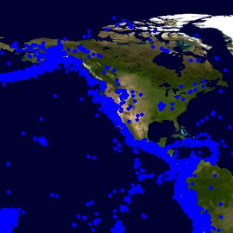
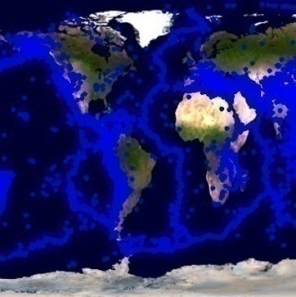
1. Using GML-tiling
The system bottleneck -(a)- is removed with the cost of
  Calculating overlapped entries and accessing tile table to get corresponding GML sets
Client’s requests/queries are served from GML tiles at federator.
Setup: Predefined threshold tile size for seismic data is 2MB
Tiles: <bbox, gml> – locally stored in memory/disk
Speedup:20.95
0.1
1
15.61
5
10
6.16
2.29
Notes:
It seems all components of overall response time is scalable.
As the data size increases the performance gain ratio increases.
Show the results for high sizes
Put a stress test

Slide 61
Range Query Partitioning
Estimating the workload of 2-dimensional range queries when the data sets have numerical attributes with real values.
The range queries are intersections of ranges, each range being defined on a single attribute.
  Lets say A is the set of attributes A={A₁, A₂, … A_{n}}
  Attribute gets values between some intervals: α_{i} < A_{i} < β_{i}
  Range queries are of the form
    (α₁ < A₁ < β₁) & (α₂ < A₂ < β₂) & .. (α_{n} < A_{n} < β_{n})
Aim: Cutting the 2-dim ranges (bounding boxes) in the queries into smaller pieces with approximately equal loads.
Notes:
Finding approximate answers to multi-dimensional range queries over real valued attributes has significant applications in data exploration and database query optimization
Partitioning the data involved in range query into approximately equal loads
Example: Earthquake seismic data
A1: Date seismic event happened : 01/01/1900<A1<12/31/2006
A2: Magnitude of the seismicity : 0<A2<10
A3: Location it happened (2-dim coordinate) : (-180,-90)<A3<(180,90)

Slide 62
-Recursively cut the ranges (R) into two sub-regions (R1 and R2)
  -Till the corresponding query sizes for the ranges R1 and R2 are less than the threshold value t and
    - remote invocation to the data server with new ranges
  -Store the partitions as pairs of <R1, query-size>

Slide 63
PT(R, t, er) { | PTInBalance(R, er){
[(R₁,gml₁):(R₂,gml₂)] = PTInBalance(R, er) If (size(gml₁) or size(gml₂) ≤ t) Put partitions into memory/disk as <R₁, size(gml₁)> <R₂, size(gml₂)> And return; else PT(R₁,t,er); PT(R₂,t,er) } | current_er = 1; l = minx r = maxx While(current_er > er){ mp = (l+r)/2 R₁ = minx, miny, mp, maxy R₂ = mp, miny, maxx, maxy gml₁ = getData(R₁) gml₂ = getData(R₂) If(gml₁>gml₂); {r = mp} else {l = mp} current_er = (size(gml₁)-size(gml₂)) / max[size(gml₁), size(gml₂)] } return [(R₁,gml₁):(R₂,gml₂)] }

